Slide 1

Basic Instruments
Revolutionizing Signal Generation…
Notes:
Edit and remove slides as needed per each planned customer engagement

Slide 2
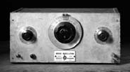
A Brief History Lesson
Over 70 years ago Bill Hewlett and Dave Packard designed and built the first HP instrument, the 200A Audio Oscillator. It was the first in a long line of signal sources from HP and Agilent.
1938 1940 1950 1960 1970 1980 1990 2000 2012
Notes:
Ask who knows who HP’s first customer was… Walt Disney (for the filming of Fantasia)
Ask who knows what HP’s first product was that Disney purchased… (technically they purchased 8 x 200B units)
The first HP instrument was… the 200A Audio Oscillator.<click slide to reveal the photo>
An audio oscillator is an instrument that generates one pure tone or frequency at a time and was used to test sound equipment. It was the first in a long line of signal sources from HP and Agilent.
-----additional story/background if needed--------
“Bill Hewlett's use of a ballast resistor (e.g. light bulb) for amplitude stabilization was considered ingenious by Hewlett’s peers. The wide frequency range, combined with excellent frequency and amplitude stability, made the H-P 200 oscillator family the standard audio frequency generator for a generation of engineers and scientists. I well recall spending many hours with these oscillators in grad school, in electronic research labs at Hughes Aircraft Company, and at TRW.” --from http://www.smecc.org/the_200-a_hewlett-packard's_first_product.htm

Slide 3
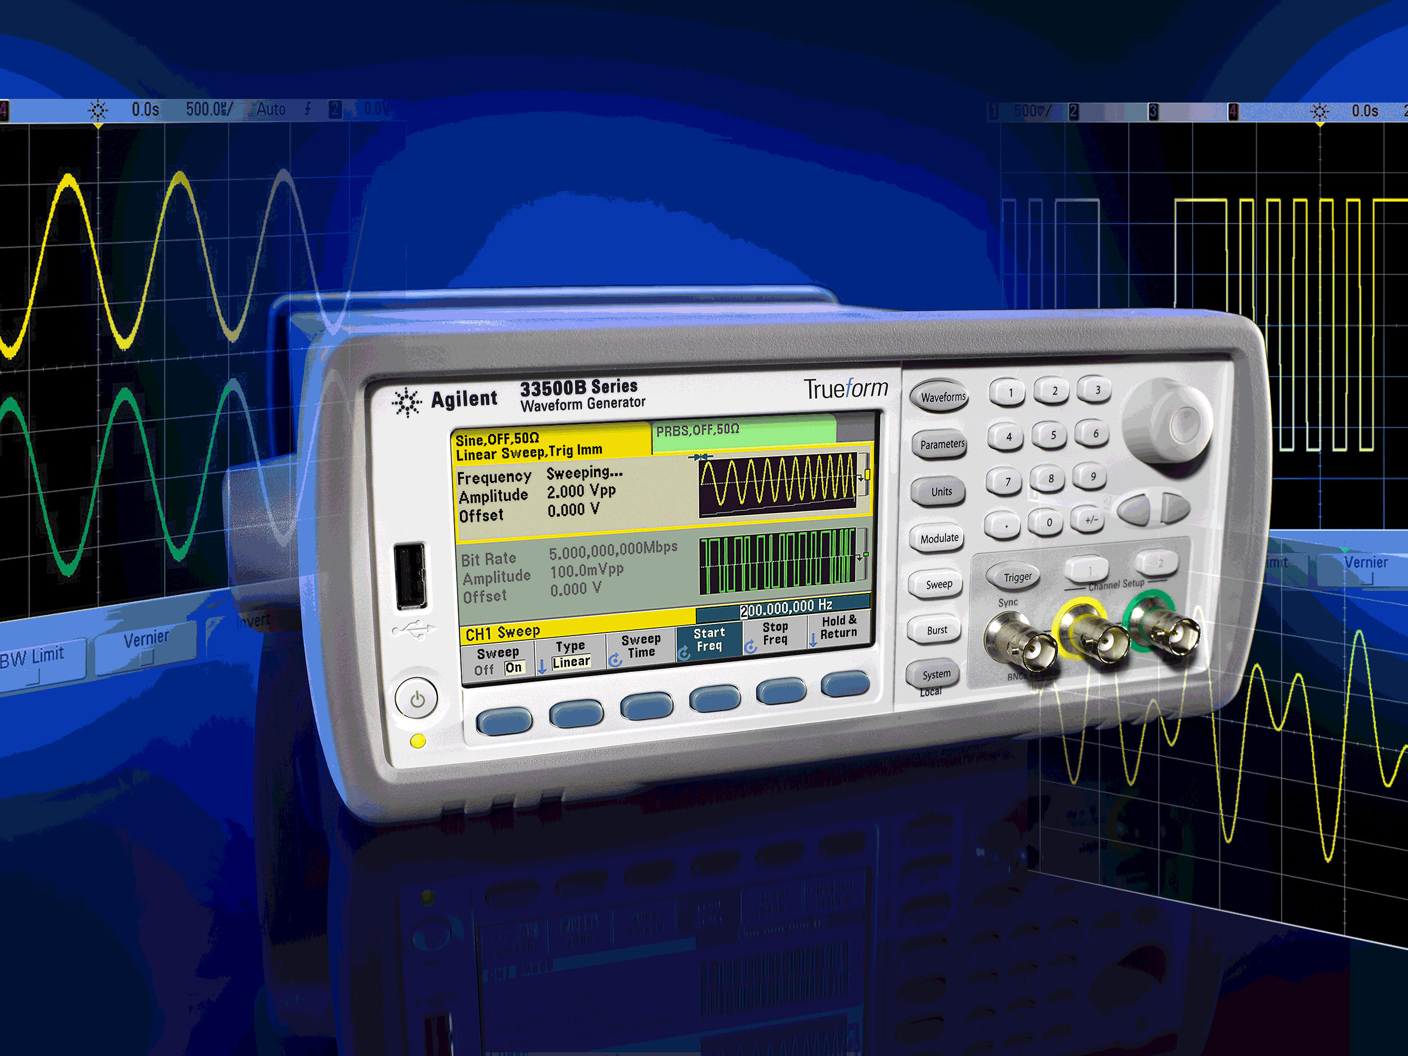
Agilent 33500B Series Waveform Generators
Now with Trueform Technology
33509B, 33510B, 33511B, 33512B, 33519B, 33520B, 33521B, 33522B
Trueform Technology: Agilent’s exclusive, revolutionary signal generation with unmatched capabilities and signal fidelity
Value Choices at 20 and 30MHz, with or without arb, 1- or 2-channels
Public Launch: Tues Aug 21, 2012

Slide 4
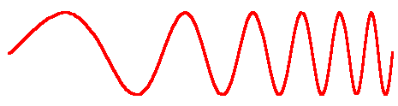
Evolution of Waveform Generators
Early waveform generators
Separate instruments
DDS-based generators
Much better frequency stability
Trueform technology: the next generation
Exclusive sampling technology
Point-per-clock arbitrary waveform generator
Function generator w/counter for verifying accuracy
Addition of pseudo-arbitrary waveforms
Tracking filter allows clean, alias-free signals
true point-by-point arbitrary waveforms
Relatively expensive
Issues with playing arbitrary waveforms
10x lower jitter than DDS
Not exclusive to any vendor
Variable-bandwidth noise
Notes:
Let me share a little with you about why this Trueform technology is such a big deal.
Early waveform generators used a technology called point-per-clock. It’s a very intuitive way to create waveforms but it is quite costly and has some inherent complexity. For that reason, it’s reserved and only used in the high-end expensive waveform generators.
A number of decades ago, DDS which stands for direct digital synthesis, was leveraged from the communications industry as an inexpensive alternative for waveform generation. In fact today, the vast majority of function / arbitrary waveform generator manufacturers use some form of DDS technology for waveform generation. The issue with DDS however is that it can skip and/or repeat points or aspects of the waveform. This creates noise and jitter on the signal which can be especially problematic when a customer requires sharp edges of a pulse or square wave, or wants confidence that every point of their waveform is in fact being generated.
Agilent has continued it’s leadership and legacy as a pioneer in signal generation. The new Trueform technology represents a leap in signal generation technology. It offers the best of both worlds providing predictable low noise waveforms with no skipped points like the point-per-clock technology, but at the price point of DDS technology.
Trueform is exclusive to Agilent and employs patented technology. The result is that Trueform waveform generators provide numerous advantages over DDS.

Slide 5

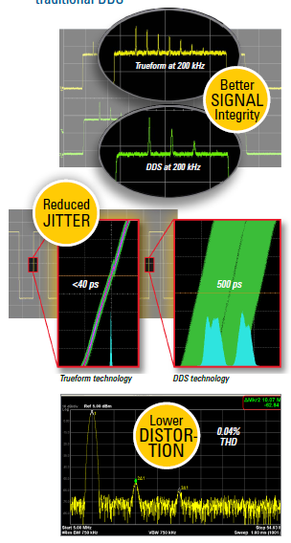
Agilent’s new and exclusive Trueform signal generation technology provides superior signal integrity
Now you can generate the exact waveforms you want
Notes:
Agilent’s exclusive Trueform technology provides superior signal integrity as highlighted in these images comparing Trueform with DDS technology. The jitter is more than 10x better, there is much lower distortion, there is no anti-aliasing artifacts and it’s now easy to create complex waveform sequences.
These are really important when considering that customer’s need confidence that the device under test is generating anomalies, and not the function generator that’s supplying the input waveform. Customers therefore need a source that produces a clean, low-distortion, stable and reliable signal. Trueform technology really allows customers to generate the exact waveforms they want and need.
By branding this technology, we are making it easy for you to talk about.

Slide 6
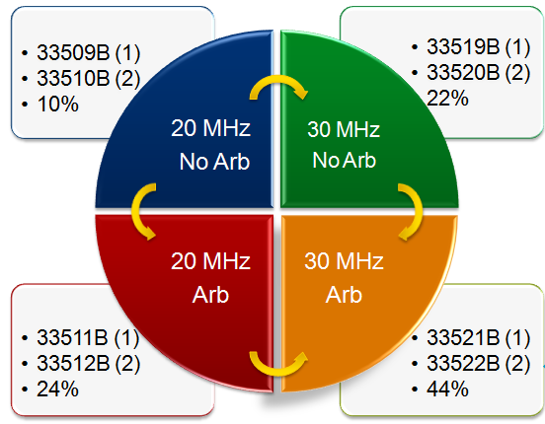

What is the new 33500B Series?
With Trueform technology (branding)
Value choices and more price points starting at $1,650
Clear replacement for 33220A @ 20 MHz
Software upgradeability, investment protection
New e-tools
Basic BenchLink Waveform Builder shipping with every unit
Streamlined product structure: GPIB standard, no print manuals
Better dual channel synchronization
IQ Player add-on; future add-on support
Notes:
Emphasize the great platform, that we can add applications on top, software upgrades
This is what is different between the A and the B – go through slide

Slide 7
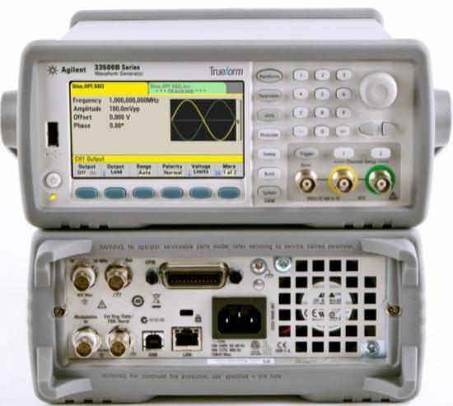

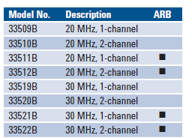
Waveform Generators Closer Look: 33500B Series
33509B, 33510B, 33511B, 33512B, 33519B, 33520B, 33521B, 33522B
Standard Waveforms
Sine, Square, Ramp, Triangle, Pulse, Noise, DC, Sinc, Exponential, PRBS and built-in arbitrary waveforms
Modulation (AM, FM, PM, FSK, BPSK, PWM, Sum)
Sweep (linear, log and list)
Burst (gated and count)
Excellent Usability
Intuitive front panel
Mobile device access to full documentation
LXI web browser
High Resolution Display
4.3” WQVGA display
Point-by-point Arbitrary Waveforms
250 MSa/s arbs, 16 bit resolution
1 MSa/channel deep memory, optional 16 MSa
On-screen Editor for arbs
Waveform Builder Basic SW included, optional advanced editing Pro SW
Computer Interfaces
LAN (LXI-C), USB and GPIB
USB port for file management
Notes:
Let’s take a closer look at the 33500B Series waveform generators.
Customers can get all of the benefits of Trueform and the superior signal integrity, and, they get to choose among 8 models to get exactly what they need now at value prices, plus the ability to easily upgrade later.
All of the standard waveforms are built-in plus the added bonus of a PRBS signal which stands for pseudo random binary sequence. This is a great value saving customers from having to first create the signal in an application before uploading it to the waveform generator to play. Now it’s available as one of the built-in standard waveforms.
Unique to the 33500B Series is the full bandwidth pulse signal. While the 33521B can produce a full bandwidth 30 Mega Hertz sine, square, and pulse, other DDS generators have only a full bandwidth sine and square waveform but a significantly degraded bandwidth for the pulse signal.
Modulation is provided in the form of amplitude, frequency, phase, frequency shift keying, binary phase shift keying, pulse width, and Sum, the last of which is the addition of any two signals on a single channel using the internal modulation source. This is a highly differentiated capability available on the 33500B Series.
Sweep is available in linear, logarithmic, and list modes, with start and stop frequencies, and hold and return times. And Burst can be counted or gated.
Arbitrary waveforms are true point-by-point waveforms to generate any customer defined wave shape using Trueform technology. They are standard on the 33511B, 33512B, 33521B and 33522B and upgradeable on the other 33500B Series models. Customers can use the built-in waveform editor accessible from the front panel, the complimentary basic waveform builder software, or upgrade to the Pro version of the software, to create and edit arbitrary waveforms. Customers can additionally use the front panel USB port to upload and reproduce real waveforms captured on an oscilloscope. Trueform technology also allows for sequencing to connect and play multiple arbitrary waveforms as a single waveform providing a great benefit to many customers. For large and/or complex waveforms, there is a 1 Mega Sample /channel standard memory available. This is orders of magnitude better than the competition. For customers that need even more memory for really complex waveforms, then cay upgrade to 16 Mega samples.
Operation from a very intuitive front panel is made easy with the function keys, keypad, and knob. The user selects the waveform and then inputs the parameters to produce the desired signal. Customers can now also access all of the product documentation in seven different languages in a smart-phone-friendly WebHelp format. No printed manuals or PC needed. The 33500B Series models also have a built-in LXI web browser to allow a customer to monitor tests and adjust settings remotely.
In addition to the LAN (LXI class C compliant) interface, USB and GPIB are also standard. The front panel has a USB port for waveform download and data storage.
There is a high resolution 4.3” color graphical display that makes it really easy to take a glance and quickly determine what channel, what waveform, the parameters, what the waveform should look like, if outputs are on or off, and more. Customers have delighted in all of the information easily and quickly available from the front panel and display. Like the display, signal outputs are also color-coded for easy reference to channel 1 or channel 2 on the dual channel models. The signal outputs are BNC terminals and a synchronization signal is also available to align with the zero crossing point on the front panel.
Rear panel connectors include external modulation and an optional ultra high-stability timebase for even better accuracy most commonly required by communications customers.
There are 1- and 2-channel models of each of the 20 Mega Hertz and 30 Mega Hertz bandwidth and with or without arb combinations. The 2-channel models all come with dual-channel capabilities including tracking plus frequency and amplitude coupling.
Customers will chose the right instrument based mainly on the bandwidth, whether or not the arbitrary waveform capability is needed, and the need for one or two channels.
The 33500B Series replaced the 33521A and 33522A waveform generators.

Slide 8
What’s Unique with the 33500B Series
30 MHz Pulse
Full-bandwidth pulse, to 30 MHz, Tektronix to 10 MHz
Set leading and trailing edge times independently
PRBS Patterns
Provides standard PRBS patterns, PN7 … PN23
Select PN type, set bit rate, set edge time
2-Channel Coupling
Dual channel coupling, frequency and amplitude, differential
Set start phase for each channel, phase shift between channels
Sum Modulation
Sum two signals together, frequency & amplitude independent
2-tone (4-tone w/combine), square-sine, noise on pulse
Point-by-point Arb
Create up to 1 million samples standard, 16 million optional
Connect arbs together, create up to 512 sequences
Voltage Settings
Lower voltage amplitude at 1 mVpp, Tektronix at 10 mVpp
Set high and low voltage limits to prevent overload on DUT
Notes:
Go through slide – these are all highly differentiated values of the 33500B Series

Slide 9
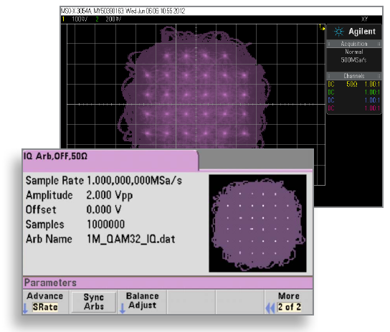
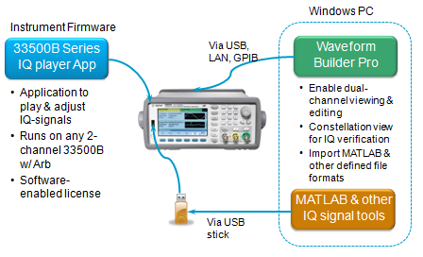
IQ Player SW Add-On
Great for low bandwidth (baseband) communications and customers working with PAN devices
Notes:
The last thing I want to leave you with to get you excited about Trueform is the IQ Player SW Add-On.
Because of our Trueform technology, customers can use the 33500B Series to play and adjust baseband IQ signals. This is a SW add-on that can run on any 2-channel 33500B model with the arb.
Customers can use Matlab or other IQ signal tools to generate the waveform and upload it directly to the waveform generator. Or, customers can use Agilent’s 33503A Benchlink Waveform Builder Pro software to:
Enable dual-channel viewing & editing
Use the constellation view for IQ verification
Import MATLAB & other defined file formats
Before uploading the IQ waveform to the unit to play.
This is a very low cost method of playing low bandwidth IQ waveforms (below 30MHz) and will be valued by communications customers. Personal-area-networks, also known as PANs, which includes Bluetooth and the growing number of emerging health monitors are great application examples.

Slide 10
Comparison of Key Competitive Attributes
20 MHz Versions
30 MHz Versions
Notes:
Spider chart to show how Agilent has the best offering on the specs customers care most about…
Bandwidth: all customers relative to their needs
Resolution: all customers relative to their needs
THD: all customers relative to their needs
Jitter: customers who use square, pulse, and arb
Arb: customer who need arb capability, i.e. true arbs

Slide 11
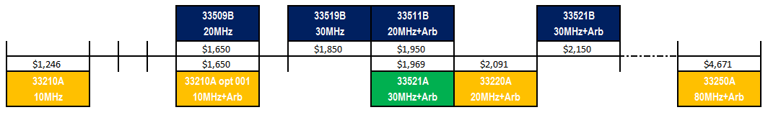
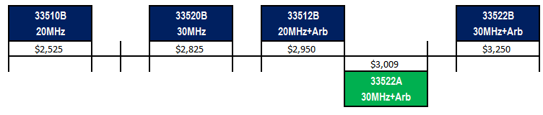

33500B Series Price Positioning
Prices start at $1,650
1-channel models
2-channel models
2 channel models are~50% more vs. 1-channel price

Slide 12
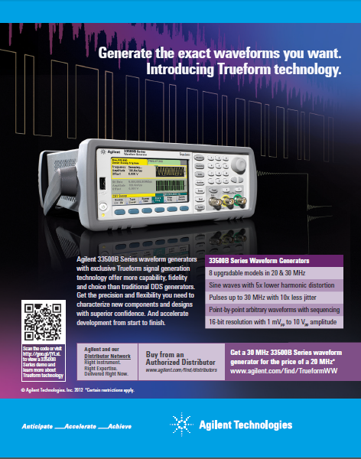
33500B Series Introductory Promotion
Get a 30MHz 33500B Series waveform generator with Trueform technology for the price of the 20MHz instrument
Valid on the following models through Feb 28, 2013:
  1-channel 33521B ($2,150) for the price of the 33511B ($1,950)
        Less than the 33521A ($1,969) and the 33220A ($2,091)
  2-channel 33522B ($3,250) for the price of the 33512B ($2,950)
        Less than the 33522A ($3,009)
Promotion code 5.885
WW implementation (excluding China, Hong Kong)
WOW!!
What a deal!
Notes:
<the “Wow!! What a deal! is automated and will come up when you click>
There is a promotion available now as a matter of fact, and through the end of Feb for all customers purchasing a 30MHz with arb model. More specifically, during this time, a customer purchasing the 1-channel 33521B ($2,150) can get it at the price of the 33511B ($1,950) – which is actually less than the 33521A ($1,969) and the 33220A ($2,091), or a customer purchasing the 2-channel 33522B ($3,250) , can get it at the price of the 33512B ($2,950).
And the advertisement as FYI (highlights promotion in bottom right)

Slide 13
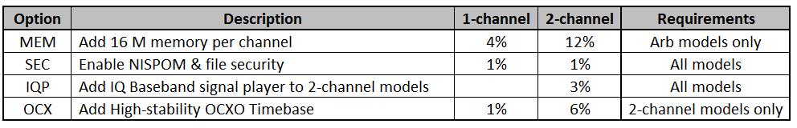
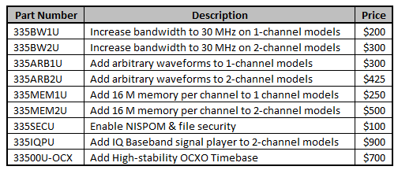
33500B Series Options and Upgrades
Options
Upgrades
Same price if purchased as an option or later as an upgrade (there is no price premium for the upgrade)
Upgrades will have 3 options for fulfillment / delivery
  Email only
  Paper only
  Email and paper
* Exception: 33500U-OCX is return to factory, labor and calibration are not included in price

Slide 14

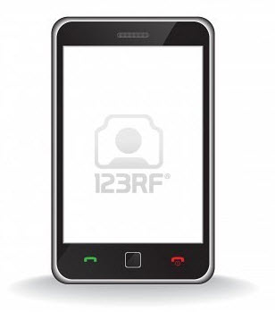
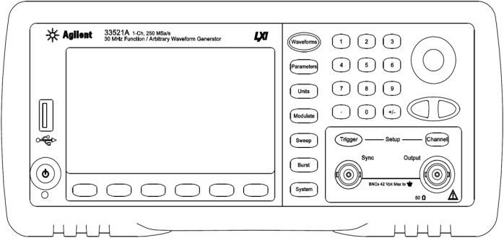
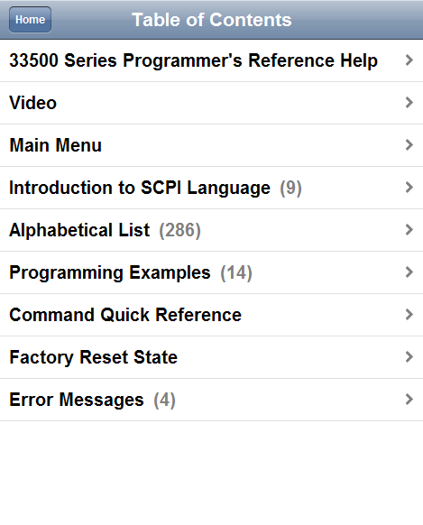

WebHelp Mobile Support
Full documentation right in the palm of your hand!
WebHelp Mobile output optimized for mobile devices
QR codes available from instrument front panel
Try It!
Notes:
The WebHelp Mobile Support will ONLY be available on the new 33500B Series models. It will not become available on the 33521A, 33522A or other older models. It is accessed from the Help menu

Slide 15
Agilent’s SPD Waveform Generators Portfolio
Model | Bandwidth and Resolution | Interface | Price
33509B | 20 MHz sine, 16 bit, 1-ch | LXI-C, USB, GPIB | $1,650
33510B | 20 MHz sine, 16 bit, 2-ch | LXI-C, USB, GPIB | $2,525
33511B | 20 MHz sine, 250MSa/s ARB, 16 bit, 1-ch | LXI-C, USB, GPIB | $1,850
33512B | 20 MHz sine, 250MSa/s ARB, 16 bit, 2-ch | LXI-C, USB, GPIB | $2,825
33519B | 30 MHz sine, 16 bit, 1-ch | LXI-C, USB, GPIB | $1,950
33520B | 30 MHz sine, 16 bit, 2-ch | LXI-C, USB, GPIB | $2,950
33521B | 30 MHz sine, 250MSa/s ARB, 16 bit, 1-ch | LXI-C, USB, GPIB | $2,150
33522B | 30 MHz sine, 250MSa/s ARB, 16 bit, 2-ch | LXI-C, USB, GPIB | $3,250
33210A | 10 MHz sine, 50MSa/s ARB (opt), 14 bit | LXI-C, USB, GPIB | $1,246
33220A | 20 MHz sine, 50MSa/s ARB, 14 bit | LXI-C, USB, GPIB | $2,091
33250A | 80 MHz sine, 200MSa/s ARB, 12 bit | GPIB, RS-232 | $4,671
33502A | 2-ch 50Vpp Isolated Amplifier | LXI-C, USB | $2,652
33503A | BenchLink Waveform Builder Pro | Software | $750
33500B Series
Trueform Technology
33200 Series
DDS Technology
Notes:
Agilent is the #1 function generator vendor in the world and Trueform technology makes signal generation all the better.
The new 33500B Series waveform generators with Trueform Technology provide superior signal quality – the best signal fidelity and true point-by-point arbs, 1 MSa/channel standard memory, full bandwidth pulse signals, greater flexibility with more waveforms, the ability to sum any two signals together on a single channel, lower voltage settings down to 1mVpp, and so on.
There are eight 33500B Series models to choose from at various bandwidth, with or without arb capability and in 1- and 2-channel models. The 33509B for example, is a 20MHz 1-channel that starts at just $1650. If a customer wants a 1-channel model but at 30MHz and with arb capability, that would be the 33521B at $2150. Another great thing about the 33500B Series is that customers can get exactly what they need now, and upgrade later as their needs grow. Bandwidth and arb capability are both upgradeable. This means that if a customer buys the 33509B now but later has a need for 30MHz and the arb, the customer can upgrade those options to effectively get the same functionality as the 33521B at a later date with no price premium.
In addition to the 33500B Series, customers can also continue to purchase the 33200 Series models which use the DDS technology. These are all 1-channel models. The 33210A is a 10MHz function generator with optional arb capability. This is most widely used by education customers. The 33220A at 20MHz has been the long-standing favorite among customers and a top seller over the years. We expect 33220A customers however to migrate over to the 33511B 20MHz with arb to get all of the excellent benefits of Trueform and at an even lower price. There is also the 33250A 80MHz function generator with arb for higher bandwidth applications.
For customers that need higher amplitude or voltage, there is also the 33502A high voltage output amplifier which can be used as a companion instrument with any vendor’s function generator to increase the output from the standard 10Vpeaktopeak maximum, all the way up to 50Vpeaktopeak. This need is most common among aerospace defense and automotive customers who’s applications require higher voltage output.
The last row listed on this table is the 33503B BenchLink Waveform Builder Pro software. This software makes a fabulous companion for any customer working with arbitrary waveforms. It provides flexible creation of application signals with built-in signals, an equation editor, math operations, and sequencing. It is compatible on all Agilent function generators, Agilent pulse generators, and even the WaveGen arb capability built-in to the 3000 X-Series scopes. A free basic version of the Waveform Builder software ships free with every Trueform waveform generator – the 33500B Series.
Agilent’s family of function & arbitrary waveform generators are focused in the 10-100MHz space. Function generators will be found across every electronics industry and application space.
Across the three models, customers have a price/performance choice dependent on their signal frequency requirements.
Typical Industries: Electronics, Industrial, Automotive, Communications, Aerospace, Computer, Medical, Government, Education

Slide 16
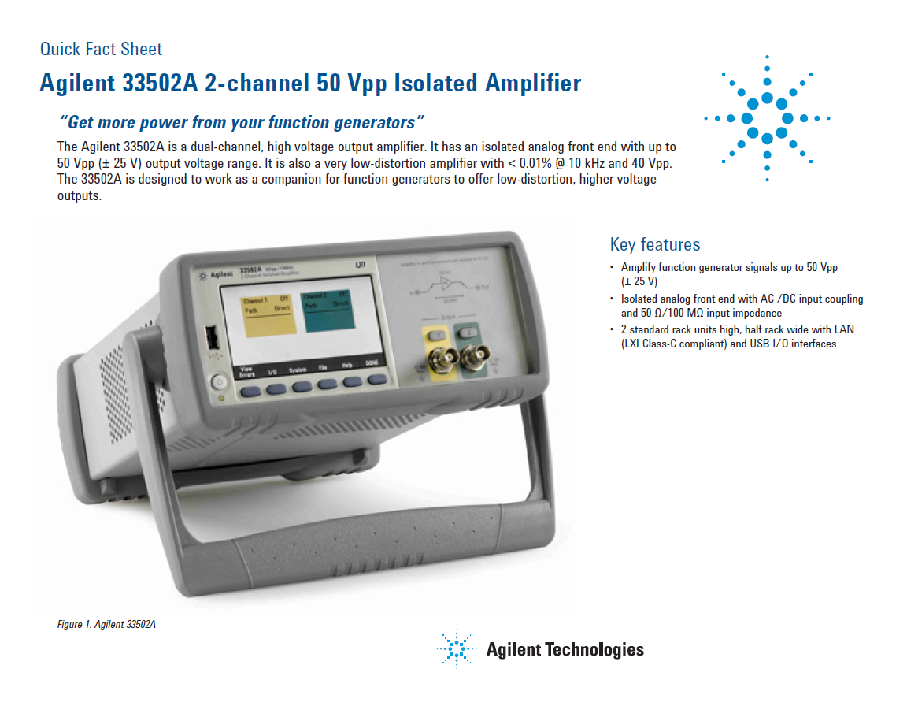
`

Slide 17
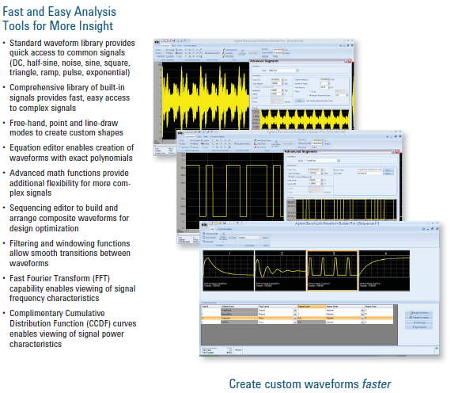
33503A BenchLink Waveform Builder Pro
For Agilent 33200, 33500 and 81100 Series Function / Arbitrary / Pulse Waveform Generators
Notes:
Waveform Builder software provides flexible creation of your application signals with built-in signals, an equation editor, math operations, and sequencing
Key Features and Benefits
Library of built-in signals, basic and advanced
Free-hand, Point, and Line-draw modes
Equation editor, Math functions, Sequencing editor
Filtering and windowing functions
2 Primary Targets
R&D engineers characterizing new designs
Test System engineers doing design validation
Key Applications
• Electronic controls, baseband wire less communications
• Linear amplifiers, DC brushless motors, switching power supplies
• Medical devices, digital audio
• Clock signals, modulation source
Additional Control and Flexibility
Easily create complex signals
Remote control and development from a PC

Slide 18
BenchLink Waveform Builder Comparison
Features | Built-in Waveform Editor | Waveform Builder | Waveform Builder Pro
Price | Free | Free | $750 US List
Basic Waveform Library | ☑ | ☑ | ☑
33200, 33500 Series Connectivity | ☑ | ☑ | ☑
Cut, Copy, Paste w/ Excel* | ☑ | ☑ | ☑
Waveform Math | ☑ | ☑ | ☑
Free Hand |  | ☑ | ☑
Line Draw |  | ☑ | ☑
Complex Waveform Library |  |  | ☑
81100 Series Connectivity |  |  | ☑
Equation Editor |  |  | ☑
Point Draw** | ☑ |  | ☑
FFT, CCDF, and Constellation Diagram |  |  | ☑
Filters |  |  | ☑
Windowing Functions |  |  | ☑
Dual Channel Operation |  |  | ☑
*Built-in Waveform Editor does not use Excel but can cut, copy and paste
**Limited functionality in Built0in Waveform Editor
Notes:
Compare to basic → Premium → Pro
Built-in editor really a different animal
Free Waveform editor does free-hand and line draw
Free waveform provides remote capability and allows a customer to create a waveform on more than a 3” display with no mouse
Dave anticipates most customers really doing arbs, would prefer SW (free or for pay version)
Use model for embedded editor
When want to do that one extra thing that can’t do with the built-in function, or want to start with built-in function and make a change (multiply) or do some adding – e.g., exponentially decaying sine wave (damp sinusoid) ← it’s a very common signal (almost any kind of physical device, like a resistor or inductor – if you were to stimulate that device with a narrow pulse, the response of a device like that to a narrow pulse is typically an exponentially decaying sine wave – hit the device with a pulse, it jumps up to some amplitude, but has some kind of natural dampening built-in so slowly oscillates back down to zero – pretty much every device does this – to do in built-in waveform editor, go to sine wave and multiply by exponential (almost as common as a single pulse because it’s the response of most devices)
Can do a ramp up, ramp down, trapezoidal shape - Like building a list in our power supplies where step through a certain output
Built-in waveform editor has a point draw (can edit points), not really a line draw
Can’t build a table in the embedded editor

Slide 19
Back Up Slides

Slide 20
What You Can Buy
Launching Aug 21, 2012
Agilent 33500B Series
On Aug 21, 2012, also announcing discontinuance of the
Agilent 33521A and 33522A
Disco date: March 1, 2013
Introducing Trueform technology
Value choices and more price points
Software upgradeability, investment protection
Clear replacement for 33220A @ 20 MHz
New e-tools, application add-ons
33509B 20MHz 1-ch
33510B 20MHz 2-ch
33511B 20MHz 1-ch + Arb
33512B 20MHz 2-ch + Arb
33519B 30MHz 1-ch
33520B 30MHz 2-ch
33521B 30MHz 1-ch + Arb
33522B 30MHz 2-ch + Arb
33210A 10MHz 1-ch opt Arb
33220A 20MHz 1-ch + Arb
33250A 80MHz 1-ch + Arb
33521A 30MHz 1-ch + Arb
33522A 30MHz 2-ch + Arb

Slide 21

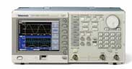
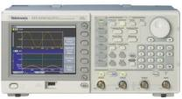
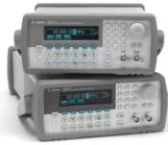
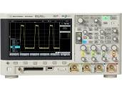
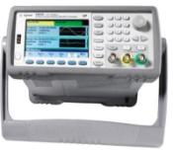



Agilent Waveform Generators Product Positioning
Agilent 81100 Series
Agilent solution
Tek AFG3000 and AFG3100 Series
Competitor solution
>$10k
Tek AFG3200 Series
Agilent 33200 Series
$1k-$5k
Price
Agilent 2000/3000 X-Series with
WaveGen functionality
Agilent 33500B Series
Agilent U2761A
< $500
Rigol DG 1000
BK Precision 4000 Series
Performance/Functionality
Notes:
Speaking of pulse generators and WaveGen, let’s look at an overall positioning of Agilent’s waveform generators.
As you can see from this chart, there are really 3 class segments of functionality and price. We’ve mostly been talking about the “sweet spot” of performance/functionality and price in the center of the slide. This represents the highest volume of waveform generator sales across the market and includes the 33500B Series and the 33200 Series.
On the high end of the spectrum, we have the Agilent 81100 Series pulse generators. While the Agilent 33500B Series does not go up to the same bandwidth as the 81100 Series, the Agilent 33500B Series does have full bandwidth pulse signals, in addition to sine and square, which is very differentiated from the competition. This, in addition to the ability to set the leading and trailing edges independently, make the 33500B Series a great alternative for lower bandwidth pulse signals at a much lower price point.
On the low end, the WaveGen functionality on the 3000 X-Series scopes is intended for the budget customer that needs just-enough capability to generate a simple waveform. Accuracy and signal fidelity are not of concern to these customers.
<click automation>
WaveGen competes more with the low-end and very low cost BK Precision 4000 Series and the Rigol DG 1000 Series. These are really a different class of generators than what we’ve been talking about in this module.
The Agilent 33500B Series has the best performance in it’s class, and at a slightly lower price point than the Agilent 33200 Series. As we discussed, Tektronix also has solutions in this space and is the next largest solution provider after Agilent for waveform generators. Their AFG3000 and AFG3100 Series are DDS generators much like the Agilent 33200 Series. The Agilent 33500B Series surpasses their performance and capability on all of the banner specifications.
Tek does also have high-end arbitrary waveform generators but those will cost more than $10,000.

Slide 22
Product Positioning:
33210A FG/ARB vs. WaveGen functionality of the 2000/3000 Series Scope – Features
The WaveGen option on the 2000/3000 X-Series oscilloscopes targets the low-end budget solution for signal generation where applying a simple signal is just-enough. As customers require more performance and features in their function generators, they will require a discrete instrument and likely move in to the mid-performance segment of the market where the 33200 and 33500 Series Function / Arbitrary Waveform Generators target. The 33210A 10MHz Function / Arbitrary Waveform Generator is the lowest-end model of this segment. Below is the first of three side-by-side tables to compare the features and specifications.
Typical Customers | 33210A Function / Arbitrary Waveform Generator | WaveGen Option InfiniiVision 2000/3000 X-Series Scopes
Typical Customers | Primarily R&D engineers and advanced education labs | Primarily entry education teaching labs and some basic R&D engineering tasks
Customer Needs Addressed | Advanced signal generation including arbitrary waveforms, modulation, sweeping, bursts, triggering, higher levels of accuracy/resolution, and higher levels of amplitude/offset | Ultra low-cost, basic signal generation

Slide 23
Product Positioning:
33210A FG/ARB vs. WaveGen functionality of the 2000/3000 Series Scope – Features
FYI: these represent different market segments
Features | 33210A Function / Arbitrary Waveform Generator | WaveGen Option InfiniiVision 2000/3000 X-Series Scopes
Basic Waveforms | Sine, square, ramp, triangle, pulse, noise, DC | Sine, square, ramp, triangle, pulse, noise, DC
Arbitrary Waveforms | Yes, 50 MSa/s, 14 bits | 3000 Series only, 100 MSa/s, 10 bits
Modulation (internal & external) | AM, FM, PWM (optional) | No
Frequency Sweep | Linear and logarithmic Sweep up and down | No
Burst Mode | Counted, infinite, and gated | No
External Trigger In | Yes | No
External frequency reference (synch to external clock) | Yes (optional) | No
Multi-instrument synchronization | Yes | No
Notes:
Jackal is just a basic FG – doesn’t have other operations
Not same precision or accuracy by a pretty large margin
If you just need a sine wave, Jackal is okay
Although many customers will use sine wave most of the time, they do still have a need to apply a burst or add modulation
Jackal’s WaveGen is really intended for education market

Slide 24
Product Positioning:
33210A FG/ARB vs. WaveGen functionality of the 2000/3000 Series Scope – Specifications
FYI: these represent different market segments
Specifications | 33210A Function / Arbitrary Waveform Generator | WaveGen Option InfiniiVision 2000/3000 X-Series Scopes
Sine, Square Bandwidth | 10 MHz, both | 20 MHz, 10 MHz
Pulse Parameters | 1% to 99% duty cycle, variable edge times | Pulse/square same, 20% to 80% duty cycle, no variable edge time
Frequency accuracy | 10 ppm, 90 days, 20 ppm, 1 year | 130 ppm, <10 kHz, 50 ppm >10 kHz
Frequency resolution | 1 µHz (internal), 1 mHz (user) | 100 mHz
Amplitude ranges | 10 Vpp into 50 Ohms | 2.5 Vpp into 50 Ohms
Amplitude Flatness (sine) | 0.1 dB | 0.5 dB
Total Harmonic Distortion (THD) | 0.04% | 1%
DC Offset Range | +/- 5 V into 50 Ohms | +/-1.25 V into 50 Ohms

