Slide 1
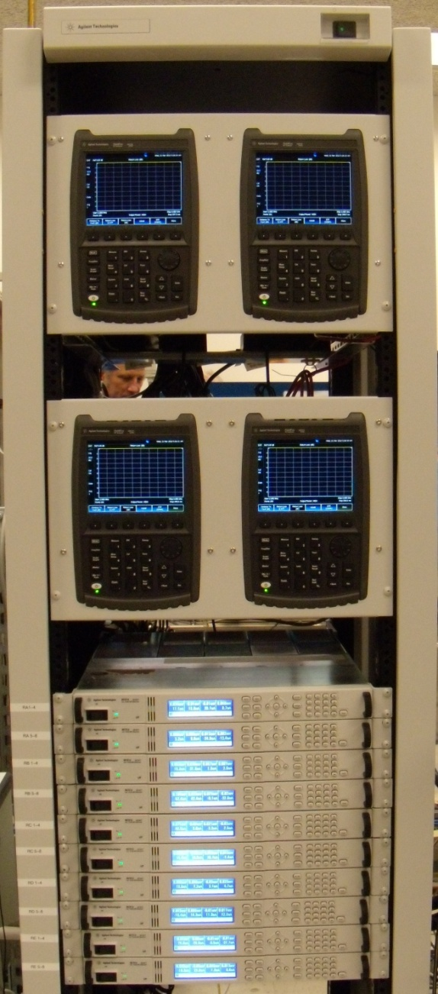
Rack Mounted FieldFox for Agilent SMT Pkg Test
A single FieldFox RF Analyzer replaced a legacy VNA, spectrum analyzer and power meter
Application:
Low volume, on-wafer manufacturing test applications
Measuring ICs
Measuring S21 gain, power, harmonics
Benefits:
Much lower cost solution
Performance and accuracy of FieldFox met the requirements
Measurement time is << than part handling time
Notes:
The FieldFox analyzers are so accurate and correlate with benchtop measurements so well, the Agilent Santa Rosa Fab decided to rack mount four FieldFox analyzers. This rack of FieldFox’s replaced a benchtop VNA, spectrum analyzer and power meter. The application is low volume, surface-mount package manufacturing test where IC’s are 100% tested for transmission gain, output power and harmonics. This was a much lower cost solution than buying three new bench instruments. The performance and accuracy of FieldFox met the requirements. The measurement speed, dynamic range and other performance attributes were more than adequate in this application.

