Slide 1
ATP FE Training
Session #3
Introduction to DDR Fundamentals, Market, and Agilent Solution
Taku Furuta
US and Japan
Business Development Manager
Digital Debug Solution Division
Agilent Technologies

Slide 2
Agenda
  What is DDR’s Market? Market Update and Pyramid Info
  10 min
  What is DDR Anyway? DDR fundamental and Our Solution Demo Hands-On
  45 min
  Sales Tool Information / Summary
  5 min

Slide 3
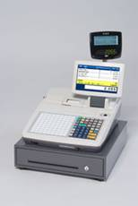
Where and How are DDRs being Used?
Controller ASIC or
FPGA w/ Controller IP
Controller ASIC or
FPGA w/ Controller IP
Display
Display
PCI-Express
PCI-Express
LVDS
MIPI
V-by-one
Camera Link
IEEE1394
SDI
etc…
DDR
DDR
HDMI
DVI
Display Port
SDI
DDR
SDRAM
DDR
SDRAM
DRAM is the temporary storage of the data.
If CPU/MPU exists, there will be DRAM
Consumer / embedded products handle large amount of graphical data (HDTV, printers, cell phone, digital camera, nav, game equipment) tend to face more troubles than others. However, not only the products associated with the graphics, even POS products have experienced DDR troubles. So,
If you hear HDMI, MIPI, LVDS… think of DDR troubles.
If you hear PCI-Express… think of DDR.
If you hear FPGA… think of DDR (ex: Xilinx Virtex 6 has DDR3 1067 (potential for 1333) core)

Slide 4
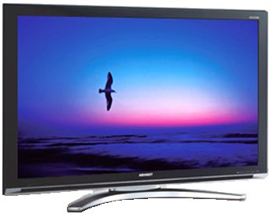


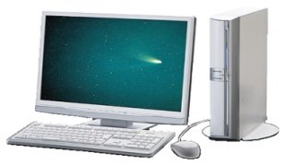





Examples of Consumer Electronics with DDR
Consumer Electronics
BD/DVD
Player/Recorders
Projectors
Flat Panel (LCD/PDP) Digital TVs
Digital Video Cameras
Desktop PCs
Set Top Boxes
Flat Panel Monitors
Games Consoles
PC related
Mobile PCs
It’s in everywhere, thus “it is hard to find the cust”; simply too broad.
Therefore, knowing the “timing” of investment is critical. Unless we approach the cust at their investment time window or during a real market trouble, the customer could be hard to time to justify the purchase.

Slide 5
When does customers invest to DDR measurement equipments?
DDR3
~ 2133MT/s
Invest!!
DDR2
Need More Speed @ Less Power!
Invest!!
~ 800MT/s
Invest!!
LPDDR2
DDR1
~1067MT/s
~ 400MT/s
Need More Speed!
Need to be GREEN
The investment are made when there is a disruption in technology.
In DDR memory, the disruption occurs in between DDR1&2, 2&3.
Reasoning /Justification for the T&M Equipment Purchases
Not enough bandwidth / spec wit the current tool.
Possible new troubles. Need to avoid making the same mistake again…
Thus, R&D budget gets allocated, reason to buy new equipments…

Slide 6
The “Disruption” Timing of the Technology is Different by Market Segment
LTE Cell phone → LPDDR2
Printer → DDR3
HDTV → DDR3
(some have DDR3-1333/1600 already)
Car Nav → DDR3
Laptop → DDR3
Cell phone →LPDDR
HDTV → DDR2
PC/Servers DDR2 → DDR3

Slide 7
DDR Pyramid Eco-System
DDR3-1600
Tier 0: Technology Enabler. Usually Selected Few (IP vendor, Semiconductor). (May or may not exist). Will not buy in quantity.
Inphi, Netlist, Diablo, IDT, PMC Sierra, Synopsys, Intel…
Tier 0
Tier 1: Technology Leader / early adaptor. Could be the same as Tier 0. Very technical and value based buyer (vs. price based). Buys in volume. Tends to buy more than rent.
Tier 1
Intel, HP (server), IBM, Dell, AMD, NEC, Micron, Elpida, Samsung, Hynix, Nanya, Broadcom, Qualcomm, STEC, Marvell, Maxim…
DDR3-1333
App: PC/Server,
DRAM + controller
Tier 2: Main stream market. Leading consumer electronics vendors looking to differentiate their product with new features and functions.
Tier 2
App: HDTV, DVD, Blu-ray, Car-Nav, Printers, Home Appliances, Cell phones, MP3 players, Cameras…
Sony, Panasonic, Hitachi, Canon, Fujitsu, Ricoh, ST Micro, NXP, Nokia, RIM, Apple, Ericsson, Xerox, Renesas, Adaptec, Lexmark, and everybody else.
DDR2-DDR3 800/1067
Tier 3: Main stream market for cost focused consumer electronics players. More price sensitive then
other segments. Or military related.
Tier 3
Smaller consumer electronics, Raytheon, Sandia, Boeing, Northrop Grumman, General Dynamics, Lockheed Martin, etc.

Slide 8
FY09 & 10 Install base info: Can you find our customer?
Do you have customers’ competitor as your customers?
  IBM
  SanDisk
  RIM
  Konica Minolta
  Hynix
  Ricoh
  Intel
  NEC
  Seagate
  DENSO
  SONY
  Samsung
  Marvell
  Analog Devices
  Ericsson
  Magnum
  Texas Instruments
  Elpida
  DATARAM
  SPANSION
  PACE
  Panasonic
  TERADYNE
  Inphi
  Netlist
  Adaptec
  Lockheed Martin
  Scandia
  AMD
  IDT
  Toshiba
  COPIVIA
  Semiconductor Insights
  Fujitsu
  HP
  Tabula
  Dell
  LSI
  Mayo Foundation
  PMC Sierra
  Qualcomm
  Sinyee International
  Diablo
  NEC
  NXP
  Nuvoton
  Juniper
  Cisco
  Broadcom
  QLogic
  University of Stuttgart
  Impact Science
  Spark Olcum
  Kowa
  Motorola

Slide 9
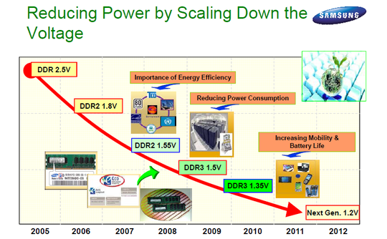
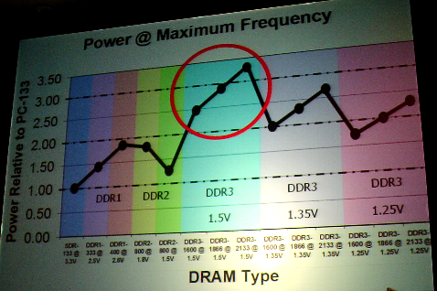
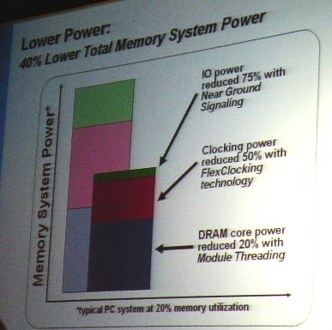
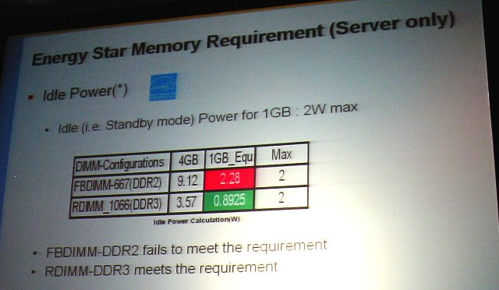
DDR Market Trends – It’s about all about being GREEEEN
LPDDR1 1.8V
LPDDR2 1.2V

Slide 10
Agenda
  What is DDR’s Market? Market Update and Pyramid Info
  10min
  What is DDR Anyway? DDR fundamental and Our Solution Demo Hands-On
  45 min
  Sales Tool Information / Summary
  5 min

Slide 11
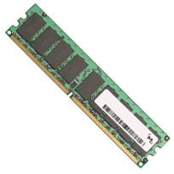
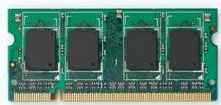
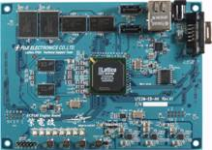

What’s DDR Anyway?
DDR = memory, the temporary data storage place for CPU.
DIMM (for mainly PCs/Servers)
Memory module with multiple DRAMs loaded. More DRAMs, bigger the memory size.
DRAM
SO-DIMM (mainly for laptops and printers)
About the half the size of DIMM used for space constrained applications.
Embedded
DRAM is mounted directly on PCB. Usually, 1, 2 or 4 DRAMs. Apps are, HDTV, digital camera, graphic boards (like medical uses), car navigation system, cell phone, industrial signal processing, etc.
Spec is own by JEDEC Standard Body
http://www.jedec.org/
Board of Director: Perry Keller @ Agilent

Slide 12



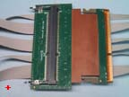


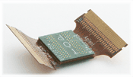
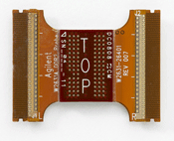
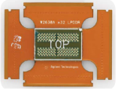

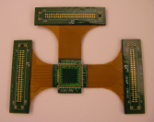
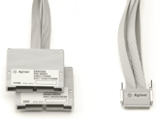

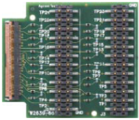


Addressing All Types: DDR Memory Probing Selections
 | DDR2 200 MT/s ~ 800 MT/s | DDR3 800 MT/s ~ 1867 MT/s | LPDDR / LPDDR2 200 MT/s ~ 1066 MT/s
DIMM Interposer | FuturePlus FS2334 (~800) | FuturePlus FS2352 (~1867) Nexus NT-DDR3DIHS (~1867) | NA
SO-DIMM Interposer | FuturePlus FS2337 (~667) | FuturePlus FS2354 (~1600) Nexus NT-DDR3SOIHS (~1600) | NA
BGA probes | W2631B (x16), W2633B (x8) E5384A (ZIF cable) | W3631A (x16), W3633A (x8) (~1333) E5845A (ZIF cable for x16) E5847A (ZIF cable for x8) | W2637A (x16), W2638A (x32) (LPDDR), Custom (LPDDR2)
Mid-bus | E5406A SoftTouch Pro | E5406A SoftTouch Pro | E5406A SoftTouch Pro
Others | W2639A DDR2/DDR3/ LPDDR Scope Adaptor Board | W2635A (x8), W2636A (x16) DDR3 Scope only BGA Probe W3635A DDR3 Scope Adaptor Board | W2639A DDR2/DDR3/LPDDR Scope Adaptor Board
FuturePlus: www.futureplus.com Nexus: www.nexustesttechnology.com

Slide 13
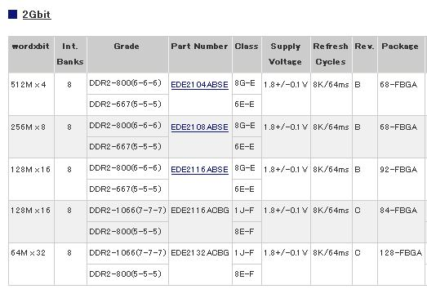
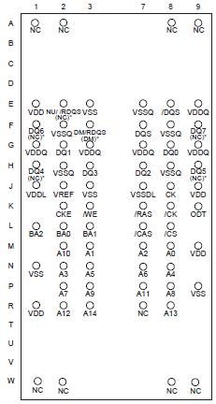
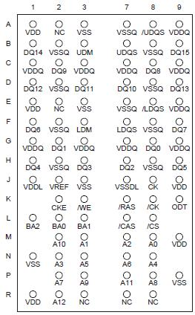
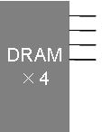
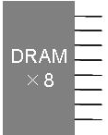
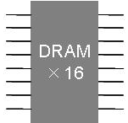
Understanding DRAM Spec
Package
Form factor, number of balls. JEDEC specifies them. When selecting a BGA probe, you must choose the correct package.
Memory size
Described in unit of bits!
# of Data Bits
Number of Data Lines
Data Rate (Mbps or MT/s)
Speed of the Data Signals
DDR = 200Mbps, 333Mbps, 400Mbps
DDR2 = 400, 533, 667, 800, 1067Mbps
DDR3 = 800, 1067, 1333, 1600Mbps
# of Banks
Internal memory structure. How many segment it has.
*Data transfer rate (MB/s, GB/s)
DRAM chip data rate is DIFFERENT then DIMM module data transfer speed. The former is frequency of the signal, the later is the data transfer rate per sec per module.

Slide 14
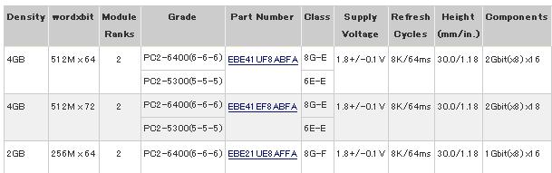
Understanding DIMM Spec
# of Bits
DRAM (x8) x 8 units = 64 bits
Components
Loaded wit 16 DRAMs with 2Gbit x 8bits (data lines). Thus 8 in front, 8 in back.
Module Ranks
Front and back are treated as a different virtual module. Rank is the number of the virtual modules on DIMM. Relates to the number of CS (chip selects)
Byte !
Density
Memory size of the module.
512M x 64bits = 512M x 8Bytes = 4GByts
MB/s, GB/s !
Back DRAM x 8
Data Transfer Rate
When data rate per date line is 800Mbps & the module has 8bytes, then 8Bytes × 800MHz＝6400MB/s . Thus PC2-6400.
Front
DRAM x 8
×8
×8
×8
×8
×8
×8
×8
×8

Slide 15
Definition of Read & Write
WRITE
The direction of the controller writing to the memory (subjective to the controller)
Controller
WRITE
DDR
DRAM
READ
READ
The direction of the controller reading from the memory (subjective to the controller)

Slide 16
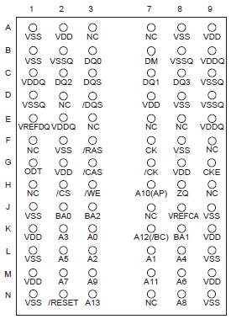
Type of DRAM’s Signals
Address Signals
A0, A1, A2, A3… around 13 to 15 signals.
Specify the address of the DRAM, where to read and where to write
During the initialization, setup the resisters by the combination of highs/lows of the address signals.
/CS: Chip Select. When multiple DRAMs shares the same data line, determine which chip to be specified.
BA0, BA1, BA2: Bank Address. Specify which bank is used.
Command Signals
CK (differential clock)
/RAS,RAS# (Row Address Strobe), /CAS.CAS# (Colum Address Strobe), /WE (Write Enabled): Command is determined by the combination of these 3 signals
CKE (clock enable)
VDD, VDDQ, Vref, VDDL (voltage level of each)
VSS, VSSQ, VSSDL (grounds)
ODT (On Die Termination)
ZQ
Data Signals
DQ0, DQ1, DQ2, DQ3… etc.
8 lines if x8, 16 lines if x 16. Standard DIMMs are 64 lines.
Differential DQS (LDQS, UDQS or DQS0, DQS1…)
Clock for DQ (data), strobe signal. 1 DQS per 8 DQs.
DM
Data Mask signal. DQ is valid only DM is High (Write)
DQ (data) is in sync with DQS (Data Strobe)
Address/Command is in sync with the CK(Clock)
Like CKE and ODT with no extra symbol, High = ON, Low = OFF.
Like /RAS and /CS with “/”, High = OFF, Low = ON. Sometimes they are written as RAS# or CS#.

Slide 17
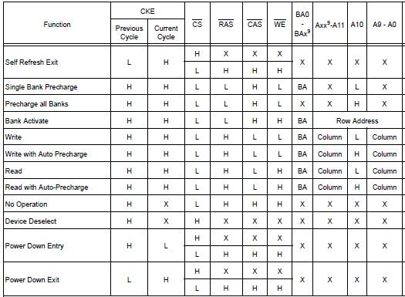
Commands
Controller sends different commands to DRAM like, “Read”, “Write”, “Activate”, “Precharge”, “Refresh”, “Mode Register Set”, etc. The commands are determined by the combination of /RAS, /CAS, /WE.

Slide 18
Structure of DRAM (Cell)
DRAM is structured with the volatile memory cells. “Volatile” means, the data / contents will get erased after a given period of time. Even if the power is kept on, it requires the system to periodically read the data and overwrite the data. Else the data is lost.
* SRAM: As long as power is provide (any format), the data won’t get erased.
* Flash memory: The data is kept even with power-off.
DRAM

Slide 19
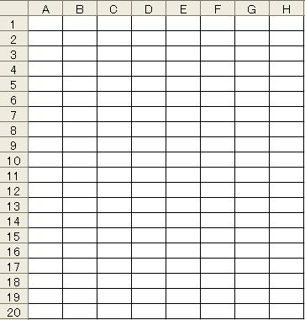
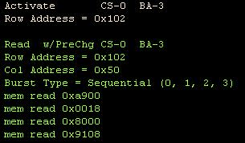
Structure of DRAM (Address Space) - 1
3. Read the data from or write the data (0 or 1) to the specified address.
Selected cell
1. Specify Row Address
Usually uses A0 to A14 address signals.
2. Specify Column Address
Usually uses A0 to A9, A11 address signals
1. Specify Bank Address
Bank
DRAM segments the memory space into several segments (Banks). Uses BA0 to BA2 command signals.
Decoded signals on Logic Analyzer (B4621A)
Activate Bank3, Row Address 102
Read data from Bank3, Row Address 102, Column Address 50

Slide 20

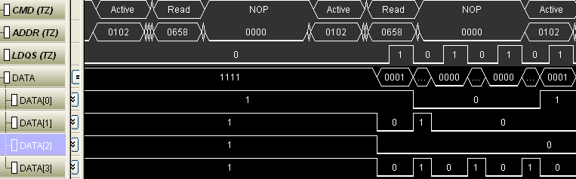
Structure of DRAM (Address Space) - 2
4 data lines
DQ0
DRAM
×4
DQ0
DQ1
Each data line has individual chart (spreadsheet)
DQ1
DQ2
DQ3
DQ2
DQ3
1
2
3
Logic Analyzer Visualizes the DRAM Activities
Activate Address 102 (Row Address)
Issue “Read” command to Address 658 (Column Address)
Data from the specified address per individual data line is read. In this example, it is 0001 (Q0=1, DQ1=0, DQ2=0, DQ3=0)

Slide 21
Offline Lab #1: With and Without B4621A
  File location
    Desktop → FE_folder → DDR
  Offline .ala file to use. Double click it to open
    Decoding_Compliance_Demo.ala

Slide 22
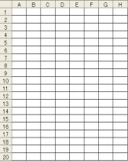
Burst Data (1)
It is not efficient to specify address of each cell at a time for read/write commands, especially large data is moved constantly. As large data (like graphics) are stored in sequential cells, it will be more efficient to read/write multiple cell data in a single address specification. This is the burst data transaction (either burst of 4 or 8)
Example for burst length = 4.
When Row Address 6, Column Address A is specified, data from 6A, 6B, 6C, and 6D are READ at once (or WRITTEN for the write command)
Example for x16 DRAM Burst transaction

Slide 23
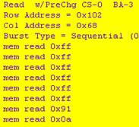
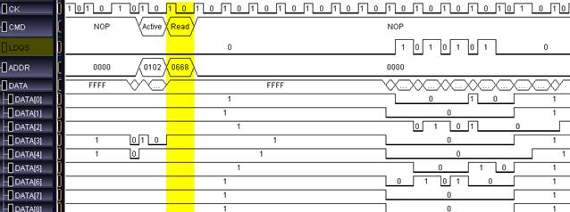
Burst Data (2)
Example of Burst Length = 8 for DRAM x 16
With a single READ command for an address, 8 data per data line is returned.
Decode listing by Logic Analyzer SW (B4621A)
# of data = 16
Burst length = 8

Slide 24
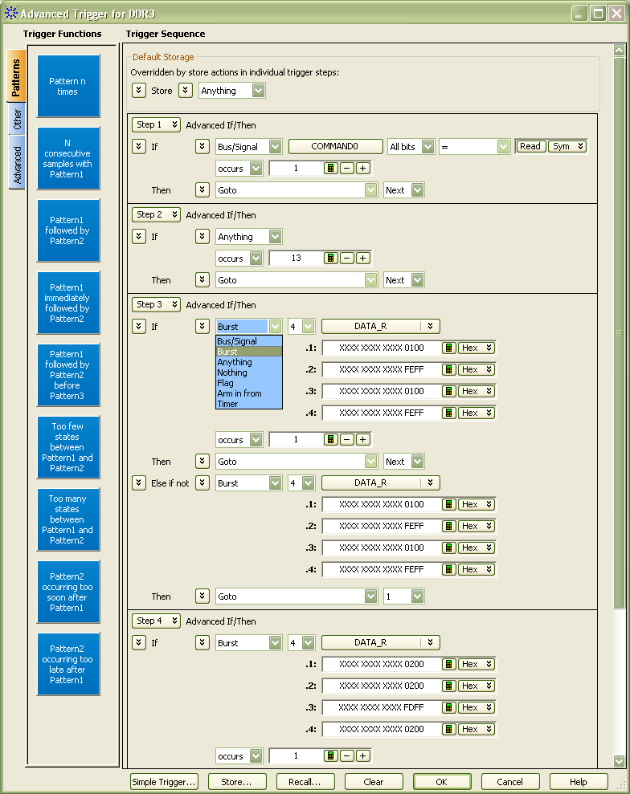
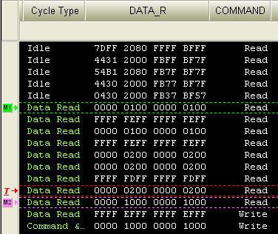

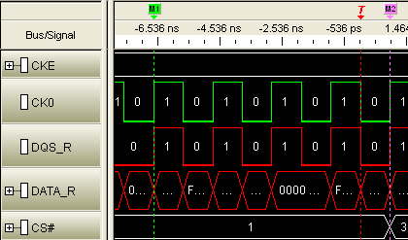
How Logic Analyzer Addresses Customer’s Needs
Burst 1
Burst 3
Burst 5
Burst 7
Burst 2
Burst 4
Burst 6
Burst 8

Slide 25
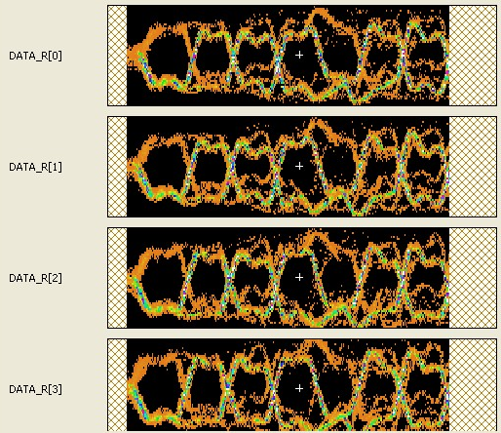
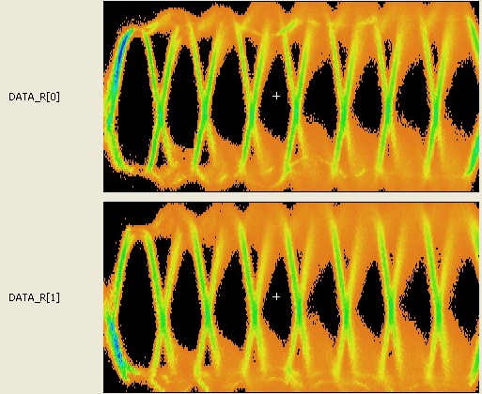
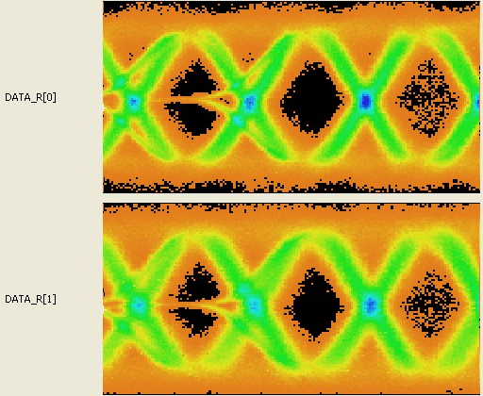
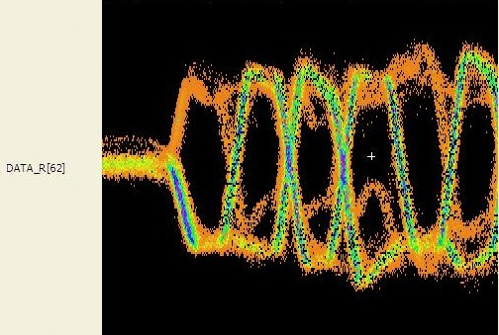
How Logic Analyzer Addresses Customer’s Needs
Quick Signal Integrity Insight into Data Burst Eyes

Slide 26
Offline Lab #2: Show and Tell with
Burst Trigger and Burst Scan Offline Data
  File location
    Desktop → FE_folder → DDR
  Offline .ala file to use. Double click it to open
    BurstTriggerSetupDemo.ala
    MidRes_BurstScan.ala
    HighRes_BurstScan_1600_Demo(SO_DIMM).ala

Slide 27
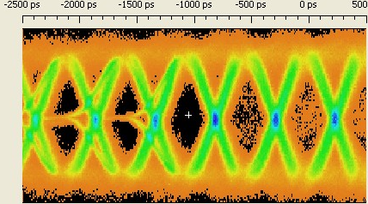
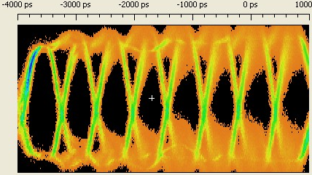
Understanding EyeScan and BurstScan for DDR Signals
DDR EyeScan: Overlaying each of 4 or 8 bursts on top of each other
(Primary use for determining the sample position)
(example of burst of 4)
Actual EyeScan overlays thousands of waveforms
BurstScan: Overlaying multiple captures on top of each other (pattern lock repetitive mode)
(Provide you the quick signal integrity insight)
(example of burst of 4)
Actual EyeScan overlays thousands of waveforms

Slide 28
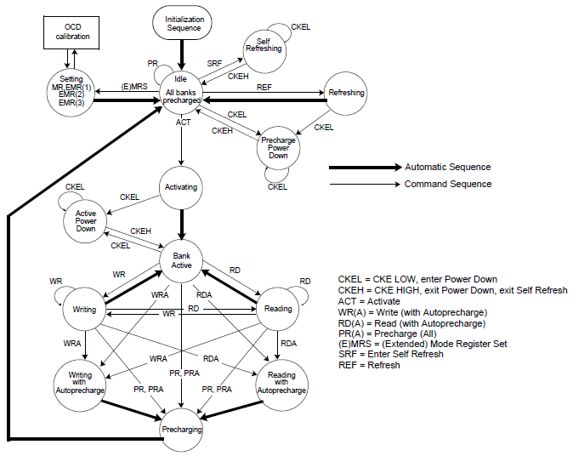
DDR State Machine
Protocol of DDR. Shows possible states and its sequences.

Slide 29
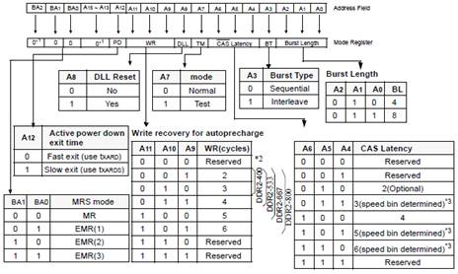
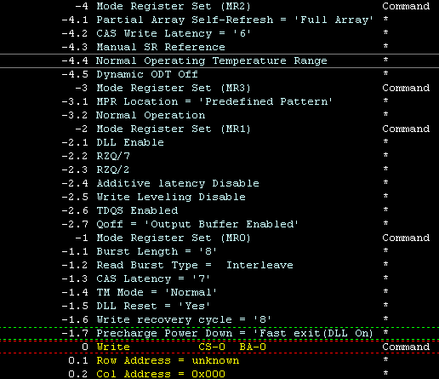
Popular States:
Refresh, Precharge, Active, Mode Register Set (MRS)
Refresh
DRAM loses data (1) with the time even if the power is kept on. Therefore, the system needs to re-charge the condenser periodically in order to prevent the data loss. This called “Refresh”. Many customers must to see the time period in-between each refresh (refresh rate) with a logic analyzer. If period is too long, there’s potential of data loss, but if the period is too short, the system runs slow creating the optimization issue.
Precharge
When you READ the cell, you will lose the electric charge in the condenser. Thus, the system will charge the cell after the READ.
Active
Before READ or WRITE, the controller activate a specific “Bank” and “Row Address”. Only after the activation, you can READ or WRITE to the specific address.
Mode Register Set (MRS)
Determines the default setting of Latencies, Burst Sequences, Burst Length, DLL, and etc. It is set during the initial power on (thus, customers want to capture initial sequence) or when you want to change DRAM settings.
MRS decoding using LA SW (B4621A)

Slide 30
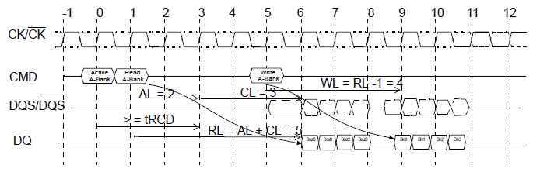
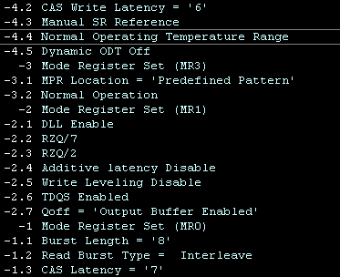
Read/Write
Timing is different between Read and Write
DQ (data) is in sync with DQS (strobe)
DQ is twice of CK = Double Data Rate (DDR)
Read = DQ and DQS are in phase
Write = DQ and DQS are out phase by 90deg
Command is in sync with clock (CK)
Read
1: Active command, Row Address
2: Read command, Column Address
3: Few clocks later, Read Data Burst
Write
1: Active command, Row Address
2: Write command, Column Address
3: Few clocks later, Write Data Burst
MRS decode
The delay from the issue of command to data burst is called latency
RL=Read Latency, WL=Write Latency, AL=Additive Latency, CL=CAS Latency

Slide 31
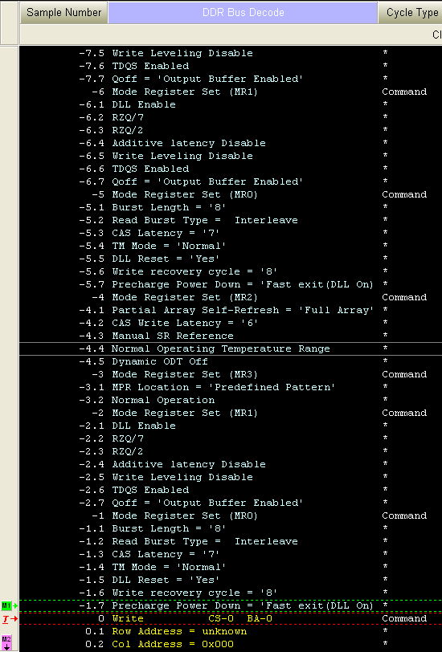
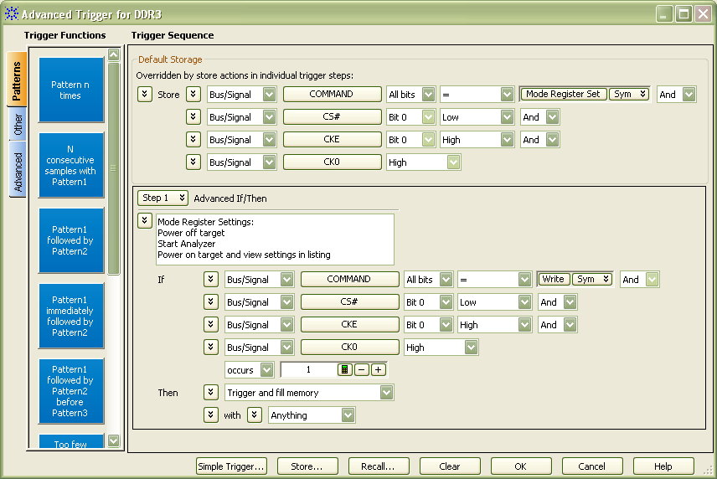
Offline Lab #3: Using MRS Offline Data
  File location
    Desktop → FE_folder → DDR
  Offline .ala file to use. Double click it to open
    MRS_Demo.ala

Slide 32
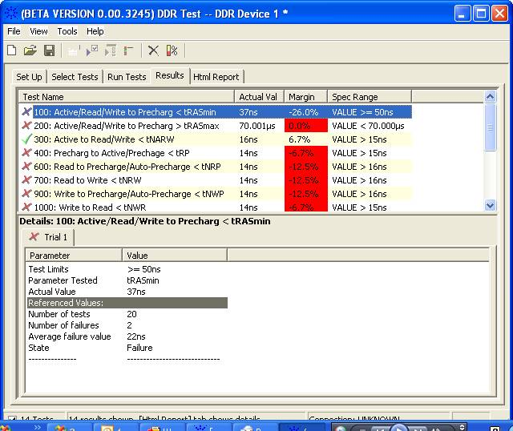
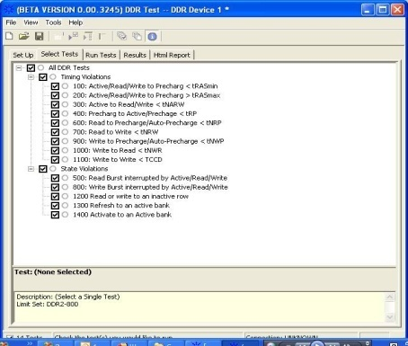




Making Engineer’s DDR Debugging Life Easer:
Unique B4622A DDR2/3 Software Solution
B4622A DDR2/3 Protocol Compliance and Analysis Tool
1
DDR2/3 Protocol Violation check
  Same framework as the Scope Compliance tool.
2
Performance Analysis
  Provides bus statistic information.
  Provides histogram view on number of access at a specific memory address
3
DDR2/3 Trigger setup
  Enable automation of creating trigger on physical address

Slide 33


B4622A: Protocol Compliance Test
Total of 15 tests: Timing and Protocol
HTML Report detailing test results

Slide 34
Offline Lab #4 Show and Tell with B4622A
  File location
    Desktop → FE_folder → DDR
  Offline .ala file to use. Double click it to open
    Decoding_Compliance_Demo.ala

Slide 35



Rank and Chip Select
DQ3
DQ18
Even if multiple DIMMs (Ranks) in the system, data still use the same data line. The example shows that DQ3 for the first DIMM is still DQ3 for the second.
In READ, the controller determines which DIMM (chip) the data is read from. In WRITE, the controller specifies target DIMM (chip) to write the data.
CS (chip select) is the signal used to determine this. When CS# is “Low”, that chip has been selected.
DQ27
DQ49
Controller
Data lines are shared among different DIMMs
Read DQS and DQ waveform, but you can observe two waveforms exist.
This is also read DQS and DQ, but you see there is two waveforms.

Slide 36
The Next Challenge: DDR2 to DDR3
With faster data rate, the signal quality worsen. The new technology to address this fundamental issue are deployed in each generation.
DDR1 (~ 400Mbps)
Diff Clock
DQS (Data Strobe): Data(DQ) sync with DQS. The clock comes out only from the controller, but DQS comes out from both directions like DQ.
DDR2 (~ 800Mbps (1066Mbps))
Differential DQS
ODT (On-Die Termination): Termination within DRAM. Reduce the reflections.
OCD (Off-Chip Driver): Control the output driver impedance of DRAM.
DDR3 (~1867Mbps (2133Mbps))
Dynamic ODT: Dynamically controls ODT impedance.
ZQ Calibration: New impedance control method to replace OCD.
Fly-By Topology: Modification of the signal routing of address/command on DIMM

Slide 37

ODT – On-Die Termination 1
Introduced with DDR2, ODT is a technology to have termination inside of DRAM to minimize the reflection and improve the signal quality. 。
The reflection issue exists due multiple DRAMs sharing the same data lines.
ODT did not exist with DDR1. Increased speed with DDR2 forced new technology.
Mother board termination
On-Die Termination
Termination on
Termination off
DRAM active
DRAM standby
DRAM active
DRAM standby
Termination on mother board
Controller
DQ bus
Controller
DQ bus
Reflection
Reflection
Pros
Controls signal reflection and improves signal quality.
Enable design cost down by decreasing the surface mount components on the mother board
Simplify your system design by removing the termination and its routing on your PCB.
Cons
Wrong timing to turn on/off ODT can impact your signal quality. Had been a cause of the signal quality issue before.
Improper implementation (or skipping of implementation) can cause a critical issue.

Slide 38





ODT – On-Die Termination 2
DDR2 has 3 on die termination values: 50ohm, 75ohm, 150ohm
ODT termination value is set during EMRS command such as during the initialization. As shown above, A2 and A6 vaues are sued to determine the value. If controller wants ODT = 150 ohm, it sends out A6 = 1 and A2 =0 to the DRAM.
Actual turn on and off of ODT is controlled by the DOT signal (high/low)
50ohm
75ohm
150ohm
ODT OFF

Slide 39


Example ODT off captured with BurstScan
Erratic behavior
Indicative of termination issue

Slide 40

DDR2 Topology: T-branch Address/Command
R
R
R
R
R
R
R
R
D
D
D
D
D
D
D
D
D
D
D
D
D
D
D
D
DQ/ DQS = Point-to-Point
DQS
DQ
Memory Controller
Clock/ Address/ Command: T-Branch Topology
Cons: Hard to match the impedance, faster speed significantly decreases the signal quality.

Slide 41

DDR3 Topology: Fly-By Address/Command
R
R
R
R
R
R
R
R
D
D
D
D
D
D
D
D
D
D
D
D
D
D
D
D
DQ/ DQS = Point-to-Point
Memory Controller
Clock/ Address/ Command: Fly-By Topology
Signal quality improves, but new issues comes up…
There will be a time lag (flight time) between DQ signals and command/address/clock, so the controller need to adjust the signal transmission timing. Thus DDR3 requires timing de-skew implementation.

Slide 42


DDR3 Topology: Write Leveling
DDR3 DRAM outputs the skew info between CK-DQS. Controller uses this info to adjust the timing of command, address, and clk, making sure they arrive at the same time of DQ, DM, and DQS
During the initialization, the adjustment starts by MRS turning on the write leveling (Write Leveling enable). If DQS is arrives too early then CK, DRAM returns 0 to controller. The controller delays DQS. When CK and DQS arrive simultaneously, then DRAM returns 1 via DQ signal.

Slide 43

Logic Analyzer Addressing the Validation Challenge of
Write Leveling 1
MRS decodes not only shows the Write Leveling activity, but it shows how long it will take to complete it.

Slide 44

Logic Analyzer Addressing the Validation Challenge of
Write Leveling 2
Quick “byte lane” check using Colored EyeScan feature.

Slide 45

DDR3 Topology: Read Leveling
During READ, after issuing address/command, return timing of DQ/DQS is different. The controller adjusts the capture timing of DQ/DQS according to the delay time of CK/ Address/ Command arriving in each memory device (DRAM)
Adjustment Method:
DDR3 SDRAM output the given data pattern. The controller adjust the capturing timing of DQ/DQS per DRAM.
* Controller needs to support this feature to enable this capability.

Slide 46


Addressing the Needs for the Current Trend: Eco & Green
Measuring Self Refresh
Self Refresh is an ultimate way to save power.
Clock is off during CKE down (and refresh command)
Trouble happens when the clock and CKE comes back. Clock needs to start at last 5 cycles before CKE is up.
  Dell Laptop for example…

Slide 47







Making Engineer’s DDR Debugging Life Easer:
DDR Setup Assistant (under development)

Slide 48
Agenda
  What is DDR’s Market? Market Update and Pyramid Info
  10min
  What is DDR Anyway? DDR fundamental and Our Solution Demo Hands-On
  45 min
  Sales Tool Information / Summary
  5 min

Slide 49

The Solution: 16962A 2GHz State, 8GHz Timing
High Speed, Deep Memory Logic Analyzer Module
16962A Key Specifications/Features
  Automated sample position at 5 ps resolution (EyeScan):(Accurate & Repeatable)
State speed: (Covers all DDR2/3 speeds!)
    2GHz (DDR); 2 GT/s (Single edge);
      Simultaneous DDR Read & Write capture
    2.2 GHz (dual sample for rising/falling edge data, half channel)
      Double probe for DDR read & write capture over 2GT/s
Triggering: (Won’t miss the elusive events)
    2 GHz trigger sequencer - capture events at full speed that other LAs miss
    Burst trigger function captures entire data burst of 8 on DDR2/3 systems
Timing speed: (Resolution with memory depth)
    2 GHz timing and transitional timing full channel (up to 100 M deep)
    4 GHz timing and transitional timing half channel (up to 200 M deep)
    8 GHz timing and transitional timing quarter channel (up to 400 M deep)

Slide 50
Typical Configuration
Computer DIMM Config
Embedded BGA Probe Config
Model | Description | # | Price
16902B | 6 slot mainframe | 1 | $19,343
16962A | 68-ch 2Gb/s state LA module – 4M | 4 | $39,355 *4
FPS/ Nexus | DDR3 1600 Interposer | 1 | ~$40,000
Total |  |  | $216,763
Model | Description | # | Price
16902B | 6 slot mainframe | 1 | $19,343
16962A | 68-ch 2Gb/s state LA module – 4M | 2 | $39,355 *2
W363xA | DDR3 BGA probe | 1 | $722
E5845/7A | DDR3 BGA ZIF | 1 | $1,290
Total |  |  | $100,065
Minimum Viable Config (add & cmd only)
Model | Description | # | Price
16902B | 6 slot mainframe | 1 | $19,343
16962A | 68-ch 2Gb/s state LA module – 4M | 1 | $39,355
W363xA | DDR3 BGA probe | 1 | $722
E5845/7A | DDR3 BGA ZIF | 1 | $1,290
Total |  |  | $60,710

Slide 51
Sales Tool and Summary:
  DDRs are everywhere. The investment timing is now due to emerging DDR3 / LPDDR2 needs. Being “Green” is the key word.
  The competition is the cust realizing the solution is available in the market, then Tektronix.
  Know the technology and terms. Qualify the cust with key terms and offline demo. If one is the “potential cust”, they will react to our material.

Slide 52


Division Experts and Contacts:
  Business Development Managers
    West Sales Region Taku Furuta (522-8979)
    East Sales Region Brad Frieden (590-2011)
  Division Application Experts
    DDR Jim Majewski (PME), Jennie Grosslight (Tech Mktg)
    FPGA Judith Smith (PME), Denny Deboer (Tech Mktg)
    PCI Express Yenyi Fu (PME), Alex Bailes (Tech Mktg)
    MIPI/DigRF Yenyi Fu (PME), Denny Deboer (Tech Mktg)
    HDMI Judith Smith (PME), Allie Schirmer (Tech Mktg)

Slide 53
Backup

Slide 54


Tektronix
Logic Analyzer Competition
AGILENT RESTRICTED DO NOT INCLUDE SLIDE TO EXTERNAL AUDIENCES AGILENT RESTRICTED
TLA 700
TLA 7BB4
Key Take Agilent has won virtually every memory deal we have competed Away for since the introduction of the 16962A in April 2009
How We Win
Product
Competencies
Portfolio of probing options
Reliable data capture (EyeFinder with 5ps x 5mv sample resolution)
Full speed trigger sequence + Burst trigger
Signal integrity insight (Colorized Eyescan, Burstscan)
Data to Insight (Decoder, Compliance, Performance)
Technical expertise
AEO & Factory
Industry presence
Pyramid solutions
AGILENT RESTRICTED DO NOT INCLUDE SLIDE TO EXTERNAL AUDIEN
Tektronix Claim | Agilent Response
50G MagniVu | + Reliable data capture enabled by Eyefinder (5ps x 5mv) + Eyescan enabled eye diagrams provide a compelling measurement technique + Timing modes to 8G in ¼ channel mode with deep memory - Above benefits more than offset the benefit provided by MagniVu
Analog Mux | + Signal integrity insight across all channels with a single measurement + Isolation event of interest with LA and cross trigger scope to get the precise parametric measurement

