Slide 1
Agilent High Speed Digital Test Symposium
Digital Software Defined Radio Test

Slide 2
Objectives & Agenda
Objectives
Review typical digital & system test Challenges of SDR prototypes
Explore logic test setups that can provide insight on SDR systems
Agenda
Architecture Overview
ADCs
Baseband Processing
FPGA
Memory
Microprocessors/Microcontrollers
Summary
Notes:
In the following presentation, we will talk about typical test challenges associated the digital parts of SDR prototypes, and how logic test solutions can provide insight on the behavior of such systems.
We will look at the various building blocs of SDR, and consider test environments for each one of them.
We will first focus our attention on the ADC, which is one of the critical parts of SDR architectures
And then look at the other main digita; building blocs of the system (FPGA, memory, uP)

Slide 3


SDR Flexible Hardware Architecture
Digital Domain
IF : Digital or Analog
RF domain
Memory DDR
Memory DDR
ASIC
FPGA
Memory DDR
Rx
Data Path
Microcontroller/
Microprocessor
+
Peripheral IO
DSP
Tx
IF Processing Simple Demodulation
Flash EEPROM
Digital Control Path
Baseband Processing
Reconfigurable RF/IF
FPGA based architecture on Signal path
DSP based Signal Processing
Embedded control
Broadband or Tunable Antennas
Flexible and Wide-range tuning
Adjustable components (Variable bandwidth filters, multimode amplifiers, variable rate/resolution converters, etc)
Notes:
On the RF side, there is a large number of different receiver architectures, but essentially the components are similar. Typically, we have a Tx and an Rx path, ADCs/DACs , simple demodulation (sometimes), and possibly an ASIC (RF_IC). As the architecture is designed for flexibility, these building blocs can be configured :
Typical examples are broadband or tunable antennas
the filter bandwidth can be adjustable
Converters will have variable rate and resolutions
On the baseband side, the system includes at least one FPGA and some DSPs on the signal/data path, and a Embedded Microcontroller (DSP and uC may be in the same Chip), with memory, and I/Os to user interface devices.
The link between the two will include software control for setup and reconfiguration, calibration and timing., many of these components can be configured from the control unit: that is represented is the Digital Control Path.
Given this, there might be SOME protocol involved on the 2 paths . We will see later that there is a way to test custom digital protocols with commercial, off-the-shelf equipment.
We’ll explore some receiver architectures next.
Let’s take a look at some of the individual components. First we’ll start with a receiver architecture overview.
One significant technology force is the migration of the ADCs and DACs closer to the antenna-and advances in substrate and electronics technologies, these devices are become part of the RF_IC.
This does represent a discontinuity from a test point of view. The measurement equipment used on the analog IQ interface can no longer be used for that purpose. Now we need different
Receivers and signal generators-yet we must still make the same kind of measurements: Distortion, Modulation Quality etc.
For example, if we’re a RF_IC designer, we still have to test the wireless protocol and physical layers on the interface. In the case of a specific digital standard, like DigRF, we have to de-packetize the frames and extract the IQ data to perform this testing. In the analog days, often the same equipment used to test the RF interface had analog BBIQ inputs available so could be used to test the base band interface as well. This is no longer the case-and we often have an added digital protocol layer as well.
While there may not be specific digital protocol for the chipset interface on a software defined radio, there are still some similarities to that of a DigRF (for example) mobile phone chipset.
Let’s start by looking at a fairly generic block diagram of an SDR chipset.

Slide 4
Receivers
RF Tx/Rx
1st Down Conversion
1st IF
2nd Down Conversion
2nd IF
Baseband Processing
Super Heterodyne
Modern receiver architecture moves the Antenna closer and closer to the ADC.
ADCs become more complex, and much faster.
While we won’t focus on receiver architecture-no single design is “standard-” we’ll look at some the components these architectures have in common-and some methods for testing them.
Namely, ADCs and some of the Baseband Processing Components.
RF Tx/Rx
Down Converter
IQ Mod
Baseband Processing
Near-Zero IF (NZIF/Low IF)
RF Tx/Rx
Down Conversion to Baseband
Baseband Processing
Direct Down Conversion (DDC)
RF Tx/Rx
Baseband Processing
Delta-Sigma ADC
Notes:
It is not the intention of this paper to present the trade offs of all the receiver architectures available (there are many), but a short discourse on the definitions of the architectures portrayed here may be beneficial to the audience.
Two subsystems that all RX architectures have in common are the ADC subsystem and the baseband processing subsystem. We will explore these further, beginning with ADC characterization.
Superheterodyne receivers have been used for years. They generally involve several down conversion, or frequency translation stages (analog IF), coming to a fairly low IF prior to input to the ADC. Each stage requires mixers and LOs, along with associated filtering and amplifiers. Though it is generally considered to be the most robust design-allowing superior selectivity and sensitivity, the disadvantage lies in the fact that the design cannot be modified for the varying requirements of different users. Other disadvantages include mirror imaging (an artifact of mixing) and power consumption.
(Not Shown): The Zero IF (ZIF) or Direct conversion receiver uses a single mixing stage which downconverts directly to baseband. A low pass filter is used to filter out any unwanted out of band signals. The advantages of this involve the removal of IF stages , much lower power consumption and it is possible to incorporate VCO, LNA and Baseband filters on a single chip. The disadvantage lies in problems with DC Offset and flicker noise. Both the NZIF and ZIF architectures use an IQ demodulator to convert the signal to baseband. If I or Q are not exactly 90 degrees out of phase, then a DC offset is produced which can cause distortion, depending on the value of the DC component. Flicker noise comes from the transistors in the chain-the ZIF receiver downconverts the signal to a frequency where the transistors have their highest noise level and this is a serious concern to designers. However, because of it’s advantages, this architecture is receiving a great deal of interest.
Near-zero IF (NZIF) , or Low IF (LIF) architectures have a single down conversion stage (Analog IF) to an IF whose frequency is close to, or at the bandwidth of the baseband signal. This is the primary difference between the ZIF and the NSIF. This helps to prevent the DC offset problem as seen in the ZIF architecture, while still maintaining a low cost and lower power consumption design. The disadvantage lies in the need for more expensive SAW filters to suppress unwanted adjacent channel interference from the image band of the desired signal.
Direct Down conversion (DDC) architecture is somewhat different. The RF is passed directly into a high speed ADC, and the DDC decimates (down samples) the signal to the desired frequency.(baseband Digital). Clearly an advantage of this is that we eliminate any of the analog IF circuitry-and by placing the ADC directly at the antenna we have reduced the RF Front end significantly, allowing for nearly all the signal processing to take place in the digital domain. Like the NZIF and ZIF, the DDC usually uses some kind of IQ demodulator. Some of the advantages of the DDC architecture lie in the ability to control it completely via software, and in its inherent stability. There’s nothing to tune or finesse. The disadvantages include the need for very high speed ADCs (consider Nyquist theory applied to microwave signals), and the limit in the dynamic range of ADCs. Thus the selectivity and sensitivity will not currently compare with a superheterodyne receiver.
Delta-Sigma ADC architecture uses delta sigma modulation with the ADCs. The ADC consists of a delta sigma modulator and a low pass filter. The delta sigma modulator outputs a pulse-proportion modulated bit stream; the output bits that are high correspond to the highest digital output value and likewise, the output bits that are low correspond to the lowest digital output value. The easiest way to think of it is as a VCO, where the control voltage is measured and linearity and proportionality are determined via negative feedback. (Simplified,) The VCO output are pulses with known constant amplitudes and which have specific durations, but where the distances between (intervals) are variable. The feed back loop determines the length of the distance between the pulses, such that a low input voltage (to the ADC) produces a long interval between the pulses and a high input voltage produces a short interval between them. The digitization of the input voltage is obtained by comparing and counting the intervals within a fixed period of time and producing a count, or Sigma . The pulses produced can be treated as the Dirac (delta) function and thus this type of modulation is called Sigma Delta.
The advantages of the delta sigma converter include very high resolution (leading to high dynamic range) and good linearity. The disadvantages include latency (feedback and complexity) size, and power consumption.

Slide 5
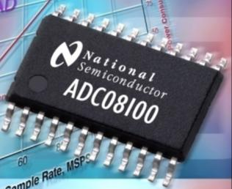
Agenda
Architecture Overview
ADC Characterization
Dynamic Measurements
Baseband Processing
FPGA
Memory
Microprocessors/Microcontrollers
Summary
For More Information

Slide 6
ADC Dynamic Characterization
There are four primary specifications for ADCs: offset error, full-scale error, differential nonlinearity (DNL), and integral nonlinearity (INL) Most methods for measuring these specifications involve mapping the ADC’s ideal transfer function-and comparing this to a histogram created by multiple samples and measurements of the digital output code versus the analog input voltage.
In addition to the four key specifications, there are other aspects of the ADC we would care to see, in particular we want to be able to look at the dynamic characterization.
It is important to understand the dynamic behavior . In other words-how much distortion is it adding? Most ADC dynamic behavior is measured using FFTs. The receiving device will of course be digital-and as such will not add any kind of distortion to the signal we’re passing through the ADC. This makes a logic analyzer an ideal receiver for these measurements. It’s available right off the shelf-and requires no customization.
There are multiple measurements we need to make in order to fully characterize the dynamic behavior of an ADC. Signal to Noise Ratio (SNR), Signal to Noise and Distortion (SINAD), Noise Figure (NF), Harmonic Distortion, Intermodulation Distortion (IMD) and more. In our example, we will talk specifically about IMD, as the effects of poor IMD performance can be fairly serious
An easy way to look at this is by using a signal generator, clock, logic analyzer, and Agilent’s 89601A Vector Signal Analysis software.
First let’s start with a block diagram of the test setup.
Notes:
Differential nonlinearity (acronym DNL) is a term describing the deviation between two analog values corresponding to adjacent input digital values. The term often used as an important specification for measuring error in a digital-to-analog converter (DAC); the accuracy of a DAC is mainly determined by this specification. Ideally, any two adjacent digital codes correspond to output analog voltages that are exactly one LSB apart. Differential non-linearity is a measure of the worst case deviation from the ideal 1 LSB step. For example, a DAC with a 1.5 LSB output change for a 1 LSB digital code change exhibits 1⁄2 LSB differential non-linearity. Differential non-linearity may be expressed in fractional bits or as a percentage of full scale. A differential non-linearity greater than 1 LSB will lead to a non-monotonic transfer function in a DAC.
Integral nonlinearity (acronym INL) is a term describing the maximum deviation between the ideal output of a DAC and the actual output level. The term is often used as an important specification for measuring error in a digital-to-analog converter (DAC).
Full-Scale (FS) error
Full-scale error is the difference between the actual value that triggers the transition to full-scale and the ideal analog full-scale transition value. Full-scale error equals offset error + gain error, as shown in this figure.

Slide 7





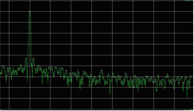
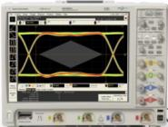
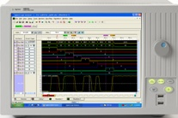
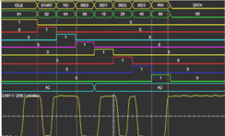
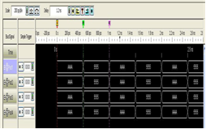
Proposed ADC Dynamic Measurement Block Diagram
N9020A MXA Signal Analyzer with internal Preamp.
View dynamic behavior with the 89601A Vector Signal Analysis software
E4438C Signal Generator with N7621B Multitone Signal Studio Software
BPF
Agilent DSO 90604A 20 GSa/s 6 GHz Bandwidth Scope (Verifies signal quality)
81134A Pulse Pattern Generator (High speed clock)
When making these measurements, it’s critical to have a spectrally pure (and accurate) signal source and a clock that has tightly controlled jitter. It is also recommended to use a band pass filter at the output of the signal generator.
Trigger Out
View Scope
16901A Mainframe with 16962A 2GHz High Speed Logic Analyzer Module
View Scope allows us to trigger on suspect data and see the precise analog representation of the signal.
Verify the Digital Output
Notes:
It’s extremely important to have a spectrally pure and accurate signal source. For added accuracy-we’ve inserted a band pass filter between the signal generator and the ADC. The signal generator should have much better dynamic range than the ADC.
The clock must also have very tight jitter control.
This is necessary because we’re trying to characterize the ADC-not the signal generator or the clock. Spectral impurities and jitter can show up in the frequency domain as distortion-phase noise, SNR, etc.
We also don’t want any external mixing effects from some harmonics generated by the signal generator-we want nothing in the bandwidth of the ADC that it doesn’t put there itself.
Multitone capability is important as we’ll see when we measure intermodulation distortion. Agilent’s N7621B Signal Studio for multitone is an off the shelf
solution that can generate up to 4096 discrete CW tones with multitone signals over 80 dBc third-order intermodulation distortion (IMD) or NPR test stimulus with over 60 dc notch depth
Alternately, we could have two signal generators with a combiner-but there needs to be a high degree of isolation between them so they don’t introduce other IMD.
The scope is there to provide a signal integrity view of the analog signal-we can use View Scope if need be. We might also want to put a spectrum analyzer there to check the spectrum on the analog side, prior to input to the ADC.
While we’re looking at the dynamic behavior-we will also occasionally want to check to see if the data is valid-we can view both simultaneously. If a glitch occurs-we’ve got the oscilloscope setup with View Scope-so the Logic analyzer will pull in the analog picture of the glitch when it happens. This helps us determine what exactly is going on if we run into a problem.

Slide 8
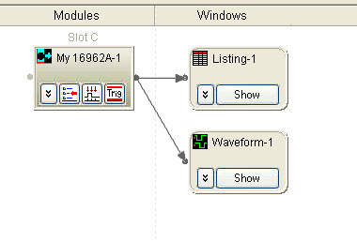
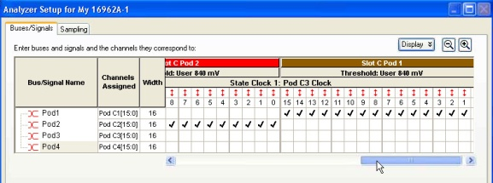
Setup
In the overview window of the Logic Analyzer Software, there are Icons for each probe, module, tool and window. This allows quick access to the associated functionality. The overview window also gives you a functional block diagram.
Activity indicators tell us which lines are active. These should always be checked prior to running the analyzer.
Notes:
First we need to setup the Logic Analyzer and ensure our data is present. Agilent logic analyzers incorporate a very easy-to use graphical interface. Activity indicators in the Bus/Signal setup window
tell us which lines are active and where a bit might be stuck For this measurement-since we have 64 bits of parallel data, there are 64 lines + clocks that need to be verified.

Slide 9
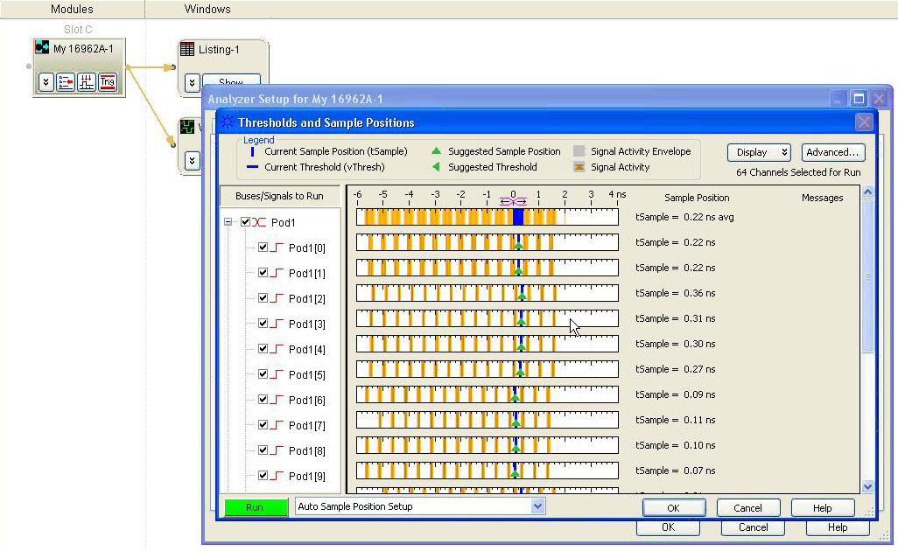
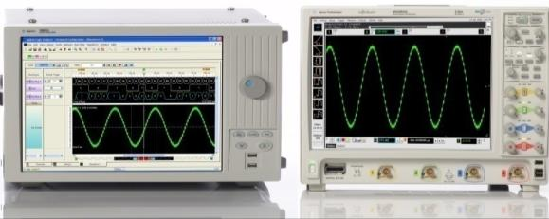
Setting the Sample Positions and View Scope
We want to identify problem signals early on so we don’t get false readings on the logic analyzer when we’re looking at dynamic behavior.
If there are any problem signals, we have to correct them before we move forward.
Agilent’s Eye Finder looks at the entire bus and sets the best possible sample position.
Agilent’s Eye Scan allows us to visualize all the bus lines simultaneously to quickly identify problem signals.
When the data isn’t correct-or a glitch occurs, we can use View Scope to quickly show us the integrity of the signals causing the issue. This is a feature of Agilent’s scopes and logic analyzers. It’s precisely time correlated. The scope’s trace is displayed on the logic analyzer’s screen directly below the signal of interest. We’ll see more of this later.
Notes:
It’s critical to set the sample positions properly.
On a high speed parallel signal, this can be tedious and time consuming.
This would also have to be done each and every time you’ve restarted the system.
Agilent’s Eye Finder does this automatically-with a high degree of accuracy-and 5 ps resolution.
Agilent’s Eye Scan allows you to see across all the bus lines simultaneously and quickly identify problem signals.

Slide 10
Intermodulation Distortion (IMD)
IMD occurs when there is more than one frequency component present within the bandwidth of the ADC and non-linearities are present. Since there are no “ideal” ADCs, it’s safe to assume that all ADCs carry some form of non-linearity.
These frequencies will mix and produce more components (which are not usually at harmonic frequencies). Such non-linear behavior can cause variations in amplitudes and phase.
Since the ADCs we are dealing with are used with modulated signals (which have multiple frequency components), we need to understand the effect of the non-linearities on the ADC output.
IMD, depending on the severity, can cause mild to severe interference with other operations on the signal. Thus it is critical to minimize the effect within the ADC.
Example:
Let’s say that two frequencies, f1 and f2 are present at the input to the ADC. The mathematical expression can be given as:
X(t) = A1 (Sin2πf1+ φ1) + A2 (Sin2πf2+ φ2),
where A is the amplitude and φ is the phase.
We can define the output signal, Y(t) = G(X(t)), where the G(X(t)) describes a non linear function of the ADC.
Y(t) contains the two frequencies, f1 and f2, in addition to the linear combinations of the frequencies,
k1f1 + k2f2.
where k1 and k2 are arbitrary values and are the intermodulation products created by the presence of the two frequencies in the ADCs bandwidth.
These products will have various amplitudes and phases, the outcome directly related to the actual non linear function that is performed upon the original signal. Thus for any range of frequencies, f1, f2, …fn, we will have k1, k2,…kn intermodulation products.
Notes:
Harmonic distortion is also a result of nonlinearity in the ADC. When a signal passes through the non-linear device, spurs, or harmonics become present. Total harmonic distortion (THD) refers to the sum of the power of all the spurs, divided by the power of the main carrier (Fundamental frequency).
Although harmonic distortion is easily measured, the harmonics produced are usually outside the ADC bandwidth and will be filtered out in DSP. It is IMD which becomes more important-IMD affects the signal passing through the ADC directly.

Slide 11

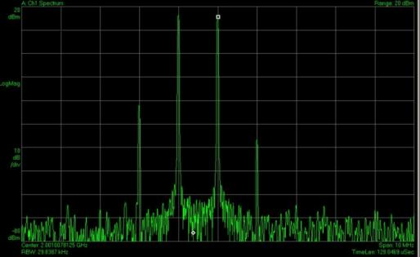

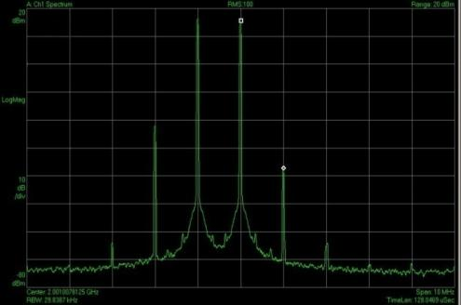
Measuring Intermodulation Distortion
Mixing products are clearly evident.
N9020A MXA Signal Analyzer with internal Preamp.
Agilent DSO 90604A 20 GSa/s 6 GHz Bandwidth Scope
E4438C Signal Generator with Multitone
BPF
81134A Pulse Pattern Generator (High speed clock)
89601A Vector Signal Analysis Software
Averaging turned on-shows a couple more products-but these may not cause issues.
There’s nothing new about IMD-it’s been around a long time.
However, what IS new is that now these can be made on the digital side- without the need for custom hardware or software-you can see exactly what the Baseband processing interface is seeing.
16901A Mainframe with 16962A 2GHz High Speed Logic Analyzer Module running Agilent’s 89601A Vector Signal Analysis Software
Notes:
These traces were taken using Agilent’s 89601A Vector Signal Software. We inject two tones, one at 2 GHz, the other at 2.001 GHz. We can see the intermodulation distortion on either side of the two carriers-they are spurs created by the two signals mixing together.
If we turn averaging on-we can see that there are more products-but these are quite far down-about -65 dBc-so these may or may not be an issue to a designer. The two primary products however, could pose some interference as the one on the left is only about -38 dBc and the one on the right about -55 dBc. Clearly IMD can cause some major issues.

Slide 12
Summary: Key Capabilities for ADC Testing
The Logic Analyzer is the measurement receiver best suited for state measurements on ADCs. Commercial, off the shelf, completely ready with the tools that you need.
2 GHz State mode provides accurate capture for high-speed devices.
Activity indicators let you quickly identify system status and stuck bits.
Eye Finder automatically sets the sampling position on multiple lanes-saving enormous time and effort.
Eye Scan allows you to identify the problem signals quickly by viewing eye diagrams across all buses and signals simultaneously.
Connection to Agilent’s 89601A vector signal analysis software allows for measurements of ADC dynamic behavior on the digital side, so you know exactly what the input to the baseband processing will look like.
Most dynamic ADC measurements can be made using a very similar test configuration.

Slide 13
Agenda
Architecture Overview
ADC Characterization
Dynamic Measurements
Baseband Processing
FPGA
Memory
Microprocessors/Microcontrollers
Summary
For More Information
Memory DDR
Memory DDR
FPGA
Memory DDR
Microcontroller/
Microprocessor
Peripheral IO
DSP
Flash EEPROM
Baseband Processing

Slide 14
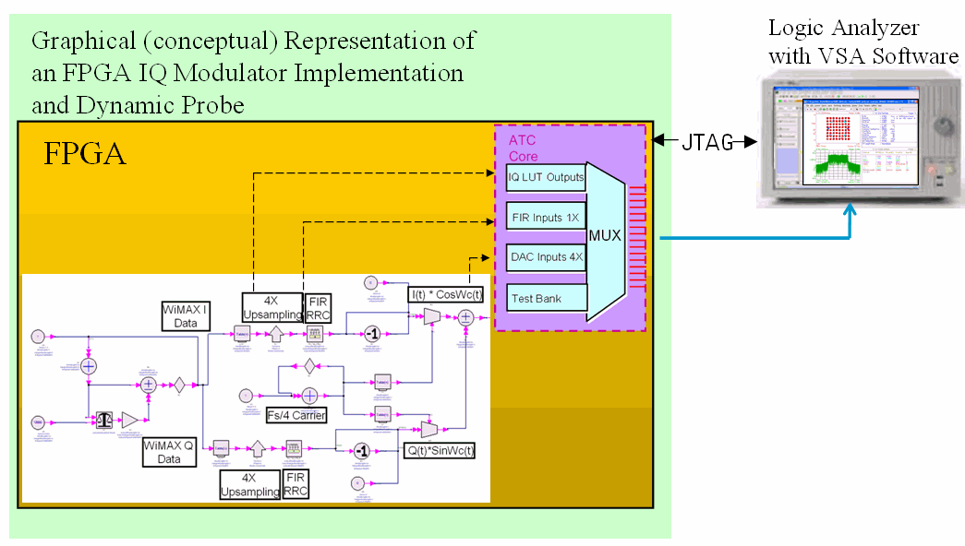
Getting insight into Digital Signal Path
Debug phase requires measurements between functional blocs in FPGA
How to get real-time visibility into internal FPGA ?
FPGA

Slide 15


Connectivity Challenge - FPGAs
FPGA
Agilent 16800/900 Series
Pins
External Logic Analyzer
Probe
points
TRADITIONAL APPROACH: route internal signals to pins
Limitations
One-to-one correspondence of FPGA debug pins used to signals visible
Time-consuming recompiles to change signals routed to debug pins
Recompile affects timing of design
Tedious to keep track of signals and correctly identify them to LA
Iterate dozens of times to find problems
Notes:
Now that we’ve seen two new physical probing products, let’s turn our attention to making signal connections in a new way, inside FPGAs. Our customer research showed very clearly that engineers incorporating FPGAs in their designs are logic analyzer users. They rely on the insight that a logic analyzer can provide to understand the behavior of their FPGA design in the context of the surrounding system. The approach they typically use is to take advantage of the programmability of the FPGA to route internal nodes to a small number (typically 8-16) of physical pins.
While this is a very useful approach, it does have some serious limitations. First, since pins on the FPGA are typically an expensive resource, there are a relatively small number available, limiting the visibility of internal nodes to the same small number of signals (i.e. one pin is required for each internal signal to be probed). When different internal signals need to be accessed, a recompile of the design may be required. This can be very time consuming and often changes the timing of the FPGA, and so is definitely something to be avoided.
Finally, the process required to map the node names from the FPGA design to the logic analyzer labels is completely manual, and is tedious and error-prone at best. When changes are made, the need to manually update these label names to match the new configuration of the measurement (potentially very useful and important) takes additional time and is a potential source of confusing errors. Since there often may be many iterations, this becomes even more of a problem.
Most engineers know the pain of testing the outputs of an FPGA. There are limitations on pins available, so in order to check the various signals we have to either design our own
multiplexer into the FPGA or change the design itself to output the different signals we need to see. Considering the complexity of today’s FGPAs, this takes multiple iterations-and a significant
investment of time for each iteration. Finally, the process required to map the signal names from your FPGA design to the logic analyzer setup is manual and tedious. When new signals
are routed out, you need to manually update these signal names on the logic analyzer, which takes additional time and is a potential source of confusing errors.
In order to make things a little easier, Agilent has worked with two of the leading FPGA vendors to provide a more convenient method of making these measurements.
Let’s start with the Xilinx FPGA dynamic probe.

Slide 16
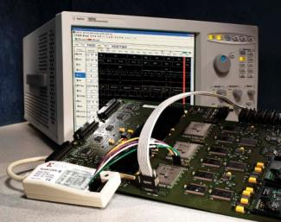

FPGA Dynamic Probe
B4655A SW application
Probe outputs of ATC II core
PC Board
Parallel or USB
FPGA
Insert ATC II core with FPGA design software
JTAG
Notes:
FPGA Dynamic Probe addresses these limitations by providing a complete debug environment incorporating the logic analyzer. Let’s take a look at the components of the solution to get a better understanding of how this works.
Making use of FPGA Dynamic Probe starts with an assessment of the internal nodes of the FPGA for which you’ll need logic analysis access, and the type of measurement (state analysis or timing analysis) that needs to be made. You then select the appropriate core (from a library developed by Agilent and incorporated into the Xilinx FPGA tools), and insert it into the design. The inputs to the core are the internal nodes to be probed by the logic analyzer, and the outputs are routed to 4-128 physical pins devoted to debug with the logic analyzer. The debug pins are physically connected to the logic analyzer using any of Agilent’s logic analyzer probes (note that the new 17-ch Soft Touch probe makes an excellent choice with its small footprint and high fidelity).
The cores can be thought of as MUXes that are controlled via the JTAG connection to the FPGA offered through the standard Xilinx JTAG cable used to download and program the FPGA. This whole system is controlled via software that runs on the logic analyzer. The new 16900 Series mainframes are supported as are the 1680 and 1690 Series from Agilent. With this measurement system, you can now select the internal signals from your FPGA that you want to probe with the logic analyzer, reconfigure the mux to bring those signals out through the FPGA pins connected to the logic analyzer, and see the new signals in 1 or 2 seconds. The signal names you see on the logic analyzer correspond to the node names from your FPGA design, and automatically update every time you make a change. All of this is controlled directly from the logic analyzer, and there no need to recompile your FPGA!

Slide 17
Agilent Trace Core (ATC II)
2, 4, 8, 16, or 32 input banks
All banks have identical width (4 to 128 signals wide)
Bank width determined by # of pins - each pin corresponds to 1 signal per bank
Using optional 2X TDM in state mode each pin corresponds to 2 signals per bank
Improved Signal Visibility
4 - 128
4 - 128
4 - 128
2X TDM
Selection MUX
4 - 128
Output to FPGA pins for debug
4 - 128
Select
.
.
.
JTAG
Change input bank selection via JTAG
Notes:
This slide illustrates more details of the general makeup of the ATC II cores that enable the FPGA Dynamic Probe.
The cores can be thought of as MUXes that offer different numbers of input “banks” or groups of internal signals that can be made available (selected) for logic analysis. The number of physical pins available for physical connection to the logic analyzer determines the input bank width. To further increase the utilization of the physical pins dedicated to debug, a 2X time-division multiplexing option is available that doubles the number of potential internal signals available. The table illustrates the maximum number of internal signals that can be accessed, given the number of pins devoted to te logic analyzer for debug.
The JTAG connection is used to control and configure the ATC II cores, and setup the measurement to be made. All this is done directly from the logic analyzer in an interactive and intuitive fashion. Both synchronous (state) and asynchronous (timing) measurements are supported, although different cores are required for each.
Also noteworthy is that fact that these cores require very little in terms of internal FPGA resources required to implement this approach. Customers told us in our research that to be a viable solution, a core that offers internal signal access should not take up in excess of 5% of the internal resources of the FPGA. In our case, the typical footprint in a XCV2000 (a mid-size part) is considerably less, around 2%. We have detailed documentation available that describes the exact resources required, as it varies depending on the specific core chosen.

Slide 18
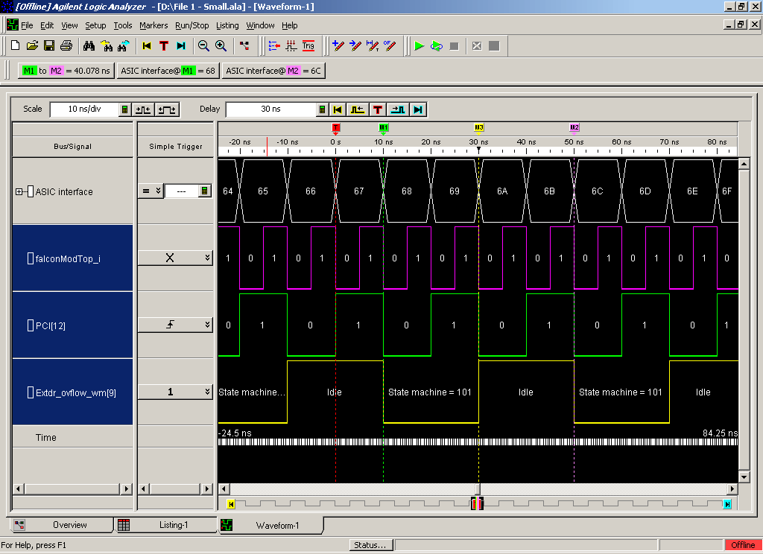
FPGA Signal Name Import
Time correlation
with external
events
New internal FPGA
probe points
& associated
signal names
Notes:
This screen shot from the logic analyzer illustrates the signal name import and mapping capability in FPGA Dynamic Probe. Here we see the signals highlighted that represent internal FPGA node names imported from the Xilinx ISE design tool environment (implemented via the .cdc file). If we were to change these to bring out another bank of signals, the names would automatically update. This capability, while conceptually simple, is a major ease of use factor, and a real contribution when making interactive measurements across many internal signals.
Also, since this is a logic analyzer and it’s designed to make time-correlated measurements, remember that you can now incorporate internal FPGA signals along with signals from other areas of your circuit. The combination of the logic analyzer and FPGA Dynamic Probe means you can now make correlated measurements from your system that include internal FPGA signals!

Slide 19
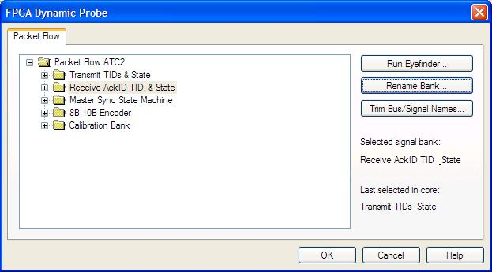
Device, Core, & Bank Naming
Notes:
To measure a different part of the FPGA design, simply click on another bank.

Slide 20
FPGA Dynamic Probe Specifications
Measures new groups of internal FPGA signals in seconds without
Recompiling the design
Impacting the timing of the design
Achieves wider internal visibility over a fixed number of pins
Up to 64 internal probe points per pin
Eliminates error prone & time consuming tasks
Automates signal/bus labeling from FPGA design SW to logic analyzer
Maps FPGA pins from board layout to logic analysis channels
→ Save 15 min to 10 hours per new measurement
→ Save 8 hours per problem by not having to create simulation testbench
→ Save 2 to 30 minutes per new measurement
Notes:
Where these capabilities really make a difference for designers is in the time saved during the development process. This slide highlights some actual perspectives shared by an FPGA designer who had the opportunity to evaluate and comment on the potential for this tool to contribute to his productivity. His comments reflect his experiences over a number of FPGA development projects.
To illustrate the potential contribution, we’ve highlighted his observations about potential time saved in each of three key areas. The first area of dynamic probing (changing internal probe points) offers the potential for major time savings, especially when a design is heavily constrained such that it requires long recompile times.
The second area (wider internal visibility) potentially allows a measurement approach to be used rather than a simulation/testbench approach, according to this designer. This means the designer can get right to the integration task at hand, and bypass the time consuming steps required to exhaustively simulate the design.
And finally, the convenience of having the logic analyzer display automatically synched with the FPGA design tool is a real help, not just in time savings (although it’s significant as shown here) but in making sure that the designer understands clearly what he or she is seeing in the logic analysis environment relative to the actual design itself.
All this adds up to significant potential time savings in debugging FPGAs and FPGA-based designs with your Agilent logic analyzer.

Slide 21
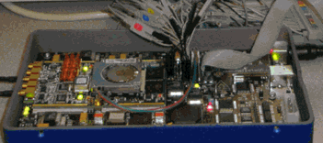
Example : Probing an FPGA Waveform with Dynamic Probe
Waveform Sources
FPGA Hardware

Slide 22
Extracting I and Q from Digital Data Flow
How to rebuild I and Q signals from Digital Data ?
What if IQ data is multiplexed or serialized ?
You have a 2-bit wide serial bus with the following signals: 1-bit wide protocol encoded I and Q values, and 1-bit clock. Assume the packet header for I and Q values is a constant pattern followed by 4 pairs of 12-bit long I and Q values.
The Signal Extractor can extract the 4 I and Q values and assign them to new buses. Again, the serial version of the I and Q values will be translated to pair of standard 12-bit wide I and Q values.
You have a 48-bit wide bus with the following signals: 4x12 bits of A-to-D conversion. Each of the 12-bits is a high-speed sample of a 3.2 GHz A-to-D converter. The A-to-D converter is running at 3.2 MHz or 312 ps per sample. The signals are multiplexed out in groups of 4x12-bits and latched so that the logic analyzer can capture the A-to-D output at a rate of only 800 MHz or 1.25 ns per four samples.
The Signal Extractor can remultiplex the A-to-D signal back to the original 12-bit wide signal.

Slide 23
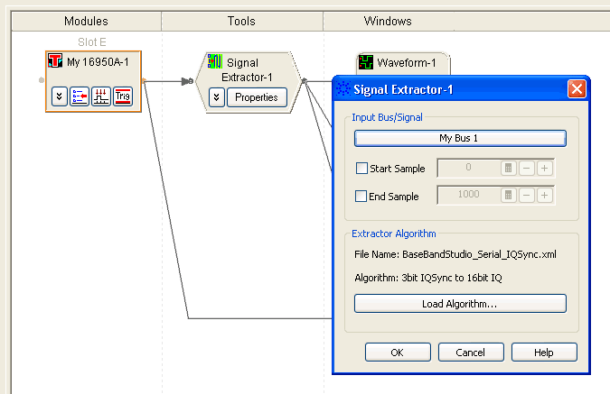
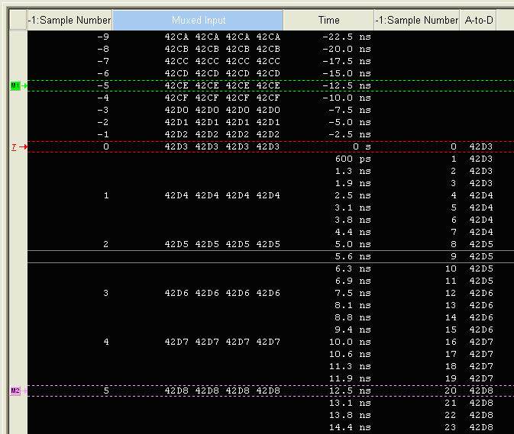
Signal Extractor Data reconstruction Capabilities
Rebuilt data from demultiplexed input
Xml based engine
Extracting Multiplexed data
Extracting Demultiplexed data
Data Aggregation
Identify Sequence starts/ends

Slide 24
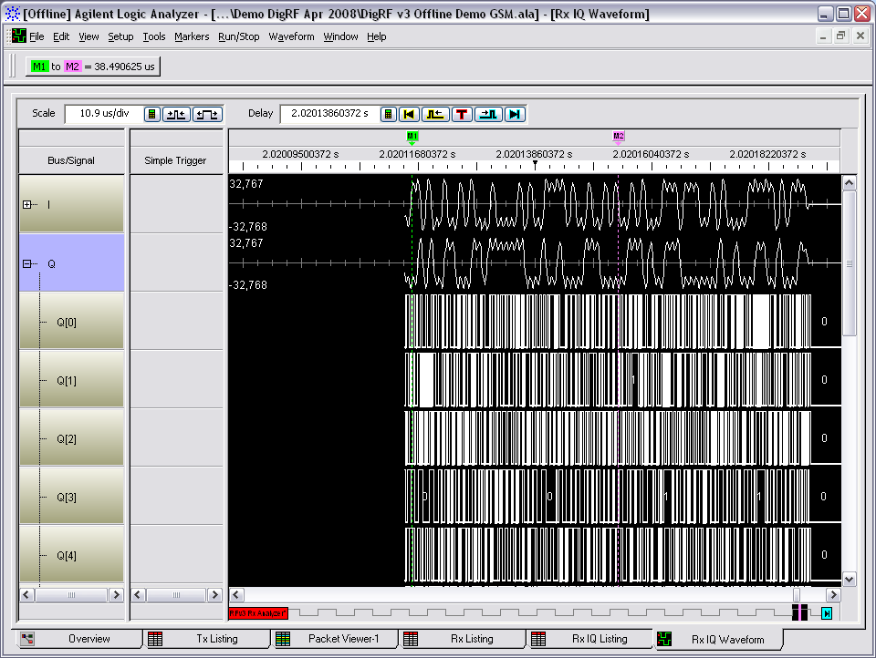
IQ visualization
Signal Extraction and Time Domain IQ visualization mode
Mixed Analog/digital view
Time correlation with other measurements
Control flow visualization

Slide 25
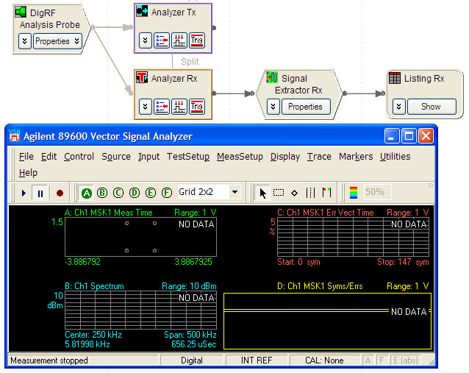
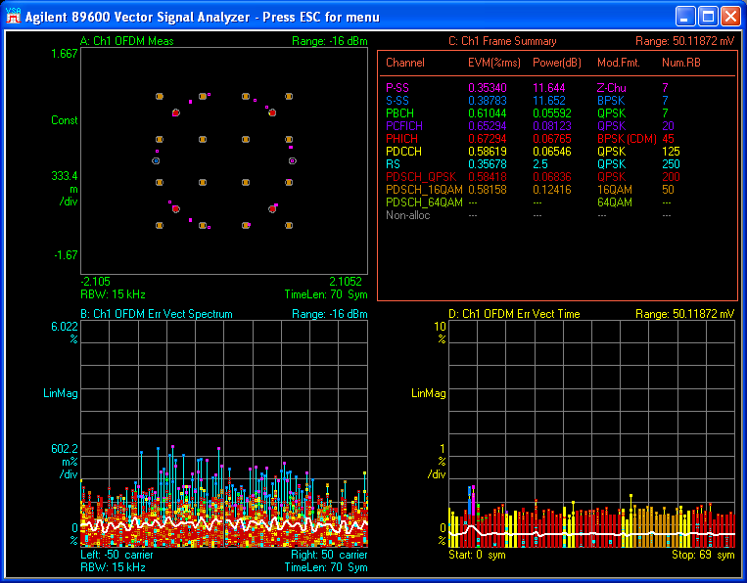
Modulation Measurement from Extracted I/Q
IQ information used by VSA for modulation measurements

Slide 26
Application Example: FPGA QAM 16 Digital Radio
The FPGA Radio was built to demonstrate how a Software Defined Radio can work, and to demonstrate some of the functionality of the FPGA dynamic probe.
This Xilinx FPGA has been loaded with the digital portion of a QAM 16 Radio.
We can see bank by bank how the digital radio works and what the output of each of these areas looks like.
Agilent’s Digital Vector Signal Analyzer (DVSA), using the 16800 or 16900 series Logic Analyzers and the FPGA dynamic probe in conjunction with the 89601A Vector Signal Analyzer (VSA) software enables us to make modulation quality measurements on the digital portion of the radio.

Slide 27
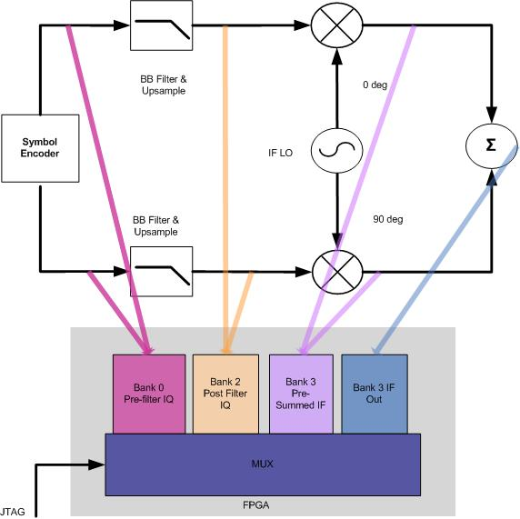
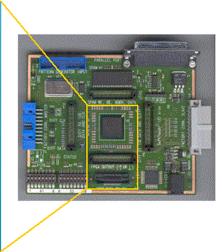
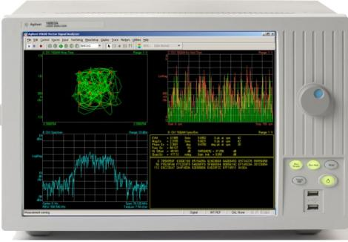
FPGA QAM 16 Measurement Setup
FPGA QAM 16 Board
To Logic Analyzer Connection
(12 Pins for Debug of 24 signals at a time)
The combination of Agilent’s Logic Analyzers, FPGA Dynamic Probe and the 89601A VSA software is a powerful tool that allows us to completely analyze and debug our digital radio design.
Notes:
Here is an example of a digital radio, partly implemented in a Xilinx FPGA. Digitized voice signals enter on the left, are encoded, filtered, and modulated up to a digital IF (intermediate frequency), before being upconverted to RF.
In this example we can imagine using 12-bit digitization.
Each link in this multi-stage DSP network is connected to an input bank of the Agilent Trace Core (the switching mux). With only 12 physical pins used, we can perform signal analysis on the IQ output of the encoder, the IQ after baseband filtering, the modulated IQ before combining, or the scalar IF data.
I and Q are multiplexed using the “2X TDM” option, and re-separated by the logic analyzer.

Slide 28
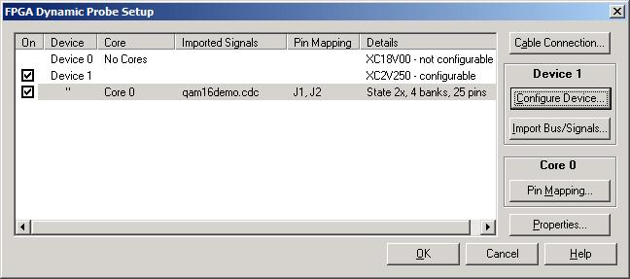
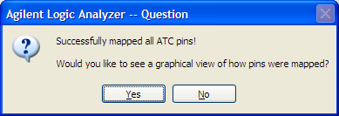
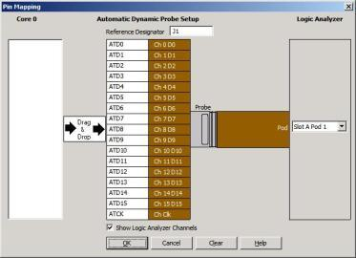
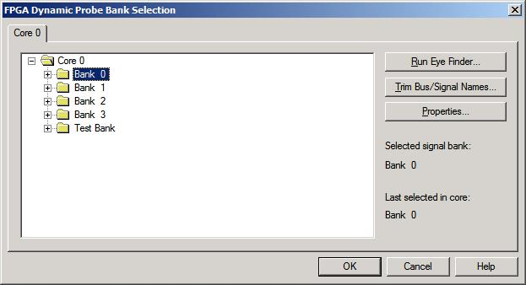

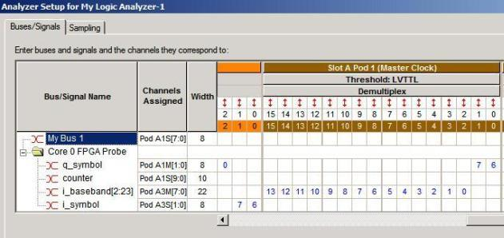
Configuring the FPGA
Auto Pin Mapping saves you a great deal of time-no guessing and no confusion.
Insert QAMautomap.bit file we’ve created with Chipscope Pro
Import the buses (qam16demo.cdc)
Click on Pin Mapping
No need to manually enter the signal names or assign channels!
Buses/signals are automatically setup for you, according to bank selection
The banks show up clearly in the Logic Analyzer .

Slide 29
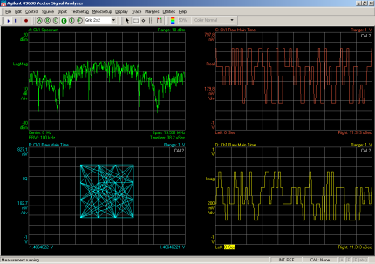
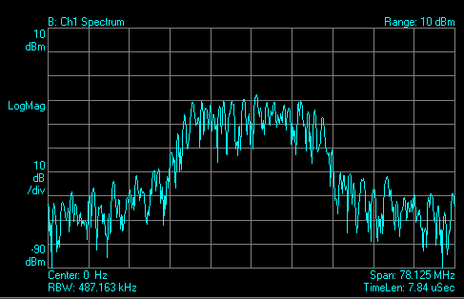
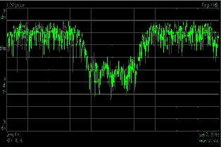
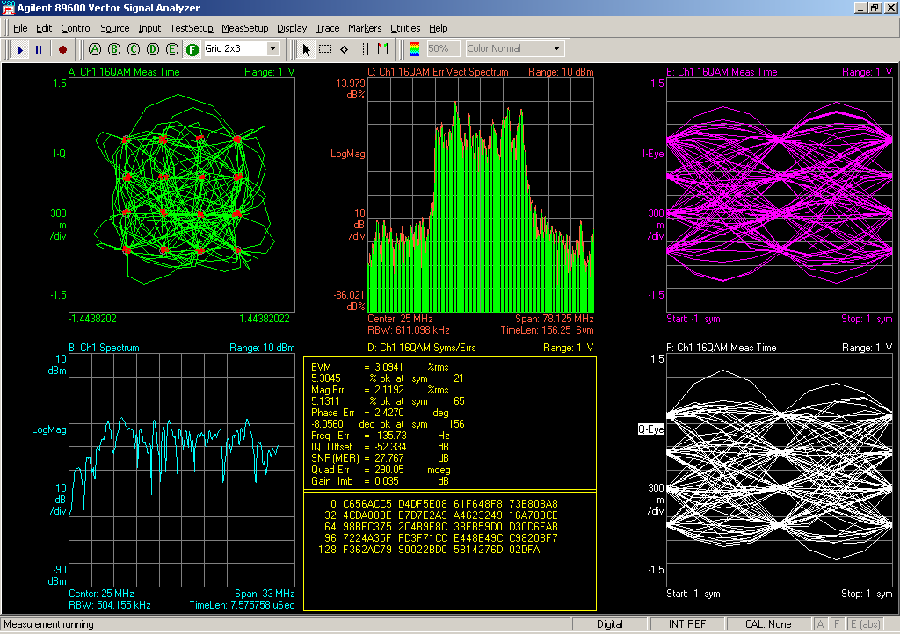
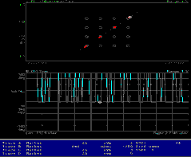
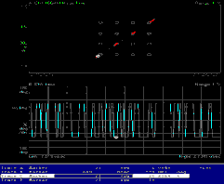
FPGA QAM 16 Radio Bank Results
Using Agilent’s 89601A VSA software we can see how our design is shaping up.
At Bank 0, there’s not much to look at because these are raw symbols.
The Frequency domain signal doesn’t show much because it’s full of aliasing products.
The IQ diagram shows that the symbol mapping is effective.
The Spectrum is full of aliasing products.
After upsampling and filtering we see a definitive spectrum.
Bank 0 Pre-Filter IQ
Bank 1 Post Filter IQ
We can look at the IF spectrum-prior to summing and see that the Iif and Qif are approximately equivalent in the spectrum.
Finally , at the final IF, we can make the full range of modulation quality measurements.
Bank 2: Pre-summed IF
We can also check to see that Iif and Qif are exactly 90 degrees out of phase.
Constellation
Error Vector Spectrum
I-Eye
Q-Eye
-90 to 90
0 to 180
Spectrum
Bank 3 Final IF
Notes:
Using Agilent’s 89601A VSA software we can see how our design is shaping up.
At Bank 0, there’s not much to look at because these are raw symbols.
The Frequency domain signal doesn’t show much because it’s full of aliasing products.
The IQ diagram shows that the symbol mapping is effective.
The Spectrum is full of aliasing products.
While the digital radio we’ve embedded in the FPGA isn’t entirely representative of how the FPGA would be used in an SDR (though it could take the place of an IQ Demodulator, as well as performing other critical functions),
This example provides a good overview of the tools: FGPA dynamic probes, and the Logic Analyzer’s connection to Agilent’s 89601A Vector Signal Analysis software. Indeed, this model
could be used to test various types of digital filters.

Slide 30
Summary FPGAs
We’ve now shown how the addition of the FPGA probe can save you time and enhance the accuracy of your measurements.
Pin compression allows us to multiplex 2 signals per pin instead of changing the design to accommodate each signal output on a single pin.
Flexibility in FPGAs: Supported are both Altera and Xilinx. If you have need for support of additional FPGA brands, please let us know!
The interface between Agilent’s logic analyzer and the 89601A Vector Signal Analysis software give us complete insight into any digital radio designed into an FPGA.
The digital radio example provided gives a good overview of the tools: FGPA dynamic probes, and the Logic Analyzer’s connection to Agilent’s 89601A Vector Signal Analysis software. Indeed, this model could be used to determine the trade-offs of various types of digital filters used in a particular design.

Slide 31

Agenda
Architecture Overview
ADC Characterization
Dynamic Measurements
Baseband Processing
FPGA
Memory
Microprocessors/Microcontrollers
Summary
For More Information
Memory DDR
Memory DDR
FPGA
Memory DDR
Microcontroller/
Microprocessor
Peripheral IO
DSP
Flash EEPROM
Baseband Processing
Memory is Everywhere
Testing it encompasses a unique set of challenges.

Slide 32
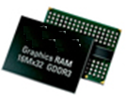
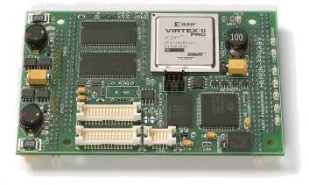
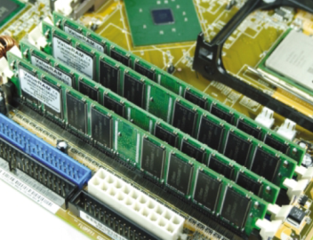
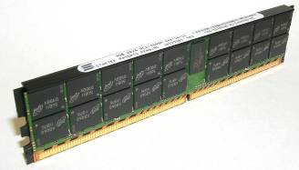
Challenges in Probing Memory signals
Ideal Probing Points – DRAM Ballout
Embedded memory design: Limited board space
High Density DIMM
1. Limited board space in embedded memory design and high density DIMM to design-in footprints and connectors for access to all memory buses.
2. Probing has to be made at the balls of the DRAM for accurate results as per JEDEC DDR specification
Notes:
Different applications use different types of memory from SO-DIMMS for laptops to embedded memory for FPGA type applications.
It is also going to be present in any type of radio.
Most memory types have migrated to at least DDR1-if not DDR2 or DDR3, so we will focus on these buses.
One of the biggest challenges is having enough space to design in foot prints and connectors for access to the memory buses.
For measurement results to meet the JEDEC DDR spec, we also have to probe at the ballout of the memory itself.
Memory technologies have become increasingly faster and more complex, making them extremely difficult to debug. At gigabit speeds, you still have added latencies and complex addressing that makes debugging these technologies a painful process. The Logic Analyzer with the right tools can dramatically reduce the time you must spend on chasing down and correcting errors.
Agilent has numerous ways of addressing the probing requirements for memory. We’ll talk about that in a little while.
First let’s look at some of the functional measurement challenges.

Slide 33
Functional Validation Challenges for Memory
Signal Integrity issues create inaccurate timing and protocol measurement. We need to be able to access and analyze all the buses at the same time to perform a quick signal integrity check.
Spending a lot of time on the work bench, trying to analyze the raw command, bank address and read/write data from the captured trace.
Need full bus information from a single data point to debug further. We need to be able to do cross triggering from scope to the logic analyzer to gain complete bus information
Memory activity is a critical visibility point into System operation. Tracing memory activity helps understand software control and data flow.

Slide 34
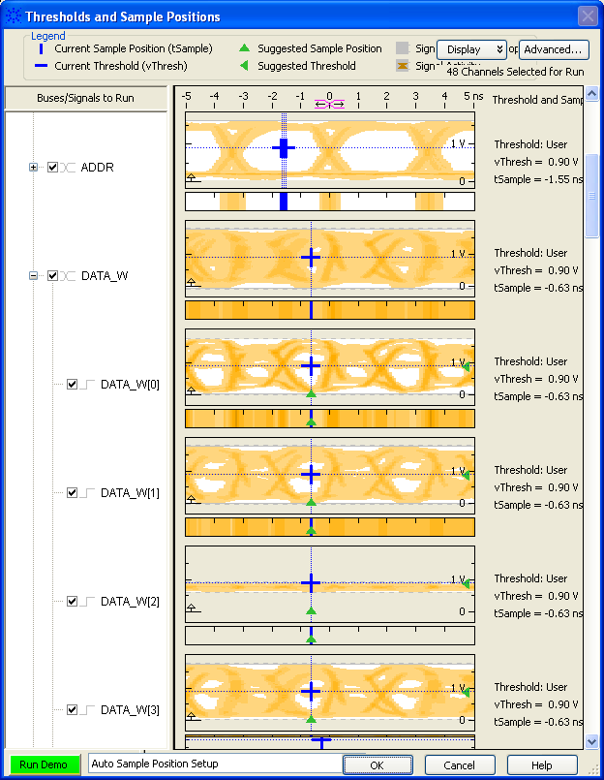
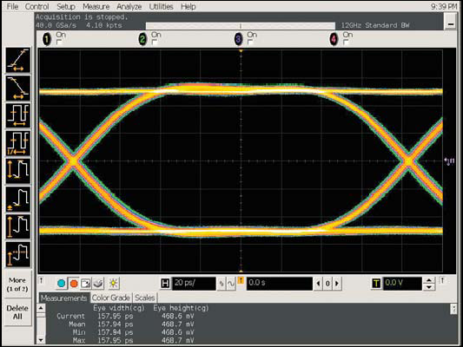
Signal Integrity: EyeScan Feature for Quick SI Check
Agilent’s Logic Analyzers can provide an eye diagram –with less resolution- but on multiple channels f or a quick signal integrity check over the entire bus!
Clear eye opening suggests good SI
Adjust threshold and sampling position for accurate data capture
Bad bit found (inactive data line)
Oscilloscope provides single channel high resolution eye diagram
EyeScan with logic analyzer result on multiple DDR channels for quick SI glance
Notes:
Probing every command, address, control and data line to check SI issues with oscilloscope can be tedious. In fact, it can take days.
Remember where we used Eye Scan with a high speed ADC measurement? It’s just as useful for the memory bus.
Agilent’s Eye Finder and Eye Scan used with a logic analyzer gives a superior and quick SI insight into all the memory buses simultaneously.
While the Oscilloscope is quite useful for looking a single channel eye width-it’s extremely important to first identify where the problem areas are.
Using the Eye Finder we can see exactly where the data lines have good signal integrity-and where those inactive lines are. Once we’ve identified problem areas,
Then we can hook up the oscilloscope the correct channel to troubleshoot further..

Slide 35
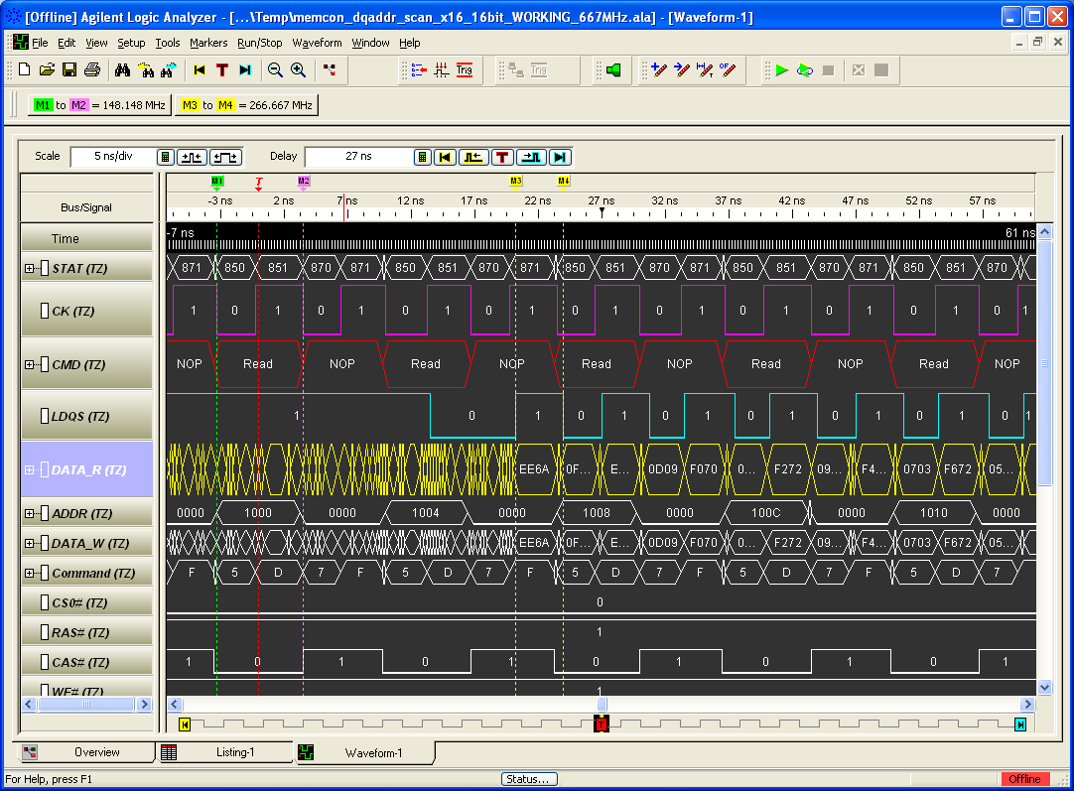
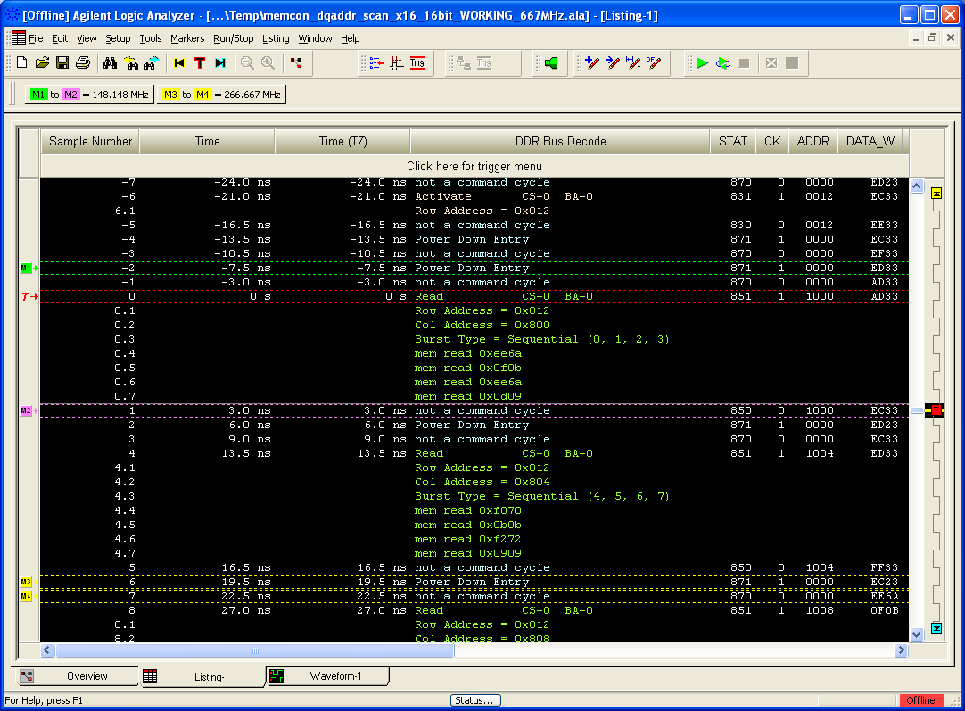
Protocol Decode Tool
Analyzing each bit for functional validation with a Timing waveform window is time
consuming. Protocol decode tools provide the information in an intuitive format.
Protocol decode:
Decodes command, Address, Burst type, Data .. Etc (First data burst reading 0xEE6A)
Timing Waveform :
Valid command at READ with first data burst reading 0xEE6A
Notes:
Protocol decode tools exist for DDR2 and DDR3. The E

Slide 36
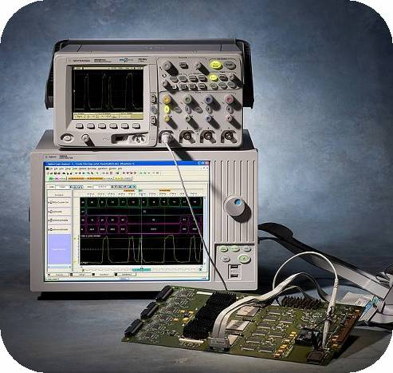
Using View Scope to Correlate Scope and Logic Analyzer DDR Measurements
Combine the triggering, memory and digital bus acquisition power of a logic analyzer with the analog measurement capability of an oscilloscope.
Great for tracking functional failures to root cause (jitter, cross-talk, EMI, etc)
We’ve already been introduced to this. With DDR it’s even more powerful.
Agilent’s Infiniium 8000 and 90000 series Oscilloscopes have an optional package, InfiniiScan Event Identification Software. This software allows you to use an oscilloscope to identify signal integrity issues that hardware triggering is unable to find in your electronic designs.
Using this in conjunction with Agilent’s Logic Analyzers and View Scope creates a powerful debug tool for both signal integrity and protocol analysis.
Group/Presentation Title
Agilent Restricted
Page 36
29 November 2009Month ##, 200X

Slide 37
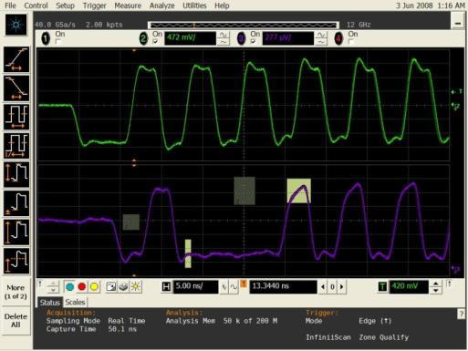
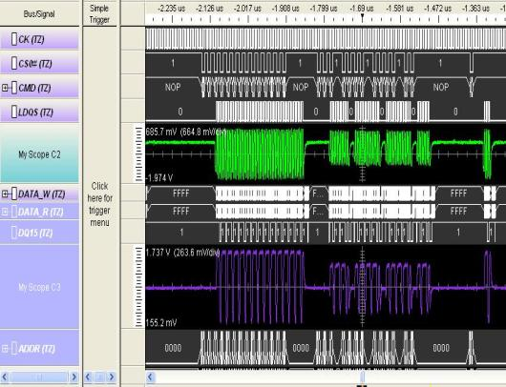
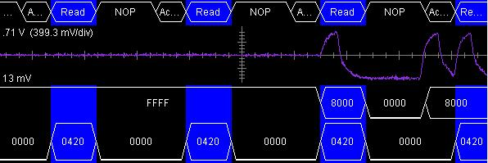
Using View Scope for Cross Bus Trigger
View scope also works in reverse-e.g. the scope can trigger the Logic Analyzer. Let’s say we want to obtain more functional information on a single bad DQ line we see with the scope. In order to do this, we’re going to need to use the logic analyzer. The Infiniiscan zone qualify from the scope will send an output trigger to the logic analyzer, which will acquire all the data surrounding this particular DQ line. This allows you to find exactly where the problem is.
Infiniiscan zone qualify sends the output trigger from scope to logic analyzer
Command
LDQS
Data
DQ 0
Address
Command
DQ scope
waveform
Obtain corresponding multiple memory bus information from a single DQ 0 bus:
Read Command at Address 0420 with data 0800
Data
Address

Slide 38
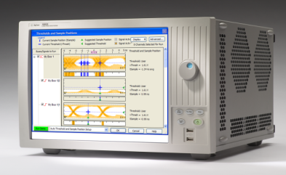
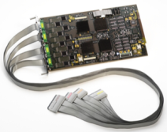










DDR Logic Analyzer Solutions
16902B Logic Analyzer Mainframe
Generation | Module | Probes (DIMM, SO-DIMM, Embedded)
DDR 1
DDR 2 |  | FuturePlus
DDR 3
Flying Leads
Soft Touch
16950/1B
FuturePlus FS2336 Interposer
FuturePlus FS2333 SO-DIMM Probe
Soft Touch
16950/1B
FuturePlus FS2332/4 Interposers
FuturePlus FS2333 SO-DIMM Probe
W2630A Series DDR2 BGA Probes
DDR3 SO-DIMMs still in development
NEW!!
Soft Touch
16962A
W363XA Series DDR3 BGA Probes
N4835A Slot Interposer
Group/Presentation Title
Agilent Restricted
Page 38
29 November 2009Month ##, 200X

Slide 39




DDR Scope Solutions
InfiniiMax Probing Solutions
Infiniium 8000 and 90000 Series Oscilloscopes
W2630A Series DDR2 and W363XA DDR3 BGA Probes
N5414A InfiniiScan for Easy Read/Write Separation

Slide 40
Memory Summary
We now seen how we can access and analyze all the buses simultaneously to perform a quick signal integrity checking using Agilent’s EyeScan and EyeFinder features. We’ve seen examples using this with ADCs and now also with memory buses.
Using the EyeFinder saves us a great deal of time and effort-imagine trying to do this on each line with an oscilloscope, or having to do this manually on a logic analyzer, each and every time the system is rebooted!
We’ve seen that Agilent’s Logic Analyzers can contain Dual-sample mode-allowing us to directly analyze the raw command, bank address and read/write data from the captured trace.
The InfiniiScan Event Identification Software combined with the View Scope feature gives us the ability to cross trigger from the scope to the logic analyzer, in order to obtain complete bus information around a single problematic line.
Agilent’s DDR probing solutions for both scopes and logic analyzers ensure there is a way to meet all your memory needs with maximum signal integrity and analysis capability.

Slide 41

Agenda
Architecture Overview
ADC Characterization
Dynamic Measurements
Baseband Processing
FPGA
Memory
Microprocessors/Microcontrollers
Summary
For More Information
Memory DDR
Memory DDR
Memory Controller
Memory DDR
FPGA
uP
Microcontroller/ Microprocessor
DSP
Signal Processing,
Peripheral IO
Flash EEPROM
Baseband Processing

Slide 42
Microprocessor (uP) and Microcontroller (uC)
A Microcontroller has a more specific purpose than a Microprocessor. It is designed to be self-sufficient and inexpensive. Microprocessors are more general purpose ICs and are often found in computers.
Our example will use an IBM PowerPC 405 microprocessor embedded in a Xilinx® Microblaze FPGA and demonstrate the source code correlation to the inverse assembly, and DDR memory.
The Xilinx Virtex families of FPGAs offer embedded IBM Power PC 405s with a built in Trace Port. Using this trace port with a logic analyzer and the inverse assembler allows you to minimize the number of pins required on the FPGA while still providing visibility of program flow on the embedded processor.
Suppose we’re seeing corruption of the external data when it reaches the memory, but it’s not obvious why? If we can trace the operation of the IBM 405 processor, we can obtain more detailed insight into the cause of the problem. We’ll take a look at the embedded uP and see how we can figure out where the problem might be.
We will also demonstrate the features of Agilent’s Packet Viewer and the power of the various modes of display available to the engineer.
Again, let’s start with a block diagram. We’ll show you the basics of correlating the source code with the inverse assembly.
.

Slide 43
uP Trace Port
FPGA
External IC
PPC 405
FIFOs
External IO
Memory S DRAM
The Trace Port allows for capture of raw bits that contain the minimum information required to reconstruct the flow of the code. We then use this information in a non-real—time process of program flow instruction. Examples of this information could be things like how many instructions executed in a cycle, whether one of these was a branch or not, whether the branch was taken or not and whether an interrupt occurred or not.
Memory SDRAM
Memory SDRAM

Slide 44

uP Reconstruction
1. The process begins with an initial condition, where the Trace Port sends out a starting 32-bit address in memory, where everything begins. The trace port is only 8 bits wide, so it takes multiple clock cycles to get this full address out to the logic analyzer.
2. The Trace Port decoder determines that the uP is saying “I'm executing a program instruction at an address” and looks into the target executable file (,elf) to figure out what is at that address and thus, what was executed.
3. Once we know what type of program instruction was expected, the inverse assembler can write that assembly instruction out for display in the logic analyzer.
4. The process continues, as the trace port decoder follows the instructions that are carried out by the uP and displays those with the help of the inverse assembler.
5. There are 2 separate data streams-the first is real-time instruction identification and the second is the actual address information for the instruction.
Notes:
The

Slide 45



Connection Options
E5346A Mictor Adaptor
Linked Connectors
There are multiple options for connecting a logic analyzer to the Trace Port: Flying leads, a Mictor or Soft Touch connector less probe, and so on. Agilent supplies configuration files to simplify setup of the logic analyzer, so the best approach is to bring the Trace Port signals out in the specified in the Trace tools documentation..
Separate Connectors

Slide 46

Logic Analyzer Configuration
The Signals are brought in through the probing block.
The Trace port block converts the 8 bit capture into readable information.
The Inverse Assembler determines the uP program execution.
The Filter block strips out unnecessary acquisition data..
The windows give us different views of the data. More on that coming up.

Slide 47



Setup
Setup the channels.
The trigger is defined in the PPC 405-and it cross triggers the logic analyzer
Recall the .elf file so we can look at the code.

Slide 48


View the Data
Once the setup is finished, and the inverse assembler has synchronized on an initialization signal, the uP program flow is traced out as shown on the left
. It’s also possible to step down through the C code to view how the code was executed or step through the disassembly and have the source view track automatically (below)
Inverse Assembly View
Source Correlation to Inverse Assembly
It’s often helpful during debug to get a system view of what’s going on involving other signals, both internal to the FPGAs and on their periphery or in other parts of the system. Agilent Trace Cores can be placed inside FPGAs to provide access to other internal FPGA signals in conjunction with the Trace Port measurements.

Slide 49
Different Views

Slide 50



Different Protocol Views and Uses
Packet Viewer
Display density allows you to see more packets. Display fields makes it easier to view & analyze packet-based data
Flexibility of display – customize it to your needs.
Makes packet data a first-class data type in the interface (has support for triggering, searching, colorizing, filtering)
Condensed Display
Strength of 1’s and 0’s: Used to debug a physical layer when there is trouble with the link
Turn ASCII decode off to get condensed display
ASCII Protocol Decode
Backward compatibility
Enable by turning ASCII decode on, HOWEVER this does impact performance
Protocol Development
While Agilent has many protocol tools available-DDR2,DDR3, DigRF etc.-there is also a tool available for custom protocols. This is Agilent’s B4641A Protocol Development Kit (PDK). Based on XML, the PDK allows the modification of existing, compatible protocol tools, or development of a complete custom protocol by the user.
Notes:
The packet viewer can be customized for any protocol.
The upper pane has packet level summary, lower pane provides packet details
As it is truly a windows object, the views can be customized to fit your needs, for example,y ou can organize the columns/packet panes for your specific interest
And specify how much screen to use for each data view
Each line is a packet
Columns are:
Fields, packet summary, time, etc.
Shared when multiple directions are fanned in
Easy to drag and drop to have the fields you care about on screen

Slide 51

Packet Viewer
Columns: Insert & Organize Protocol Fields
Customized for protocol family decoded by upstream packet decoder tool
Upper pane has packet level summary, lower pane provides packet details
Flexible views
Organize the columns/packet panes for your specific interest
Specify how much screen to use for each data view
Rows (each line) is a packet
Columns are:
Fields, packet summary, time, etc.
Shared when multiple directions are fanned in
Easy to drag and drop to have the fields you care about on screen
Each row is a packet
Packet Details, Header, Payload, Lanes
Two Packet Compare Panes

Slide 52



Standard Agilent Logic Analyzer Views
The Waveform window displays captured data as a digital waveform. You can configure the window to display selected buses and signals with time or pattern markers in the data. You can also set up bus pattern triggers and signal trigger options.
Chart Mode is a modified waveform view and allows us to see the analog representation of the waveform. Here, we are looking at a GSM signal coming from a DigRF interface.
The output in state mode is a listing of the values that crossed the bus, with
the option of a time stamp noting when the values occurred. The state listing
window will tell you what the values were going across the bus at the time the
clock transitioned.

Slide 53
Summary Microprocessors/Microcontrollers
We’ve seen that we can trace a uP and correlate the inverse assembly code with the uP code.
We showed how to correlate multiple traces from memory buses, to microprocessors, in state and timing mode.
Flexible views like Packet Viewer, Event Editor and waveform, list and other windows help you customize the environment to best fit your needs.

Slide 54


Agenda
Architecture Overview
ADC Characterization
Dynamic Measurements
Baseband Processing
FPGA
Memory
Microprocessors/Microcontrollers
Summary
For More Information

Slide 55
Summary
In this session, we’ve covered several examples of digital test that apply to a software defined radio:
ADC test: Dynamic Characterization measurements
FPGA test: Digital Radio test, cross-domain (digital to RF) test
Memory test: Protocol and signal integrity analysis
Microprocessors: Inverse assembly and protocol/signal integrity analysis on the outputs.
Several tools have been revealed that will greatly reduce the time spent debugging the digital device:
Eye Finder, which looks at the entire bus and sets the best possible sample position.
Eye Scan, which allows us to visualize all the bus lines simultaneously to quickly identify problem signals.
B4655/46 FPGA dynamic probes: The FPGA dynamic probe gives us greater ease of accessing and testing those signals while reducing the amount of time spent on manually reprogramming.
View Scope and InfiniiScan Event Identification Software: Using the Logic Analyzer with an Oscilloscope-with View Scope and InfiniiScan Event Identification Software-provides the most comprehensive digital debug solution for ADC, Memory and Microprocessor test and measurement.
89601A Vector Signal Analysis Software: Connection to Agilent’s logic analyzers allows for comprehensive dynamic and modulation quality measurements on digital radios and ADCs.
Agilent’s Suite of Signal Studio Software: Here, we used the N7621B for Multitone.
B4641A Protocol Development Kit
Multiple views allow you to see the information you need quickly. Customized protocol analysis can be performed using the Protocol Development Kit-B4641A.

Slide 56
Digital System Level Insight in SDR system
Digital Domain
IF : Digital or Analog
RF
Memory DDR
Memory DDR
ASIC
FPGA
Memory DDR
Rx
Data Path
Microcontroller/
Microprocessor
+
DSP
Tx
IF Processing Simple Demodulation
Flash EEPROM
Digital Control Path
Baseband Processing
Reconfigurable RF/IF
Agilent 16800/16900 Series Logic Analyzers

Slide 57








The Agilent Advantage
From RF to Analog Converter to Inverse Assembly to Memory to Peripheral IO busses, Digital Test of Software Defined Radios requires unparalleled speed, trace correlation and the right tools to be successful
Agilent’s portfolio of Test and Measurement equipment offers solutions for your complete digital software defined test and measurement needs.
Memory DDR
Memory DDR
FPGA
ASIC
Memory DDR
Rx
Software Control,
Calibration, Configuration: CDMA, GSM, WiMAX etc
Micro-controller/
Microprocessor
DSP
+
Tx
Peripheral IO
IF Processing Simple Demodulation
Flash EEPROM
Clock
Baseband Processing
Reconfigurable RF/IF
Agilent 8000 and 90000 series of Infiniium Oscilloscopes
Agilent 16800/16900 Series Logic Analyzers
Agilent MXA and PSA Series Signal Analyzers
Agilent Pulse Pattern Generators
Agilent 89601A Vector Signal Analysis Software
Agilent Signal Studio Software
Agilent ESG/MXG/PSG Series Signal Generators

Slide 58
For more information
Architecture Overview
ADC Characterization
Measuring Speed and Data
Dynamic Measurements
Baseband Processing
FPGA
Memory
Microprocessors/Microcontrollers
Summary
For More Information
Agilent's Software Defined Radio Development and Test (SDR)
Agilent Logic Analyzers
Digital VSA
Agilent's 90000 Series Infiniium Oscilloscopes
Agilent's 8000 Series Infiniium Oscilloscopes
Agilent's 89601A Vector Signal Analysis Software
Agilent's Signal Studio Software
Or Contact Your Local Agilent Representative

Slide 59
Thank you for attending!

Slide 60
Backup Slides

Slide 61
Signal to Noise Ratio (SNR)
SNR is the relationship of the noise power generated by the signal to the signal power itself and is given in dB. It does not include Harmonic Distortion or IMD.
In this case, we pass a single tone through the ADC to measure the output in frequency domain.
Quantization error contributes to this as quantization noise. Although Quantization error can be more precisely measured using the histogram method,( Using the given quantization error versus output code) we can also take a look at the SNR to see where we are.
Ideally, quantization error is the only error that is part of an ideal ADC. While we won’t go into specifics of thermal noise and other sources, these would be considered minimal in the face of a large quantization error.

Slide 62



ADC: Measuring SNR
N9020A MXA Signal Analyzer with internal Preamp.
E4438C Signal Generator
BPF
81134A Pulse Pattern Generator (High speed clock)
16901A Mainframe with 16962A 2GHz High Speed Logic Analyzer Module
In this case we’ve just injected a 2 GHz sine wave.
The additive noise can be measured using the band power markers, and SNR can be calculated.

Slide 63
Spurious Free Dynamic Range (SFDR)
SFDR is the difference between the magnitude of the measured signal to it’s highest spur peak; this is given in dBc (dB with respect to the carrier level).
Usually, the spur is a harmonic of the fundamental frequency-but it isn’t always. A quick check can tell the engineer whether or not he’s dealing with a suitable ADC.

Slide 64

Measuring SPDR
Once again we’ve injected a 2 GHz sine wave.
The spur showing up here is quite far down.-about -85 dBc. We had to turn averaging on to really see it. This would generally be outside the dynamic range of most ADCs. So the ADC could be given a SPDR of about 85 dB.
N9020A MXA Signal Analyzer with internal Preamp.
E4438C Signal Generator
BPF
81134A Pulse Pattern Generator (High speed clock)
16901A Mainframe with 16962A 2GHz High Speed Logic Analyzer Module

