Slide 1
2 important RDX use models and the equipment needed for each use model
They seem to already have the rest. If the want to buy another set for development then we can accommodate this.

Slide 2
Use model 1: DigRF v3/v4 end point probing
N5343A
Exerciser Emulates:
Data to DUT (Tx/Generate)
512Mb
-BBIC DigRF v3
-BBIC DigRF v4
-RFIC DigRF v3
-RFIC DigRF v4
Tx
Either RFIC or BBIC
Data from DUT
(Rx/Capture)
512Mb
Rx

Slide 3
RDX equipment needed for use model 1
N5343A - Core Option +
N5343A-V3A (License for DigRF v3 capture and analysis) +
N5343A-V4A (License for DigRF v4 capture and analysis ) +
N5343A-V3E (License for DigRF v3 stimulus generation) +
N5343A-V4E (License for DigRF v4 stimulus generation) +
N5343A - Dual Capture (Removes need for N5344A)

Slide 4
Use model 2: Passive probing for DigRF v3/v4
BBIC
Tx
RFIC
Rx
N5344A
Analyzer passively probes:
Data to DUT (Tx/Generate)
1Gb
N4860A Passively probes
-BBIC DigRF v3
-RFIC DigRF v3
-BBIC DigRF v4
-RFIC DigRF v4
Data from DUT
(Rx/Capture)
1Gb
168xx or 169xx Logic analyzer
DigRF v3/v4 time correlation application under development.
ETA Late Feb.
Shane & Denny working on this

Slide 5
Minimum equipment needed for use model 2
N5344A-Core (DigRF v4 Analyzer)
Either N5345A (mid bus) or N5346A (Flying lead)
N5344A-V4A (DigRF v4 protocol)
N5344A-2GM (2Gb of Memory)
N4860A (DigRF v3 Analyzer)
Flying lead or mid bus probe
168xx or 169xx logic analyzer

Slide 6
Recommended equipment for use model 2
N5343A-Core (DigRF v3/v4 exerciser)
N5343A-V3A (License for DigRF v3 capture and analysis) +
N5343A-V4A (License for DigRF v4 capture and analysis ) +
N5343A-V3E (License for DigRF v3 stimulus generation) +
N5343A-V4E (License for DigRF v4 stimulus generation) +
N5343A - DCE Dual Capture (Removes need for N5344A)
N5344A-Core (DigRF v4 Analyzer)
Either N5345A (mid bus) or N5346A (Flying lead)
N5344A-V4A (DigRF v4 protocol)
N5344A-2GM (2Gb of Memory)
N4860A (DigRF v3 Analysis probe)
N4850A (DigRF v3 Stimulus probe)
Flying lead or mid bus probe
168xx or 169xx logic analyzer

Slide 7
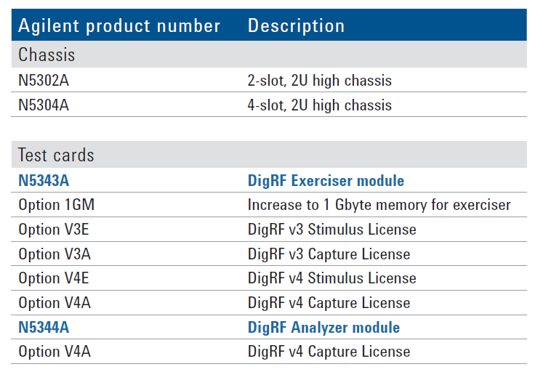
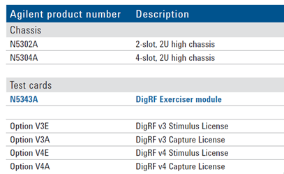

Data Sheet Discrepancies: Pg 14
Given
Actual
Note that this option has been removed
Option DCE | Dual Capture License
Option 2GM | 2Gb Memory Usage

Slide 8
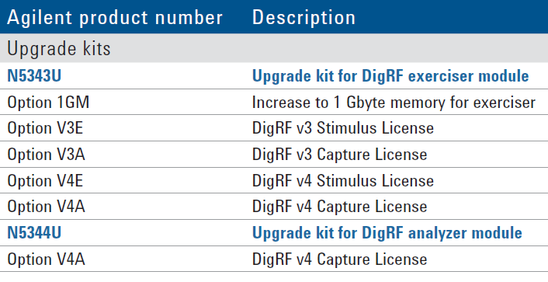
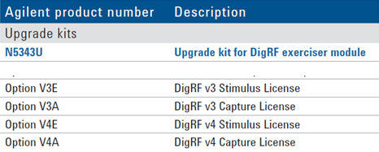

Data Sheet Discrepancies: Upgrade Options: Pg 15
Given
Actual
Note that this option has been removed
Option DCE | Dual Capture License
Option 2GM | 2Gb Memory Upgrade
Note: The pricing schema for the upgrade path is being revised. We will work with all quotes to insure the $3k price point for DCE upgrade. The 2GM option price point will remain.

Slide 9
A few other notes
For use model 2 it can be more useful to have an exerciser/stimulus to allow for debugging and isolating an issue.
If there are error isolating and troubling shooting is made easier with the exerciser. For example you can emulate a BBIC or RFIC to narrow down where and how the errors are occurring.
A N5343A or N5344A must have at least one capture and/or stimulus license installed or else the blade cannot perform any function of any value.

