Slide 1
Agilent Technologies DigRF Introduction
April 2010

Slide 2
Agenda
Introduction to Agilent and DigRF Technology
Testing DigRF
Digital PHY Testing
Digital Protocol Testing
Wireless Domain Testing
Recommended Configurations

Slide 3

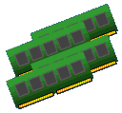



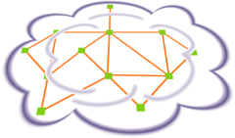





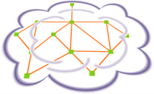












DTD Technology Deployment Eco System
Infrastructure
Interfaces
Desktop Chipset
Enterprise Infrastructure
CPU o
DDR
DVI
DP
HDMI
SATA II
HT
QPI
HDD
DDR, BoB
NB
FibreChannel
FC
Storage
CEI
GbE
PCIe
SAN
PCIe
FC
HT
PCIe
GbEthernet
GbE
Server
CEI
GbE
HD Audio
DMI
LAN
Ethernet
Ethernet
SB
SATA
USB
Infiniband
SFI
SFP Module
PCI
GbE
LTE
DWDM
PON
PON
RF IC
WiMAX
RH
MAN
OLT
DP
HDMI
OBSAI-RP3(01)
PON
PON
USB
digRF
CPRI
Tx/Rx
OBSAI-RP1/2
BTS
BSC/
RNC
XFI
XFP
Module
USB
BB IC
DDR
A/V
Decoder/
Processor
DSI
AP
CSI
OBSAI-RP3(01)
SONET
CPRI
Telco
Switch
DSI
MIPI
D-Phy
RH
Longhaul
BB IC
RF IC
WAN
OTN
WiHD
Public Wireless
Infrastructure
Consumer
Mobile Device
Public Wireline Infrastructure

Slide 4

MIPI Mobile Platform Example
Camera
Display
Display
Camera
CSI-2
DSI-1
DSI-2
CSI-3
WLAN
UniPort
Application
Processor
(SoC)
GPU
(SoC)
UniPort
Off-board
UniPro Extension
UniPort
PA
RF
DigRF
MODEM
(SoC)
HSI
LLI
SLIMbus
MEMs
RFFE Control
Micro
SPMI
UFS on UniPort
Speaker
Power
management
Bluetooth , GPS ,
FM-Radio , NFC
Mass
Storage
DRAM
Test & Debug connector
USB
HDMI
Trace
Notes:
Change logo on this slide.

Slide 5

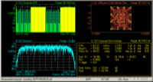
Physical / Protocol / Application Support
MIPI
Mobile industry processor Interface
Application
Protocol
Standard
CSI camera
Interface
DSI
Display Interface
DigRF
V3
DigRFv4
UFS
Unipro
D-PHY
M-PHY
Physical
Standard
Notes:
MIPI specs are split into PHY an protocol groups. For example D-PHY, and CSI, DSI.
DigRFv3 is different, it was there before MIPI alignence first started. It is completely different to DigRFv4, and very different

Slide 6
Changes/Differences From DigRF v1.12 v3 (1) Physical Connection Differences
RxTxData
Rxp
BBIC
RxTxEn
RFIC
BBIC
Rxn
RFIC
CtrlData
Txp
CtrlEn
Txn
CtrlClk
Strobe
SysClk
SysClk
SysClkEn
SysClkEn
*The number of signals changes depending on the diversity
Points
Low Amplitude, Differential Signals (1.2v LVDS, 1.8v LVDS, SLVDS)
Variable Transmission Speed (Sleep, Low, Mid, High)
Clock Data Synchronization Performed at the Receiver
Eliminated Dedicated Device Control Line
Notes:
V1 is a very slow serial bus. Can be analyzed just using a regular LA.

Slide 7
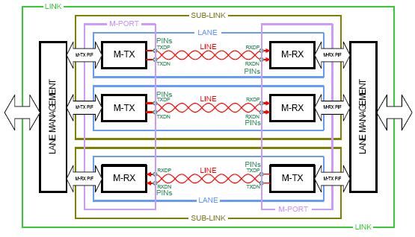
Changes/Differences From DigRF v3 v4 Electrical Differences
Rxp
BBIC
Rxn
RFIC
Txp
Txn
SysClk
SysClkEn
*The number of signals changes depending on the diversity
Points
DigRFv4 based on M-PHY definition from MIPI
Differential signaling
8B/10B encoded data transmission, with embedded clock
Notes:
V3 to V4 is a complete change. V4 will become similar to other high speed technologies, 8B/10B encoding, embedded clock.
V4 bus uses a very low swing. This is a key change from V3. (a couple of 100 mV). V4 is always differential.

Slide 8
Testing Digrf

Slide 9
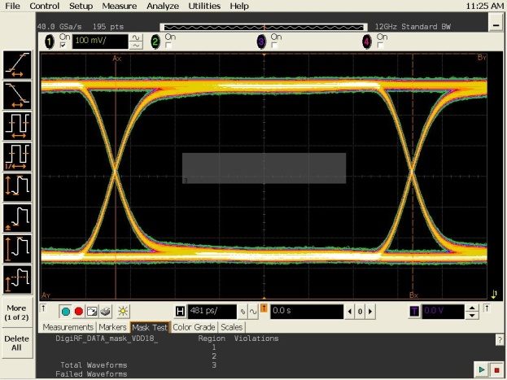
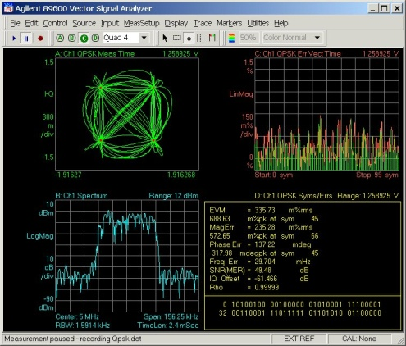
Knowledge/Techniques Required for DigRF Analysis
Sync
Header
Control
EOF
Sync
Header
Control
EOF
Sync
Header
I
Q
I
Q
I
Q
I
Q
EOF
Sync
Header
I
Q
I
Q
I
Q
I
Q
EOF
Logical Analysis Technique
Signal Integrity Knowledge
Various knowledge/techniques are required for DigRF analysis.
In particular there are new high speed digital physical layer and protocol level testing and validation required.
Digital I/Q Analysis Technique
Notes:
Customers need to be knowlegable on all three aspects, signal integirty knowledge (Digital Physical), Protocol (Logic Analysis). As well as the wireless aspects.

Slide 10
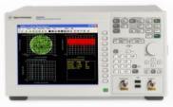
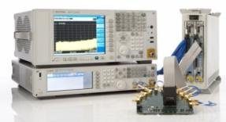
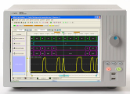
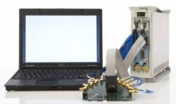

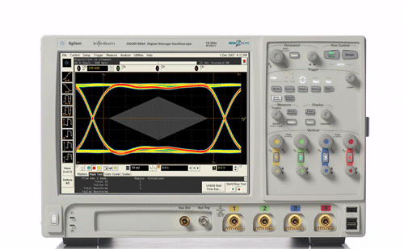
Agilent DigRF Solution Portfolio
Wireless Protocol Layer Validation
Wireless Communication Test Set
Wireless Domain
Wireless Physical Layer Validation
Signal Analyzer
Signal Source
Cross Domain test
DigRF
Digital Protocol Layer Debug / Validation
Digital Domain
LA based DigRF v3 tester
Dig RF v4 tester
DigRF
Digital Physical Layer Debug / Validation
BERT
Wide Band Oscilloscope

Slide 11
Agilent DigRF Solution Portfolio
Wireless Protocol Layer Validation
Wireless Communication Test Set
Wireless Domain
Wireless Physical Layer Validation
Signal Analyzer
Signal Source
Cross Domain test
DigRF
Digital Protocol Layer Debug / Validation
Digital Domain
LA based DigRF v3 tester
Dig RF v4 tester
DigRF
Digital Physical Layer Debug / Validation
BERT
Wide Band Oscilloscope

Slide 12
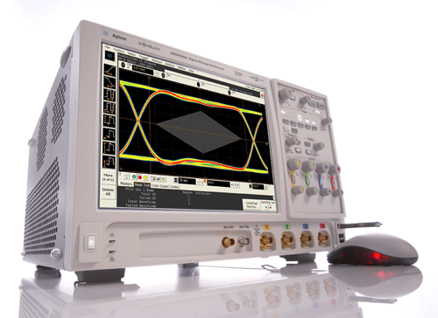

Digital Signal Integrity Evaluation
DSO90000B Infiniium Series Oscilloscope
Signal Integrity Evaluation
RF IC
BB IC
DigRF evaluation begins with the digital physical layer evaluation.
Digital quality is tied directly to the final RF quality
Due to the low margin, RFIC or BBIC compatibility problems could arise
Can dramatically affect EVM or BER values

Slide 13
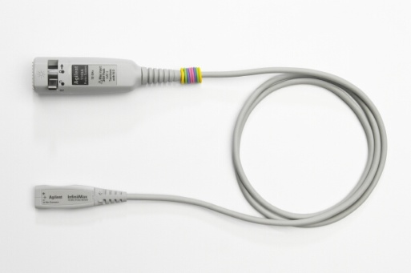
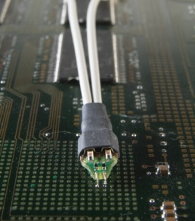
DigRF Digital Physical Layer Measurement/Analysis
Eye Diagram Evaluation
Jitter Evaluation
Normal Sync Pattern Confirmation
Agilent DSO90000 Series
Agilent InfiniiMax II Probing
A low noise/jitter oscilloscope with a bandwidth greater than
2 GHz and active probing are used for a DigRF physical layer analysis

Slide 14
DigRF v3 Eye Diagram
Extracted from DigRF v3.09
Under the DigRF v3.09 specification, the following minimum specs can be fulfilled regarding the opening of the eye as measured at the receiver:
Time - 1.67ns Voltage - 100mv
In an actual implementation it is important to use a design with an adequate margin

Slide 15
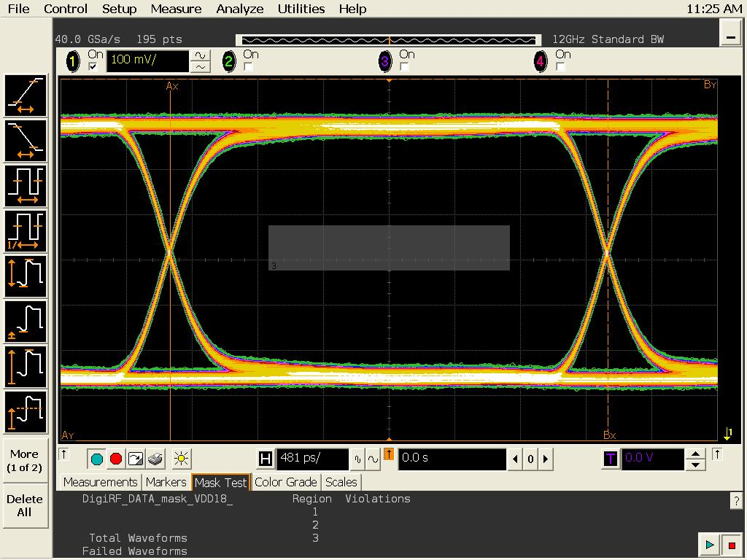
Eye Pattern Evaluation With the Oscilloscope
3G DigRF Compatible Mask
By using the oscilloscopes mask testing functionality you can check whether or not the DigRF physical layer specification is being fulfilled. (Make sure that the signal does not touch the mask.)

Slide 16
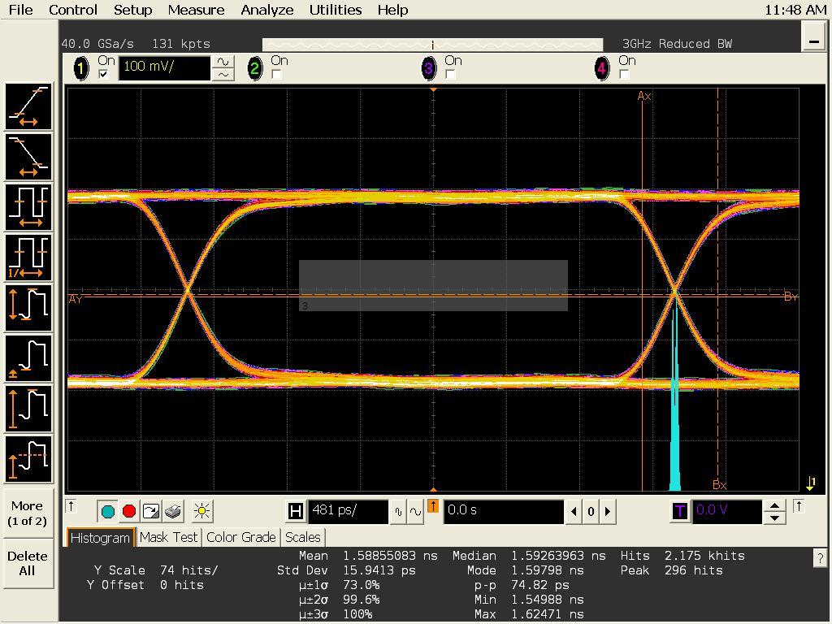
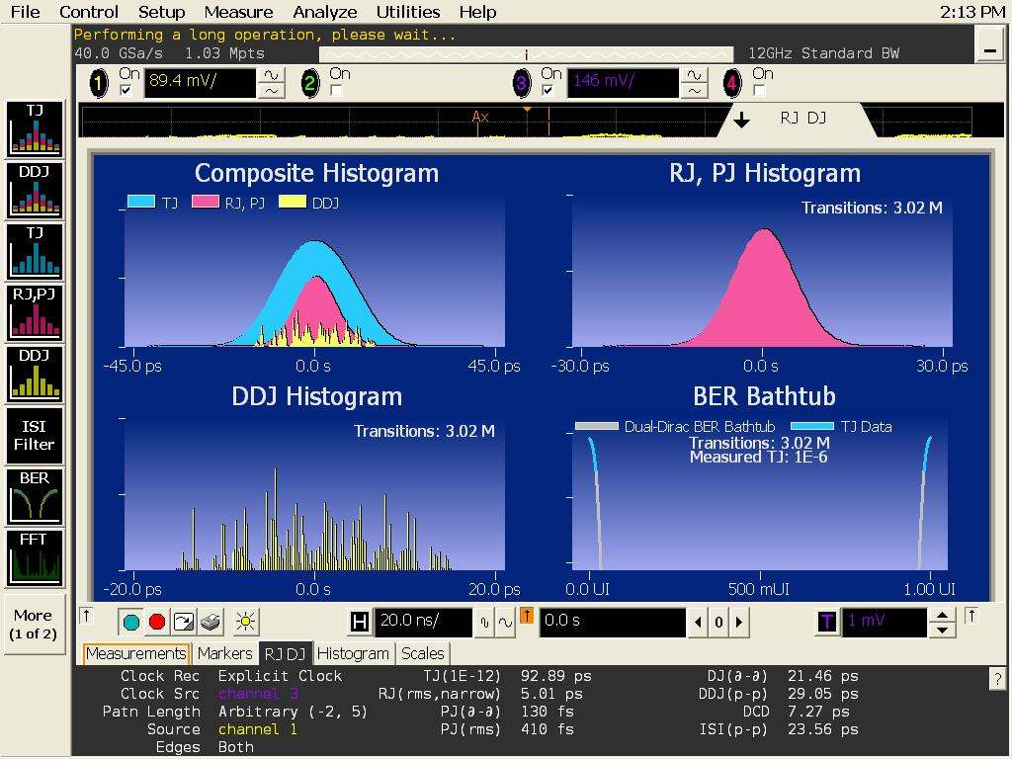
Jitter Measurement
Simple Measurement With the Histogram Display
Detailed Analysis Using the Jitter Measurement SW
Use the jitter measurement package to identify jitter components and check the amount of jitter present. The DigRF v3 spec is a total jitter only spec, but a breakdown and detailed analysis of jitter components is crucial when performing debugging or evaluation.

Slide 17
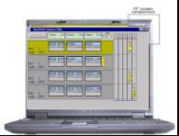
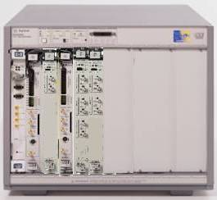
Digital/Bit Error Rate Measurement
Loopback
RF IC
Agilent ParBERT 81250
You can measure the reliability of the DigRF transmission line by performing a bit error test.The error rate of the digital physical layer affects EVM or RF bit error rates.
Notes:
DigRFv3 is not strightly serial. So the RX testing is more tricky.

Slide 18
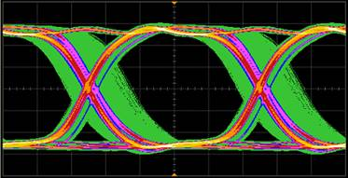
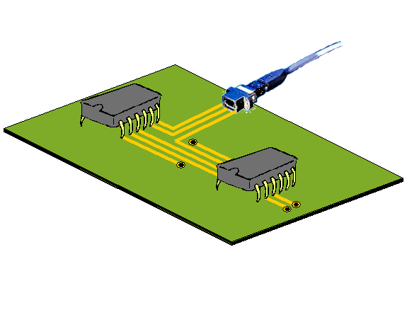
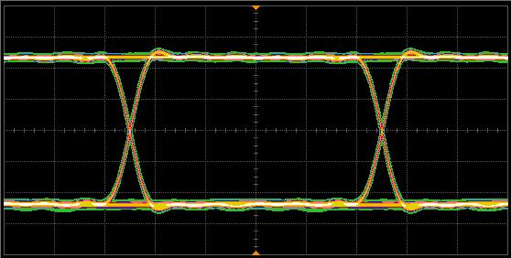
Common Factors That Affect BER
Power Level, Receiving Sensitivity, S/N Ratio
Data Rate Inconsistency
Timing Discrepancy Caused By Jitter
Coding, Modulation Scheme Difference
Wavelength Difference
Intersymbol Interference
Crosstalk, Interference
Faulty Equipment
Notes:
When transmitting digital information, a number of factors can affect BER.
Given this broad range of factors, you can probably see the benefit of having an instrument that can be used to analyze bit errors and help isolate the cause.

Slide 19
What is a Bit Error Rate Tester (BERT)?
A BERT consists of a pattern generator (PG) and an error detector (ED). Signals sent to a device are compared with the signals received by the ED in order to measure the BER.
PG
ED
Clock Source
Pattern Generator
Data Formation
Data
Measured Object
DUT
Data
Decision Circuitry
Error Detection
Counter
Clock Formation
Clock
Clock
Pattern Generator
A PRBS (Pseudo Random Binary Sequence) is used in the DigRF payload. DigRF packets sent are compared with the contents of loopback packets when they return.
Notes:
We will consider the main components and functions of a BERT. But first, a quick overview.
The device under test will be specific to your application. For example, it may be a transmitter/receiver pair, a MUX/DEMUX pair, or an amplifier.
A repeating pattern of bits is sent from the PG data output to your device at a certain bit rate (or frequency), and in a specific electrical format. At the same time, the expected data output pattern of your device is internally generated in the ED - this provides a reference by which to compare the output pattern of your device.
A clock signal from the PG clock output may also be sent to your device in a specific electrical format.
The ED receives the data output pattern of your device, and also requires a frequency reference (from the clock signal of your device or the PG). The incoming bits from the data pattern are sampled in “decision” circuitry and synchronized with the internal reference pattern. Each bit from the incoming pattern is compared with the reference and a BER measurement is made.

Slide 20
Agilent DigRF Solution Portfolio
Wireless Protocol Layer Validation
Wireless Communication Test Set
Wireless Domain
Wireless Physical Layer Validation
Signal Analyzer
Signal Source
Cross Domain test
DigRF
Digital Protocol Layer Debug / Validation
Digital Domain
LA based DigRF v3 tester
Dig RF v4 tester
DigRF
Digital Physical Layer Debug / Validation
BERT
Wide Band Oscilloscope

Slide 21
Why is DigRF Protocol Analysis Required
Analyzing Problems When Connecting RFIC and BBIC
Is RFIC starting in the proper sequence?
Is an error being returned from the source?
Are packets being sent in the bit pattern found in the RFIC requirements specification?
What happens if a out -of specification control packet is sent?
It is difficult to completely analyze a packet's bit string by tracing it with an oscilloscope. DigRF protocol analyzation is highly needed
Notes:
V3 there is no control line, so the developer need to look at the highspeed bus to see what’s going on on the line. In v3, you have to probe the 312MHz bus to find out what’s going on in the system.
It is very hard to understand what is happening in a scope looking at 0 & 1 bit sequences.

Slide 22
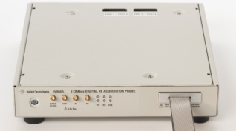
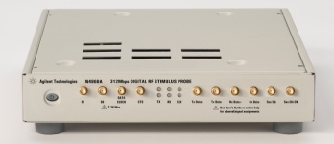

DigRF V3 - Digital Protocol Analysis
RF IC
BB IC
Packet data transfer at 312 Mbps
DigRF Signal Analysis
DigRF Signal Generation
N4850A
DigRF v3 Acquisition Probe
N4860A
DigRF v3 Stimulus Probe
The N4850A/N4860A probes are used by connecting them to a logic analyzer for the 3G DigRF's high speed serial packet input/output
Notes:
Analysis :
Stimulus :
The Stimulus probe can generate both DigRFv3 packets both data packets and control packets

Slide 23
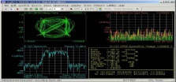
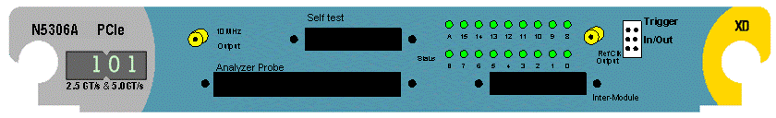
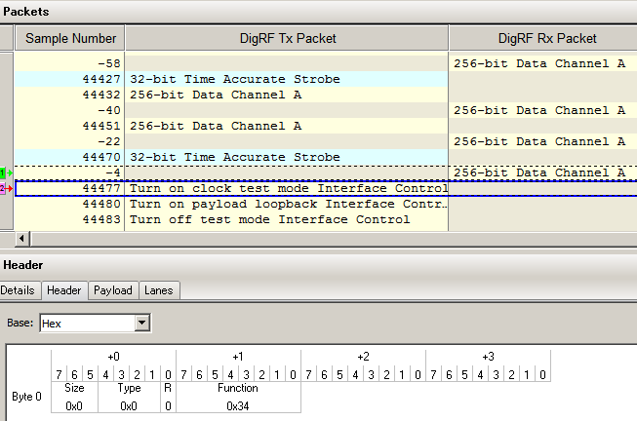
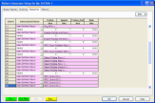
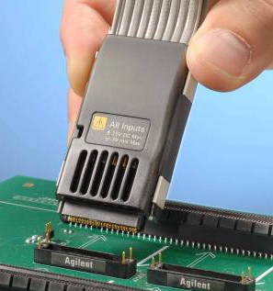
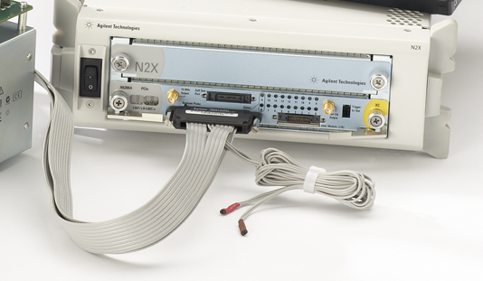
DigRF V4 – Digital Protocol Analysis
Can be used alone for DigRF Traffic capture
Logic Analyzer Software environment for Digital Debug
VSA environment for RF level Analysis
VSA
Logic Analyzer SW
RF IC
2 (4) channel input
via flying leads or soft touch probe
DigRF v4 up/down link
BB IC

Slide 24
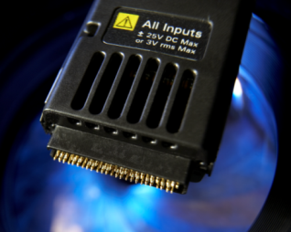
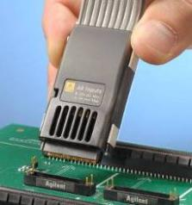
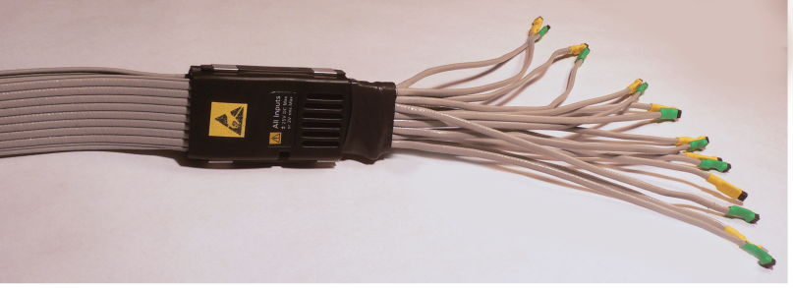
Probing Solutions Insight with minimal intrusion
with its very low capacity loading, it enables insight without influencing the monitored signals
Monitoring DigRF v4 in space constrained designs
Exposes hard to reach signals and gives visibility to debug
Allows access to DigRF v4 links at full bus transfer speeds
Unique to Agilent
Industry’s Best
Probe amplifier outside the probe tip ensuring minimum space and thermal constraints

Slide 25
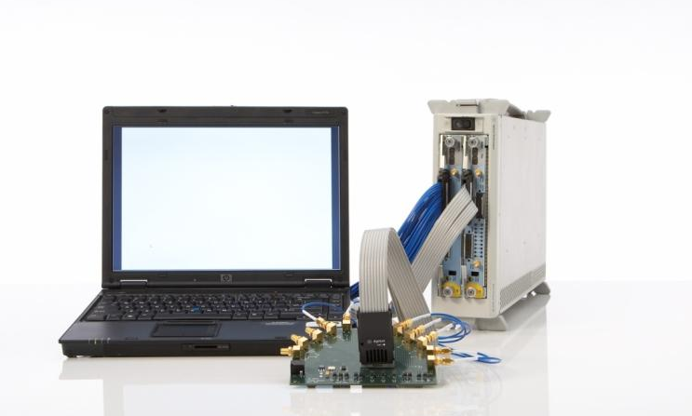
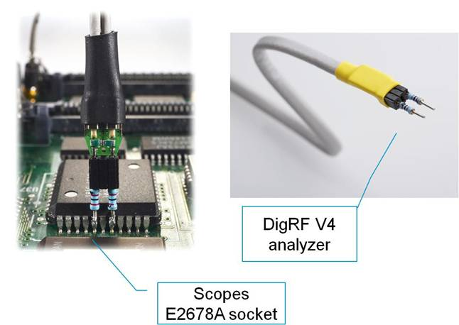
Probing Solutions Common Tip Resistor Setup for both Oscilloscope & DigRF Analyzer

Slide 26
DigRF Packet Analysis Functionality
Monitors the flow of data across the DigRF Tx/Rx Ports
Decodes and displays what each bit inside a packet means
By using theDigRF packet viewer functionality of the logic analyzer you can easily understand the exchange of packets between the BBIC and RFIC.Rapidly increase the efficiency of DigRF packet debugging such as the software debugging of the RFIC control command, etc.

Slide 27
Agilent DigRF Solution Portfolio
Wireless Protocol Layer Validation
Wireless Communication Test Set
Wireless Domain
Wireless Physical Layer Validation
Signal Analyzer
Signal Source
Cross Domain test
DigRF
Digital Protocol Layer Debug / Validation
Digital Domain
LA based DigRF v3 tester
Dig RF v4 tester
DigRF
Digital Physical Layer Debug / Validation
BERT
Wide Band Oscilloscope

Slide 28
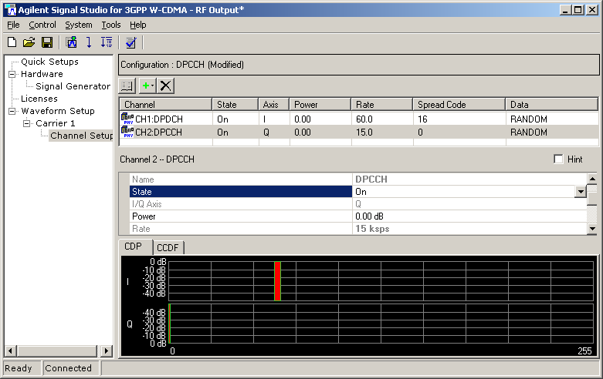
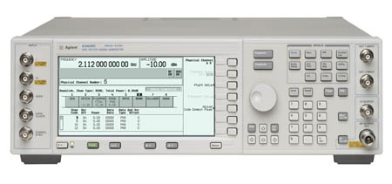

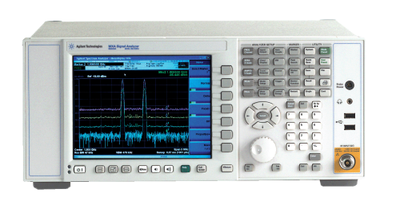

RF-IC Validation
DigRF v3/v4 RF-IC Unit Testing Environment
Signal Studio Software
Signal Generator
Tx
RF-IC
Rx
N5343A Exerciser
Vector Signal Analysis
Spectrum Analyzer
Modulation Analysis and C/N Measurement
Notes:
For RFIC testing, the system, can be used to generat the data (encapsulated in DigRFv3 packets), and sent to the RFIC.

Slide 29
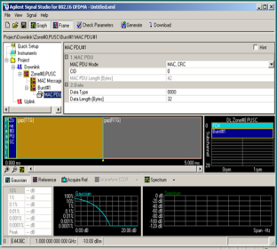
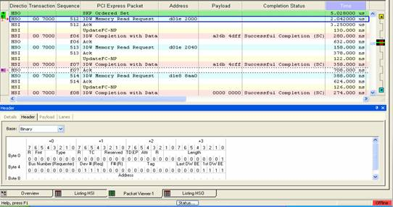

BB-IC Turn-on
DigRFv3/v4 BB-IC Unit Testing Environment
Agilent solutions block diagram
Signal Studio Software
BB-IC
Visibility Port
DigRF Packet Analysis
uC
Tx
DigR Interface
DSP
Rx
Vector Signal Analysis

Slide 30
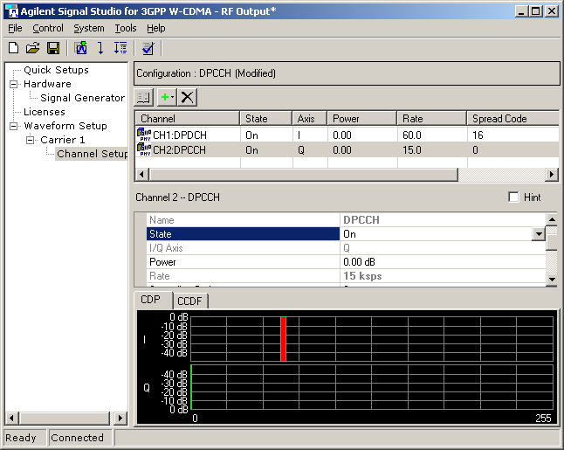
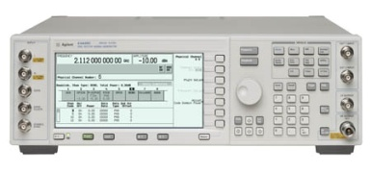

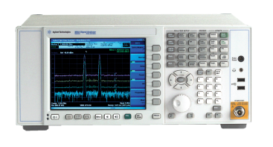


RF-IC / BB-IC Integration
RF-IC, BB-IC, Integration Testing Environment
Agilent solutions block diagram
Signal Generator
DigRF
RF
Signal Studio Software
DSP
BB-IC
RF-IC
DigRF
v3.xx
DigRF
v3.xx
uC
Vis Port
Digital
RF
Vector Signal Analysis
DigRF Analyzer
Oscilloscope
Signal Analyzer
DigRF Packet Analysis

Slide 31
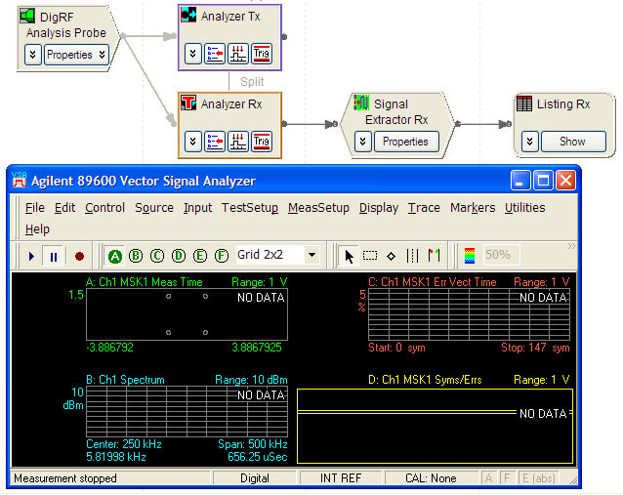

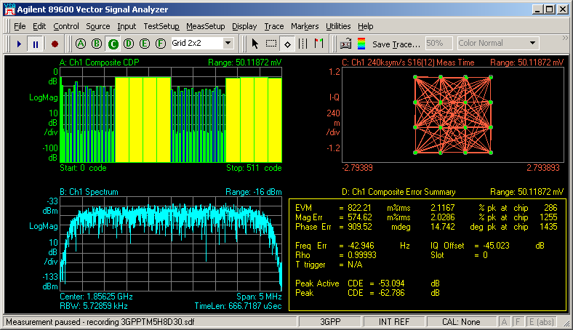
Extraction of I/Q Data From DigRF Packets
Logic Analysis SW (Signal Extractor)
Signal Analyzer SW (Vector Signal Analyzer)

Slide 32
Customization Via Signal Extractor
<ExtractorPatterns>
<ExtractorPattern Value='b0X0XXXX1 1010100X XXXXXXXX XXXXXXXX' Width='32' Enabled='T' />
</ExtractorPatterns>
<ExtractorCmds>
<ExtractorCmd Cmd='LoadRange' BitStart='16' BitEnd='31'/>
<ExtractorCmd Cmd='WriteLabelTime' Name='I' BitTime='31'/>
<ExtractorCmd Cmd='LoadRange' BitStart='40' BitEnd='55'/>
<ExtractorCmd Cmd='WriteLabel' Name='Q'/>
By editing this XML, a multitude of IQ packet data formats can be supported
Differences in payload length, IQ bits, etc. can be handled with great flexibility

Slide 33

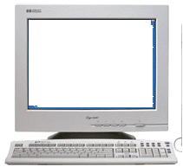
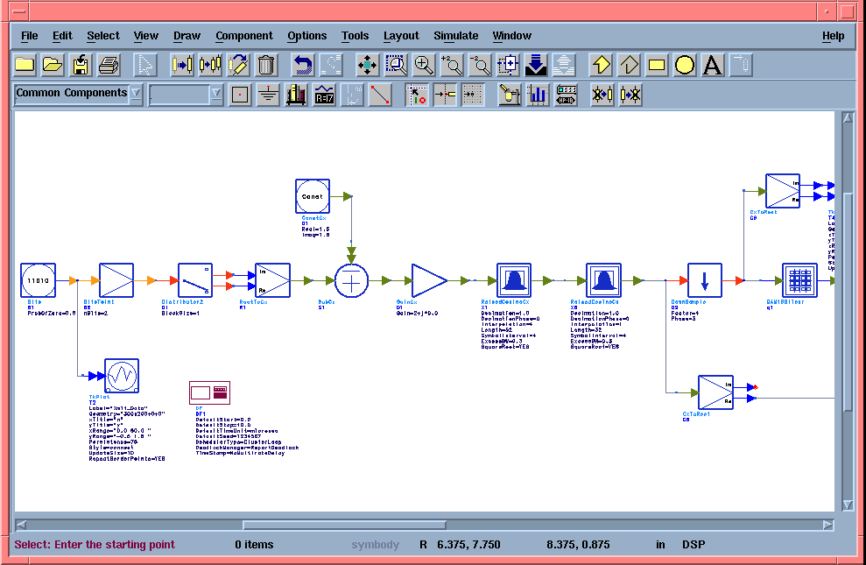
Creation of DigRF Output Data (Control Signal and I/Q Data)
Signal Studio Software
Signal Inserter
Software
or
N5343A DigRF Exerciser)
ADS Software

Slide 34
Agilent DigRF Solution Portfolio
Wireless Protocol Layer Validation
Wireless Communication Test Set
Wireless Domain
Wireless Physical Layer Validation
Signal Analyzer
Signal Source
Cross Domain test
DigRF
Digital Protocol Layer Debug / Validation
Digital Domain
LA based DigRF v3 tester
Dig RF v4 tester
DigRF
Digital Physical Layer Debug / Validation
BERT
Wide Band Oscilloscope

Slide 35
Recommended Configurations

Slide 36
Recommended Configuration Protocol (V3 & V4)
Customer Requirements | Recommended Equipment
 | N4850A (Acquisition probe) | N4860A (Stimulus Probe) | N5343A (Stimulus) | N5444A (Analyzer)
Exerciser V3 Only (requires analyzer for even Exerciser only) |  |  | X
Analyzer V3 Only | X
Exerciser V4 Only |  |  | X
Analyzer V4 Only |  |  |  | X
Exerciser V3 & Analyzer V3 | X | X
Exerciser V4 & Analyzer V4 |  |  | X | X

