Slide 1
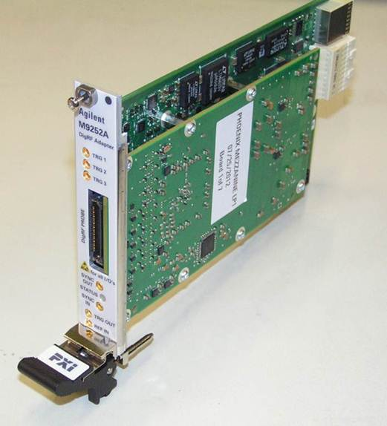
LTE-A – DigRF Testing needs and Solutions
M9252A DigRF Host Adapter
January 21, 2013

Slide 2
Phoenix Overview
→ The M9252A DigRF Host Adapter is reducing the RF validation test time of RF-ICs.
Supporting statements:
One PXIe module supporting all RF test cases.
Fast programming speed:
Fast IQ transfer in both direction: receive and transmit.
Fast VSA connection.
Designed for test automation.
Seamless integration with Agilent RF validation test tools, like sources, analyzers and signal generation / validation software.

Slide 3
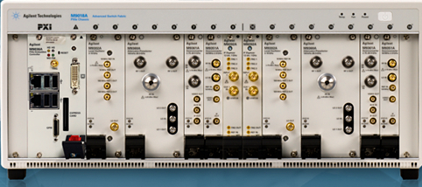
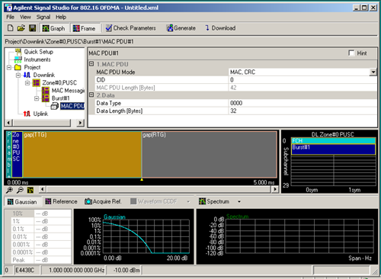
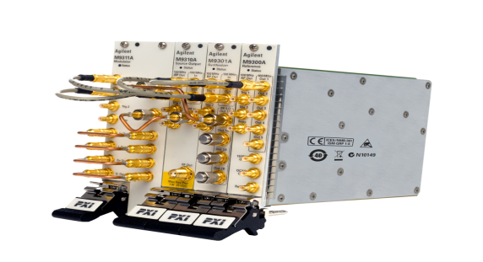

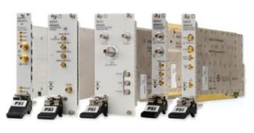
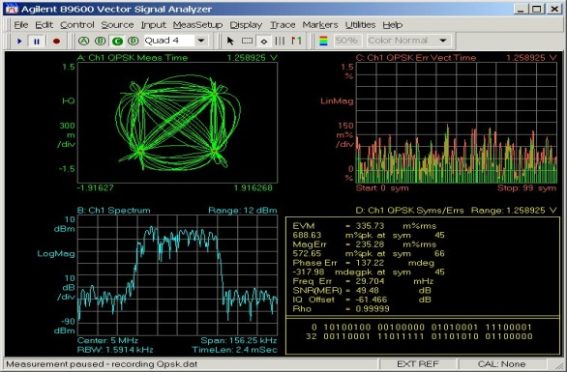
RFIC Transmitter/Receiver Test
Signal Studio
M9381A VSG
Tx
RF-IC
Rx
M9252A DigRF Host adapter
Vector Signal Analysis
M9392A VSA

Slide 4
Phoenix Product Structure
M9252A DigRF Host Adapter for a 1.5Gbps link
Supporting 2 x Rx and 1 x Tx lines for sending and receiving digital IQ data.
Option 1: Gear 2
Extends the Rx and Tx lines to support up to 3.0Gbps.
Option 2: 2nd link (cannot be activated together with option 3)
Adds a second link with 2 x Rx and 1 x Tx lines for sending and receiving digital IQ data.
Option 3: More lines on link0 (cannot be activated together with option 2)
Adds addiditional 2 x Rx and 1 x Tx lines for sending and receiving digital IQ data.
Option 4: Software support (1Year (bundled for the 1st year)
M9255A DigRF DUT cable

Slide 5
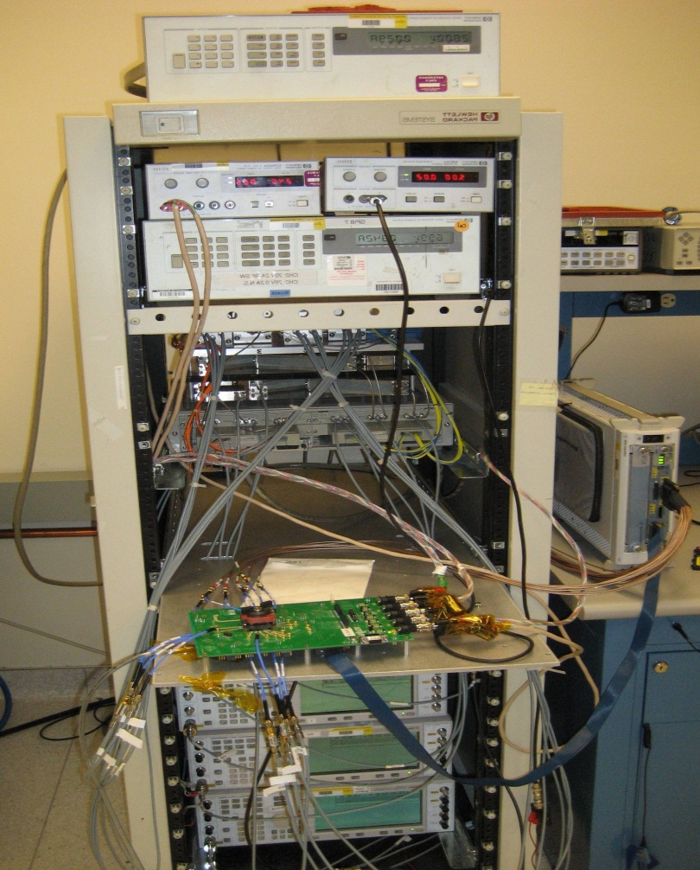
DigRF testing Agilent Solution comparison
PXI with embedded controller
RDX (N5343A)
Advantages RDX (M9252A)
Test execution time reduced (estimate) > 50%
Cost reduced > 25%
DigRF v4 Host Adapter: Supports 2 links, Aggregated links, Gear2
Roadmap:
BBIC Exerciser
DigRF analyzer
Automated test bench for 2G, 3G and 4G

Slide 6
Phoenix: PXIe DigRF host adapter Extendable product offering, starting with the DigRF Host Adapter
LabView
Scripting, like Python
89600 VSA
Signal Studio
SystemVue
SW (on Host Controller)
GUI for HW configuration
API (.dll)
PCIe
HW
IQ Insertion / Extraction
DigRF protocol engine
Option 1: Gear2
Link0: 2 x Rx & 1 x Tx @ Gear1
Option 2: Link1: 2 x Rx & 1 x Tx @ Gear1
Option 3: Link0: 2 x Rx & 1 x Tx @ Gear1
DigRF Host Adapter

Slide 7
Family Overview: PXIe DigRF test offering Extendable product offering, starting with the DigRF Host Adapter
LabView
Scripting, like Python
89600 VSA
Signal Studio
SystemVue
SW (on Host Controller)
GUI for HW configuration
GUI for error definition
Protocol Analyzer GUI, e.g. Matrix
Not part of Phase 1 Project
API (.dll)
API (.dll)
API (.dll)
PCIe
DigRF v.4 Protocol Variations / Error Injector
DigRF Trace Memory
Error Dector
Trigger Engine
HW
IQ Insertion / Extraction
DigRF protocol engine
Option 1: Gear2
Link0: 2 x Rx & 1 x Tx @ Gear1
Option 2: Link1: 2 x Rx & 1 x Tx @ Gear1
DigRF Analyzer option
Option 3: Link0: 2 x Rx & 1 x Tx @ Gear1
DigRF Exerciser option
DigRF Host Adapter

Slide 8
Solution Components
Description | Remarks
M9018A 18 slot PXIe Chassis
M9021A PCIe Cable Interface | PCIe x8, Gen2
M9252A Phoenix Card: | DigRF Host Adapter
M9252A to DUT connection Cable
M9048A PCIe Desktop Adapter | PCIe x8, Gen2 | Desktop Connection
Connecting Cable: | Y1202A PCIe Cable: X8, 2,0m
M9045B PCIe ExpressCard Adapter | PCIe x1, Gen1 | Laptop Connection

Slide 9
Pricing
USD List | Item | Description
$ 20,540.00 | M9252A | DigRF host adapter for 1.5 Gbps link - includes 12 month SUS
$ 5,000.00 | -001 | G2 speed enhancement license
$ 5,000.00 | -002 | Upgrade to 2 links (2Rx/1Tx each)
$ 5,000.00 | -003 | Link upgrade to 4Rx/2Tx license
$ 1,000.00 |  | Twelve month M9252A core software update subscription renewal
$ 1,500.00 |  | Twenty-four month core software update subscription service renewal
$ 1,027.00 | M9255A | DigRF device cable
Note:
- Option 001 can be combined with either 002 or 003.
- Option 002 and 003 can be activated only at one at a time.

Slide 10
M9252A Chassis configurations
M9252A w/ embedded PC
Item | Price
M9252A | $ 20,540
M9018A (PXIe Chassis) | $ 8,568
M9036A (embedded cpu) | $ 7,000
typ config | $ 36,108
Display and keyboard required
M9252A w/ PCIe connect
Item | Price
M9252A | $ 20,540
M9018A (PXIe Chassis) | $ 8,568
M9021A (PCIe interface) | $ 671
typ config | $ 29,779
PC with PCIe connection required

Slide 11
Are there any questions?

