Slide 1
MIPI Interfaces in a Mobile Platform
This picture is only an illustrative example for several ways of integration with the purpose of demonstrating MIPI diversity on interfaces
D-PHY based
M-PHY based
SLIMbus
SPMI/RFFE
UniPort : UniProTM + D-PHY or M-PHY
UniPro based IF technology are:
UFS, CSI-3, DSI-2, GBT, UniPort
(*) Transferred to IEEE
(**) Liaison with JEDEC

Slide 2
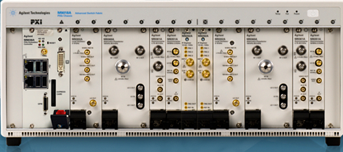
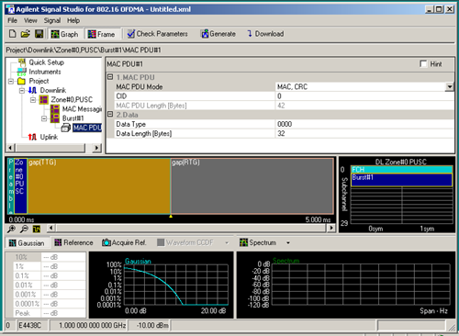
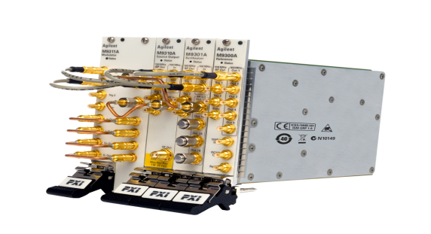
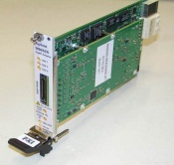
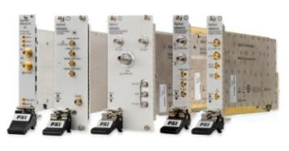
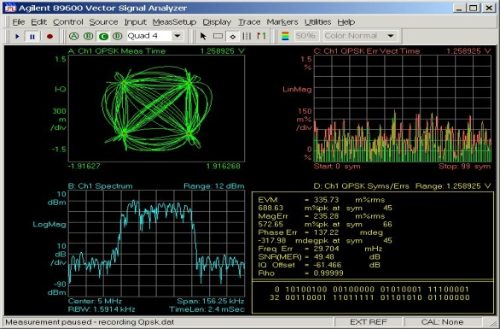
RFIC Transmitter/Receiver Test
Signal Studio
M9381A VSG
Tx
RF-IC
Rx
M9252A DigRF
Host adapter
Vector Signal Analysis
M9392A VSA

Slide 3
DigRF Protocol Test
RF-IC Validation
M9252A
Fully test your design’s DigRF link and protocol interface
• Configurable DigRF traffic generation
• Customize header and payload, and frame sequence generation
• Repetitive and loop events
• Control and data traffic generation
• Low power and high speed mode control
• Error insertion to validate device’s robustness and error recovery

Slide 4

M9252A DigRF Host Adapter
Host Adapter for a 1.5Gbps link
    2 x Rx and 1 x Tx lines for sending and receiving digital IQ data. –
    Option 1: HS2x (Gear 2) Rx and Tx lines to support up to 3.0Gbps.
    Option 2: 2nd link second link with 2 x Rx and 1 x Tx
    Option 3: Lane extension support for 4 x Rx and 2 x Tx lines
Fast programming speed:
    Fast IQ transfer in both direction: receive and transmit.
    Fast VSA connection.
    Designed for test automation.
Seamless integration with Agilent RF validation test tools, like sources, analyzers and signal generation / validation software.
M9381A Vector Signal Generator
Notes:
Agilent’s PXIe M9381A
Vector Signal Generator
10x faster switching times with an industry leading 160MHz BW

Slide 5

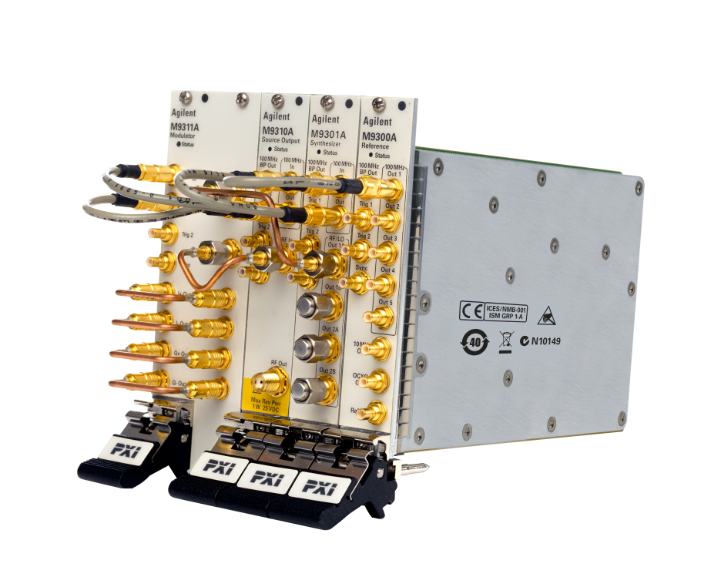
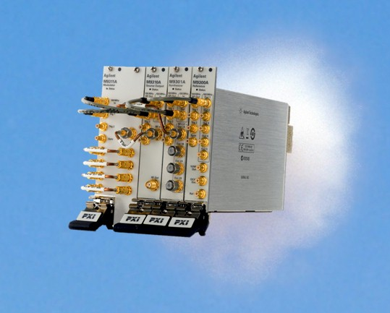
PXIe VSG: M9381A
Break the Speed Barrier
Frequency Range: 3 or 6 GHz
Bandwidth: 40 or 100 or 160 MHz
Excellent Output power, linearity, accuracy specifications
Amp and Freq Switching speeds:
  <10us baseband, <220us full RF band
Innovative support throughout the lifecycle
  3 year Warranty, Upgradable Options, Core calibrated exchange, express repair services, Asset inventory management
M9381A Vector Signal Generator
M9381A Vector Signal Generator
Notes:
Agilent’s PXIe M9381A
Vector Signal Generator
10x faster switching times with an industry leading 160MHz BW

Slide 6
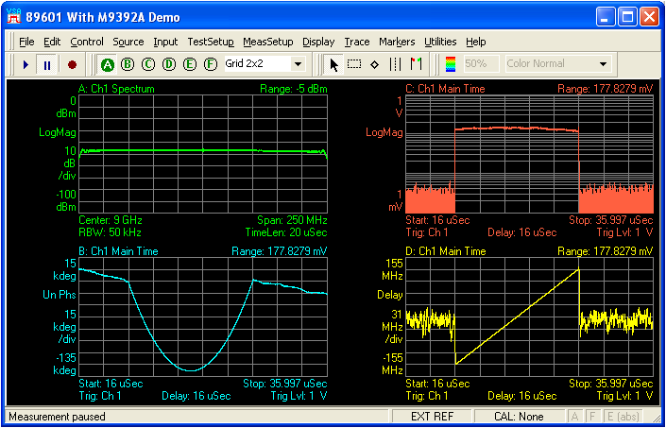
M9392A Microwave Vector Signal Analyzer
First single-vendor PXI microwave VSA
M9392A Includes:
M9202A PXIe IF Digitizer
M9302A PXI LO
M9360A PXI Attenuator/Preselector
M9361A PXI Downconverter
M9351A PXI Downconverter (Option)
Modular RF Design
    4 or 5 module (7 or 8 slot) PXI Vector Signal Analyzer
    50 MHz to 26.5 GHz
    Combine with PXI uWave switches to create Test System
Integration to Agilent Measurement Science Software
    89600 VSA Software for Modulation Analysis
Wide Bandwidth (250 MHz instantaneous BW and 100 MHz streamed analog BW at C.F. > 2.25 GHz)
    Measure Broadband Communications and Radar Signals
    Flexible
  Easy integration to: Visual Basic, C++, C#, LabView, LabWindows, Matlab, and VEE -- with examples
Spectrum, phase, frequency and time domain displays of a chirped radar signal using the Agilent 89601 VSA software and the M9392A PXI vector signal analyzer.

Slide 7
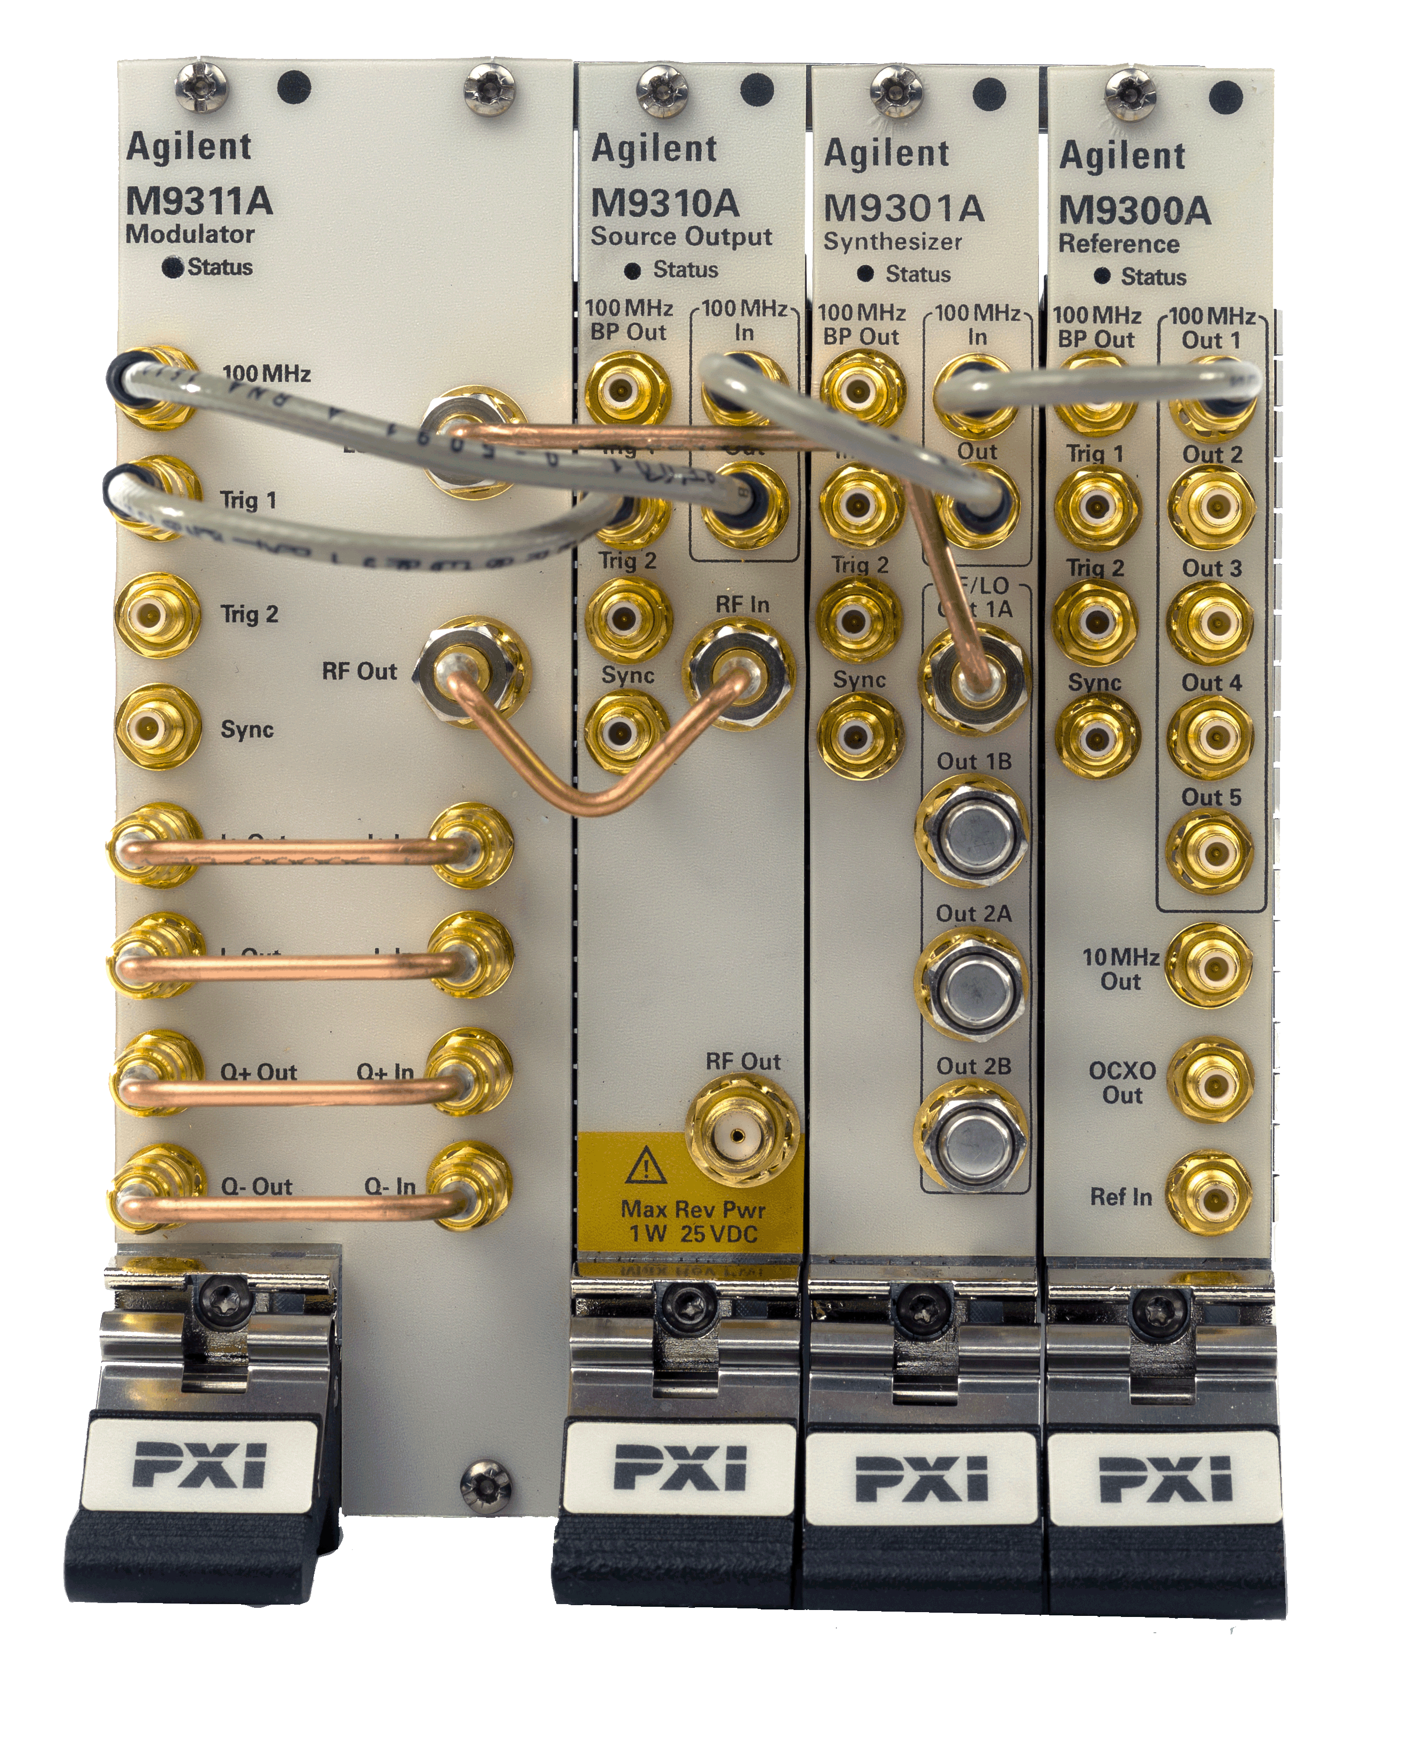










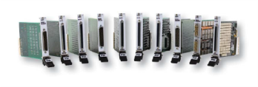





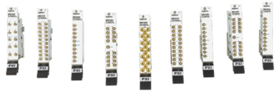
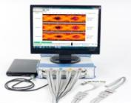



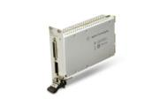
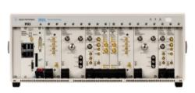



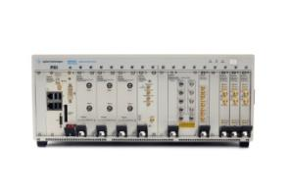


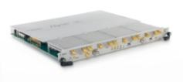

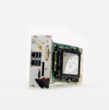





Modular: A Growing Portfolio
Functional Test | Digital | A/D | Wireless | BERs
Chassis, Controllers and IO
NEW
NEW
High Speed
DMMs
uW Vector Signal Analyzer
M9380/81A RF Source
NEW
Signal conditioning
Low Frequency Switching
DigRF
uWave Switches
PXI 10 & 15-bit AWG
Digitizing
Scopes
RF Switching
Logic Analyzers
uWave Switches
IF
Digitizers
PXI Dual Channel Vector Signal Analyzer
NEW
DAQ
Protocol Analyzers
NEW
N7109A 8-channel MIMO Analyzer
PCI Express
NEW
VI Source
M8190A AXI AWG
NEW
M9703A AXIe Digitizer
PXI Wideband MIMO
Vector Signal Analyzer
HDMI
Digital IO
NEW
NEW
Chassis & Controller
M940xA PXI Optical Extenders
NEW
Chassis & Controller

