Slide 1


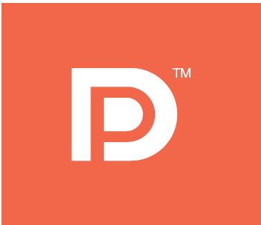
DisplayPort 1.2 Protocol Analysis with Agilent Logic Analyzers
Since 1991

Slide 2
Outline
What is a DisplayPort Protocol Analyzer?
DisplayPort Protocol Example Displays
How to connect to the High Speed Main Link, Aux Chanel and HPD
Probe Manager Software
Phy Level debug and visibility
How is this tool different?
How can this tool aid compliance testing?
Summary

Slide 3
What is a DisplayPort Protocol Analyzer?
Snoops the Aux Port, HPD and High Speed Main Link with little or no measureable effect on the signals
Cracks the packet and decodes all the of the information being transferred
Displays all of the packet protocol in English, hex or binary so that engineers can quickly relate the information to the DisplayPort Specification

Slide 4
Examples of DisplayPort Data
Using an Agilent Logic Analyzer

Slide 5
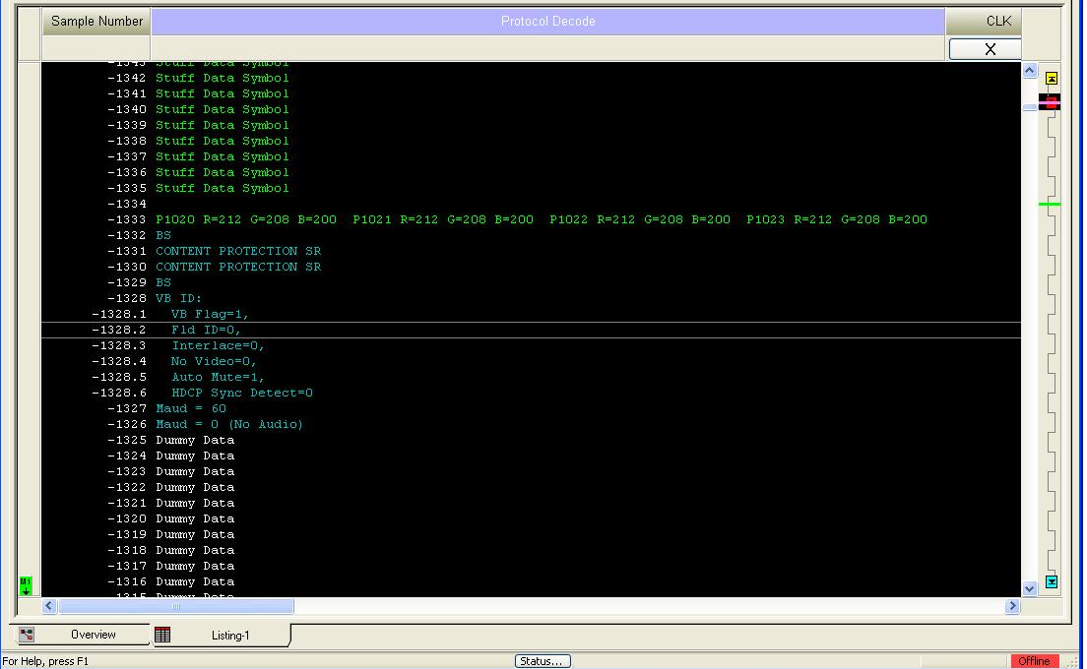
Blanking Start
Stuff Data Symbols only appear when filtering is disabled
Symbols such as Blanking Start and Content Protection Scrambler Reset appear often in DisplayPort traffic
VBID now indicates Vertical Blanking period. This is the end of one Frame and the start of the next

Slide 6
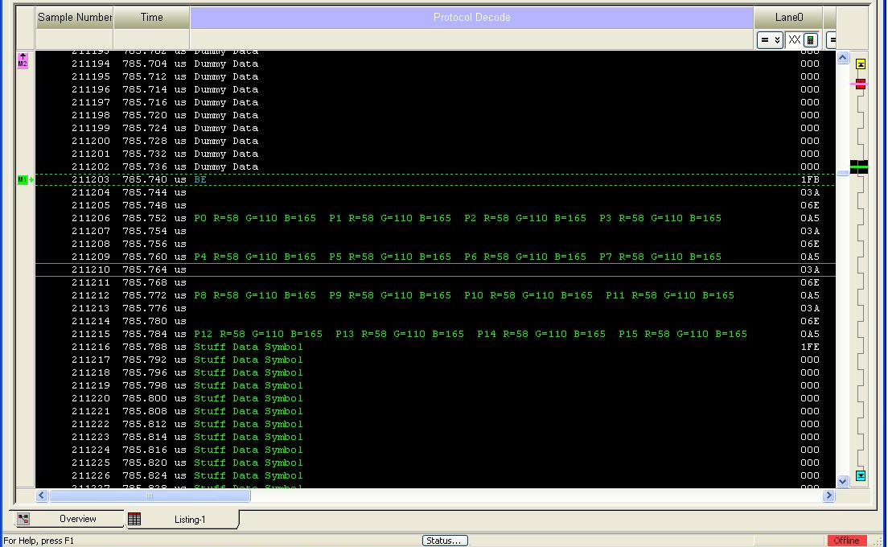
Blanking End
Pixels are given an index number within a frame and a color value
Stuff Data Symbols only appear when filtering is disabled

Slide 7
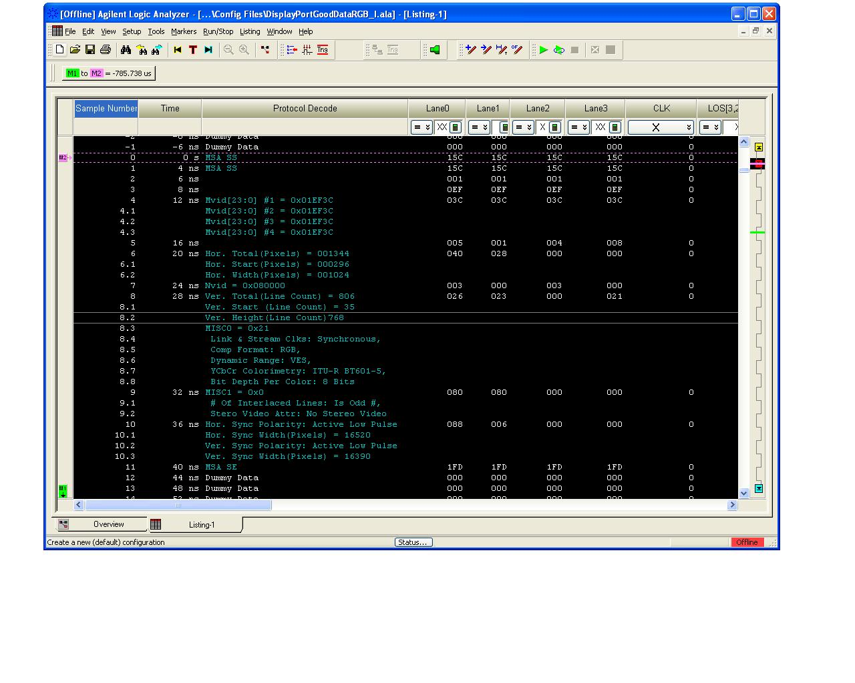
Main Stream Attribute Packet
MSA packets are bounded by SS and SE symbols because they are considered secondary data packets
The Mvid and Nvid are 24 bit values used for stream clock recovery
Horizontal and vertical characteristics of the frame are found in the MSA packet
Pixel information such as Colorimetry format, number of bits per pixel and component format
The MSA packet is Inserted once per video frame during the video blanking period and is used by the DisplayPort receiver in reconstructing the stream.

Slide 8
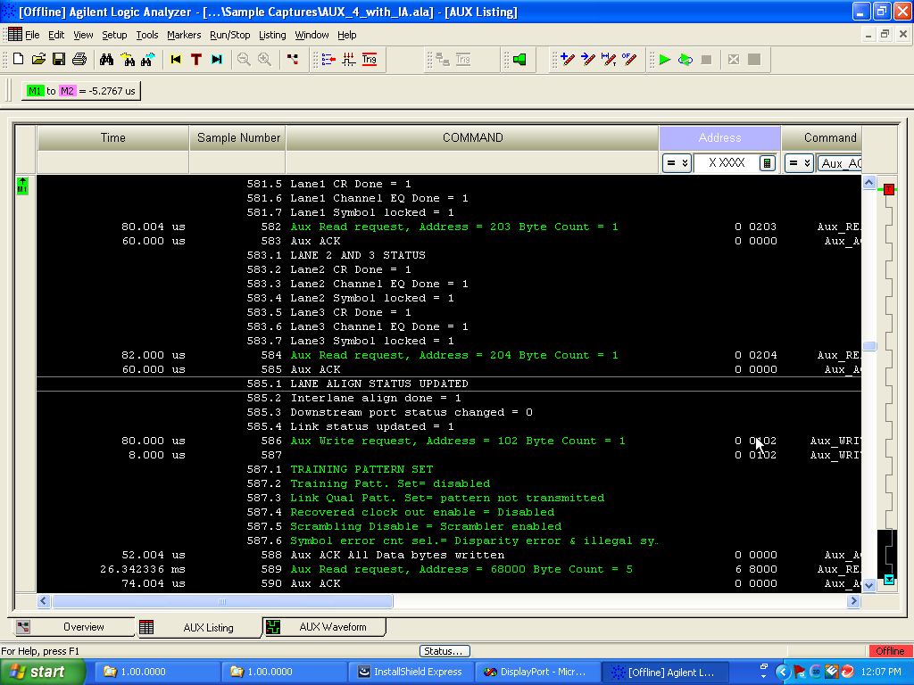
Aux Channel Decode
Aux Channel is a bidirectional half duplex 1 Mb/sec communication channel
Aux Port communicates configuration data between the monitor and the host PC
The serial data is deserialized into a 48 bit wide bus and clocked to the logic analyzer. This wide bus makes triggering easy
Diagnostic mode information is also communicated over the Aux Port

Slide 9
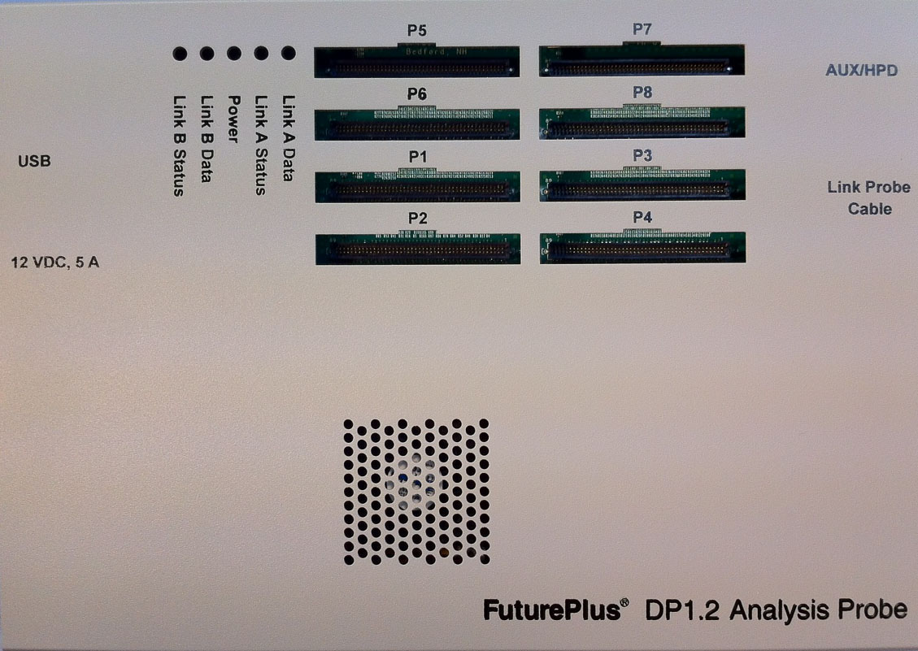
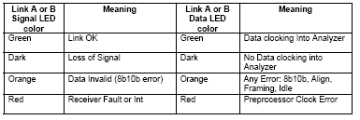
FuturePlus FS4439 DisplayPort 1.2 Analysis Probe
Probe Manager Input (USB)
Sideband Signal Input
Power Supply Input
Probe Input Cable
Power Switch
Logic Analyzer Connections
Quad-State Status LED’s:

Slide 10
How does this tool connect to the target?
Three probing choices for the High Speed Main Link
½ size Midbus footprint (FS1042)
Flying Leads connect to AC coupling caps (FS1036B)
DisplayPort 1.2 Cable Interposer (FS1041)
Sideband signals (Aux, +/- and HPD) connect with stake pins

Slide 11
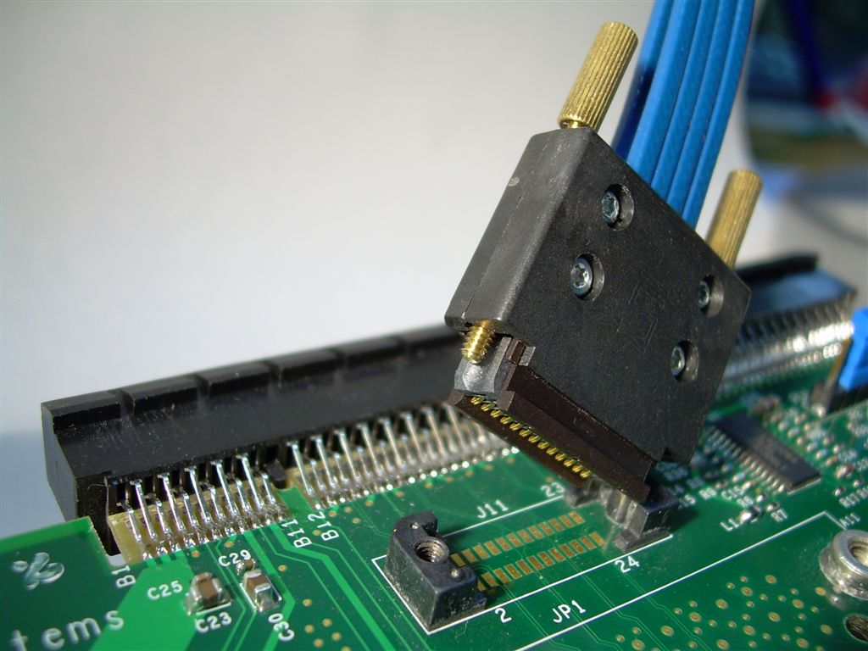
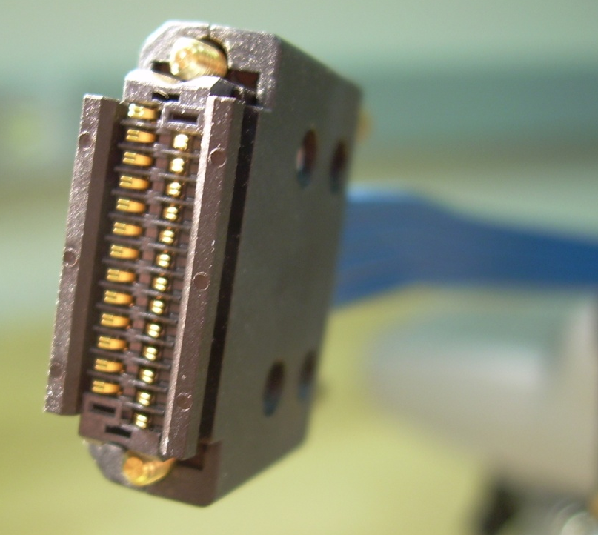
High Speed Main Link Probing FS1042 1/2 Size Midbus Probe
Supports X1, X2, X4 lane widths
Lowest loading
Requires pre-design planning
Minimal board space required
Ideal for embedded DisplayPort Applications

Slide 12
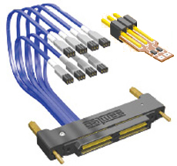
High Speed Main Link Probing FS1036B Flying Lead Set
Probing individual lanes
Low loading
No pre-design planning
Greatest flexibility of use
Well suited for embedded DisplayPort Applications
Attaches to AC coupling caps

Slide 13
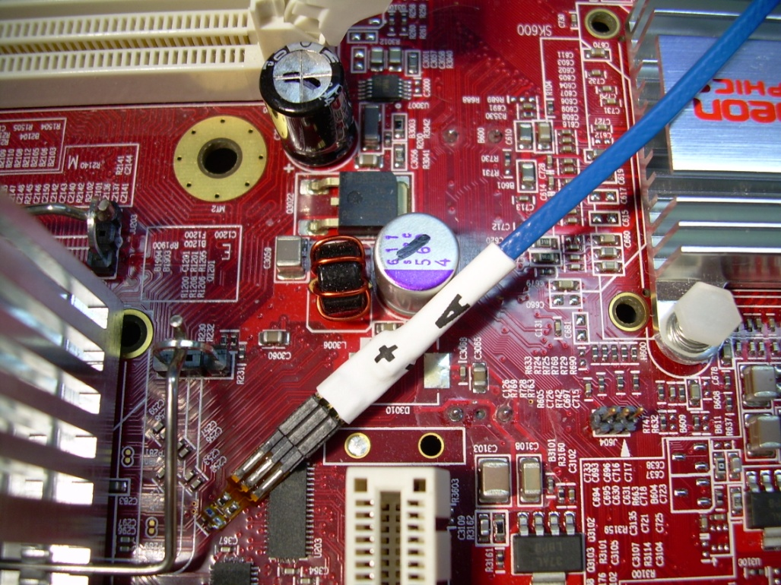
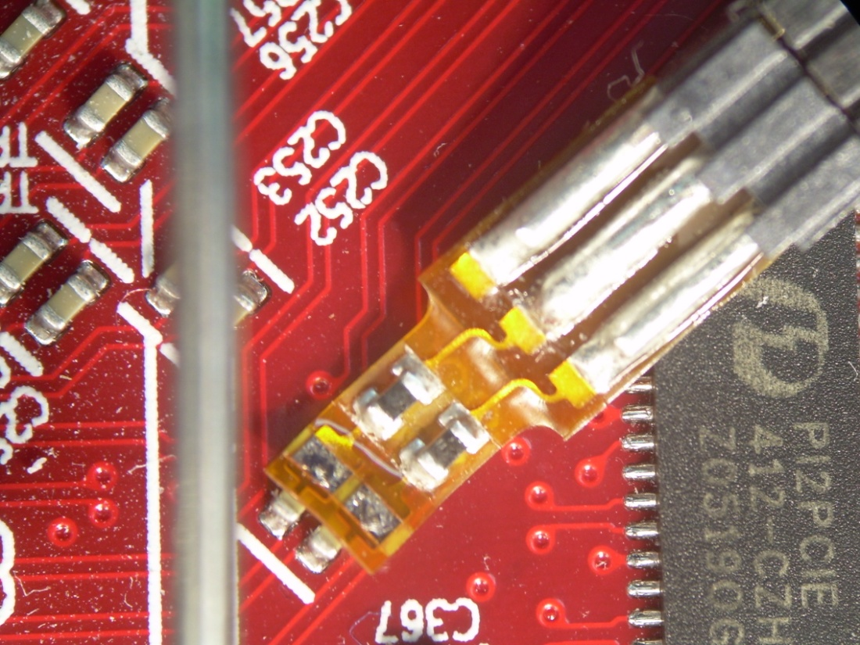
Probing with Flying Leads
Using the FS1036B to connect to caps with the Flex Tip connectors

Slide 14
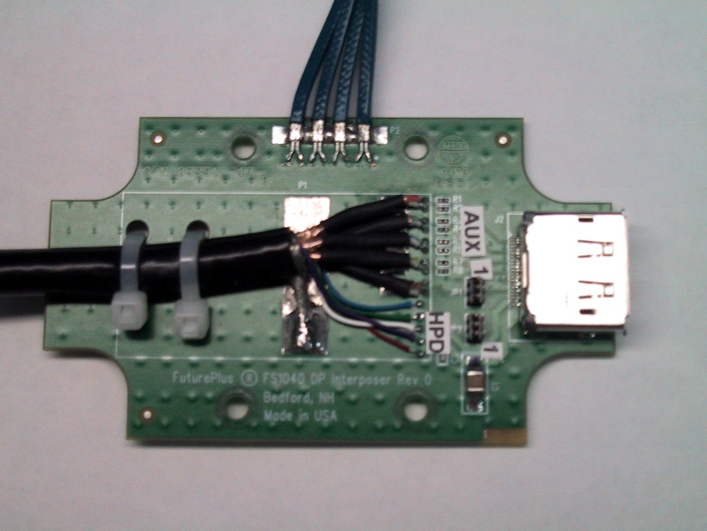
High Speed Main Link Probing FS1041 - DP Cable Interposer
Easiest to use
Connects between the PC and the monitor
To the FuturePlus Analysis Probe
To the motherboard
To Monitor
To the Aux Cable
To the HPD Cable

Slide 15
Probe Manager Software
Used to start and stop the Analysis Probe
Sets up the configuration of the Analysis Probe
Controls the filtering of the data sent to the logic analyzer

Slide 16
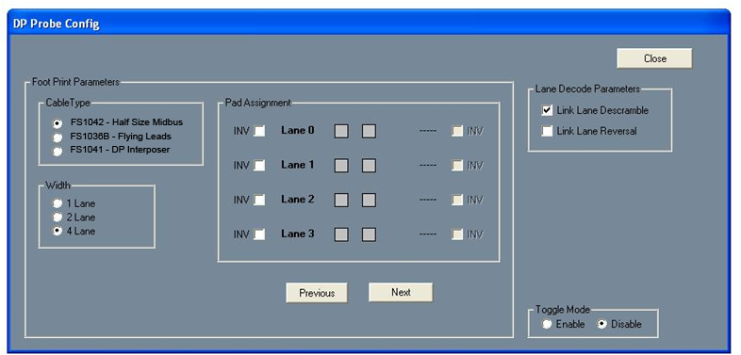
Probe Manager Software
DisplayPort Probe Configuration
Probing Choice
Width
Lane Decode Parameters
Pad Assignment
Toggle Mode

Slide 17
Probe Manager Software
Filter Setup

Slide 18
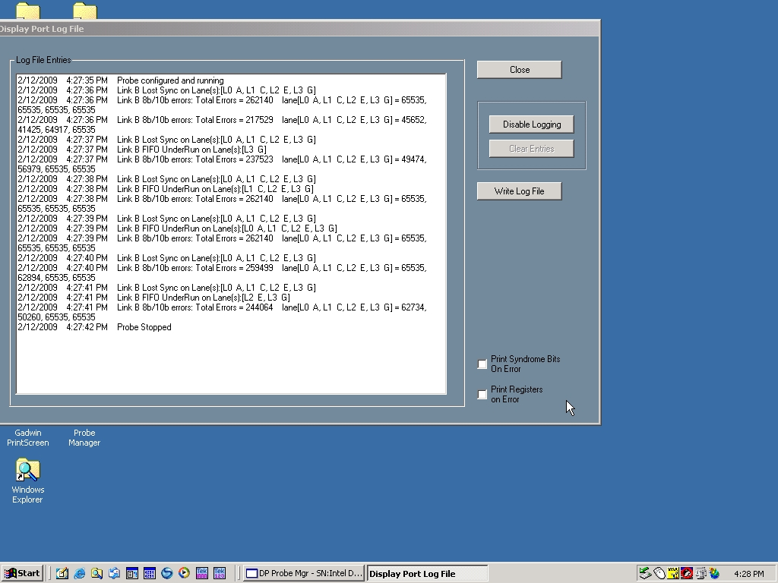
The Log File
Diagnose problems with the link without using the logic analyzer
Helps solve installation problems
In addition to the LEDs, tells you if the Analysis Probe is installed and running correctly

Slide 19
10b mode
Intended for low level phy debug
Allows the bypass of 8b decoder so raw 10b data may be processed and displayed.
The analysis probe hardware does real-time, lane-based 8b10b error checking, lane deskew and lane deskew checking. There are no filters or pattern recognizers provided in 10b mode

Slide 20
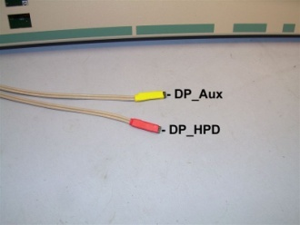
DisplayPort 1.2 FS4439 Logic Analyzer Requirements
High Speed Main Link
68 channels at 540 MHz – 16962A, U4154A
Aux Channel
68 channels at 47 KHz – 16950B
Only 47 of those signals are used
90 pin logic analyzer modules only
HotPlug Detect stake pin connection to flying lead from the FS4439

Slide 21
How is this tool different?
This tool ‘cracks the packet’
This tool monitors the High Speed Main Link and the Aux Port simultaneously
Cause and effect relationships can be observed
This tool does not use the Genesis Chip
We have our own phy/serdes 8b/10b decode generic to 8b/10b architectures
All Pixel values, Audio values, secondary packets, MSA, VBID and control characters can be seen
Performance measurements can be made
Real Time Triggering on any event
Correlation between DisplayPort and other busses in the system can be achieved

Slide 22
How can this tool aid compliance testing?
If a link layer test fails we can see the actual cause of the error
For Aux based tests that control the Main Link, the Main Link can now be seen to verify event
Triggers can be setup to look for violations
Product is FPGA based and can be enhanced for more automation

Slide 23
Budgetary Pricing – USA only
FS4439- DP 1.2 Main Link and Aux Analysis Probe - $60,000
Choose one of the following adapter cables to connect to the target under test:
FS1041 DP 1.2 cable interposer - $6,995
FS1042 DP 1.2 midbus adapter - $8,500
FS1036B flying lead set - $4,995

Slide 24
Summary
The DisplayPort Ecosystem now has a full function DP 1.2 protocol analyzer
Protocol Analyzers provide quick insight into complex problems
A logic analyzer based protocol analyzer leverages pre-existing test equipment
Older Agilent logic analyzers can be used
Only a logic analyzer can provide cross-bus analysis
Aux Port/Main Link, System Bus/Aux Port/Main Link, etc.
Available 2011 Late Q4

Slide 25
FuturePlus Systems
Providing validation and debug tools
for today’s high-speed buses
Bill Furch
Senior Applications Engineer
Bill.furch@futureplus.com
719 278-3540
www.futureplus.com

