Slide 1
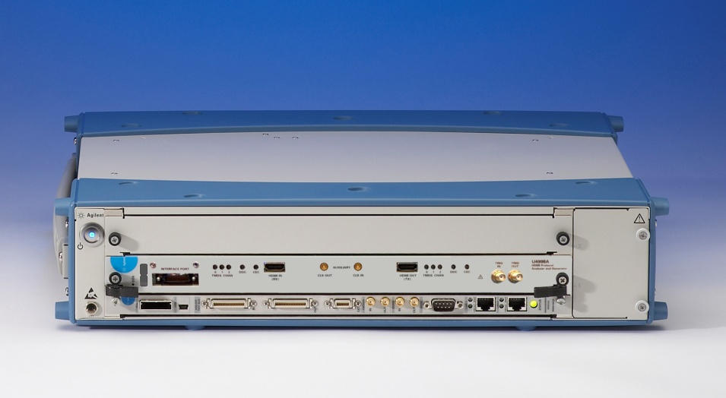
March 2011
Introducing the U4998A HDMI Protocol Audio/Video Analyzer and Generator!
Insert Presenter Photo Here

Slide 2

Terms You Will Hear Today
HDMI – High Definition Multimedia Interface
CTS – Compliance Test Specification
ATC – Authorized Test Center
PAG – Protocol Analyzer and Generator
HPD – Hot Plug Detect
HDCP – High-bandwidth Digital Content Protection

Slide 3

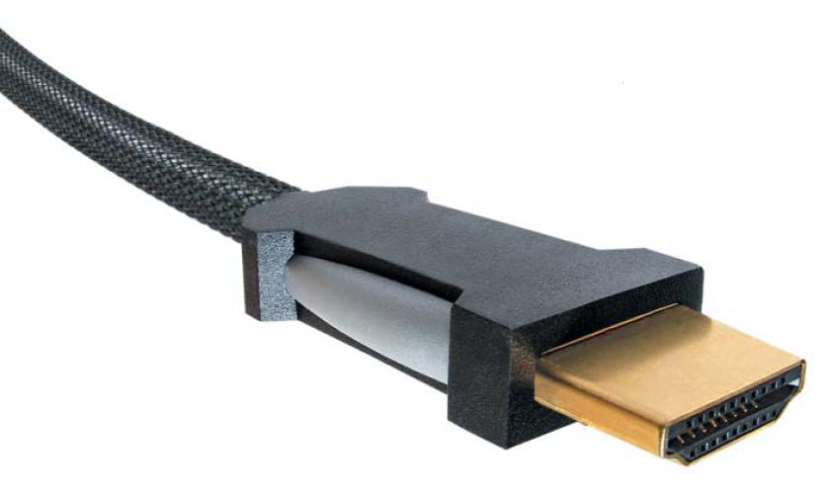
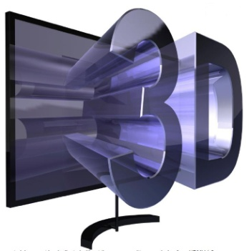
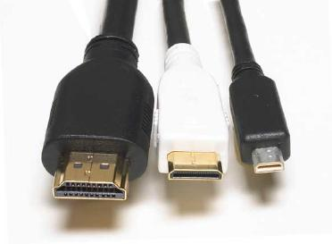
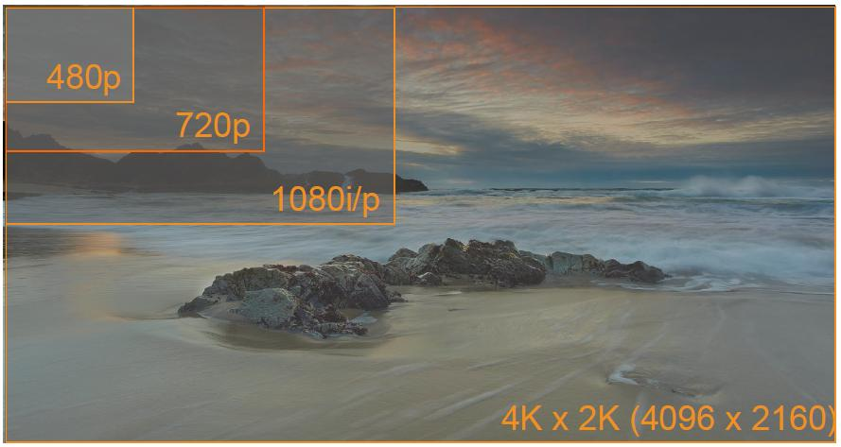
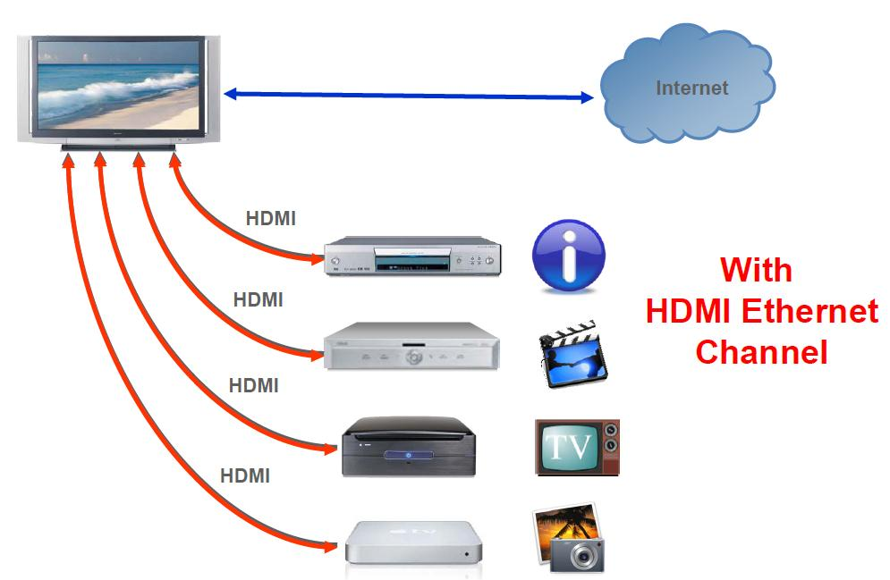
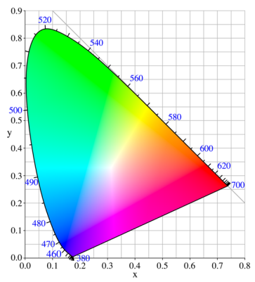
HDMI 1.4a
HDMI 1.4a is the latest version of the HDMI standard adding new functionality inc.
Support for 3D over HDMI,
4Kx2K video,
additional color spaces,
HDMI micro connector for phones/portable devices, Automotive connection system
HDMI Ethernet Channel – adding high speed IP networking over the HDMI cable
Audio Return Channel - integrated upstream audio to a surround sound system

Slide 4




HDMI Trends
With the latest release, HDMI 1.4 enables:
Fewer cables
State-of-the-art and life like cinema quality at home
Connections for small devices & automotive
1.4
1.3
1.0 to
1.2
Future of HDMI
Speeds?
Formats?
…?
HDMI Version Release Date | 1.0 to 1.2 Dec 2002 to Aug 2005 | 1.3 Jun 2006 | 1.4 Dec 2009
TMDS throughput per channel | 1.65 Gb/s | 3.4 Gb/s | 3.4 Gb/s
Driver | Digital alternative to analog consumer standards transmitted through a single cable | Full color for “Full HD” | Mobile devices, multimedia, heightened viewing experience
Supports | Blu-ray Disc, HD DVD, Type A connectors for PCs, Super Audio CD, Low voltage sources | Increase to 3.4 Gb/s single-link bandwidth, Deep color | Ethernet & audio return channels, 3D, 4k x 2k, more color spaces, micro and automotive connectors
Notes:
HDMI ORG MESSAGING
Why is HDMI so successful? The three reasons are: simplicity, performance, and intelligence.
SIMPLICITY: HDMI is simple, all the information is transmitted through one cable. Just “plug in and play” via a single digital link. It is also backward-compatible with previous versions.
PERFORMANCE: HDMI has excellent performance, with bandwidth capacity for movies, fast gaming, and rich audio. With a bandwidth capacity of 10.3 Gigabit/s, you have more than twice the bandwidth needed to transmit a 1080p signal. The transmission is all-digital, you don’t loose performance because of conversion or compression. The performance is sufficient for faster refresh rates like 120 MHz, higher resolutions are possible.
- INTELLIGENCE: Lastly, HDMI is intelligent in that it provides automatic configuration and system-wide behavior. The connection is a two-way connection that allows devices to communicate and interact with each other. Devices connected to the HDMI system automatically detect certain settings so you have the same system-wide behavior.
Trends in HDMI
The HDMI standard continues to evolve over time.
In December, 2002 the HDMI 1.0 standard was released with a maximum TMDS throughput per channel of 1.65Gb/s.
In May, 2004 HDMI 1.1 added support for DVD-audio.
In August of 2005, HDMI 1.2 provided support for Super Audio CD.
In June of 2006, HDMI 1.3 doubled the bandwidth to 3.4 Gb/s over the previous version of the standard and provided deep color. Deep color was the biggest driver from HDMI 1.2 to 1.3. With it, each company used “Full HD” as a key word to expand their market. The key product was Play station-3. The other key words were “Type C mini connector”, and “HD Audio format”.
In 2009, HDMI 1.4 opened the door to a new connected, multimedia world and provided a heightened viewing experience.
The key driver from HDMI 1.3 to 1.4 was to expand the market segment from TV and Video to the mobile segment. The key words are “Type D for mobile, compact digital camera”, “Type E for automotive”, “eHDMI”. HDMI 1.4, defines new Ethernet and Audio Return Channels. These features eliminate the need for additional Ethernet and audio cables. HDMI 1.4 incorporates this functionality in the HDMI cable. Think about the cabling in your living-room …
Another major improvement is a heightened viewing experience with 3D support and support for additional color spaces. I remember the times we used 3D glasses in the cinema. This experience now comes to your home. HDMI now also supports the same resolution as huge, state-of-the-art cinema theater screens with the 4K x 2K format. The new color spaces help you to reproduce the rich, natural, lifelike colors from digital still cameras and ensure that skin looks like skin and you don’t look like a pink monster.
New connectors for connecting your cell phone to your TV. You can imagine how small the connector has to be. In the car you need reliable, robust connectors. HDMI 1.4 defines both
THE FUTURE OF HDMI
The key driver from HDMI 1.4 and beyond would be to increase the transmission speed, however no one can illustrate a clear vision yet.

Slide 5
HDMI 1.4
HDMI 1.4 is the latest version of the standard adding new functionality inc.
Support for 3D over HDMI,
4Kx2K video,
additional color spaces,
HDMI micro connector for phones/portable devices, Automotive connection system
HDMI Ethernet Channel – adding high speed IP networking over the HDMI cable
Audio Return Channel - integrated upstream audio to a surround sound system

Slide 6
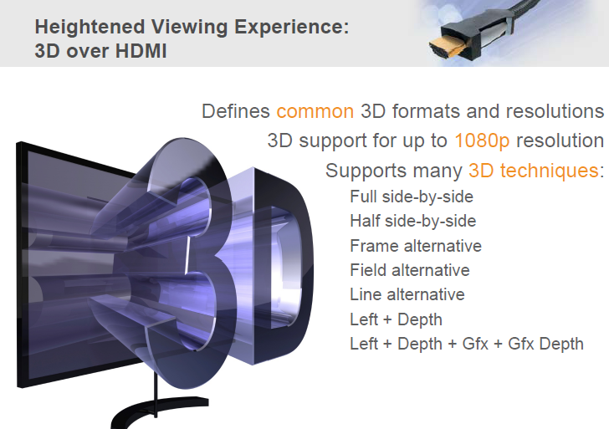
HDMI 1.4 Requirements 3D Support

Slide 7
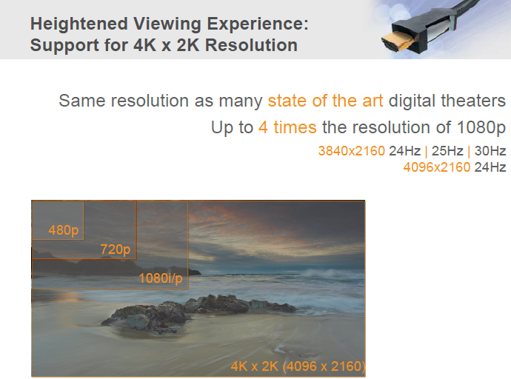
HDMI 1.4 Requirements 4K x 2K Support

Slide 8
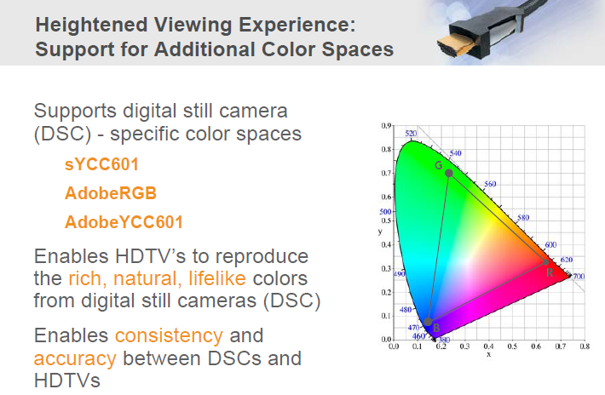
HDMI 1.4 Requirements 4K x 2K Support

Slide 9
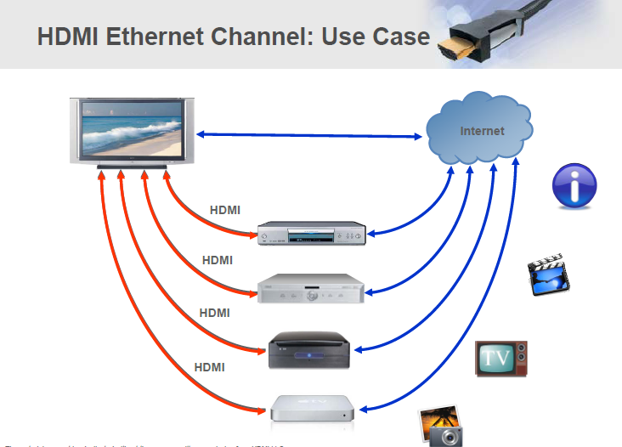
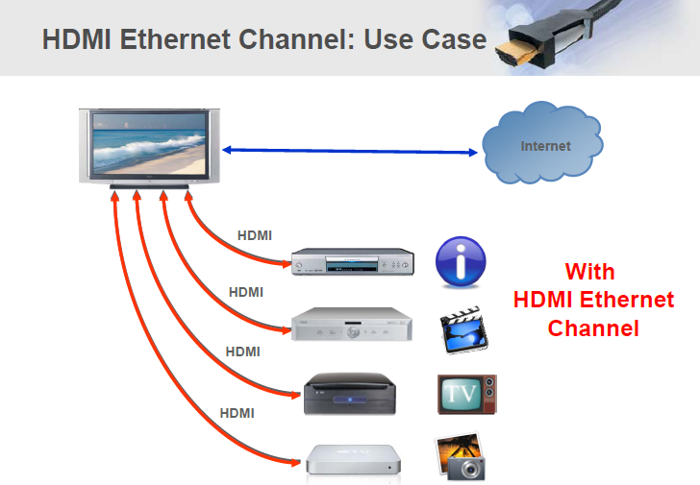
HDMI 1.4 Requirements Ethernet Channel

Slide 10
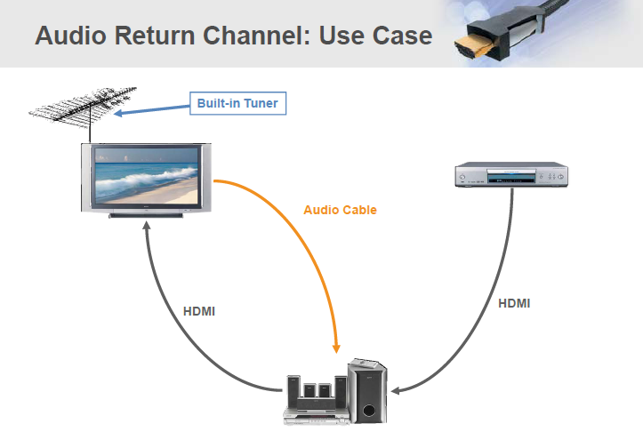
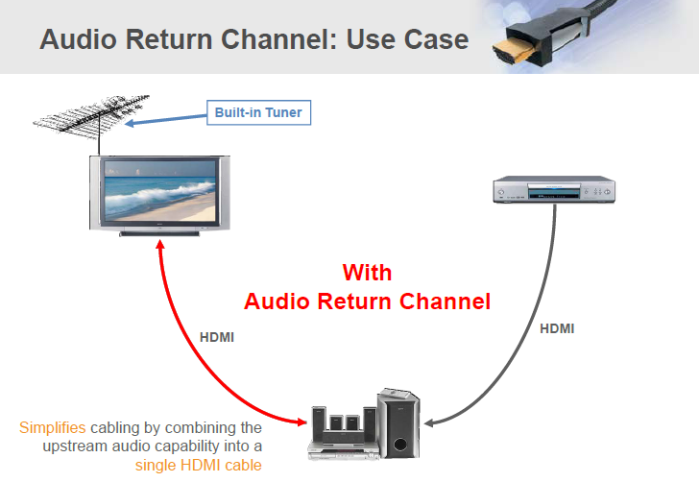
HDMI 1.4 Requirements Audio Return Channel

Slide 11
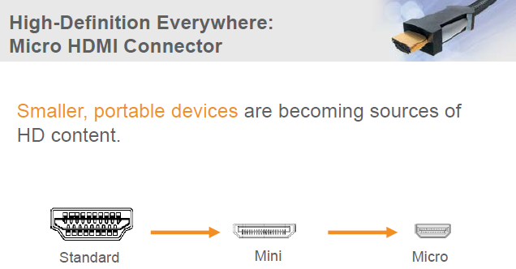
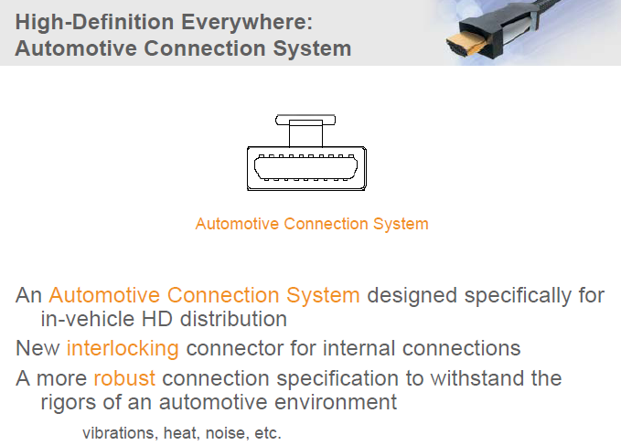
HDMI 1.4 Requirements New Connectors

Slide 12



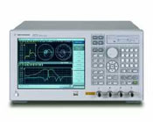
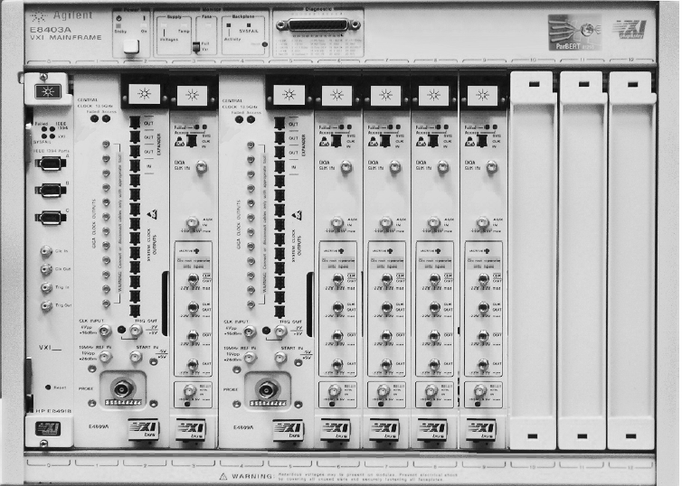
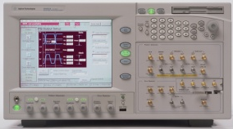
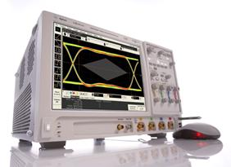
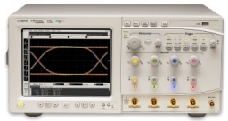
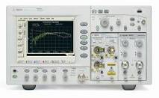
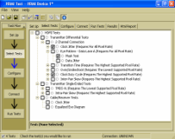


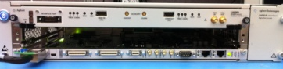
Agilent HDMI Total Solution Portfolio ~ From the Physical to the Protocol Layer ~
Source Test Solution
Media Test Solution
Sink Test Solution
Cables, PC Boards, Connectors
PC Monitor, HDTV, Repeaters
PC, DVD Players, Set Top Boxes, Chips
DSO90000/80000 Infiniium Real Time Oscilloscopes
E5071C Vector Network Analyzer
E4887A TMDS Signal Generator,
N4903B JBERT
86100C DCA-J Sampling Oscilloscope
E4887A Cable Emulator
DP Cable Emulator
N5399A HDMI Compliance Test SW
U7232A DisplayPort Compliance Test SW
W2641 DP fixture
N5990A Software
W2641 DP fixture
U4998A HDMI Protocol Compliance
N1080A TPA fixtures
U4998A HDMI Protocol Generator
N1080A TPA fixtures

Slide 13
Trends in HDMI
The Customer’s Challenge:
Ensure protocol compliance to the HDMI specification and receive product certification on the first pass at an Authorized Test Center (ATC)
HDMI Spec Speeds Increasing
Devices Incorporating HDMI Increasing
HDMI 1.4a
10110101…
HDMI Standard Features/Functionality Increasing
Increasing Interoperability Issues
1110101…
0100101…

Slide 14
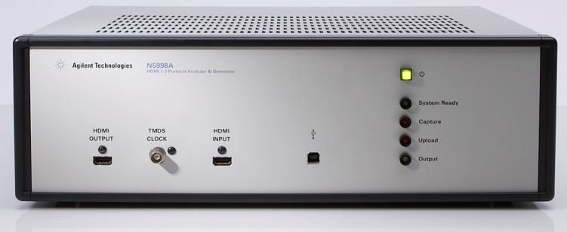

Change in HDMI Protocol Test Equipment Agilent U4998A HDMI PAG Replaces N5998A
N5998A PAG (DISCONTINUED)
Upgrades to 1.4a still available via N5998U
U4998A Module + U4002A Chassis
HDMI CTS recommends Agilent N5998A for HDMI protocol compliance test
N5998A discontinued in 2010 (custom part limitation)
Per HDMI CTS guidelines, Agilent designates U4998A HDMI PAG module as N5998A replacement for HDMI Compliance Test
Panasonic and Sony ATCs have evaluated, both products provide same results

Slide 15
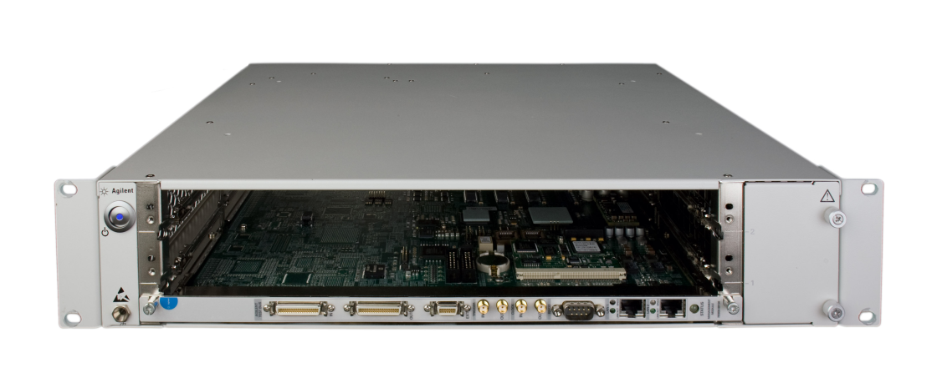
U4998A HDMI PAG Blade Runs In New Agilent AXIe Modular Platform
HDMI Module
PCI Express Module
Logic Analysis Module
Modular architecture
Mix and match different technologies for full system view
Next generation chassis
2-slot and 5-slot chassis
Fast download speeds → up to 10 Gbps

Slide 16

Agilent HDMI PAG U4998A
N4998A System Reference Price
Starting at: US$58,967
HDMI CERTIFICATION: Replacement for CTS recommended N5998A
PERFORMANCE: Highest performance HDMI PAG available (3.4 Gbps)
GENERATION: Flexible pattern generation for extended testing
Notes:
16
16

Slide 17
HDMI CTS Certified
CTS Recommended Test Equipment for Protocol Compliance Test
(replacement for N5998A)
Source Tests
7-16 through 7-19, 7-23 through 7-38, and 7-40
Sink Tests
8-16, 8-21, 8-23, 8-29, 8-31, and in conjunction with the Agilent E4887A TMDS Signal Generator through test 8-25.

Slide 18
Performance
Complete coverage of HDMI speeds: 3.4 Gbps…
4kx2k Source /Sink Protocol Test
Supports all four 4kx2k video formats defined in HDMI 1.4a (2.97 Gbps)
Recommended test equipment for 4k x2k is currently TBD
16-bit Deep Color Source Protocol Test
Supports full HD (1920x1080p 50/60 Hz) 16-bit deep color
CTS 1.4a only tests 12-bit deep color

Slide 19
Generation
More margin, more confidence…
Flexible pattern generation for sink testing
3-D generation
Top-and-bottom
Side-by-side (half)
Frame-packing

Slide 20


Agilent HDMI PAG Comparison
 | N5998A HDMI PAG | U4998A HDMI PAG
HDMI Spec Support | HDMI 1.4a (via upgrade) | HDMI 1.4a
Measurement Modes | Capture Compliance Generation | Capture Compliance Generation Passive Monitoring (via option)
Max Data Rate | 2.25 Gbps | 3.4 Gbps
4k x 2k, VIC 63 & 64 Support | No | Yes
Frequency Counter | Requires external frequency counter | Automatic frequency detection
Hot Plug Detect | No | Yes
Remote programming via COM | Yes | Yes
Host PC Connection | USB | PCIe
Host PC Operating System | Windows XP | Windows 7
Notes:
20
20

Slide 21
U4998A/U4998U New Features: Four Test Modes
1) Capture (Analyzer) Mode
(Compliance Test for Source DUT)
Standard Features of U4998A
2) Generator Mode
(Compliance Test for Sink DUT)
EDID
EDID
DDC
U4998A
U4998A
TMDS
TMDS
Same as N5998A
Same as N5998A
Source DUT
Sink DUT
Capture
Source DUT reads U4998A’s EDID
No EDID communication
(U4998A doesn’t read EDID of Sink)
New!
Available with option U4998U-PSV
New!
3) Pass-through Mode
(Debug for Source and Sink)
4) Mirror Mode
(Compliance Test for Source DUT)
EDID
EDID
DDC
DDC
U4998A
U4998A
Source DUT
TMDS
Source DUT
TMDS
Capture
Sink DUT
Capture
Sink (not DUT,
simply monitoring)
Source DUT reads Sink’s EDID
Source DUT reads U4998A’s EDID

Slide 22
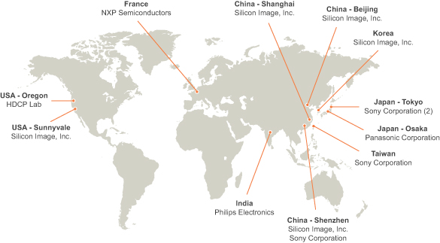
M5998A/U4998A uses in every ATC

Slide 23
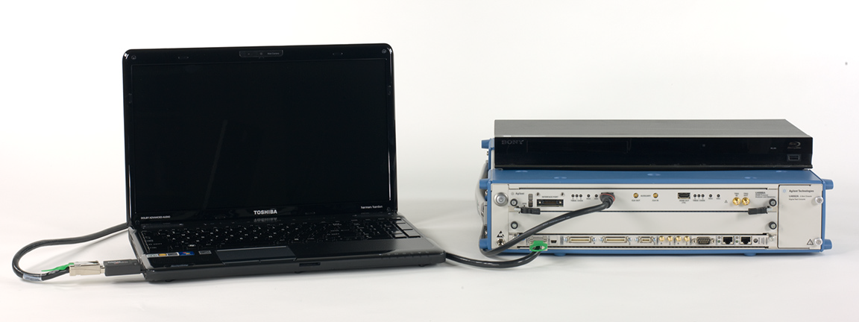
HDMI System Example Configuration
1
Measurement Module
DUT (DVD Player) with customer supplied HDMI cable
Compatible Host PC with PCIe adapter and cable
Agilent U4002A
AXIe Chassis
3
2

Slide 24
U4998A HDMI PAG
Key Applications
Compliance Test
Image Generation
Debugging
Introduce your product, with photo, price, key app, and CPL date. You will likely have more than one slide for the product.
(this is an example)
CPL Date: Available Now (requires pass code)
HDMI CTS compliance test equipment
Model | Includes | US Reference Price
U4998A | HDMI 1.4a capture, compliance, generator, with 4 GB memory depth | $51,020

Slide 25
U4998A HDMI PAG System Configuration
HDMI System Components | Quantity | Model Number/Description | Reference Price
1. Measurement Module | 1 | U4998A HDMI Protocol Analyzer/Generator (PAG) Module Includes HDMI 1.4a support, Capture/Compliance, Generator, 4GB memory U4998U HDMI PAG Module Upgrades U4998A-PSV (Passive Monitoring) | $51,020 $2,910
2. Agilent Modular Chassis | Select one | Recommended (tested and shipping) U4002A 2-slot AMP chassis (PCI Express connection) Compatible (shipping in April 2011) M9502A 2-slot Agilent AXIe chassis (PCI Express connection) M9505A 5-slot Agilent AXIe chassis (PCI Express connection) | $7,275 $7,274 $9,602
3. Compatible controllers, PCIe adapters, and cables | Select Embedded Controller OR use compatible Host PC with appropriate PCIe adapter and cable for selected controller | Embedded Controller TBD For a Laptop or Desktop PC connected to U4002A chassis U4002A-EXP: Card adapter for laptop connections U4002A-SLT: Slot adapter for desktop connections U4002A-2MC: PCIe cable (2.0m) U4002A-5MC: PCIe cable (5.0m) For a Laptop PC connected to M950XA chassis M9045A PCIe ExpressCard adaptor: Gen 1 Y1200A PCIe cable: x4 to x8, 2.0m For a Desktop PC connected to M950XA chassis M9047A PCIe desktop PC adapter: Gen2, x8 Y1202A PCIe cable: x8, 2.0m | TBD Varies $432 $432 $240 $432 Varies $287 $191 Varies $321 $239

Slide 26

Q and A Session

