Slide 1
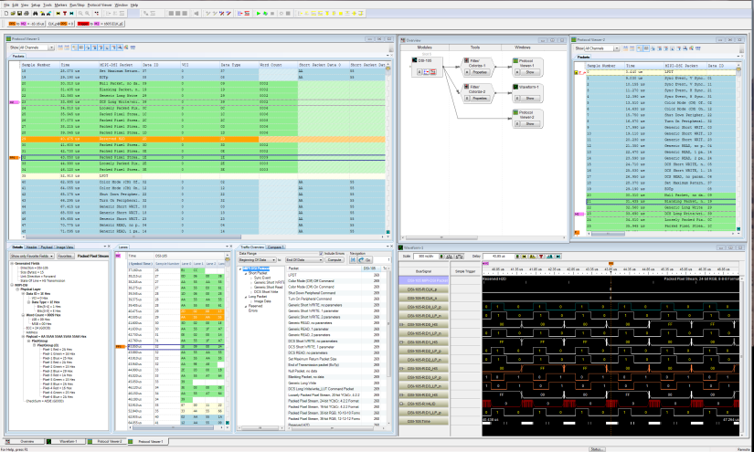
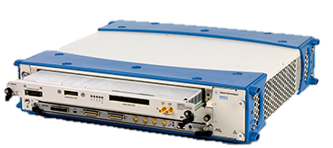

U4421A MIPI D-PHY (CSI-2/DSI)
Protocol Exerciser and Analyzer
Bring your CSI-2 and DSI-1 designs to market faster –
with complete confidence

Slide 2






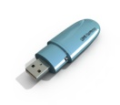
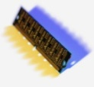

Mobile Computing
Architecture
Support
Planned
I/O
Currently
Supported
DPHY
DPHY
CSI
DSI
Application Processor
Application Processors (SoC)
ARM (ex: Nomadik), Intel XMM, Snapdragon
MIPI Buses
CSI, DSI, DigRF, LLI, UFS, UniPro
Standard Buses
Memory: LPDDR2, DDR3
Display: PCIe 2.0, HDMI, MHL
I/O: USB2, USB3, Ethernet, audio
Control: I2S, I2C, SPI
Cellular: LTE, HSPA, WCDMA, etc.
UFS
LPDDR
MPHY
CSI
Co-processor
MPHY
DSI
LLI
Modem/
BBIC
DigRF
RFIC
Notes:
Let’s take a look at where MIPI D-PHY fits into the mobile computing architecture. For such a small footprint, there are many devices inside of these mobile computing designs.
There are busses for memory, displays, cameras, I/O and digital RF data. MIPI plays a central role. There are two physical layers in MIPI – D-PHY and M-PHY.
D-PHY is the more mature standard. The standard has expanded to allow data rates to 1.5 Gbs per lane, and up to 4 lanes. It combines a differential “high speed” signaling scheme with a single-ended “low-power” signal, in the same pins. It has a relatively small footprint, and uses battery power efficiently.
M-PHY is the emerging standard. It is purely differential, allows data rates up to 6 Gbs, with room to grow and has a smaller footprint.

Slide 3

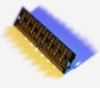


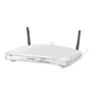
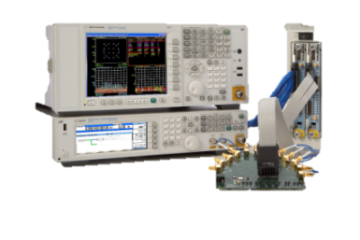
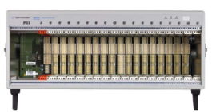
Agilent’s MIPI Solutions
Application
Protocol
Standard
CSI-2
camera
Interface
DSI-1
Display
Interface
DigRF
v3
DigRF
v4
CSI-3
DSI-2
UFS
LLI
UniPro
Physical
Standard
D-PHY
M-PHY
Current
Solutions
NEW!
U4421A
New PXI Solution
Coming Soon
Protocol
Solution Planned
Notes:
Agilent is taking a company-wide approach to mobile computing, in general; and MIPI , in particular. We have physical layer transmitter and receiver test solutions with scopes and BERTs; and we even have an existing analysis solution for lower-speed MIPI D-PHY.
The U4421A exerciser/analyzer is designed to test the protocol layers of CSI-2, the camera serial interface, and DSI, the display serial interface. There can be multiple CSI and DSI busses in a single design to accommodate multiple camera and multiple display systems. These busses need to be tested together as a system, and our modular approach allows this.

Slide 4
Agilent U4421A MIPI D-PHY
Protocol Exerciser/Analyzer
Two instruments in one module
Opt 601
MIPI D-PHY Analyzer
See ALL system behavior
Opt 602 MIPI D-PHY Exerciser
Characterize and Optimize
Fully protocol-aware
Performance for today and tomorrow
  Up to 1.5Gb data rate
  Up to 16GB trace depth
  1-4 data channels + CLK
“Raw” view of state traffic for additional insight
Flexible probing options
Integrated image extraction
Generate user-defined D-PHY traffic
Change speed, slew rate, voltage levels and lane skew
Flexible pattern creation
GUI
Packet inserter
Image inserter
High-bandwidth SMA cables
Notes:
What makes the U4421A a good option for your lab? It is two instruments in one – a fully protocol-aware D-PHY analyzer that gives deep insight into system behavior, as well as robust exerciser that allows you to characterize and optimize your designs.
Both the exerciser and analyzer support the full 1.5 Gbs data rate across 4 lanes, and share up to 16 GB of memory (This is 2-5 orders of magnitudes more than existing options).
Unlike competitive D-PHY solutions, the analyzer is a true protocol analyzer. Triggers, filters, storage qualification – everything is protocol aware.
There’s another analysis feature that you will love. Agilent’s design is built on the same state machine that is used for our PCI Express Gen 3 analyzer. Bus states are oversampled at 5ns intervals. You can opt to keep this “raw” data, and display it in a waveform or lister view to get insight into the “why” behind your protocol. More on that in a few slides.
You will also appreciate how the exerciser allows you to change a wide variety of signal parameters; and how it enables “end to end” analysis of how your system handles image data.

Slide 5
Why is Agilent introducing a new D-PHY tool?
Keep up with your latest-generation designs
Cover needs for all D-PHY based designs
Provides an upgrade path to M-PHY
To help reduce your debug time by giving you additional insight
Correlate busses across your design
View state timing relationships with Raw Mode
Isolate and identify events of interest with protocol-aware triggers, filters, storage qualification, and coloring.
Help optimize your image and video-intensive designs
10x to 10,000x deeper memory than other options
End-to-end image analysis
Allow you to optimize your design
Change signal and lane parameters with exerciser
Traffic overviews that let you see broader traffic patterns
Notes:
As I mentioned, we have an existing D-PHY analyzer. So why create a new tool, and why this design?
First, it maintains pace with the growth of the D-PHY spec, which was originally conceived as a gateway to the M-PHY spec. By increasing the data rates and lane counts, the life of D-PHY is extended. The spec and physical layer designs are stable, which is important to getting to market quickly. The performance specifications have been expanded to allow up to 6 Gbs in the 4-lane configuration. We needed a product to handle the new D-PHY needs, and to provide an upgrade path to M-PHY.
Second, the AXIe-based approach gives you better insight into these designs. It is much easier to correlate multiple devices (including multiple CSI and DSI busses, DDR, PCIe, and HDMI) in a single mainframe, new features like Raw Mode give you more insight than a simple protocol view.
Third, this architecture is growing to meet the needs of engineers who are adding more image and video traffic to their designs. It has orders of magnitude more memory than our current or competitors’ logic-analyzer-based approaches. Image insertion/extraction software allows you to generate and view image traffic throughout your design.
Finally, the new exerciser makes it even easier for you to optimize your designs by giving you a high-level view system traffic; and by allowing you to change signal and lane timing characteristics. This capability lets you test your system under different operating conditions, and discover ways to make it more energy efficient – which is critical in battery-powered designs.

Slide 6
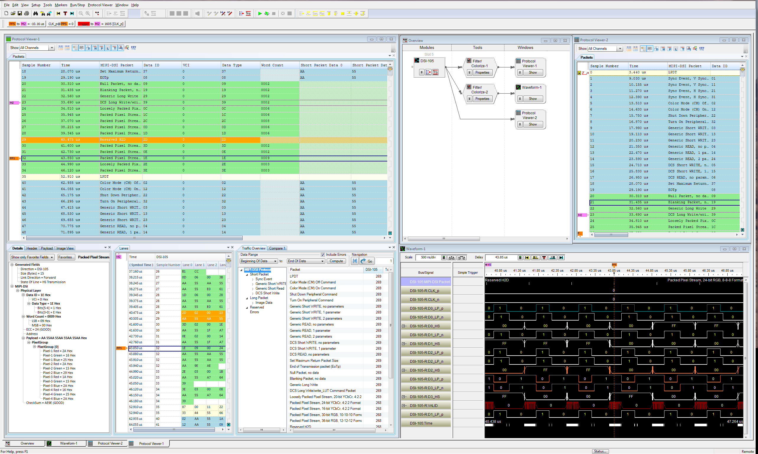
Analyzer display
Unfiltered
Protocol
Filtered Protocol
Time-correlate to other windows with markers or link windows
Configuration
Packet details
Lane view
Traffic Overview
“Raw Data”
Notes:
Let’s take a closer look at some of the features that we think you will love:
Let’s start with the analyzer display. It is flexible and functional. In this display we see:
The configuration window, which is where we set up views, filters, and time-correlation
Two protocol views – one is unfiltered and one has filters to color-code certain packets and hide others.
Our hottest new feature, Raw Mode, presented as a timing waveform
Three of the dockable packet information tabs, including packet details, a view into each lane, and a high-level overview that shows the hit rate of different types of traffic and allows navigation from one occurrence to the next.
All these views can be time correlated with markers or by locking the windows together.

Slide 7
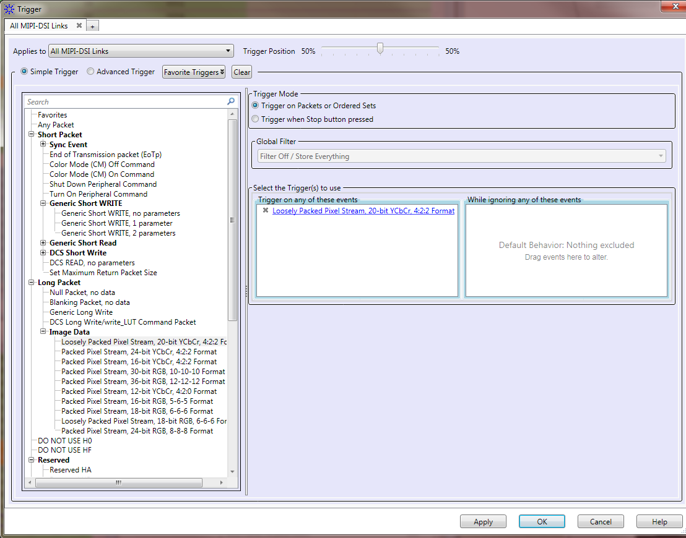
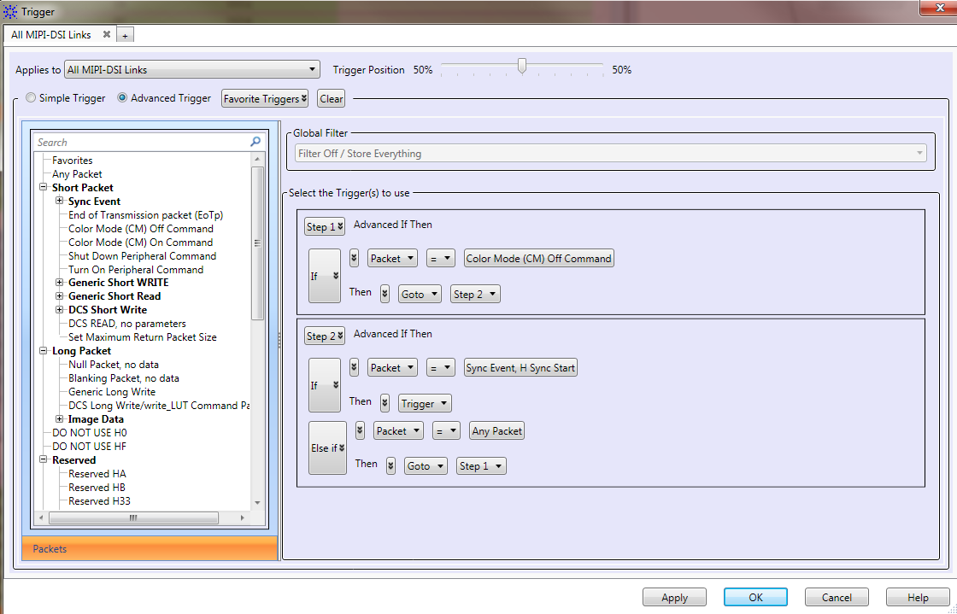
Trigger Capabilities
Simple (drag & drop)
Sequence (if-then-else)
  Customizable packet-level macros
    Edit at a bit level
    Trigger up to 4 bytes into payload
  Up to 8 sequence levels
    N-way logical branching
    Counters, timers, and flags supported in trigger sequencer
  Triggering on errors
Notes:
There are two types of triggers
Simple drag and drop triggers – just drag one of more than 70 packet macros to the trigger box, and click on the hyperlink to customize, if necessary.
Sequence triggers expand upon the simple trigger use model by allowing users to branch in any direction among 8 unique sequence states. Counters, timers, and flags make these triggers even more powerful.

Slide 8
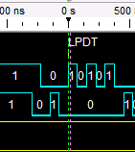
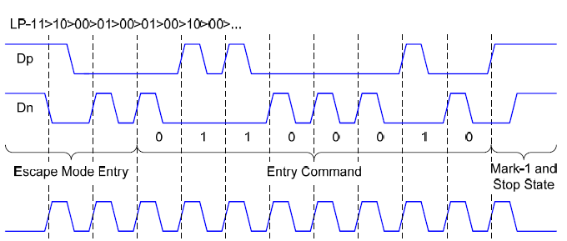
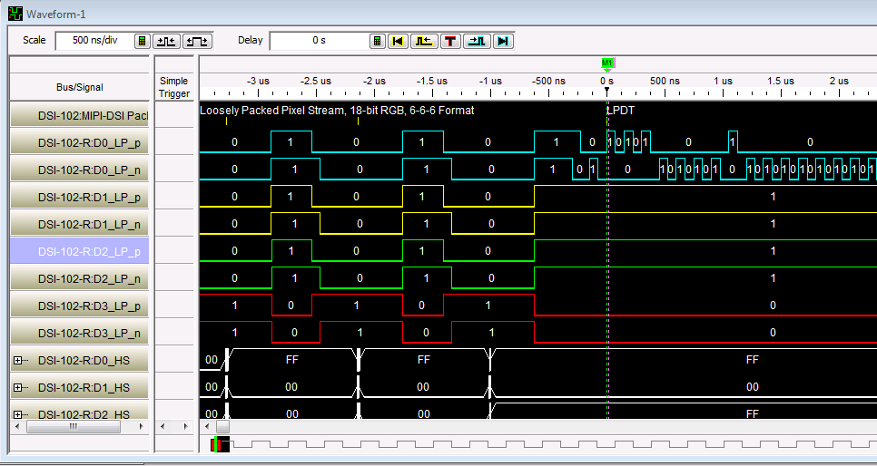
Raw Mode – Verifying Escape Mode
Go beyond “what?” to “why?”
Notes:
Let’s go back to Raw Mode, by diving into a specific case.
Raw mode gives you deeper insight than protocol alone. You can go beyond the “what” of D-PHY to the “why”.
As we discussed earlier, MIPI D-PHY supports two types of traffic – High Speed and Low Power. So how does the system know to switch between the two modes?
The box in the upper left corner shows the Escape Mode sequence from the D-PHY standard. A data lane “n” line drops from high to low, followed by the “p” line dropping during the next clock. The n line then asserts itself for one clock cycle. The next 8 bits are identified as either ones, when the p line is asserted, or zeroes, when the n line is asserted. These 8 bits constitute the entry command for when LP mode is entered.
Below the timing diagram we see what this traffic looks like in a working system. We’re triggering on any Low Power Data Transition. We can see in the exploded view to the upper right that the captured sequence behaves exactly as expected from the spec.

Slide 9

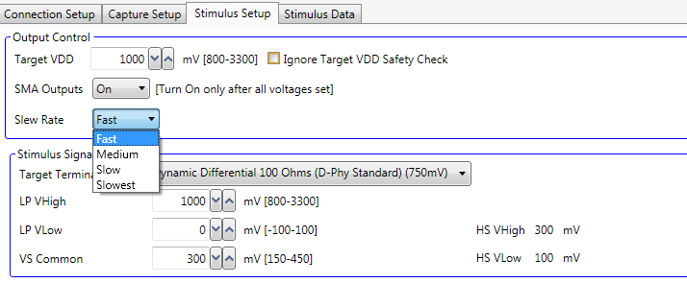
Exerciser parametric control
Enables physical characterization and performance optimization
  Data Rate
  Low Power Mode Voltage (High & Low)
  High Speed Mode Voltage (High, Low is calculated automatically)
  Slew Rate (Fast, Medium, Slow, Slowest)
  Lane Skew
Notes:
The U4421A offers significant control over output signals. Users can control:
Data rate
Low Power and High Speed voltages
Slew Rate, and
Lane-to-lane skew
This flexibility gives designers an extensive toolkit for optimizing performance.

Slide 10
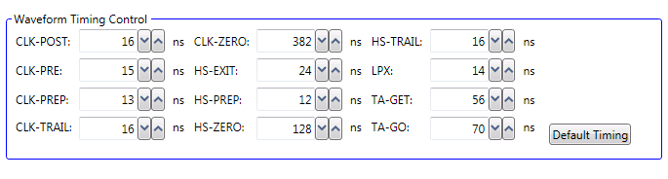
U4421A : Waveform Timing Controls
  Parametric Control of Signal Timing relationships
    Low Power Mode switching
    Turnaround Timing control
    Standby State control
  Values can be automatically calculated or manually modified
Notes:
It is also possible to precisely control protocol timing relationships, including switching and turnaround timing. This helps you tune waveforms to meet changes in the spec, and lets you see the impact of design variances.
These, like all other exerciser parameters, can be adjusted programmatically, allowing you to design powerful automated test suites

Slide 11
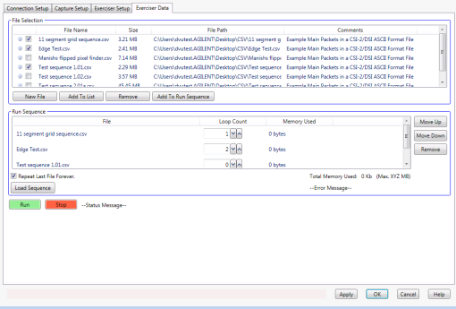
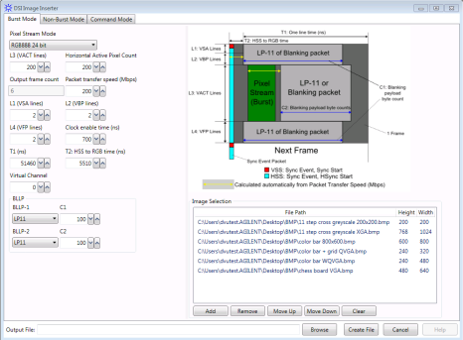

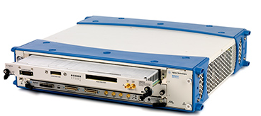

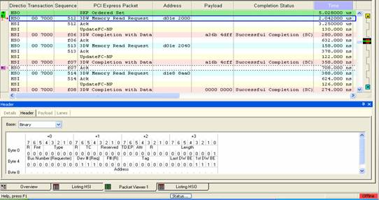
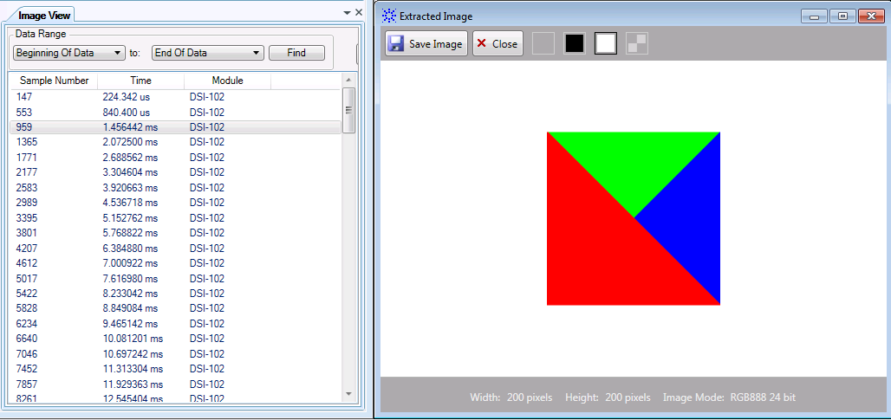
End-to-end analysis of image traffic
Image Insertion (opt 001)
Stimulus to display
MIPI
D-PHY DSI
Image Extraction (opt 003)
Direct or internal loopback
Notes:
The optional image inserter and extractor packages make it easy to perform end-to-end image analysis.
These tools make it possible to:
Take source images,
Convert them to stimulus vectors,
Send them to a target, and use the Image Extractor software as a “golden receiver” to:
Verify what they sent with internal loopback, or
Probe the bus and verify the bus return
Image traffic is the foundation of the MIPI bus, and these tools simplify the task greatly.

Slide 12
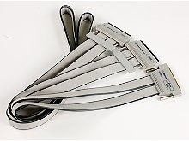
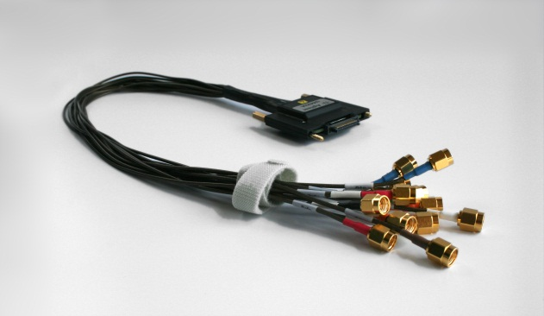
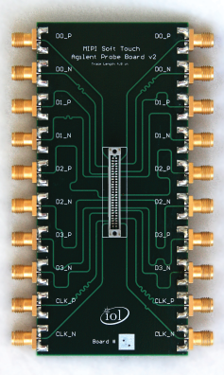
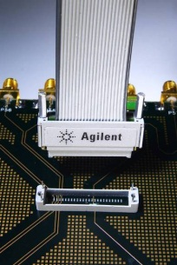
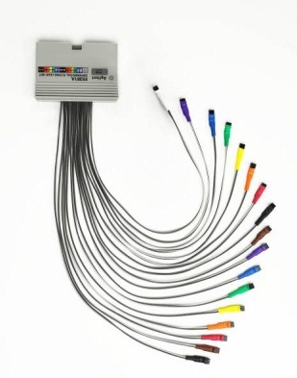
Flexible probing options
D-PHY Analyzer
D-PHY Exerciser
U4201A Logic Analyzer cable
U4422A SMA harness
E5405A Soft Touch Pro Probe
E5381A
Differential
Flying Leads
UNH-IOL Breakout Board (TBA)
Notes:
One of the most challenging aspects of debugging high-speed busses is accessing signals without intrusion. Agilent offers many flexible options.
These powerful analysis tools are useless if you cannot access your signals. No two companies do it in the same way – some have downstream customers who define their own connection schemes, others are opting to eliminate the debug board stage of design, choosing to debug production boards. Agilent’s probing solutions are flexible enough to meet your needs.
The exerciser’s 50Ω connection is delivered with the U4422A SMA harness. Most test boards have SMA designed in for signal insertion, and those that don’t usually have something, like SMP or RF connectors that can be easily adapted to SMA.
The analyzer offers three options:
The Soft Touch Pro “connectorless” interface. An alignment bracket allows “pogo” pins on the probe to connect directly to pads on the board. Unused pads on this 40-pin configuration can be routed for other busses, even oscilloscopes using the N2887A InfiniiMax adapter.
The differential flying leads use one of three options, to connect directly to boards, traces, and vias. The 82Ω resistor option delivers full 1.5 Gbs data rates, the damped resister is the best for soldering directly to traces, and the 3-pin header combines flexibility and ruggedness.
The newest option is an SMA to Soft Touch breakout board that will be offered by UNH-IOL. This board combines the flexibility of cabling with a non-intrusive high-impedance connection. This board is also designed to connect directly to UNH-IOL’s popular termination board.

Slide 13
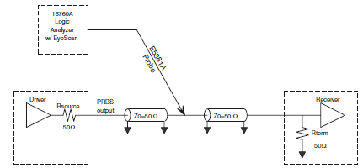
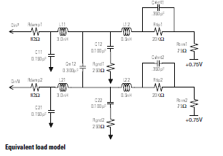
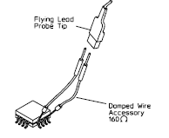
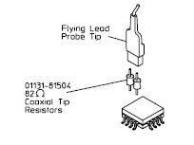
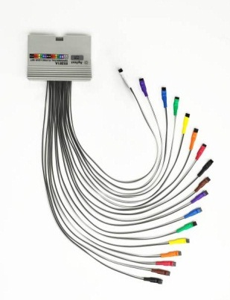
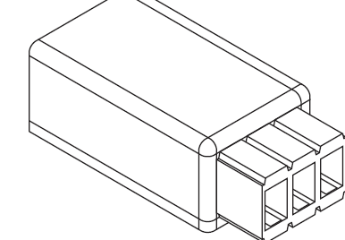
Differential flying lead options
Solder-in
(1.5 Gbs)
Damped wire
(1.0 Gbs)
3-pin header
(1.0 Gbs)

Slide 14
MIPI D-PHY Roadmap
 | Feb 2012 | Mar 2012 | Apr 2012 | May 2012 | Jun 2012 | Jul 2012 | Aug 2012 | Sept 2012 | Oct 2012
U4421A
Alpha Units
U4421A
Beta Units
U4421A
Shipments
Video
Extractor
Inserter (Q4)
Early Customer Engagements
VIP Engagements
Corporate
Price List
Public
Launch
Limited Release
Full Production Release
Notes:
This product is currently orderable, however the public introduction date is June 12th.
There is a limited ship release that will begin in late July. This LSR build will have final hardware. The software will be post-feature freeze, but will not be fully validated.
The final, production release is scheduled for early October.

Slide 15
Pricing – core options
Model | Description | Price
U4421A/ U4421U | Protocol test solution, MIPI D-PHY/ Protocol test solution, MIPI D-PHY upgrades | $ 20,000/ $0
601 | MIPI D-PHY Analyzer-only License | $ 15,000
602 | MIPI D-PHY Exerciser-only License | $ 10,000
603 | MIPI D-PHY Exerciser and Analyzer License | $ 22,500
402 | MIPI D-PHY 2 lanes | $ 2,000
404 | MIPI D-PHY 4 lanes | $ 4,000
M04 | Memory depth to 4 GB | $ 4,000
M16 | Memory depth to 16 GB | $ 10,000
701 | MIPI D-PHY Camera Serial Interface (CSI-2) license | $ 3,000
702 | MIPI D-PHY Display Serial Interface (DSI-1) license | $ 3,000
703 | MIPI D-PHY Camera Serial Interface (CSI-2) and Display Serial Interface (DSI-1) licenses. | $ 5,000
001 | MIPI D-PHY Image Extractor Package | $ 3,000
003 | MIPI D-PHY Image Inserter Package | $ 3,000
Notes:
This product is heavily optioned.
There are options to license the exerciser, analyzer, or both
There are options to license CSI, DSI, or both
There are lane options to expand from 1 to 2 or 4.
There are options to expand from 1GB to 4 or 16.
There are options to enable image insertion and extraction.
All options can be licensed post-purchase as well.

Slide 16
Pricing – probing and chassis
Model | Description | Price
U4201A | Logic analyzer cable (required for all analyzer probing options) | $ 2,200
E5405A | Probe, 17 channel, Soft Touch Pro, differential, connects to 90-pin LA cable [for analyzer] | $ 3,645
E5381A | Flying leads, 17 channel, differential, connects to 90-pin Logic Analyzer cable [for analyzer] | $ 3,482
reference | SMA to Soft Touch Pro breakout adapter [requires E5405A] | UNH-IOL
U4422A | SMA cable, MIPI D-PHY, 13 leads/1.5 Gbps [for exerciser] | $ 3,645
M9502A | 2 slot chassis | $ 7,499
M9505A | 5 slot chassis | $ 9,900
M9536A | Embedded Controller PC module (fills one slot) | $ 8,900
M9045B | ExpressCard adapter | $ 340
M9047A | PCIe Desktop adapter | $ 334
Y1200B | PCIe cable (8121-2057) (x4 to x8) | $ 199
Y1202A | PCIe cable (8121-2056) (x8 to x8) | $ 249
Also required: customer-supplied clock source (33250A is recommended)
Notes:
Configuration requirements also include:
Selecting a chassis. There are two and five-slot options. Three busses (some can be multi-slot) can be configured in a five-slot frame. – and
A method of connecting to a PC. This can be done by purchasing an M5436A embedded controller module, or by using PCI Express adapters to an external PC. USB control is also on our software roadmap.
Users must also configure their probing selections. All analysis probing options require the U4201A logic analyzer cable.

Slide 17
Agilent U4421A MIPI D-PHY
Protocol Exerciser/Analyzer
Two instruments in one module
Opt 601
MIPI D-PHY Analyzer
See ALL system behavior
Opt 602 MIPI D-PHY Exerciser
Characterize and Optimize
Fully protocol-aware
Performance for today and tomorrow
  Up to 1.5Gb data rate
  Up to 16GB trace depth
  1/2/4 data channels + CLK
“Raw” view of state traffic for additional insight
Flexible probing options
Integrated image extraction
Generate user-defined D-PHY traffic
Change speed, slew rate, voltage levels and lane skew
Flexible pattern creation
GUI
Packet inserter
Image inserter
High-bandwidth SMA cables

Slide 18
Backup:
Benefits by Design Type

Slide 19
Target Customer – For Designers and Validators of:
Devices and embedded systems
Unmatched insight into cross-system behavior
Correlate across multiple busses (CSI, DSI, PCIe, DDR, and HDMI)
Isolate events in any single bus, or combination of busses
Simulate missing components
Analyze system timing and performance
Notes:
The U4421A addresses four key design types:
Devices and embedded systems,
Silicon and IP,
Displays, and
Cameras
All are focused on Designers and Validators. It is not focused on Manufacturing Test, outside of troubleshooting applications. This is because production mobile designs are typically not optimized for test. In many cases, the same feature appeals to multiple user groups, but in different ways.
Device and embedded system designers benefit from:
Our modular approach, which allows you to correlate multiple CSI and DSI busses, and even PCIe, DDR and HDMI
Powerful triggers, which lets you isolate specific events in your system.
The exerciser, which allows you to simulate components, like cameras, that may not be available at early stages of the design
And features like Raw Mode, which lets you drill down into protocol details and still go to higher levels of abstraction to understand overall system traffic composition

Slide 20
Target Customer – For Designers and Validators of:
Silicon/IP
Validate designs and solve customer integration problems
Deep protocol analysis, plus lane and raw views for physical layer insight.
Triggering that isolates complex events
Flexible probing options that let you connect to any of your customer’s targets
Deep memory to capture and simulate long periods of system interaction
Notes:
Silicon and IP designers benefit from:
The ability to look deeply into packets, including headers, payload on a lane-by-lane basis and raw states
Triggering that isolates complex events – even allowing you to trigger up to 4 bytes into the payload, which lets you create DNA-like markers for isolating different areas of the design
A number of flexible probing options so that you can interface to your customers’ targets, and
And deep memory, which allows you to capture and simulate long sequences of traffic – letting you get to the root of customer integration problems

Slide 21
Target Customer – For Designers and Validators of:
Displays
Simulate long bursts of traffic from devices with widely-varying signal characteristics
Up to 16 GB of stimulus memory for full-frame, high-definition images and videp
Change signal amplitude parameters including slew rate, HS voltages and LP voltages
Change signal timing parameters including data rate and lane skew.
Verify exerciser signals with “monitor” mode”, using the analyzer’s internal loopback
Notes:
Display designers benefit from:
Having up to 16GB of memory, which can allow a target to be stimulated with long periods of high-definition traffic
The ability to change signal parameters to simulate a wide variety of host processors, and
The integration of the exerciser and analyzer – you can internally monitor the stimulus that they send to the display

Slide 22
Target Customer – For Designers and Validators of:
Cameras
Unmatched insight into the protocol sent to host systems
Up to 16GB of memory allows the capture of complete high-resolution images and videos bursts
Extract images and compare them compare to the original objects.
Time-correlate to host system to debug interoperability issues
Notes:
Camera designers benefit from:
The ability of deep memory to capture long bursts of traffic
An optional image extractor to verify the expected image with a “golden” receiver, and
Correlation with the host processor to debug the interaction between the camera and the processor

