Slide 1
ATP FE Training
Session #5
PCIe Fundamentals and Winning Against LeCroy
Taku Furuta
US and Japan
Business Development Manager
Digital Debug Solution Division
Agilent Technologies

Slide 2
Agenda
  PCIe Fundamental/Agilent Solution Portfolio 60 min
  Competition vs. LeCroy 30 min
Page 2

Slide 3
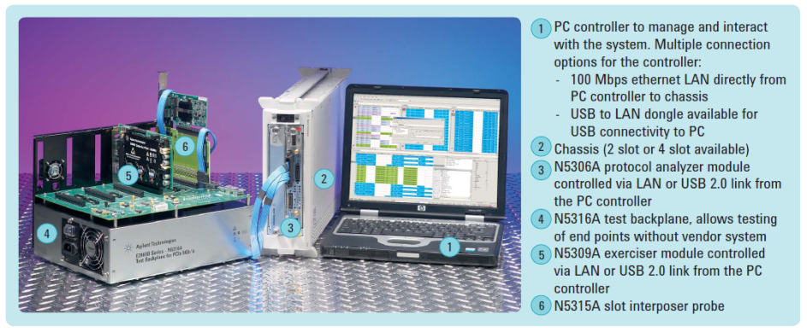
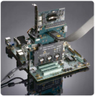
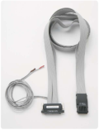
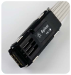
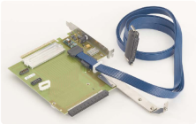
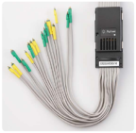
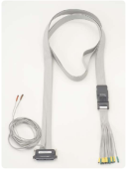
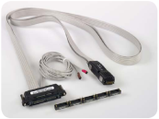


PCI Express Protocol Solution Portfolio (Gen1 & 2)
7
N5323A Jammer
N4241F Flying Lead Probe
N5328A Half Size Mid-Bus Probe
N4241A Mid-Bus Probe
N5315A Slot Interposer Probe
N4241Z ZIF Type Flying Lead Probe
Page 3
Notes:
3

Slide 4
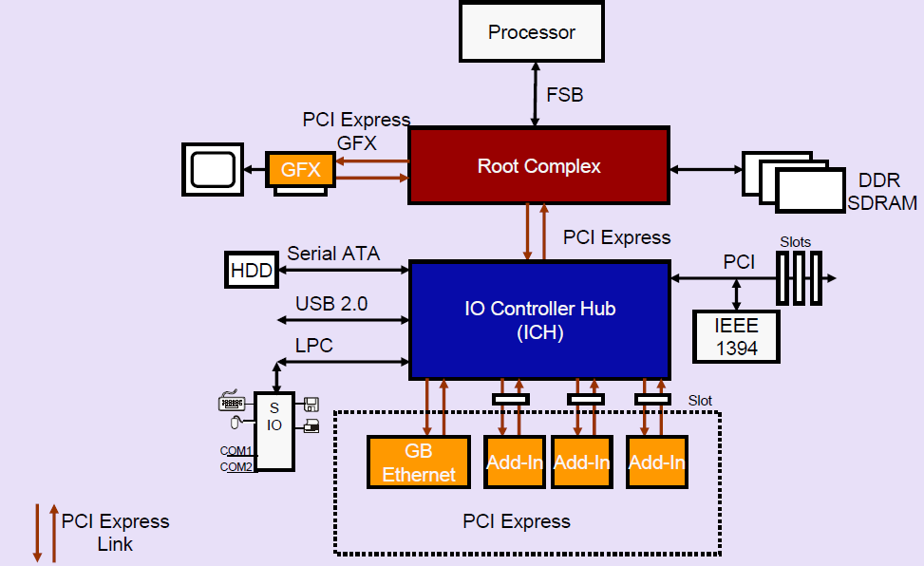
Basic System
Page 4

Slide 5
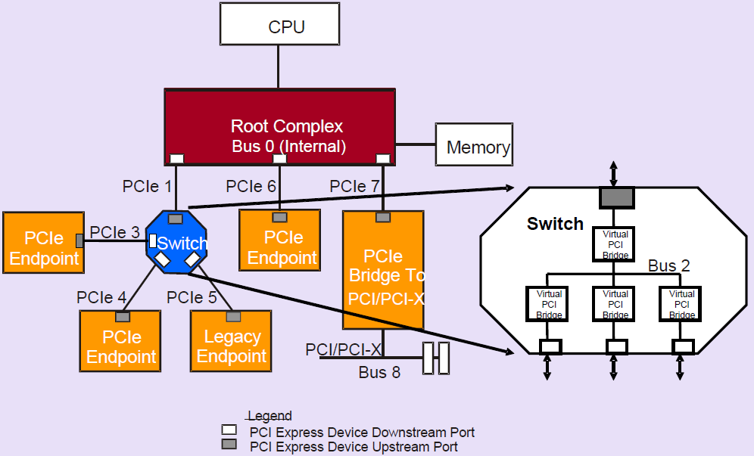
PCI Express Topology
Page 5

Slide 6
Signaling / Encoding of PCI Express
Feature | PCI Express Gen1 | PCI Express Gen2 | PCI Express Gen3
Signaling Rate | 2.5 GT/s | 5 GT/s | 8 GT/s
Encoding | 8b/10b | 8b/10b | 128b/130b
Effective Bandwidth | 2 GT/s | 4 GT/s | 7.99 GT/s
Bit Timing | 400 ps | 200 ps | 125 ps
Jitter Tolerance | 60 ps (?) | 44 ps | 14 ps
How effective bandwidth is calculated:
Gen1/Gen2: Signal rate x 8 /10
Gen3: Signal rate x 128 / 130
What is 8b10b encoding?
Degrades performance by 25%.
Encoding reasons:
  Ensures transition density for PLL, embedded clock.
  Balances 1s and 0s for DC balance.
  Allows encoding of K characters.
  Helps with detection of Tx errors.
Page 6

Slide 7
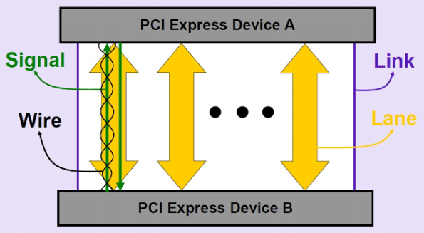
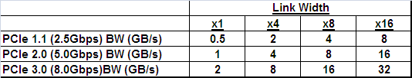
Link and Lane (Link Width)
Calculation formula: xxGpbs x 80% (8b10b) x 2 (bi-direction) / 8 (8 bits = 1 byte) x linkwidth (Gen1& 2)
Calculation formula: xxGpbs x 2 (bi-direction) / 8 (8 bits = 1 byte) x linkwidth (Gen3 = no 8b10b)
Page 7

Slide 8
Additional Features
*Bold blue font items will get addressed in this training
  Switches used to interconnect multiple devices
  Packet based protocol
  Same memory, IO and configuration address space as PCI – backward compatible
  PCI Express Transactions include:
    memory read/write
    memory read lock
    IO read/write
    configuration read/write
    message requests
  Data Integrity and Error Handling
  Quality of Service (QoS)
  Flow Control
  MSI style interrupt handling
  Advanced power management (ASPM (Active State Power Management))
  Hot Plug and Hot Swap support
  PCI compatible software model
Page 8

Slide 9
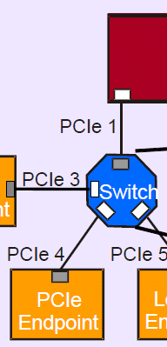
Layered Architecture: Packet Based Protocol
PCI Express Device Layers 1
System Software
  PCI compatible and extended configuration mechanism.
Extensions
RC
  PCI-like 32bit/64bit address load-store transaction semantics. End to end point packet.
  Provides reliable data transport services. Point to point (link base).
  Electrical interface and signaling mechanisms.
Transaction
Data Link
Physical
Mechanical
  Market segment specific form factors.
PCI Express Layering Enables Modularity, Reuse and Scalability
Page 9

Slide 10
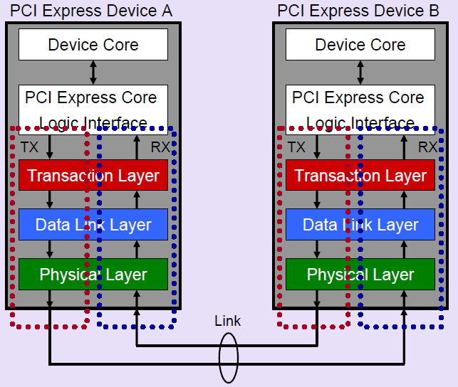
Layered Architecture: PCI Express Device Layers 2
→ Like OSI 7 Layer of Ethernet Protocol
TLP
DLLP
PHY
Page 10

Slide 11

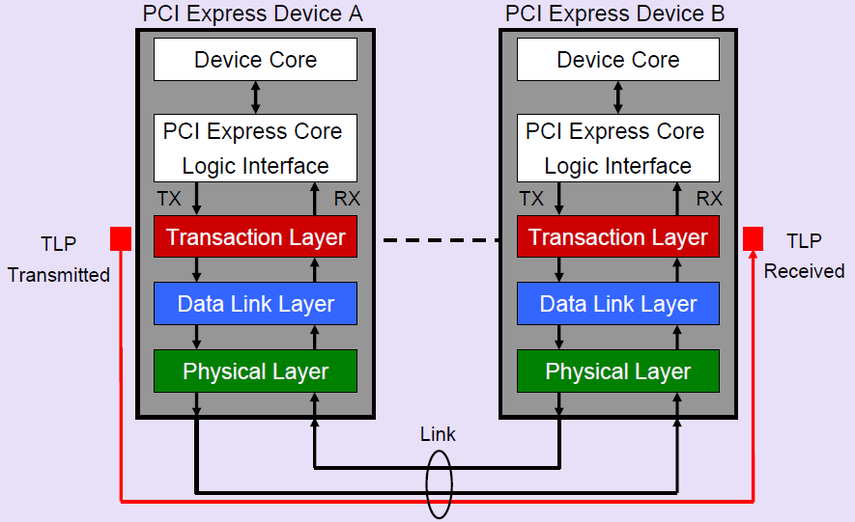
TLP Layer: TLP Origin and Destination
RC
Page 11

Slide 12
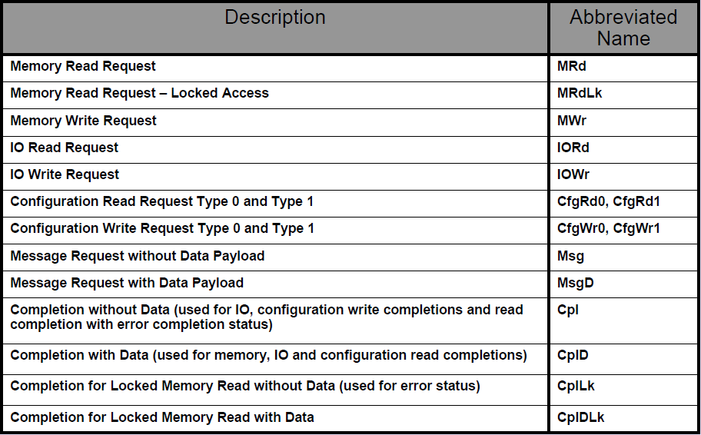
TLP Layer: PCI Express TLP Types = Only 13 of Them!
Page 12

Slide 13
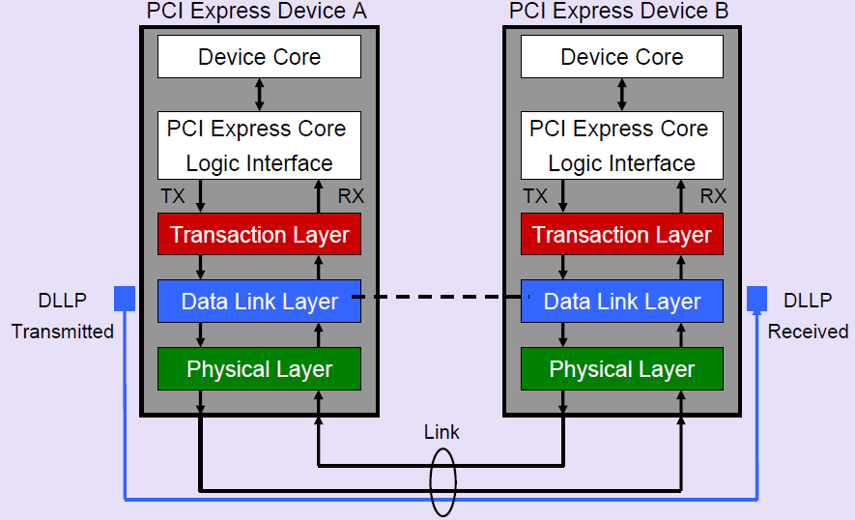

DLLP Layer: DLLP Origin and Destination
RC
Page 13

Slide 14

DLLP Layer: Responsibilities and Operation
  Primary is to assure the integrity of TLPs moving across the link (QoS = Flow Control, ACK/NACK)
  Tracking of link state and passing messages and status between Transaction and Physical layers.
  Exchanges traffic with neighboring port’s DLL using DLLPs.
  DLLPs start and end at the Data Link Layer of each device (point to point).
  DLLPs and TLPs are interleaved on the link.
Page 14

Slide 15
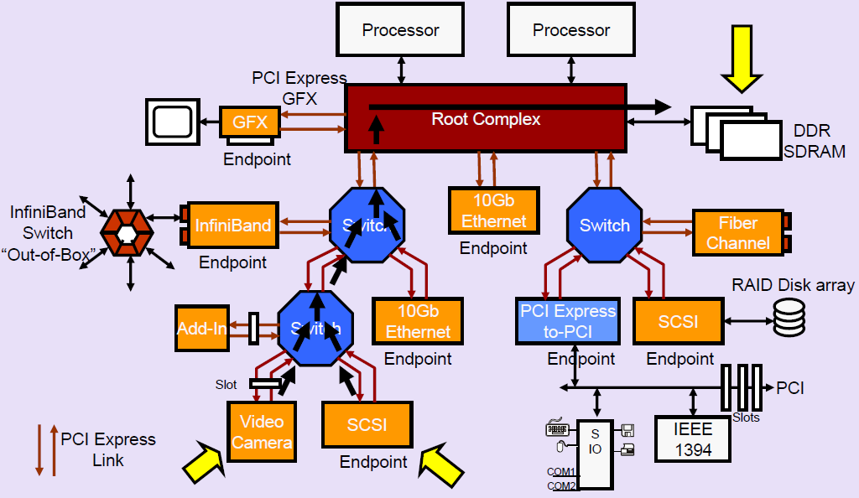
DLLP Layer: One of the Reason PCI Express is Successful:
Quality of Service (QoS)
Page 15

Slide 16
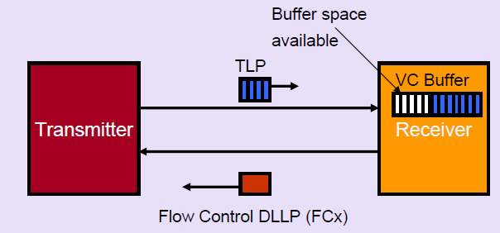
DLLP Layer: PCI Express QoS: Flow Control
Credit-based flow control is point-to-point based, not end-to-end.
Receiver sends Flow Control Packets (FCP) which are a type of DLLP (Data Link Layer Packet) to provide the transmitter with credits so that it can transmit packets to the receiver
Page 16

Slide 17
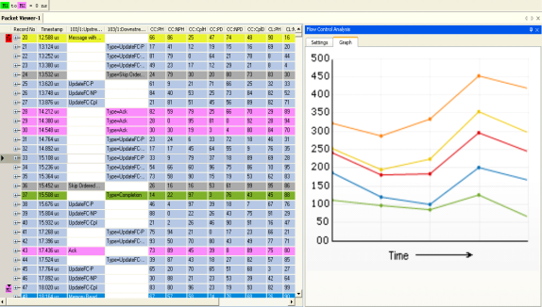
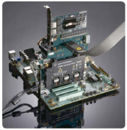
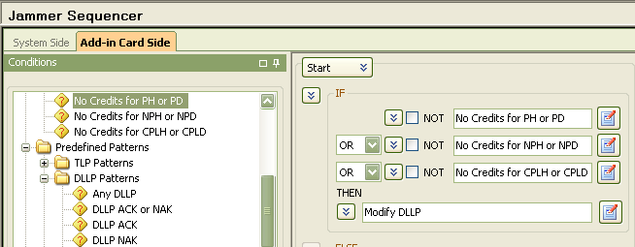

Agilent Solution: New Flow Control Analysis on N5306A Analyzer & N5323A Jammer To Create Error Condition
DM
Using Jammer, modifying the DLLP packet whenever it sees credit starvation
New Flow Control Analysis GUI
Page 17

Slide 18
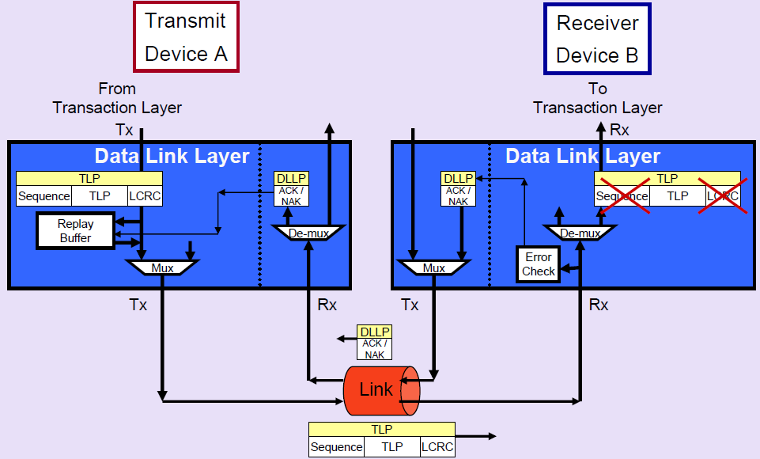
DLLP Layer: PCI Express QoS: ACK/NAK Protocol
Page 18

Slide 19
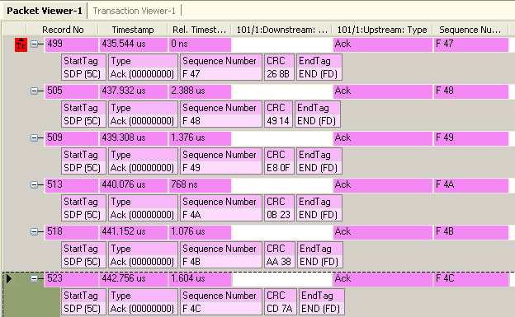

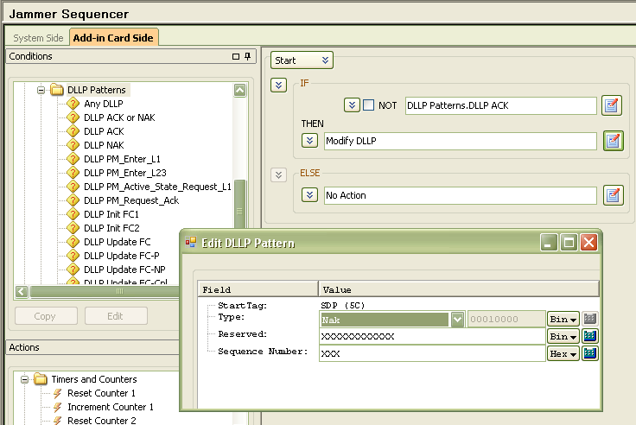

Agilent Solution: N5306A Analyzer and N5323A Jammer
DM
Filter out all except Ack packets
Changing Ack to Nak Using Jammer
Page 19

Slide 20
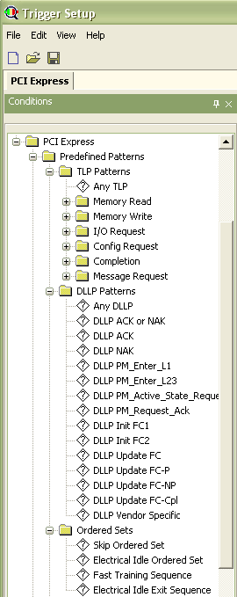
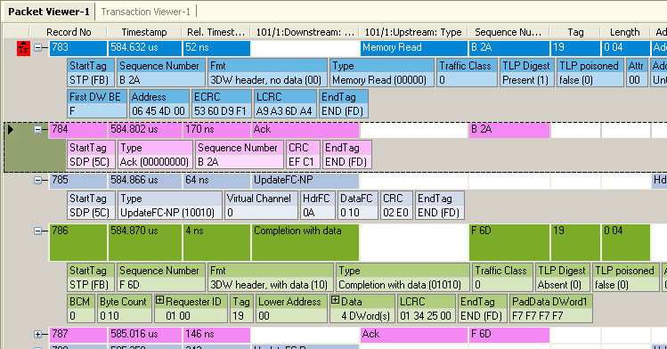
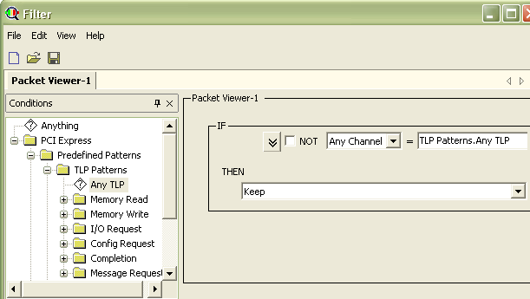
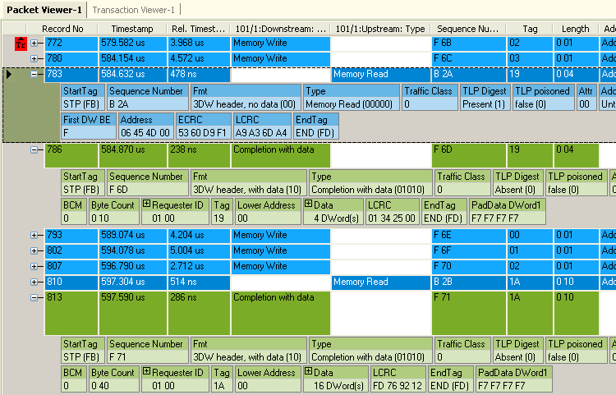
Agilent Solution: N5309A Analyzer
Trigger Screen and Packet Screen
DM
Page 20

Slide 21
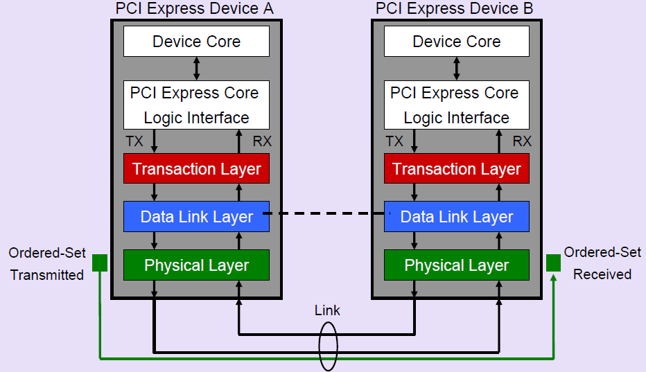
PHY Layer: Ordered-Set Origin and Destination
Page 21

Slide 22
Ordered-Set Structure
TS (Training Sequence) 1 and TS2 Ordered Sets
  Start with COM but contain D characters
Skip Ordered-Set
  Allows the receiver to compensate for differences in clock frequencies.
Electrical Idle Ordered Set
  Used to put link into Electrical Idle.
Electrical Idle Exit Ordered Set
  Used to put link out from Electrical Idle (L0s, L1, L2)
FTS (Fast Training Sequence) Ordered Set
  Fast training, used to bring the link from L0s to L0 state, i. e. back from Electrical Idle.
Page 22

Slide 23
Training Sequence
What gets Configured
DM Help file
Polarity Reversal
Up Stream Port
D+D- D+D-
  Link Width is established and set to the minimum width of the two devices.
  Link Data Rate.
  Polarity Inversion, if necessary.
    Alleviates the need to cross traces.
  Lane Reversal, if necessary.
    Alleviates the need to crossing of traces.
    NOT a required feature of the spec.
Link
D-D+ D-D+
Down Stream Port
Lane reversal
Up Stream Port
0 1 2 3 4 5 6 7
½ Link
7 6 5 4 3 2 1 0
Down Stream Port
Page 23

Slide 24
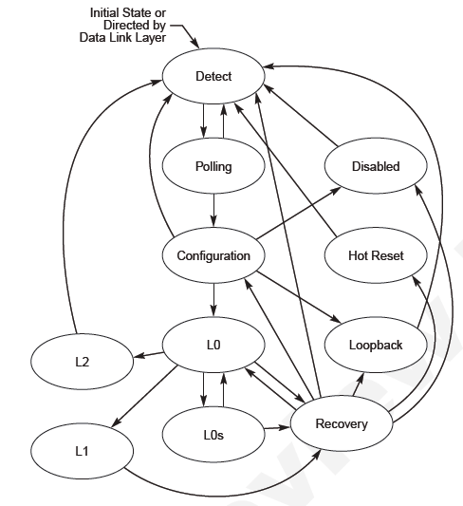
LTSSM (Link Training and Status State Machine) and
ASPM (Active State Power Management)
Normal Operation
Power Saving – Green!!
ASPM states
Important for Gen3
Page 24

Slide 25
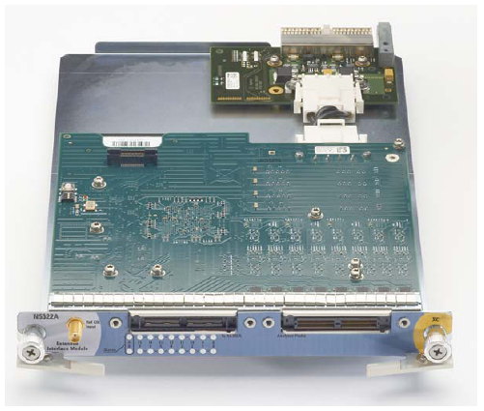

Agilent Solution: N5322A Extended Interface Module (ASPM Module)
Page 25

Slide 26
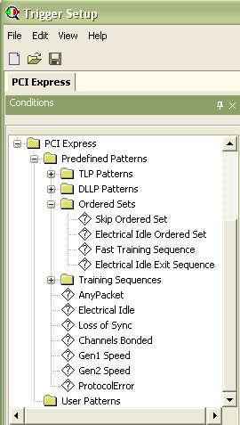
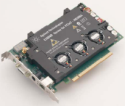
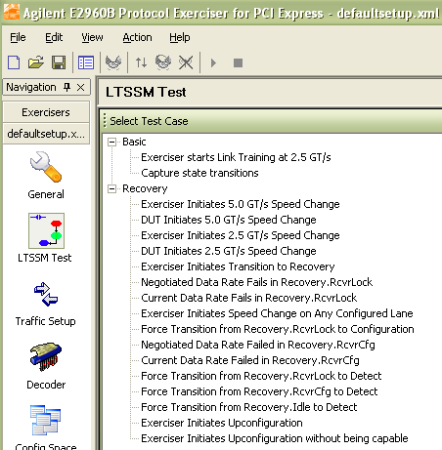
Agilent Solution: N5309A Exerciser LTSSM Feature & N5306A Analyzer Trigger Feature
DM
LTSSM Exercising GUI
from N5309A
Triggers associated with PHY layer for N5309A Analyzer
Page 26

Slide 27
Three Methods For Packet Routing
  Programmed I/O Transaction
  DMA Transaction
  Peer-to-Peer Transaction
Page 27

Slide 28
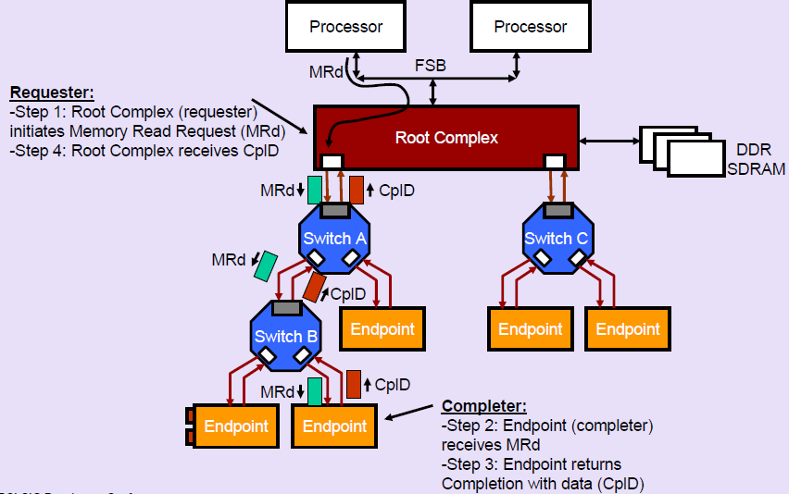
Programmed I/O Transaction
Page 28

Slide 29
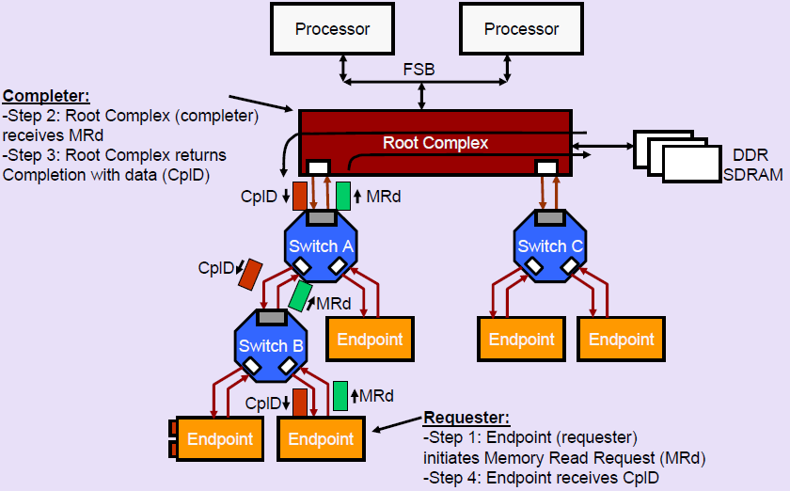
DMA Transaction
Page 29

Slide 30
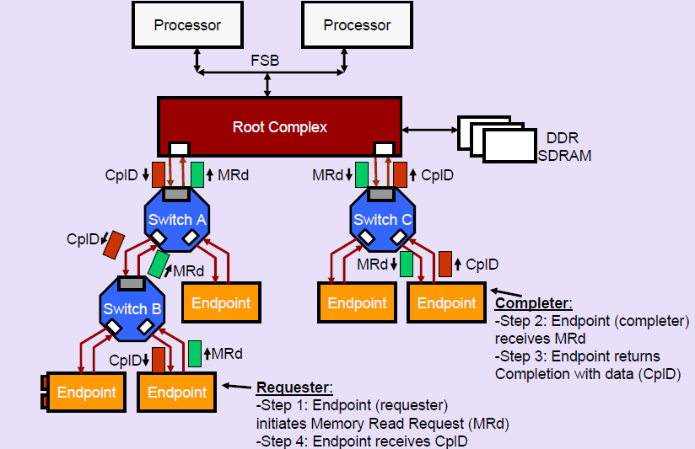
Peer-to-Peer Transaction
Page 30

Slide 31
Agenda
  PCIe Fundamental/Agilent Solution Portfolio 60 min
  Competition vs. LeCroy 30 min
    Competing against the analyzer
    Competing against the exerciser
    Competing against the discount
Page 31

Slide 32




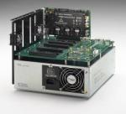
Where We Win: Agilent’s Strength
  Analyzer
    Better probing / Superior signal integrity
    More protocol specific predefined trigger
    New and advanced flow control analysis solution
    x16 solution configurable to use in two x8 analyzer systems
  Exerciser
    Industry’s standard form factor
    4 in 1 solution (LTSSM, EP emulation, RC emulation, PTC (protocol test card))
    >170 additional PCI SIG recommended tests beyond required PTC (13 tests) tests.
  Jammer: Agilent is the Industry’s only solution provider
  Backplane: Jammer: Agilent is the Industry’s only solution provider
  No annual SW maintenance fee
N5315A Slot Interposer Probe
Need updates
N4241Z ZIF Flying Lead Probe
N5323A Jammer
N5316A Backplane
Page 32

Slide 33
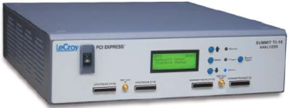
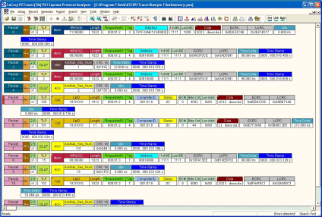

Competing LeCroy with the Analyzer opportunity
LeCroy: 5 Steps Offensive Approach
  CATC View
  LTSSM (Link Training and Status State Machine) Viewer
  Flow Control Analysis
  ASPM (Active State Power Management)
  Data Saving Time
  …
  and Discount!
Need updates
Page 33

Slide 34

LeCroy’s CATC View
Need updates
Page 34

Slide 35
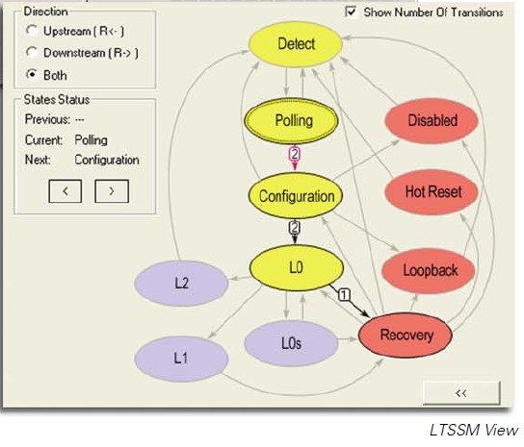
LeCroy’s LTSSM View: Good for Novice User, but Not for the best for Expert. More sub-states under each state
Need updates
LeCroy’s LSTTM View
LTSSM Table from PCI Express Specification
Page 35

Slide 36
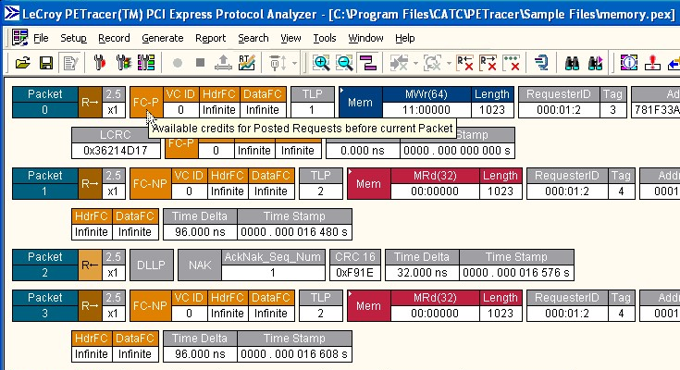
LeCroy’s Flow Control
Need updates
  No independent column to see the movement of flow control credits.
  No graphical info, thus no link to the packet viewer
Page 36

Slide 37
Agilent on Offence:
Interposer Probe- Signal Integrity Side by Side Comparison
Conclusion:
Different Interposers from Different Vendors are NOT made equal!!
Some slot interposers can add a lot more jitter and distort original signal than others.
If a PCI Express slot interposer distorts the signal quality and CAUSES the end point / root complex to generate an intermittence error packets, is this acceptable? The error I see on my analyzer, is it real or fake?
Need updates
Page 37

Slide 38
Setup
Base line
Test with slot interposer
Need updates
Agilent or LeCroy SI
CBB
CBB
S3 card directly connected to the compliance base board
run compliance test at both 3dB and 6dB.
S3 card connected to the compliance base board through the slot interposer
Slot interposer with/without cables. With/without analyzer attached.
run compliance test at both 3dB and 6dB.
Page 38
Notes:
I only show one of the results setup, because most of the results look pretty similar.

Slide 39
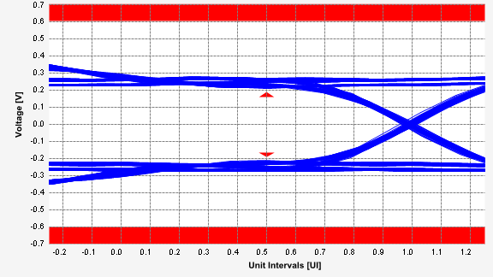
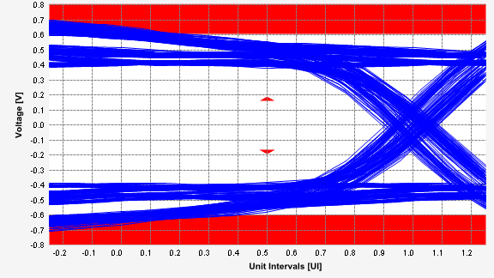
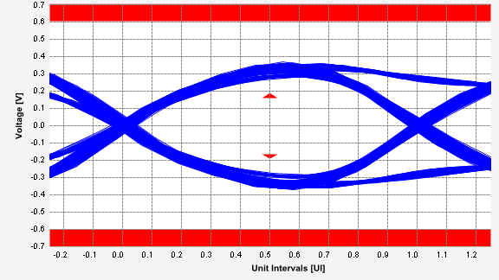
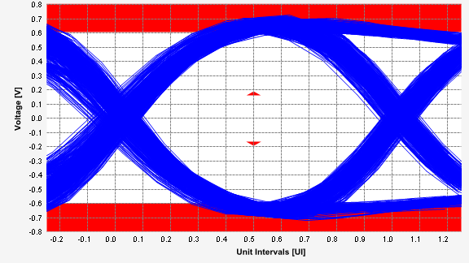
S3 Card stand alone & S3 Card with
LeCroy Active Interposer: 3dB De-emphasis
S3 Card, no interposer
S3 Card, LeCroy Active interposer
Need updates
Page 39
Notes:
LeCroy Active Interposer seems to violate the electrical compliance of PCI Express Gen2. Overshooting.
Also, with the active interposer, the characteristics of the device is completely changed; the signal through the interposer, and the signal of the standard alone devices has no relationship to each other. This could mask problems that were in the device.

Slide 40
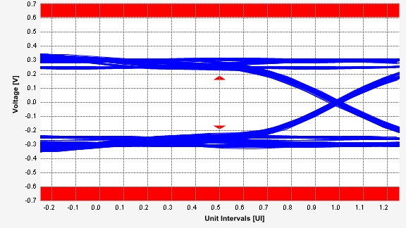
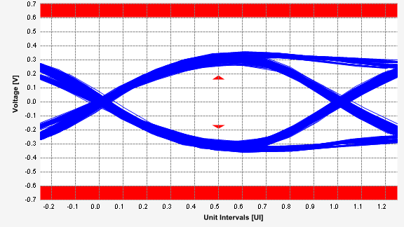
S3 Card stand alone & S3 Card with
Agilent Interposer: 3dB De-emphasis
S3 Card, no interposer
S3 Card, Agilent Analog amplified interposer
Need updates
Page 40

Slide 41
Quantitative Result Comparison
S3 Card with LeCroy Interposer
Pass | # Failed | # Trials | Test Name | Actual Value | Margin | Spec Range
Yes | 0 | 1 | Add-in Card Tx, Unit Interval (PCIE 2.0, 5.0 GT/s) | 199.99ps | 41.7 % | 199.94ps <= VALUE <= 200.06ps
No | 1 | 1 | Add-in Card Tx, Template Tests -3.5dB (PCIE 2.0, 5.0 GT/s) | 1.579498M | -157,949,750.0 % | -500m <= VALUE <= 500m
No | 1 | 1 | Add-in Card Tx, Peak Differential Output Voltage -3.5dB (PCIE 2.0, 5.0 GT/s) | 1.4302V | -28.1 % | 380.0mV <= VALUE <= 1.2000V
Yes | 0 | 1 | Add-in Card Tx, Eye-Width -3.5dB with crosstalk (PCIE 2.0, 5.0 GT/s) | 153.75ps | 25.0 % | VALUE >= 123.00ps
Yes | 0 | 1 | Add-in Card Tx, RMS Random Jitter -3.5dB with crosstalk (PCIE 2.0, 5.0 GT/s) | 1.222ps | 93.9 % | VALUE <= 20.000ps
Yes | 0 | 1 | Add-in Card Tx, Maximum Deterministic Jitter -3.5dB with crosstalk (PCIE 2.0, 5.0 GT/s) | 29.138ps | 48.9 % | VALUE <= 57.000ps
Yes | 0 | 1 | Add-in Card Tx, Total Jitter at BER-12 -3.5dB with crosstalk (PCIE 2.0, 5.0 GT/s) | 46.252ps | 39.9 % | VALUE <= 77.000ps
Yes | 0 | 1 | Add-in Card Tx, Eye-Width -3.5dB without crosstalk (PCIE 2.0, 5.0 GT/s) | 153.75ps | 22.0 % | VALUE >= 126.00ps
Yes | 0 | 1 | Add-in Card Tx, RMS Random Jitter -3.5dB without crosstalk (PCIE 2.0, 5.0 GT/s) | 1.222ps | 93.9 % | VALUE <= 20.000ps
Yes | 0 | 1 | Add-in Card Tx, Maximum Deterministic Jitter -3.5dB without crosstalk (PCIE 2.0, 5.0 GT/s) | 29.138ps | 46.0 % | VALUE <= 54.000ps
Yes | 0 | 1 | Add-in Card Tx, Total Jitter at BER-12 -3.5dB without crosstalk (PCIE 2.0, 5.0 GT/s) | 46.252ps | 37.5 % | VALUE <= 74.000ps
Need updates
S3 Card with Agilent Interposer
Pass | # Failed | # Trials | Test Name | Actual Value | Margin | Spec Range
Yes | 0 | 1 | Add-in Card Tx, Unit Interval (PCIE 2.0, 5.0 GT/s) | 199.99ps | 41.7 % | 199.94ps <= VALUE <= 200.06ps
Yes | 0 | 1 | Add-in Card Tx, Template Tests -3.5dB (PCIE 2.0, 5.0 GT/s) | 0.000 | 50.0 % | -500m <= VALUE <= 500m
Yes | 0 | 1 | Add-in Card Tx, Peak Differential Output Voltage -3.5dB (PCIE 2.0, 5.0 GT/s) | 725.7mV | 42.2 % | 380.0mV <= VALUE <= 1.2000V
Yes | 0 | 1 | Add-in Card Tx, Eye-Width -3.5dB with crosstalk (PCIE 2.0, 5.0 GT/s) | 174.61ps | 42.0 % | VALUE >= 123.00ps
Yes | 0 | 1 | Add-in Card Tx, RMS Random Jitter -3.5dB with crosstalk (PCIE 2.0, 5.0 GT/s) | 889fs | 95.6 % | VALUE <= 20.000ps
Yes | 0 | 1 | Add-in Card Tx, Maximum Deterministic Jitter -3.5dB with crosstalk (PCIE 2.0, 5.0 GT/s) | 12.936ps | 77.3 % | VALUE <= 57.000ps
Yes | 0 | 1 | Add-in Card Tx, Total Jitter at BER-12 -3.5dB with crosstalk (PCIE 2.0, 5.0 GT/s) | 25.386ps | 67.0 % | VALUE <= 77.000ps
Yes | 0 | 1 | Add-in Card Tx, Eye-Width -3.5dB without crosstalk (PCIE 2.0, 5.0 GT/s) | 174.61ps | 38.6 % | VALUE >= 126.00ps
Yes | 0 | 1 | Add-in Card Tx, RMS Random Jitter -3.5dB without crosstalk (PCIE 2.0, 5.0 GT/s) | 889fs | 95.6 % | VALUE <= 20.000ps
Yes | 0 | 1 | Add-in Card Tx, Maximum Deterministic Jitter -3.5dB without crosstalk (PCIE 2.0, 5.0 GT/s) | 12.936ps | 76.0 % | VALUE <= 54.000ps
Yes | 0 | 1 | Add-in Card Tx, Total Jitter at BER-12 -3.5dB without crosstalk (PCIE 2.0, 5.0 GT/s) | 25.386ps | 65.7 % | VALUE <= 74.000ps
Page 41

Slide 42
Jitter Measurement Result Comparison Summary
~ Can your DUT take this much more jitter and yet work properly? ~
Jitter Measurements Made (at PCIe 2.0 5.0GT/s) | Baseline | With Agilent Interposer | With LeCroy Interposer | Delta to Baseline
Add-in Card Tx, RMS Random Jitter -3.5dB with crosstalk | 0.875 ps | 0.889 ps | 1.222 ps | 40% more jitter!
Add-in Card Tx, Maximum Deterministic Jitter -3.5dB with crosstalk | 9.408 ps | 12.936 ps | 29.123 ps | 210% more jitter!
Add-in Card Tx, Total Jitter at BER-12 -3.5dB with crosstalk | 21.658 ps | 25.386 ps | 46.252 ps | 113% more jitter!
Need updates
Page 42

Slide 43

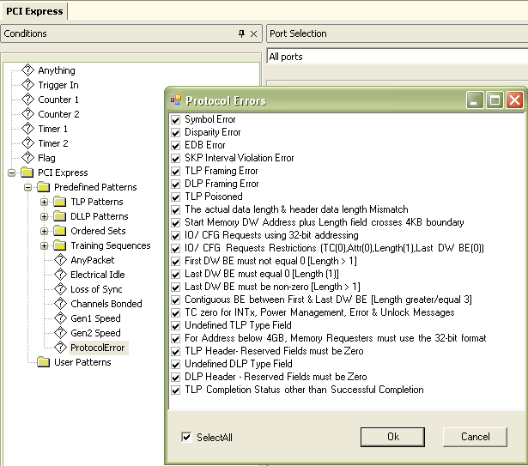

More Protocol Error Triggers (22 vs. 8 (?)) x16 Configuration Can be Used as two x8 systems
Need updates
    Agilent x16 solution uses 2 x N5306A Analyzer modules (in one chassis). By moving one module to another chassis, you quickly end up with two x8 analyzers!!
    LeCroy has an independent x16 system… can’t divide it by two!
?
    22 Protocol Error Predefined Trigger for N5306A Analyzer
Page 43

Slide 44


Competing LeCroy with the Exerciser opportunity
Agilent Win 99.9% of the Time!!
Agilent
    Agilent’s 4 in 1 Exerciser Solution
    (LTSSM, EP emulation, RC emulation, PTC).
    How we differentiate:
    Size & cost of the solution (LeCroy = Z2-16 + cables + EP card or RC emulation platform)
    To be SIG compliant, the cust would need to buy a separate PTC card from LeCroy.
    Agilent has an on-board memory and as a result offers real-time DATA COMPARE function. A key advantage for cust doing EP, especially if their EP is doing IO operations, LeCroy can NOT do this.
Need updates
LeCroy
    LeCroy requires different HW for the exerciser controller, device (EP) emulation, host (RC) emulation, and PTC.
Page 44

Slide 45
LeCroy’s Discount Strategy… Outrageous!
  Recently, we have seen some ridiculous offerings by LeCroy.
    Fusion-IO
    Marvell
    Etc
  Strategy
    If all possible, close the deal before LeCroy contacts them and/or the cust contacts LeCroy.
    Contact the division immediately.
    Use “two” quotation effectively: One new, One RSD.
    Do not use the word “final offer”.
Need updates
Page 45

Slide 46

Battle goes on for Gen3…
The New Forma Factor
… LeCroy’s Gen3 exerciser is a copy-cat of our exerciser
Need updates
Page 46

Slide 47


Division Experts and Contacts:
  Business Development Managers
    West Sales Region Taku Furuta (522-8979)
    East Sales Region Brad Frieden (590-2011)
  Division Application Experts
    DDR Jim Majewski (PME), Jennie Grosslight (Tech Mktg)
    FPGA Judith Smith (PME), Denny Deboer (Tech Mktg)
    PCI Express Yenyi Fu (PME), Alex Bailes (Tech Mktg)
    MIPI/DigRF Yenyi Fu (PME), Denny Deboer (Tech Mktg)
    HDMI Judith Smith (PME), Allie Schirmer (Tech Mktg)
Need updates
Page 47

