Slide 1
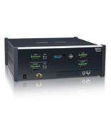
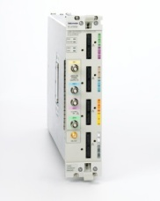

Competitive Positioning
AGILENT RESTRICTED DO NOT INCLUDE SLIDE TO EXTERNAL AUDIENCES RESTRICTED
 | Agilent | LeCroy | Tektronix
Announcement | Feb 1st, 2010 | Sept 2009 / Feb 1st, 2010 | Announced (April 12th, 2010)
Name | Digital Test Console | Summit T3 | TLA7SA08/16
Analyzer for PCIe 8GT/s | Yes | Yes | Yes
Link width | x1 – x16 | x1 – x16 | x1 – x16
Auto Speed detect | Yes | Yes | Yes
Capture Depth | 8GB (x16) | 8GB (x16) | 16 GB (x16)
Slot Interposer probe | Yes | Yes | Yes (but expensive)
Mid-bus probe | Yes | Yes | Yes
Flying leads probe | Yes (by end of 2011) | No | Yes
Ability to probe all platforms | Yes (through ESP) | We believe they will have issues with long traces | OpenEYE??
Software capabilities | On par with Gen 2 | On par with Gen2 | They seem to have added significant capabilities since Gen2 (?)
Expected x16 Analyzer Price (with interposer) | ~$150K | ~$ 150K (Aggressive trade-in programs in the transition) | ~$210K
Exerciser for PCIe 8GT/s | Yes | Yes | Not expected
Link width | x1 – x16 | x1 – x16 | Not expected
LTSSM | Yes | Yes | Not expected
Exerciser SW on roadmap | Yes | Yes | Not expected
Expected Exerciser Price | ~$120K
AGILENT RESTRICTED DO NOT INCLUDE SLIDE TO EXTERNAL AUDIEN

