Slide 1

SATA & SAS 12Gb/s Physical and Protocol Layers Complete Test Solutions
Verify your designs to the specification
Notes:
Thank you …
Welcome to SATA and SAS 6Gbps Physical and Protocol Layers Compete Test Solution Web seminar.
My name is Min-Jie Chong. I am the storage applications manager at Agilent Technologies.
With me today is Matt Hallberg. He is the storage program manager from SerialTek and will cover the protocol material.
This presentation will provide information on what do you need to know about solutions for testing storage products to ensure they work reliably and meet the specifications. Both product and measurement information will be covered. I will also cover advanced debugging techniques such as SSC waveform emulation, de-embedding and scope based protocol triggering and decode solutions which will help you quickly verify your design meets demanding specification requirements.

Slide 2
Difference between SATA and SAS
Intro
SATA (Serial AT Attachment)
SAS
SAS (Serial Attached SCSI)
SATA
Serial ATA was designed to replace the older IDE hard drives which were commonly found in most home computer and business workstations.
Benefits:
Capacity intensive
Low availability
Sequential reads
Long seek time
Designed to be on 8 Hours a day, 5 days a week
SAS has evolved separately from the SCSI standard, SCSI drives have traditionally been found in server solutions.
Benefits:
Performance intensive
High availability
Random reads
Short seek time
Designed to be on 24 hours per day, 7 days per week
SATA/SAS Complete Test Solution
Page 2
Feb 22, 2010
Notes:
For end users, SAS and SATA compatibility offers a new level of price/performance flexibility. Do note that SATA is compatible in a SAS architecture but it is not the same vice-versa.
SATA drives will suit those requiring the best price advantage for servers and storage deployments, while SAS drives will deliver the highest performance, reliability and software management compatibility. If you want good performance and you don’t want disk I/O bottlenecks and prefer longevity over small price difference, always choose SAS over SATA. If your requirements are for home computer or workstations in a very small office and are not worried about server performance and the larger capacity, cheaper SATA drives will appeal to you.
Generally, sequential access on the drive is fairly common for small tasks so… random access is not very common when you are writing email or using a browser.. However, add a few users doing different tasks, throw in a database with many more users accessing the data, and all at the same time, the disk(s) will be mostly randomly accessed. SAS drives are better at handling such situations.
SCSI - Small Computer System Interface
SATA - Serial Advanced Technology Attachment

Slide 3
SATA / SAS technology trends
SAS3(12Gb)
SATA Express (8-16Gb)
SATA3 (6Gb)
SAS2 (6Gb)
SATA2 (3Gb)
SATA Gen3 speed is another doubling to 6Gbps. So far only SSD (Solid State Drives) are capable to provide 6Gps data. Now running v3.1.
eSATA defines separate cables, connectors, and revised electrical requirements for external applications. Competition from USB 3.0 expected.
SATA to connect with PCIe 3.0 and be called SATA express operating up to 16Gb/s. Two PCIe lanes together provide 16Gb/s, with each lane running at 8Gb/s.
Improved read and write speeds have made significant performance increases.

Slide 4
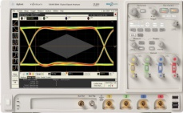
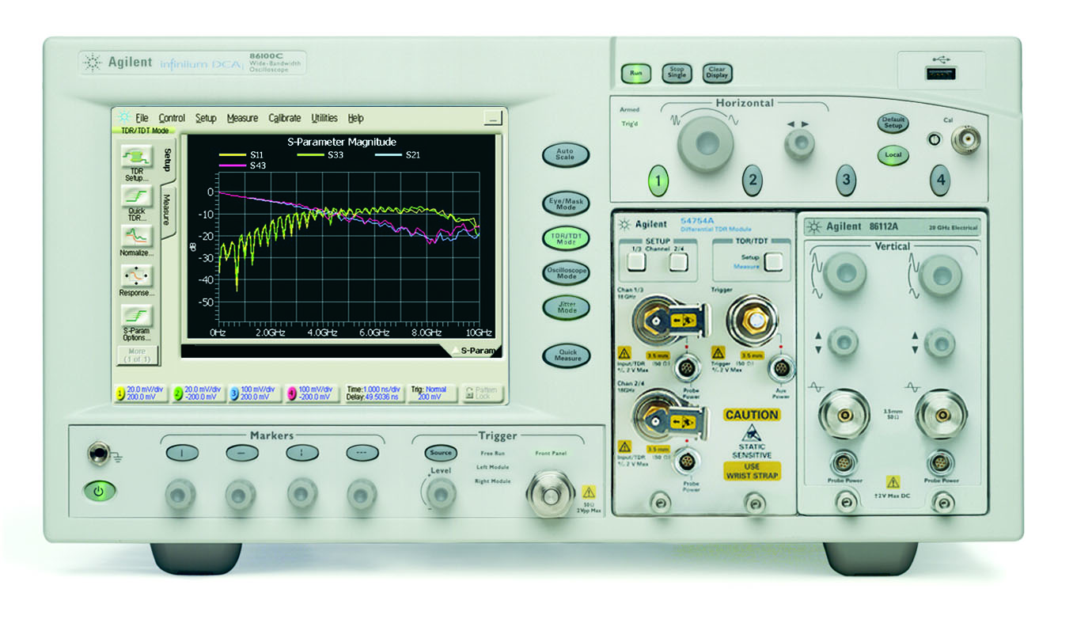
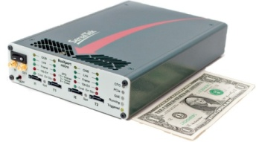
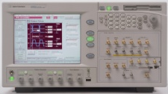
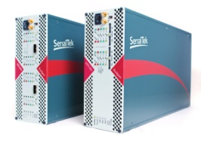
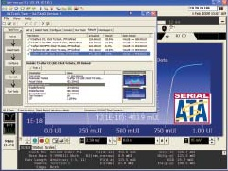
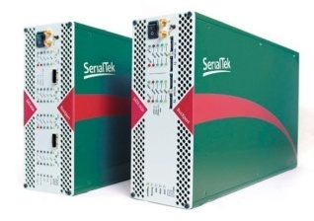
Agilent SATA and SAS Total Solution Coverage
Intro
PHYSICAL LAYER
PROTOCOL LAYER
Transmitter Characterization
(PHY/TSG/OOB)
DSA91204A oscilloscope
N5411B SATA and N5412 SAS compliance
N8801A Protocol viewer software*
Receiver Characterization
(RSG)
N4903B High-performance serial BERT
BusXpert FER Counter
N5990A Automated compliance and device characterization test
Impedance/Return Loss (RX/TX)
DCA 86100C Wideband sampling oscilloscope
54754A TDR/TDT module
86108A Precision waveform analyzer*
Host/Device Digital (ASR, GTR, NCQ, SSP, IPM, DOF)
U3052A BusXpert PRO Protocol Analyzer
U3051A BusXpert MicroLite Protocol Analyzer
Industry’s lowest scope noise floor/sensitivity and trigger jitter
Automated compliance software accurate, efficient, and consistent
DCA ultra low jitter
Hardware with Native PHY and Fast Data Re-Lock. Software with Pre-Indexing, view any size trace in under 5 seconds
SATA/SAS Complete Test Solution
Page 4
Feb 22, 2010
Notes:
Agilent has test solution that provides complete coverage to the SATA and SAS 6Gbps validation needs.
For physical layer testing, we offer the transmitter, receiver and impedance/return loss measurements.
For transmitter characterization, the Infiniium DSA91204A oscilloscope and the SATA/SAS compliance provides automated measurements
-For receiver characterization, we offer the N4903B high-performance serial BERT and BusXpert as the FER counter. The BERT is used as the signal and jitter stimulus, and the FER counter can be used to check for the CRC check sum in the packet from the BERT and DUT.
-For impedance and return loss measurements, we offer the DCA 86100C sampling scope with the TDR/TDT module. It has ultra low jitter to provide accurate measure characterization.
For the protocol space, we also have 2 series of new analyzers, called the U3052A PRO series and U3051A MicroLite Series. They are the highest performance analyzers in the market space today.
Automated compliance software for both transmitter and receiver testing eliminates days (sometimes months) out of testing and debug time. Measurements are made efficiently without you having to manually place cursors, and, therefore, accurate as well.

Slide 5
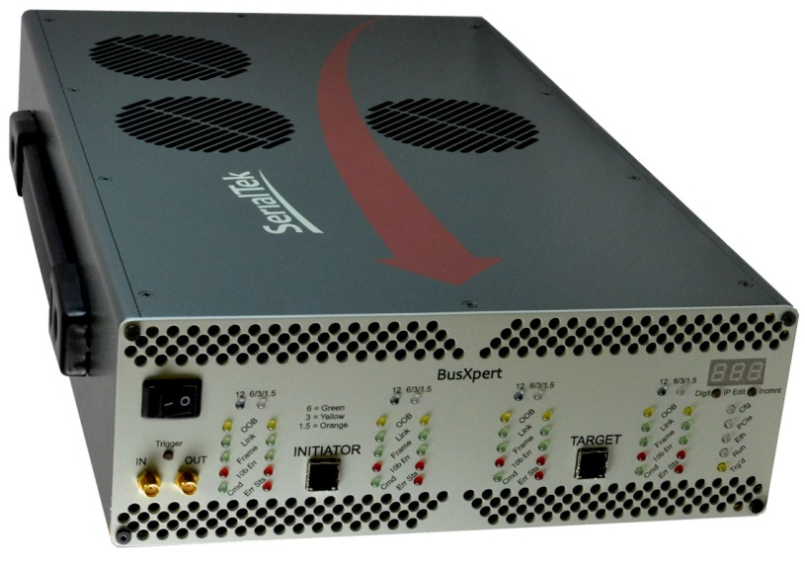
U3055A/U3056A 4 port, 12Gbps SAS analysis
Key Features:
Enhanced Gigabit Ethernet > 70MB/s
500 picosecond Timestamp Resolution
Eye-Opener front end
Tunable RX/TX signaling
Cascadeable up to 4 BusXpert Pro platforms
Supports 1.5 / 3.0 / 6.0 /12.0 SAS Gbps
Support for 6G/3G SATA/STP
Deep Triggering and Filtering
Trace Buffer up to 72GB (144GB coming soon)

Slide 6
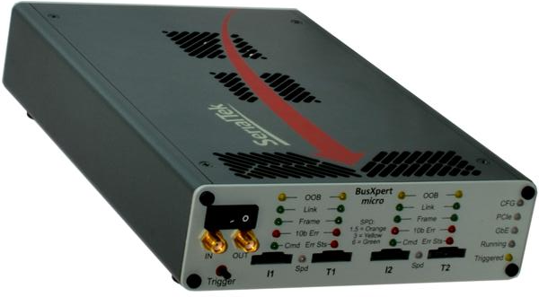
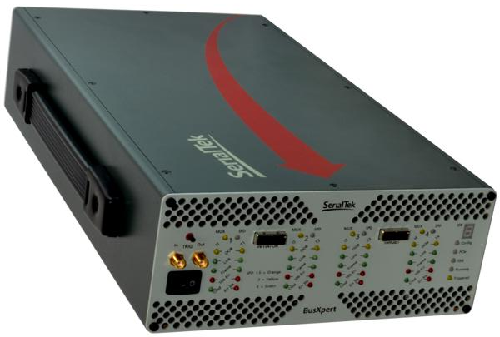
U3051B – BusXpert Micro (2port) U3052A – BusXpert Pro (4port) SAS/SATA protocol analyzer
Key Features:
Native PHY
Fast Data Re-Lock
2ns Timestamp Resolution
Eye-Opener front end
Tunable RX/TX signaling
Cascadeable up to 4 BusXpert Pro platforms
Available with either Mini-SAS or SATA 7-pin connectors
Supports 1.5 / 3.0 / 6.0 Gbps SAS and SATA
Deep Trigger and Filter
Trace Buffer up to 36GB

Slide 7
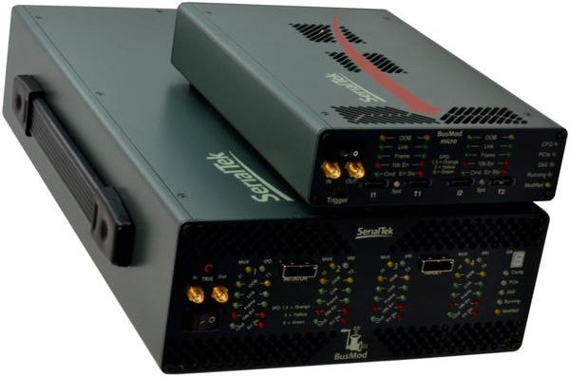
U3053A – jammer (1 or 2 port) U3054A – jammer (4port)
UNPARALLELED ERRORINJECTION
Connect / Disconnect link
CRC, 8b10b encoding, Running Disparity (RD+/-), and Invalid Symbol encoding error generation
Replace/substitute primitives
Replace frame values (with or without CRC regeneration)
Insert/Delete DWORD into/from frame

Slide 8
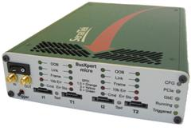
Using a Protocol Analyzer with a Jammer
Combining a protocol analyzer with a jammer / error injector allows developers to easily see what changes to the traffic have caused and further improve product design.
Viewing Traffic before/after BusMod
BusMod
T1- I1
BusXpert
T1- I2
I1
T2
Device
Host
SATA/SAS Complete Test Solution
Page 8
Feb 22, 2010
Notes:
The setup above allows developers to see the traffic before and after it is changed. This allows both validation that the change was made and what the effects were.

Slide 9
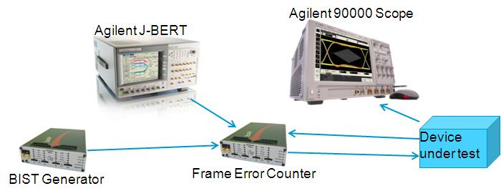
Powerful test setup for SAS and SATA physical compliance testing:
The BusGen sends a SATA BIST frame to put the device under test into a special loop-back test mode.
The J-BERT is then used to send compliance patterns with varying levels of jitter.
The device sends the pattern back, and the BusXpert, using it's Frame Error Counter capability, counts if there are any CRC errors in the frames from the device.
The scope is used to verify the eye pattern of the device under test.

Slide 10
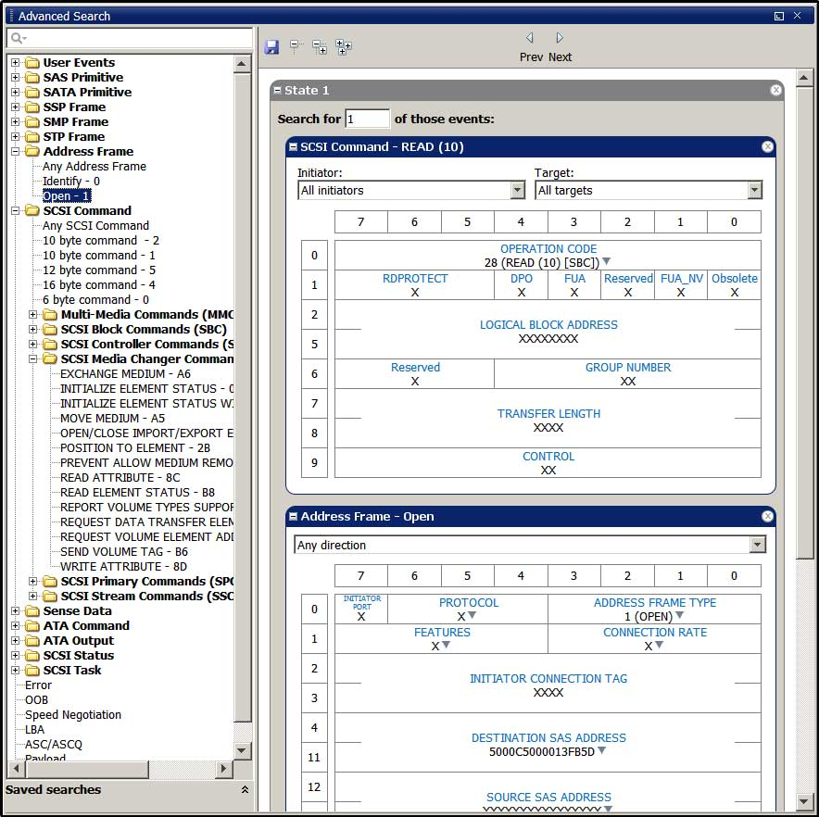
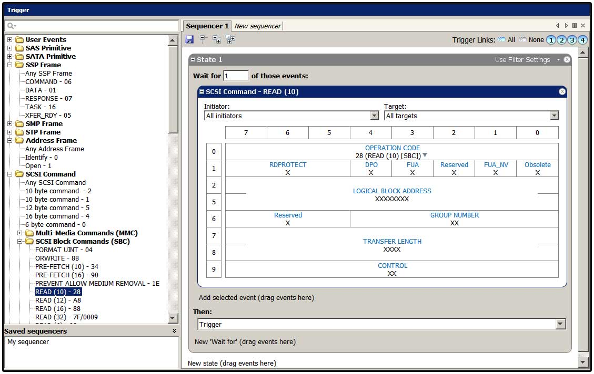
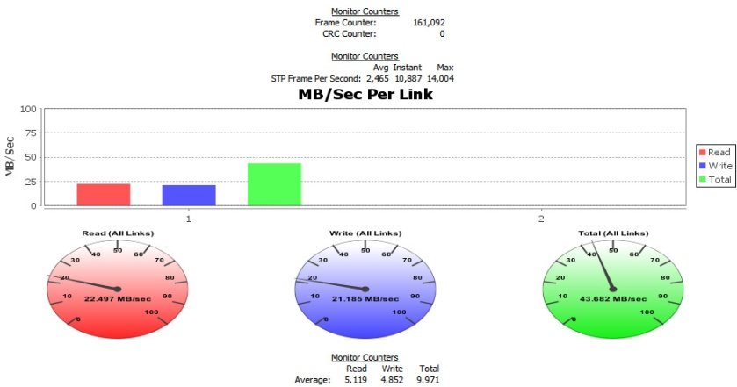
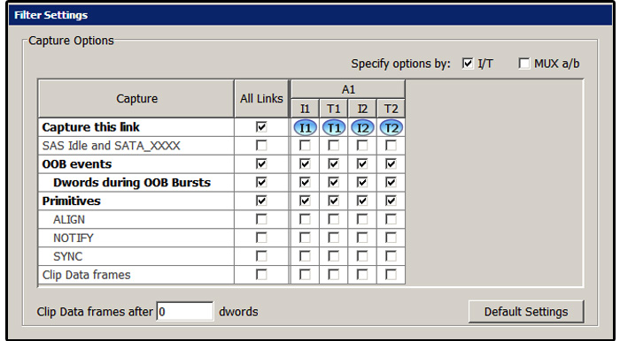
Using a Protocol Analyzer to find issues
Protocol
When looking for issues occurring at the protocol layer, it is essential to have an analyzer capable of capturing large amounts of traffic and being able to drill down to the root cause. In-depth triggering, filtering, live performance and event counting and other options help find root cause and other related problems.
SATA/SAS Complete Test Solution
Page 10
Feb 22, 2010
Notes:
Having a good trigger system is essential for being able to point the analyzer to capture around a series of events. This allows developers to really focus on areas of importance. The live performance monitor and counter tracks read and write traffic, so if your system is being throttled, you can determine which link is responsible. The live counter allows counting of frames / primitives and other user-defined events without having to trigger the analyzer. Having good pre and post capture filter settings is good. Pre-settings allow you to filter out items undesired, such as repetitive primitives like ALIGN. Searching is also important, especially when working with larger traces or when trying to find a specific sequence of events in a captured trace.

Slide 11
Testing Design Robustness at the Protocol Level
Tools such as the SerialTek BusMod Error Injector are very useful with testing for design issues such as error handling and recovery, compatibility, and duplicating issues seen in the field.
An error injector / jammer is used to inject errors into the data streams between two devices, thus potentially causing unwanted behavior.
This is helpful during the product development stages as it is difficult to produce errors in a consistent manner without such tools.
These tools, combined with a protocol analyzer, create a great platform for testing design validity
SATA/SAS Complete Test Solution
Page 11
Feb 22, 2010
Notes:
Error Injectors and Jammers are the same thing. They are both used to inject errors into a live stream of data, between live devices. This functionality is important as you are changing real traffic, not in a simulated environment with simulated devices.

Slide 12
Design Robustness cont.
Error Injectors (Jammers) can be used to create a variety of issues both at the link and application layer.
Link errors include 8b10b encoding, CRC, link disconnect, running disparity and ALIGN errors.
Protocol / Application layers include changing/deleting frames and frame content, inserting and deleting DWORDs into/from a frame, and replacing primitives.
With the Error Injector, creating scripts to starve the buffer, disconnecting a link with outstanding command requests, cause random CRC errors, and change responses from good to bad is very easy.
SATA/SAS Complete Test Solution
Page 12
Feb 22, 2010

Slide 13
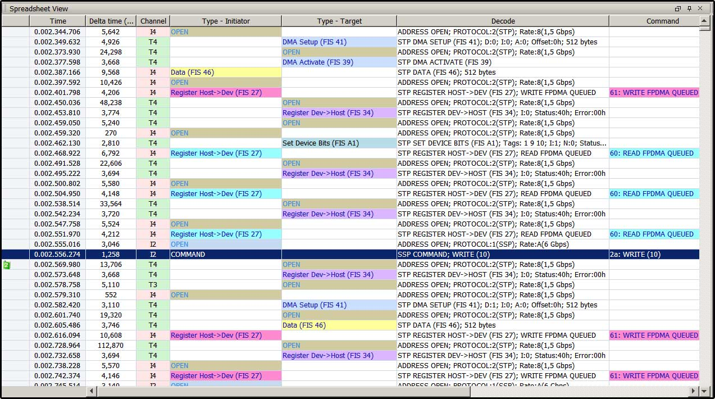
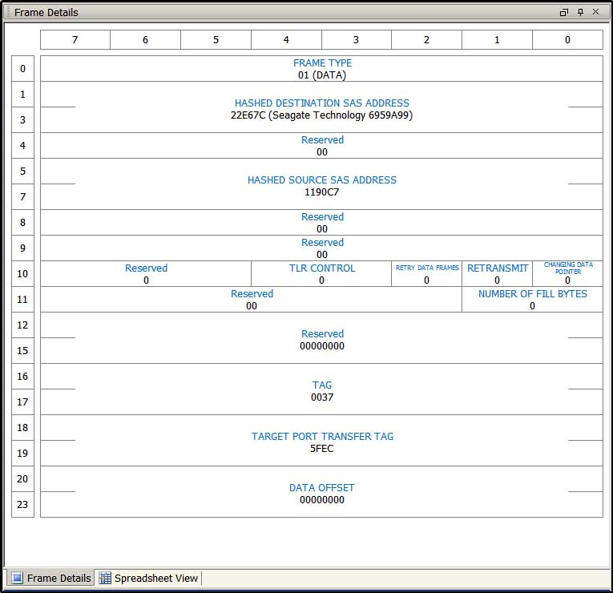
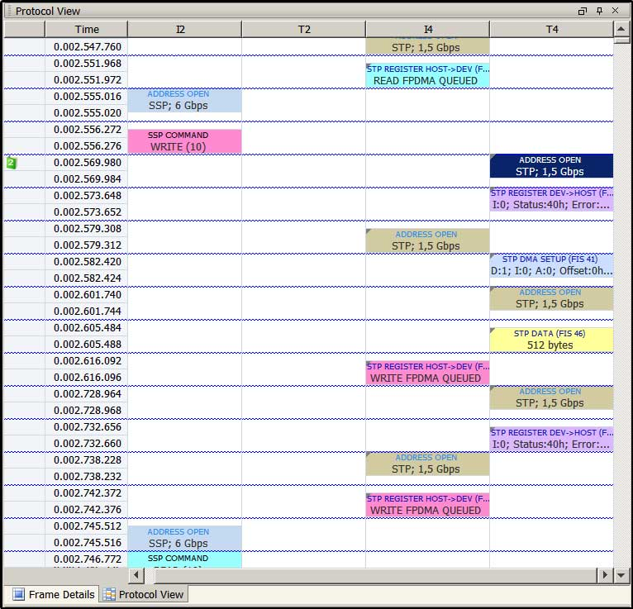
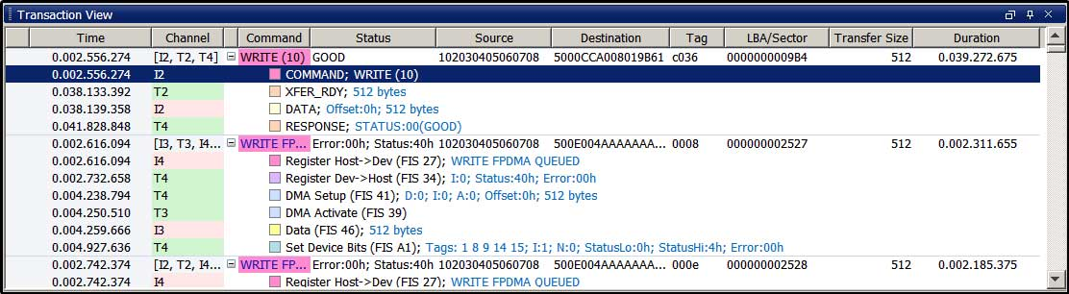
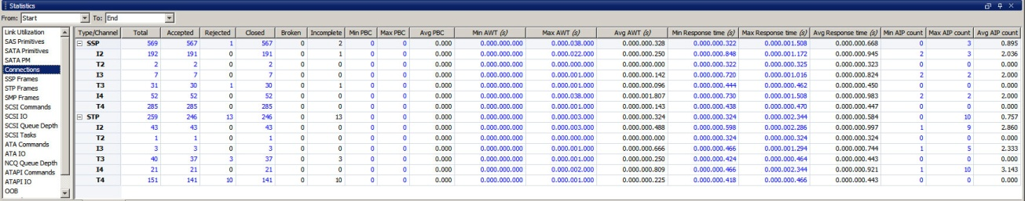
Viewing and Decoding the Protocol Layer
Using a protocol analyzer is essential for determining issues at the link layer and above. Protocol analyzers are capable of displaying captured traffic in a easy to understand format.
SATA/SAS Complete Test Solution
Page 13
Feb 22, 2010
Notes:
Five different views, each with their own application. The transaction view is used to look at all of the frames associated with commands, making it easy to narrow down on a bad frame. The spreadsheet view is useful for looking at frames and primitives as they come in for an accurate top-down view of the captured traffic. The protocol view is useful when debugging issues at the link level, like primitive handshaking, OOB/speed-negotiation, and finding line errors like 8b10b encoding. The frame details view gives a spec-level definition of the captured frame, making it easy to correlate with the associated SAS or SATA specification.

Slide 14
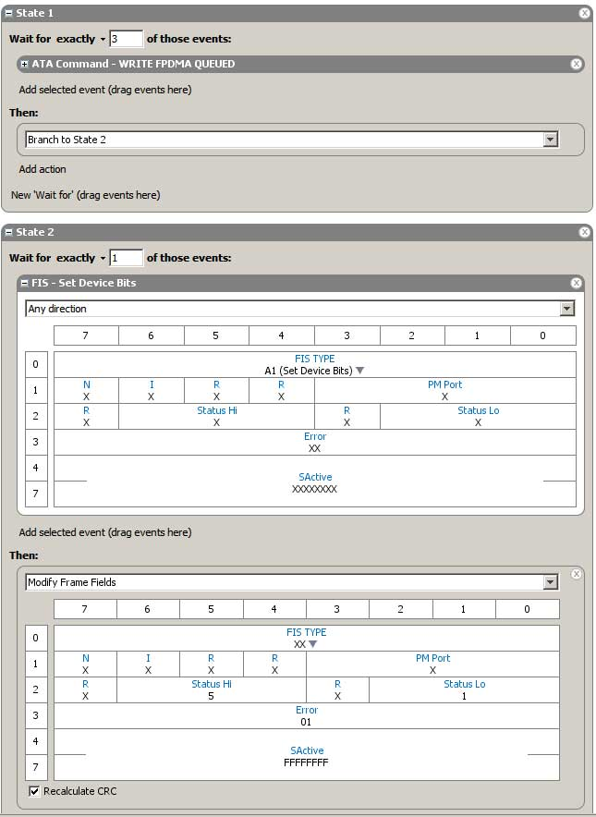
Creating the Injection Scenario
In State 1, BusMod first looks for a Write FPDMA Queued command and then branches to the next state
In state 2, BusMod identifies the type of frame it is looking for, a Set Device Bits, and specifies an action of modifying the frame fields
The Status Hi, Status Lo, Error, and SActive fields are changed to reflect a new value
SActive = FFFFFFF tells the application layer that all queued commands must be aborted. The other fields we edited also signal that there was an issue with this command
SATA/SAS Complete Test Solution
Page 14
Feb 22, 2010

Slide 15
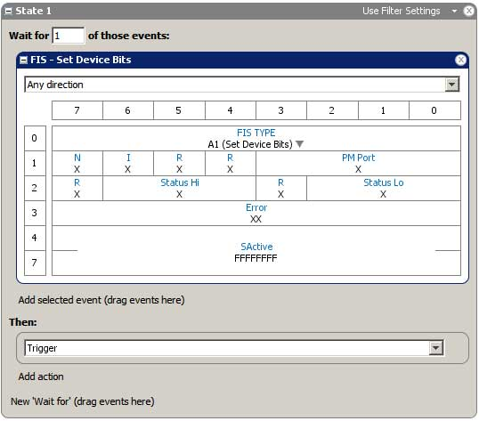
Creating a Trigger
Since we know that we are going to change the values of a Set Device Bits FIS, we can set a trigger on a Set Device Bits with the SActive field set to FFFFFFF
We set the action to Trigger to send a signal to the analyzer hardware to trigger when it sees this event occur
SATA/SAS Complete Test Solution
Page 15
Feb 22, 2010

Slide 16
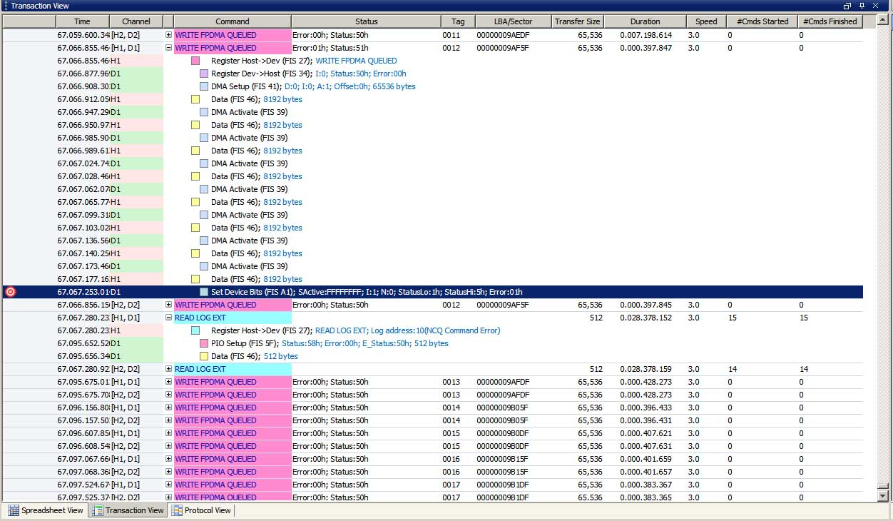
Looking at the Trace pt 1
Using Transaction View, we are able to see the trigger point in relation to the command it was seen in.
SATA/SAS Complete Test Solution
Page 16
Feb 22, 2010

Slide 17
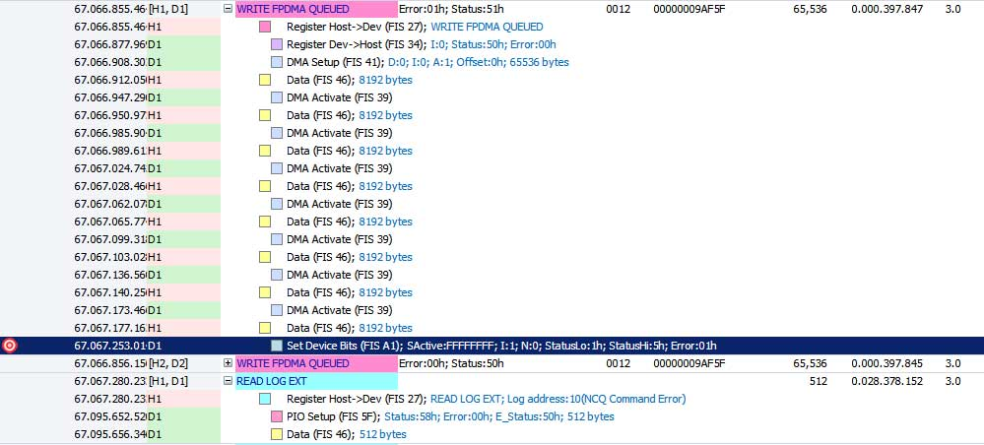
Looking At the Trace pt 2
In the Transaction view, you can also see that there was a Read Log, which is a command used by SATA to read error logs to help determine cause of an error. Notice that for other commands there are no corresponding Read Logs.
SATA/SAS Complete Test Solution
Page 17
Feb 22, 2010

Slide 18
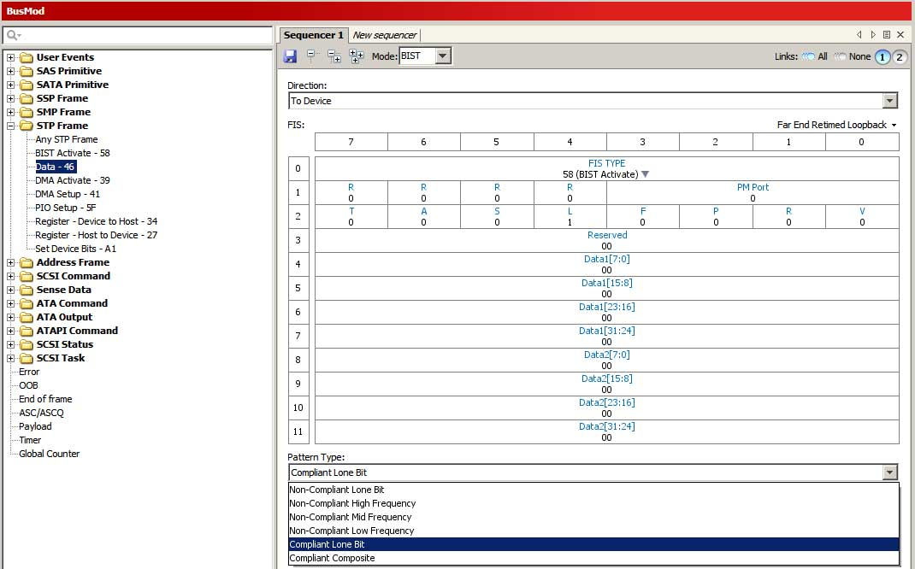
Creating the BIST Command for SATA
Developers can also create a desired BIST frame to send when testing SATA compliance. Specify via drop downs or entering desired values into the fields

Slide 19


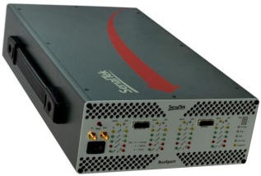


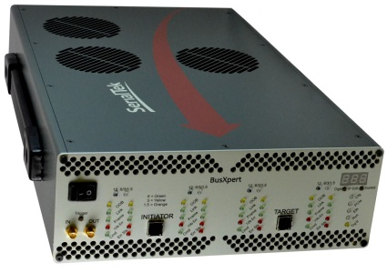
SAS/SATA Protocol Analysis
U3051B | Micro SAS/SATA Protocol Analyzer 1 or 2 port, up to 18GB buffer, 6Gbps | $20K
U3052A | Pro SAS/SATA Protocol Analyzer 4 port, up to 36GB buffer, 6Gbps | $40K
U3053A | Micro SAS/SATA Jammer / Error Injector 1 or 2 port error injection, 1 port BIST, 6Gbps | $12K
U3054A | Pro SAS/SATA Jammer / Error Injector 4 port error injection, 1 port BIST, 6Gbps | $30K
U3055A | Pro II SAS/SATA Protocol Analyzer 4 port, up to 36GB buffer, 12Gbps | $70K
U3056A | Pro II SAS/SATA Protocol Analyzer 4 port, 72GB buffer, 12Gbps | $90K

Slide 20
U3055A/U3056A 4 port, 12Gbps SAS analysis
Decrease development time with
Industry’s largest trace buffer
Hardware-accelerated interfaces
Native PHY implementation for fast locking
Pre-indexing and trace processing
Key Features:
Trace Buffer up to 72GB (144GB coming soon)
Deep Triggering and Filtering
500 picosecond Timestamp Resolution
Eye-Opener front end
Tunable RX/TX signaling
Cascadeable up to 4 BusXpert Pro platforms
Supports 1.5 / 3.0 / 6.0 /12.0 SAS Gbps
Support for 6G/3G SATA/STP

Slide 21
BusXpert Pro II – 4 port analyzer 12Gbps SAS – 6Gbps SATA
 |  | List price
U3055A | BusXpert Pro II Analyzer | $ 69,995
U3055A-001 | 4 port, 12Gbps link speed, SAS, 9 GB capture memory | $ -
U3055A-002 | 4 port, 12Gbps link speed, SAS, 18 GB capture memory | $ 6,000
U3055A-003 | 4 port, 12Gbps link speed, SAS, 36 GB capture memory | $ 13,000
U3056A | BusXpert Pro II Analyzer; 4 port, 12Gbps link speed, SAS, 72 GB capture memory | $ 89,995

Slide 22
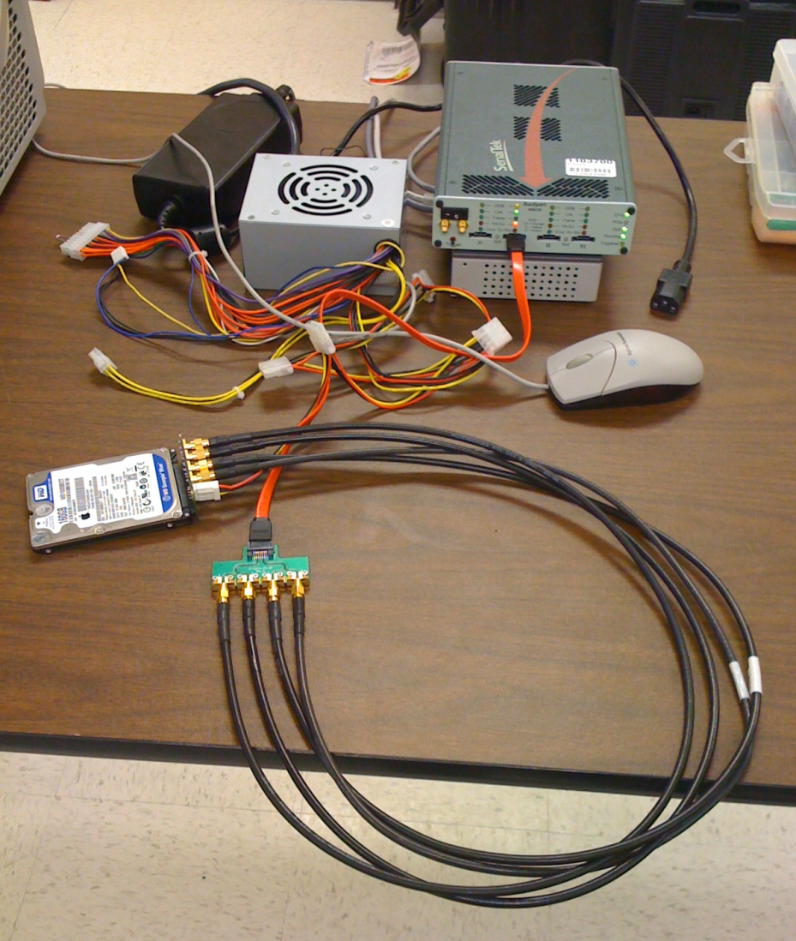
BIST Generation with U3053A BusMod
New
Item / option | Description
U3053A | SerialTek Micro BusMod for SAS/SATA
U3053A-006 | Linkspeed 1.5 Gbps to 6 Gbps
U3053A-1PB | Software License, BIST Generator, 1-port
Quickly enable BIST generation with the new U3053A BusMod

