Slide 1
USB 3.0 Overview
-Atul Gupta

Slide 2
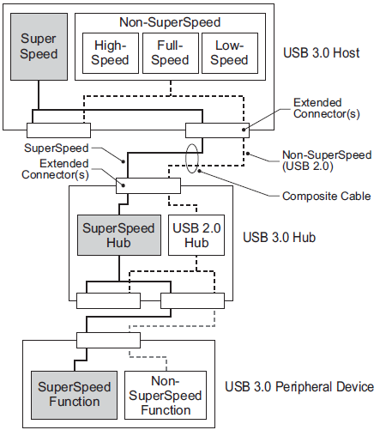
USB 3.0 Bus Structure
USB 3.0 utilizes a dual Bus Architecture to provide simultaneous operation of SuperSpeed and non-SuperSpeed.
The USB 3.0 connection model accommodates backwards and forward compatibility for connecting USB 3.0 or USB 2.0 devices into a USB 3.0 bus.
Similarly, USB 3.0 devices can be attached to a USB 2.0 bus.

Slide 3
USB Protocol History
USB Protocol | Release Data | Supported Speeds
USB 1.0 | Jan 1996 | Low Speed (1.5 Mbps) Full Speed (12 Mbps)
USB 1.1 | Aug 1998 | Fixed problems identified in 1.0, mostly relating to hubs.
USB 2.0 | April 2000 | High Speed (480 Mbps)
USB 3.0 | Nov 2008 | SuperSpeed (5.0 Gbps)
All USB specifications are backward compatible.

Slide 4
USB 3.0 Main Goals
Increase the data transfer rate : Upto 5 Gbit/s of operation.
Decrease power consumption : Better power management at SuperSpeed for power efficient operation of the bus. The power management of the USB 2.0 bus portion is unchanged.
Increase power output : USB 3.0 power distribution is similar to USB 2.0, with increased supply budgets for devices operating at SuperSpeed.
Be backwards-compatible with USB 2.0

Slide 5
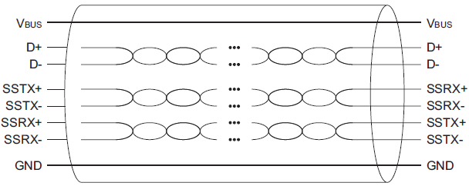
USB 3.0 Cable
USB 3.0 cables have Eight primary conductors:
One twisted pair (D+ and D-) for USB 2.0. It is Half Duplex
differential signaling.
Two twisted pair signal pairs (SSTX+, SSTX-, SSRX+,
SSRX-) are provide for SuperSpeed (USB 3.0) data path.
It is dual Simplex differential signaling meaning one pair
for the transmit and one for receive.
One pair (VBUS, GND) for power.

Slide 6
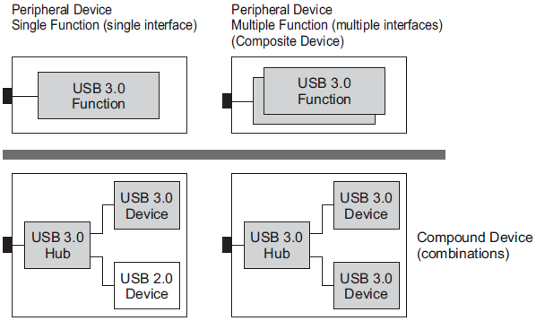
USB 3.0 Peripheral Device
A USB 3.0 peripheral device must provide support for both SuperSpeed and at least one other non-SuperSpeed speed.
The minimal requirement for non-SuperSpeed is for a device to be detected on a USB 2.0 host and allow system software to direct the user to attach the device to a SuperSpeed capable port.
Simultaneous operation of SuperSpeed and non-SuperSpeed modes is
not allowed for peripheral devices.

Slide 7
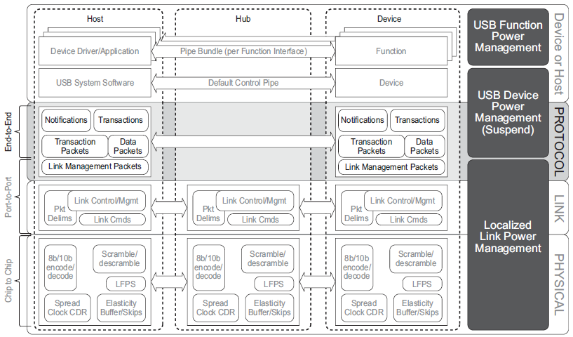
USB3 Layered Structure

Slide 8
Physical Layer

Slide 9
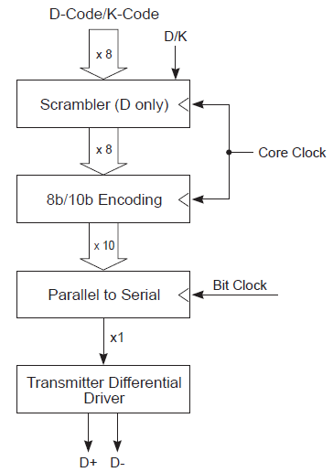
Transmitter Block Diagram

Slide 10
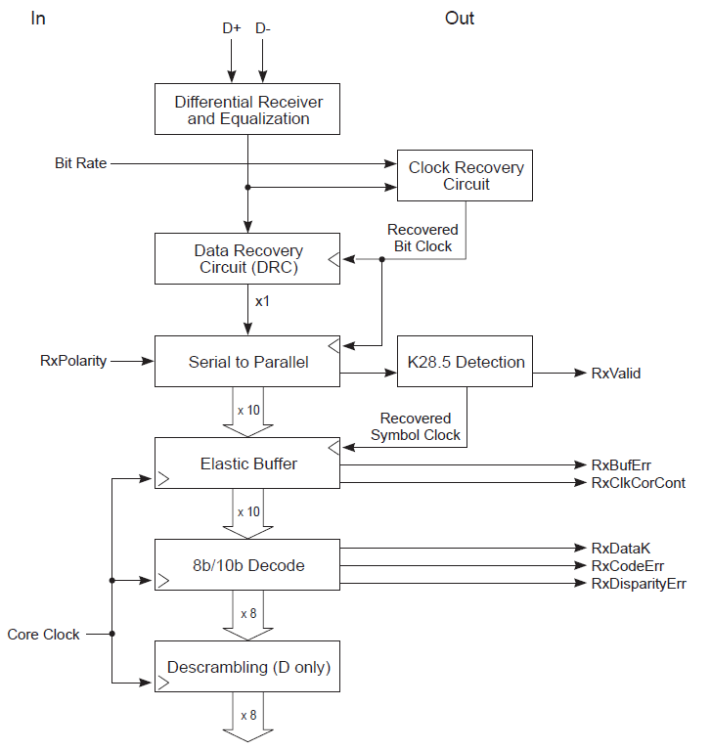
Receiver Block Diagram

Slide 11
Training Sequences
TSEQ OS
32 Symbol long (0 to 31)
Symbol 0 is COMMA, Symbol 1 to 15 are various
D- characters.
Symbol 16 to 31 are TS1 Identifiers (0x4A). These are used to detect
the Lane polarity inversion.
Sent 65536 times for testing during link training (Polling.RxEQ State).
TS1 OS
16 Symbols long
Symbol 0 to 3 are COMMA Characters.
Symbol 4 is Reserved.
Symbol 5 is Link Configuration field.
TS1 Identifier (0x4A). Can be used for Lane polarity inversion
detection.
TS2 OS
Same as TS1 except that TS1 Identifier is replaced with TS2 Identifier (0x45)

Slide 12

SKP OS
SKP Ordered Sets shall be used to compensate for frequency differences between the two ends of the link.
The transmitter sends SKP ordered sets at an average of every 354 symbols.
No SKP Ordered Sets are to be transmitted during the entire TSEQ time (65,536 ordered sets). This means that the PHY must manage elasticity buffer differently than during normal operation.
The transmitter is allowed to buffer the SKP ordered sets up to a maximum of four SKP ordered sets.

Slide 13
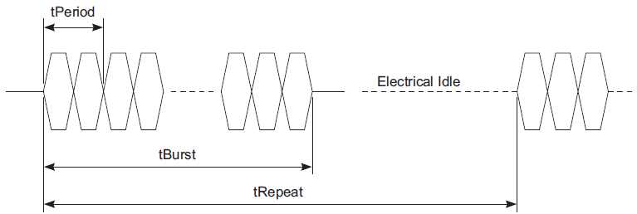
LFPS (Low Frequency Periodic Signaling)
LFPS is used for side band communication between the two ports across a link that is in a low power link state.
It is also used when a link is under training, or when a downstream port issues Warm Reset to reset the link.
tPeriod is the period of an LFPS cycle. An LFPS burst is the transmission of continuous LFPS signal over a period of time defined by tBurst. An LFPS sequence is defined by the transmission of a single LFPS burst of duration tBurst over a period of time defined by tRepeat. The link is in electrical idle between the two contiguous LFPS bursts.
An LFPS message is encoded based on the variation of tBurst.

Slide 14
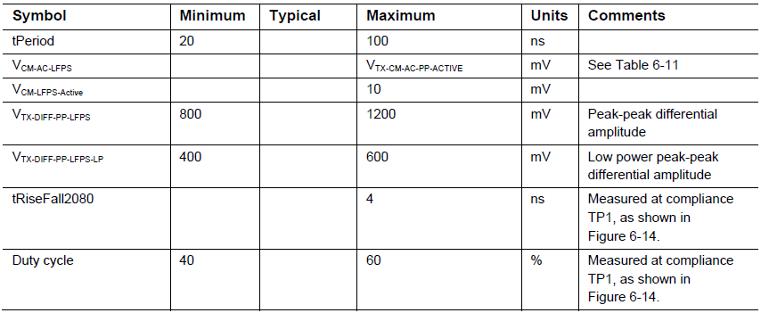
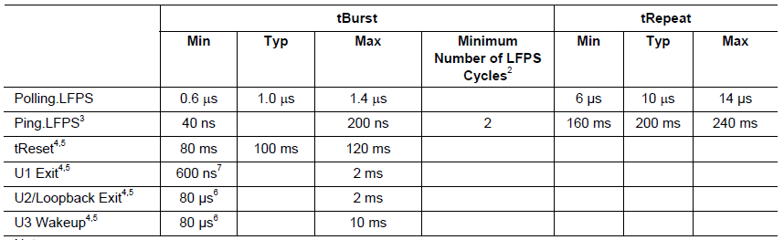
LFPS Continued…
Warm Reset, U1/U2/Loopback Exit, and U3 Wakeup are all single burst LFPS signals. tRepeat is not applicable.
Only Ping.LFPS has a requirement for minimum number of LFPS cycles.

Slide 15
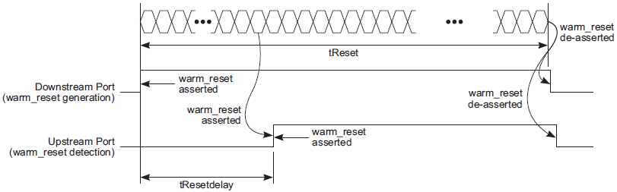
Warm Reset
A Warm Reset is a reset generated only by a downstream port to an upstream port.
A downstream port may issue a Warm Reset at any Link states except SS.Disabled. An upstream port is required to detect a Warm Reset at any link states except SS.Disabled.

Slide 16
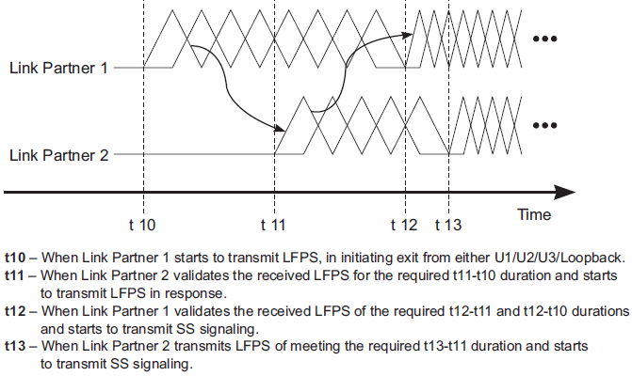
Example LFPS Handshake for U1/U2 Exit, Loopback Exit, and U3 Wakeup

Slide 17
Link Layer

Slide 18
Link Training & Status State Machine (LTSSM)

Slide 19
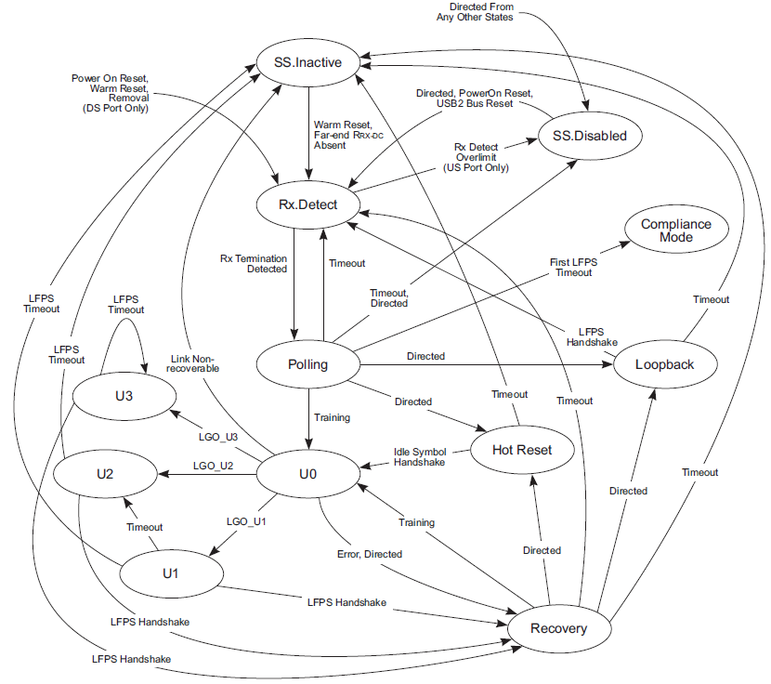
LTSSM

Slide 20
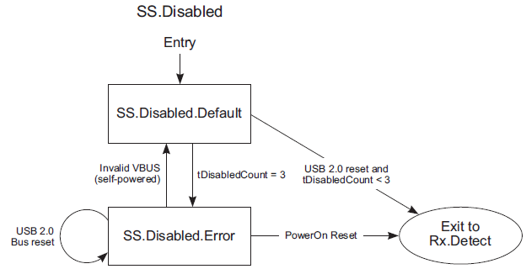
SS.Disabled
It is a state where a port’s SuperSpeed connectivity is disabled. Port’s Low impedance receiver termination is removed.
A downstream port shall transition to Rx.Detect from SS.Disabled when directed.
• A Hub upstream port shall transition to Rx.Detect only when VBUS transitions to valid or a USB 2.0 bus reset is detected. For a peripheral upstream port, the number of SuperSpeed attempts upon USB 2.0 bus reset is limited to 3.

Slide 21
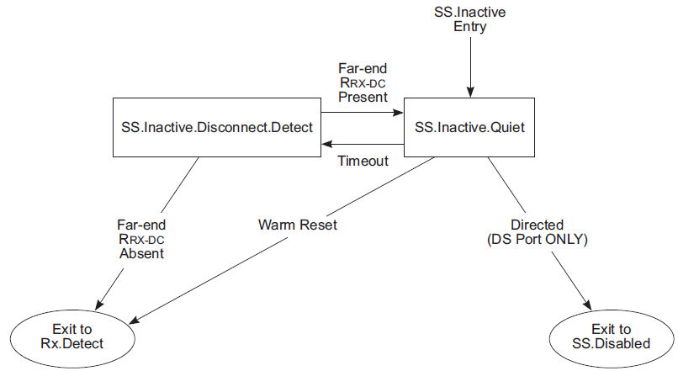
SS.Inactive
SS.Inactive is a state where a link has failed SuperSpeed operation.
VBUS must be present.
During SS.Inactive, a port periodically performs a far-end receiver
termination detection. If a disconnection is detected, a port will return to
Rx.Detect. If a disconnect is not detected, the link will stay in SS.Inactive
until software intervention.
Exits to Rx.Detect on Warm Reset.

Slide 22
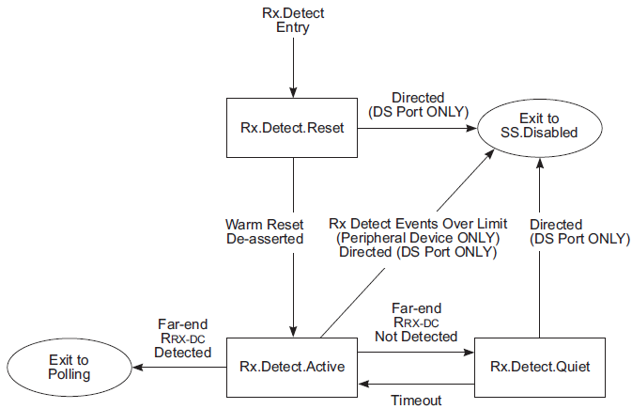
RX.Detect
It is a state for a downstream port upon issuing a Warm Reset, and the state for an upstream port upon detecting a Warm Reset from any other link state.
The purpose of Rx.Detect is to detect the impedance of far-end receiver termination to ground.
If far end receiver termination is not detected for 8 times, the SuperSpeed peripheral device may transition to USB 2.0.

Slide 23
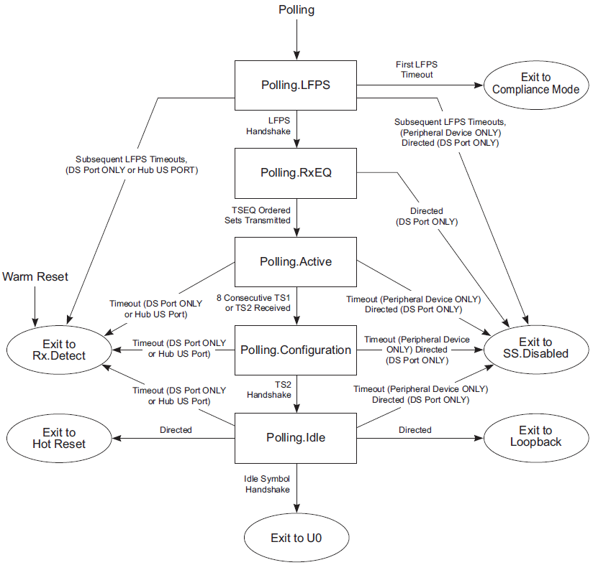
POLLING State

Slide 24
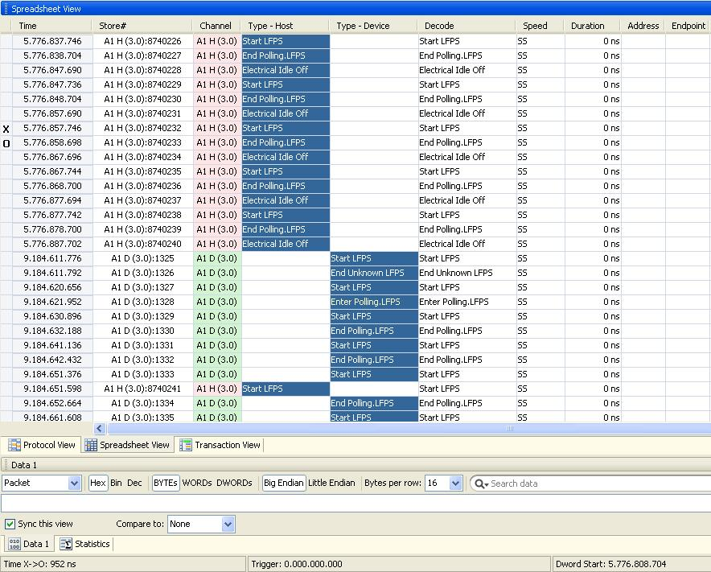
Example Trace - POLLING.LFPS
X – O = 952ns
tBurst time for Polling.LFPS

Slide 25
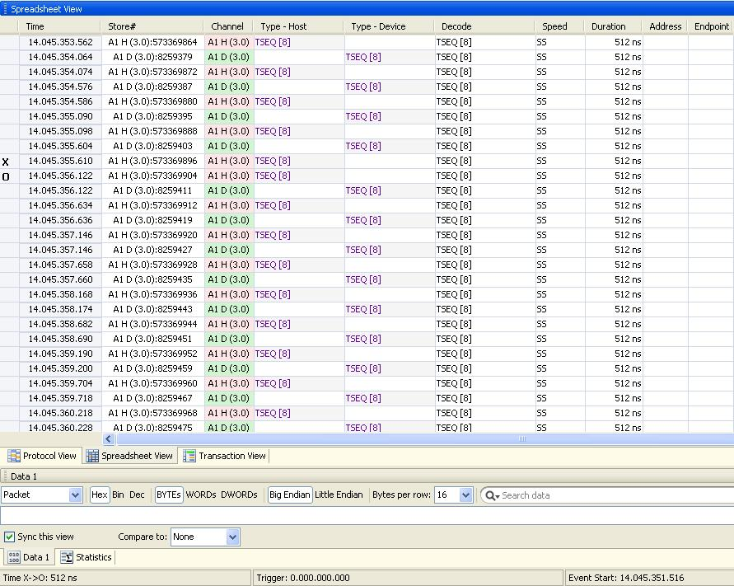
Example Trace – Polling.RxEQ

Slide 26
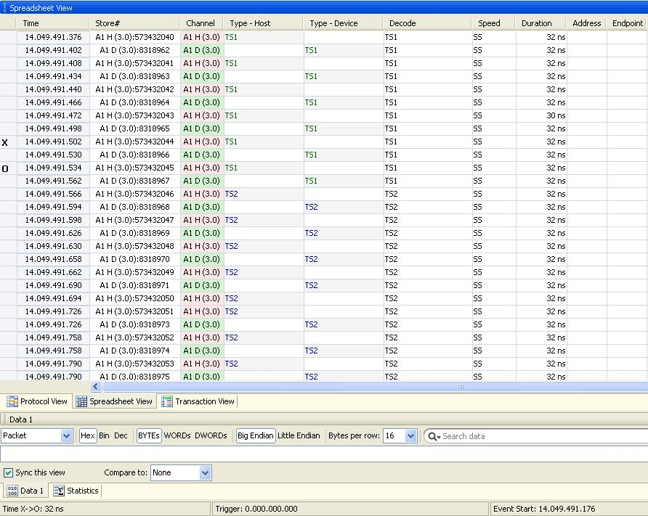
Example Trace – Polling.Active & Polling.Configuration

Slide 27
U0 State
U0 is the normal operational state where packets can be transmitted and received.
The port shall transition to Recovery upon any errors that will cause a link to transition to Recovery.
The port shall transition to Recovery upon detection of a TS1 ordered set or directed.
The port shall transition to U1 or U2 or U3 upon successful completion of LGO_U1 or LGO_U2 or LGO_U3 entry sequence.
A downstream port shall transition to Rx.Detect when directed to issue Warm Reset. An upstream port shall transition to Rx.Detect when Warm Reset is detected.

Slide 28
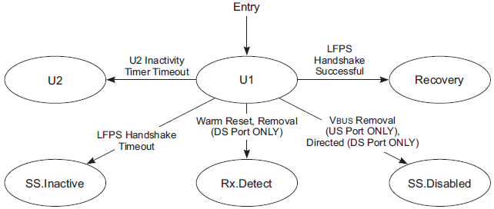
U1 State
U1 is a low power state where no packets are to be transmitted and both ports agree to enter in a low power state.
An upstream port shall transmit Ping.LFPS.
The port shall transition to Recovery upon successful completion of a LFPS handshake meeting the U1 LFPS exit handshake signaling.
A U2 inactivity timer should be enabled upon entry to U1 State. The port shall transition to U2 upon the timeout of the U2 inactivity timer.

Slide 29
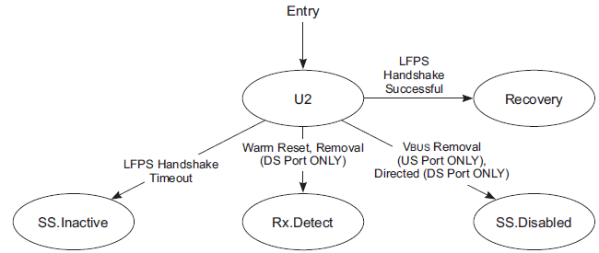
U2 State
U2 is a link state where more power saving opportunities are allowed compare to U1, but with an increased exit latency.
When a downstream port is in U2, its upstream port may be in U1 or U2. If the upstream port is in U1, it will send Ping.LFPS periodically. A downstream port shall differentiate between Ping.LFPS and U1 LFPS exit handshake signaling.
The port shall transition to Recovery upon successful completion of a LFPS handshake meeting the U2 LFPS exit signaling.

Slide 30
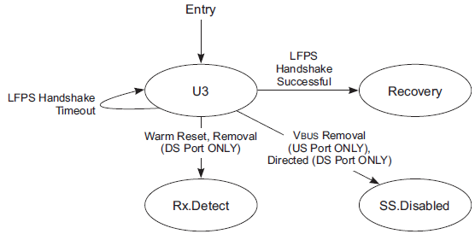
U3 State
U3 is a link state where a device is put into a suspend state. Significant link and device powers are saved.
The port not able to respond to U3 LFPS wakeup within tNoLFPSResponseTimeout may initiate U3 LFPS wakeup when it is ready to return to U0.
The port shall transition to Recovery upon successful completion of a LFPS handshake meeting the U3 wakeup signaling.

Slide 31
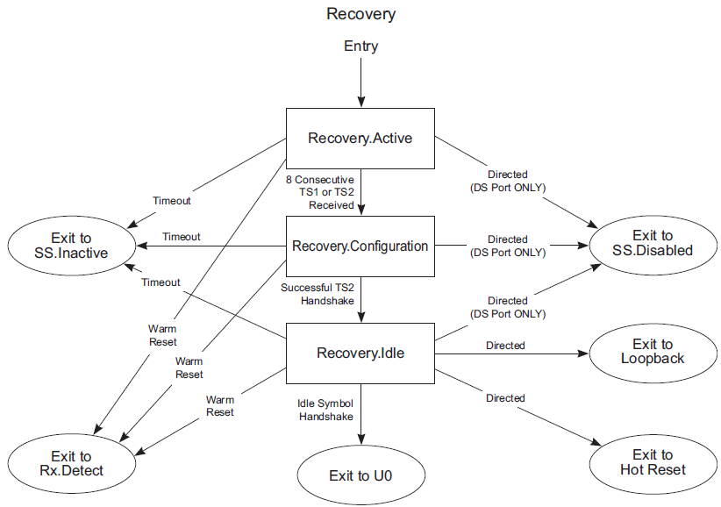
Recovery State
The Recovery link state is entered to retrain the link, or to perform Hot Reset, or to switch to Loopback mode.

Slide 32
Loopback State
Loopback is intended for test and fault isolation.
A loopback master is the port requesting loopback by setting the Loopback bit in TS2 OS in Recovery.Configuration State.
A loopback slave is the port that retransmits the symbols received from the loopback master.
Loopback has two substates: Loopback.Active and Loopback.Exit
Loopback.Active is a substate where the loopback test is active. The loopback master is sending data/commands to its loopback slave.
The loopback slave is either looping back the data or detecting/executing the BERT commands it received from the loopback master.
Loopback master shall transition to Loopback.Exit when directed.
The loopback slave shall transition to Loopback.Exit upon detection of Loopback LFPS exit handshake signal.

Slide 33
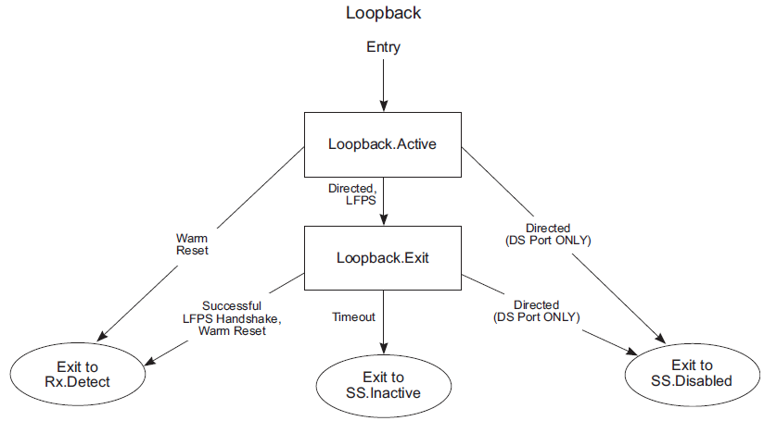
Loopback State Continued…

Slide 34
Loopback BERT
Loopback must occur in the 10-bit domain.
All symbols must be transmitted as received with the exception of SKP and BERT commands.
4 Ordered Sets are defined: BRST, BDAT, BERC & BCNT.
Any time a BRST is received, the error count register EC is set to 0 and the scrambling LFSR is set to 0FFFFh. BRST is looped back as received.
BDAT are looped back as received. The BDAT sequence is the output of the scrambler and is equivalent to the logical idle sequence (Scrambled 0s). The receiver must compare the received data to the BDAT sequence. Errors increment the error count register (EC) by 1.
BRST followed by BDAT starts the bit error rate test.
BERC ordered sets are not looped back but are replaced with BCNT ordered sets.
The BCNT ordered set includes the nonscrambled 8b/10b encoded error count (EC) register based on the running disparity.

Slide 35
Hot Reset
Hot Reset contains two substates : Hot Reset Active and Hot Reset.Exit
Only a downstream port can be directed to initiate a Hot Reset. It does this by settings the Reset bit in TS2 OS in Recovery.Configuration State.
The upstream port shall respond by sending the TS2 ordered sets with Reset bit asserted.
A downstream port shall reset its Link Error Count & PM Timers in Hot Reset State.
The port Configuration information shall remain unchanged upon completion of Hot Reset processing.
Upon completion of Hot Reset processing, the upstream port shall signal the downstream port by sending the TS2 ordered sets with the Reset bit de-asserted.

Slide 36
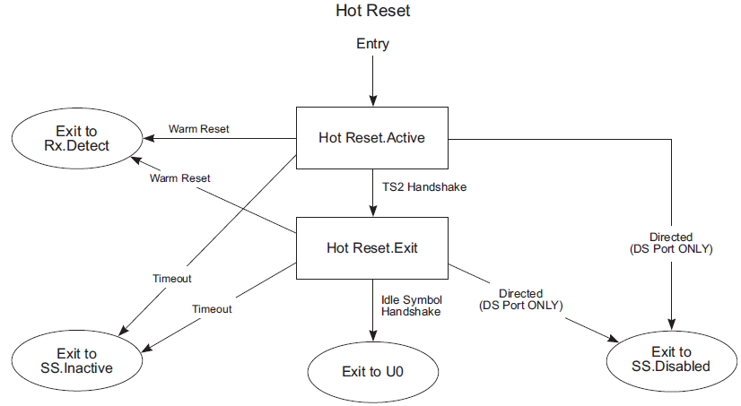
Hot Reset Continued…
The downstream port then respond with the Reset bit de-asserted in the TS2 ordered sets.
Once both ports receive the TS2 ordered sets with the Reset bit de-asserted, they shall exit from Hot Reset.Active and transition to Hot Reset.Exit.
Once a successful idle symbol handshake is achieved, the port shall return to U0.

Slide 37
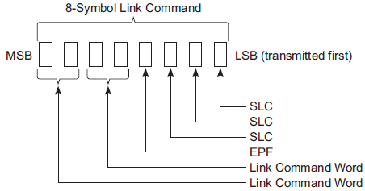
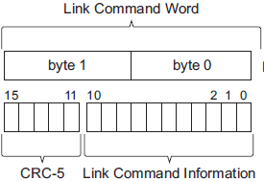
Link Commands
Link commands are defined and used by Link Layer.
Link command names have the L-preface to differentiate their link level usage and to avoid confusion with Packets.
Link commands have fixed length of eight symbols and contain repeated symbols to increase the error tolerance.
The first four symbols, LCSTART, are the link command starting frame ordered set consisting of three consecutive SLCs followed by EPF.
The second four symbols consist of a two symbol link command word and its replica.

Slide 38
Link Command Usage
Link Level Data Integrity
LGOOD_n, LRTY, LBAD
Flow Control
LCRD_x
Power Management
LGO_Ux, LAU, LXU, LPMA
Port Presence Indication in U0
LDN, LUP

Slide 39
Link Data Integrity (LGOOD_n)
n is Header Sequencer Number. n = (0, 1, 2, ....7 ).
Sent by a port receiving a Header Packet when all of the following conditions are true:
The header packet has a valid structure and can be recognized by the receiver.
CRC-5 and CRC-16 are valid.
Header Sequence Number in the received header packet matches the expected Rx Header Sequence Number.
An Rx Header Buffer in the receiver is available for storing the received header packet.
Mismatch between a Header Sequence Number in the received header packet and the expected Rx Header Sequence Number will result in a port transitioning to Recovery.
Also sent by a port upon entry to U0 as the Header Sequence Number Advertisement.
Receipt of LGOOD_n mismatching the expected ACK Tx Header Sequence Number will result in a port transitioning to Recovery.

Slide 40
Header Sequence Number Advertisement
Both the devices, upon entry to U0, Advertizes the sequence number of the last good Header packet they have received. They do this by transmitting LGOOD_n just after entering U0, where n = Sequence number of last good Header packet received.
This is used to maintain the link flow before and after Recovery such that a port upon re-entry to U0 is aware what was the last header packet sent successfully prior to Recovery, and decides what header packets in its Tx Header Buffers that can be flushed or need to be retransmitted.

Slide 41
Link Data Integrity (LBAD & LRTY)
Port sending LBAD is indicating that it has received a BAD Header Packet.
Bad Header Packet here means corrupted CRC-5 and/or CRC-16.
Receipt of LBAD will cause a port to resend all header packets after the last header packet that has been acknowledged with LGOOD_n.
LRTY is Sent by a port before replaying the first header packet in response to receipt of LBAD.

Slide 42
Flow Control (LCRD_x)
x is called Rx Header Buffer Credit Index. x= (A, B, C, D).
Signifies that a single Rx Header Buffer Credit has been made available.
Sent by a port after receiving a header packet that meets the following criteria:
LGOOD_n has been or will be sent.
The header packet has been processed, and an Rx Header Buffer Credit is available.
LCRD_x is sent in the alphabetical order of A, B, C, D, and back to A without skipping. Missing LCRD_x will cause the link to transition to Recovery.

Slide 43
Rx Header Buffer Credit Advertisement
The Rx Header Buffer Credit Advertisement refers to exchange of available Local Rx Header Buffer Credits information.
Rx Header Buffer Credits Advertisement is done every time the port enters into U0.
A port shall initiate the Rx Header Buffer Credit Advertisement after sending LGOOD_n during Header Sequence Number Advertisement.
If a port enters U0 from Polling or Hot Reset, its Local Rx Header Buffer Credit Count is 4.
If a port enters U0 from Recovery, its Local Rx Header Buffer Credit Count is the number of Header Buffer space available at the receiver.

Slide 44
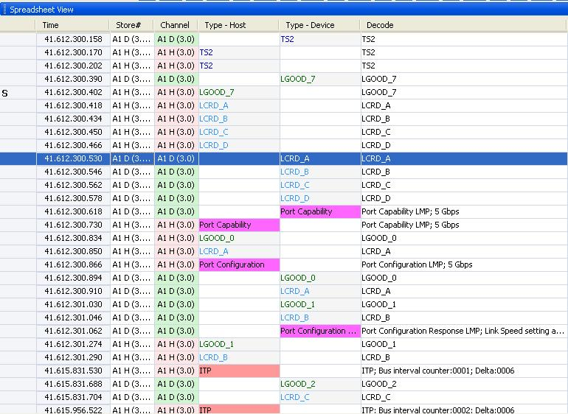
Example Trace – SEQNUM & CREDIT Advertisement

Slide 45
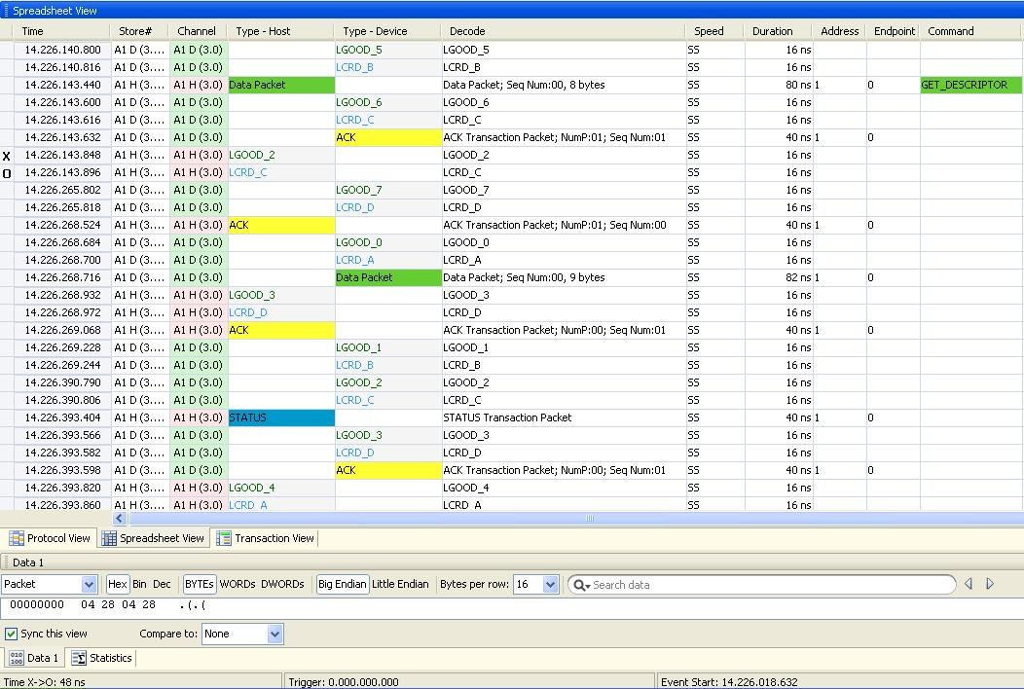
Example Trace – LGOOD_n & LCRD_X on Reception of Packets

Slide 46
Link Power Management (LGO_Ux, LAU, LXU, LPMA)
LGO_U1: Sent by a port requesting entry to U1.
LGO_U2: Sent by a port requesting entry to U2.
LGO_U3: Sent by a downstream port requesting entry to U3. An upstream port must accept the request.
LAU: Sent by a port accepting the request to enter U1, U2, or U3.
LXU: Sent by a port rejecting the request to enter U1 or U2.
LPMA: Sent by a port upon receiving LAU. Used in conjunction with LGO_Ux and LAU handshake to guarantee both ports are in the same state.

Slide 47
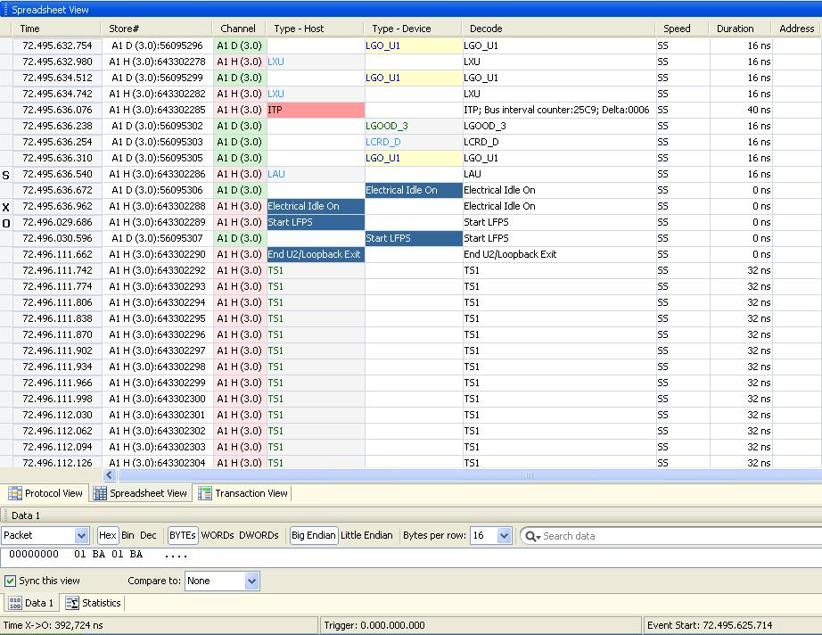
Example Trace – U1 Entry/Exit
U2 Inactivity Timer is set to 256us. So Link silently entered into U2 after spending 256us in U1.
X-O = ~392us total time in Elec Idle

Slide 48
Port Presence Indication in U0 (LDN, LUP)
LDN: Downstream port present in U0. Sent by a downstream port every 10 μs when there are no packets or other link commands to be transmitted.
LUP: Device present in U0. Sent by an upstream port every 10 μs when there are no packets or other link commands to be transmitted.
A downstream port shall transition to Recovery upon not receiving any link commands in U0 for 1 ms.
An upstream port shall transition to Recovery if it does not receive any link command or any packet in U0 for 1 ms.

Slide 49
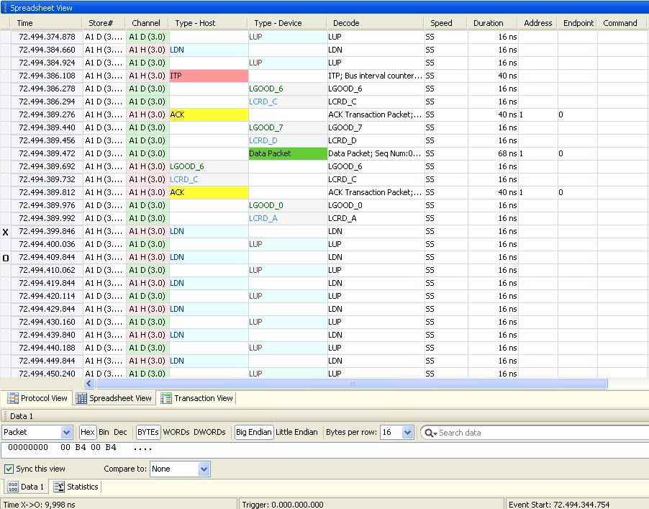
Example Trace – LDN/LUP
X-O = ~10us

Slide 50
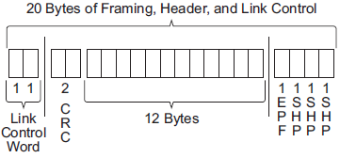
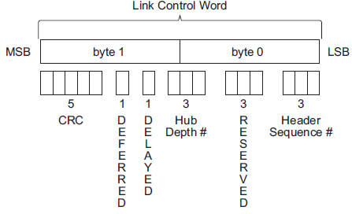
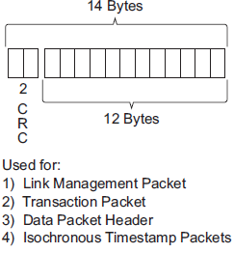
Header Packet Structure
All header packets are 20 symbols long
A header packet consists of three parts, a header packet framing (HPStart), a packet header, and a Link Control Word.
HPStart

Slide 51
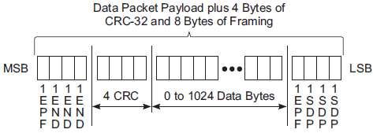
Data Packet Payload (DPP) Structure
Data packets are a special type of packet consisting of a Data Packet
Header (DPH) and a Data Packet Payload (DPP).
The DPP consists of a data packet payload framing, and a variable length
of data followed by 4 bytes of CRC-32.
DPP end can be END or EDB. END is a normal end of the packet. EDB is
the DPPABORT which indicates abnormal ending of the packet.
The DPP section consists of 0 to 1024 data bytes followed by 4 bytes
CRC-32.
A DPP shall immediately follow its corresponding DPH with no spacing in
between
DPPSTART
DPPEND

Slide 52
Packet Delimiters
Packets are defined and used by Protocol Layer for communication.
SuperSpeed defines two structures of Packets:
Header Packet (HP)
Data Packet Payload (DPP)
It is the Job of Link Layer to attach the Delimiters to the Packets.
HPStart is the Packet Delimiters for Header packet Start.
DPPStart is the Packet Delimiters for Data Packet Payload Start.
DPPEND & DPPABORT are the Packet Delimiters for DPP normal End and abnormal End respectively.

Slide 53
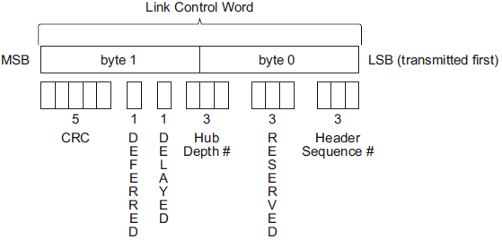
Link Control Word
Header Sequence Number is the Link Layer Sequence Number.
Delayed (DL) bit shall be set by a hub and optionally by a peripheral device or host. Following are the possible reasons of Delay:
1. When a header packet is resent.
2. When the link is in Recovery.
3. When the Remote Rx Header Buffer Credit Count is zero.
4. When the Tx Header Buffer is not empty.
Note: The delayed bit only has significance if it is set in an ITP. If a device uses the ITP to synchronize its internal clock, then it should ignore any ITPs with the delayed bit set.
Deferred (DF). When a host initiates a transaction that encounters a link in a non-active state, a deferred response is sent by the hub to tell the host that this particular path is in a reduced power managed state and that the host should go on to schedule other transactions. In addition, the hub sends a deferred request to the device to notify it that a transaction was attempted.
Hub Depth. This field is only valid when the Deferred bit is set and identifies to the host the
hierarchical on the USB that the hub is located at in the low power state (either U1 or U2).

Slide 54
Protocol Layer

Slide 55
Overview
Endpoints & Pipes
Concept of Bus Interval & Service Interval
Transaction Generation
Packets Types
USB Transfer Types (Bulk, Control, Isochronous & Interrupt)
Device Enumeration & Configuration
Descriptors
Device Classes

Slide 56
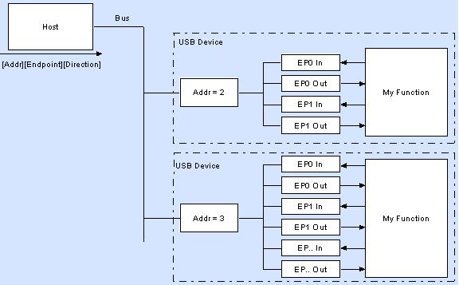
Endpoint(s)
Hub
Each Function implements a series of Endpoints - EP0 IN, EP0 OUT, EP1 IN etc.
Each Endpoint has a buffer associated with it.
If the data is flowing out from the Host, it will end up in the EP[x] OUT buffer. Device firmware will then read this data.
If data needs to be transfer from Device to Host, the Device will write data in EP[x] IN buffer. Host will then read that by issuing an IN packet to that endpoint requesting the data.
All devices must support Endpoint zero.

Slide 57
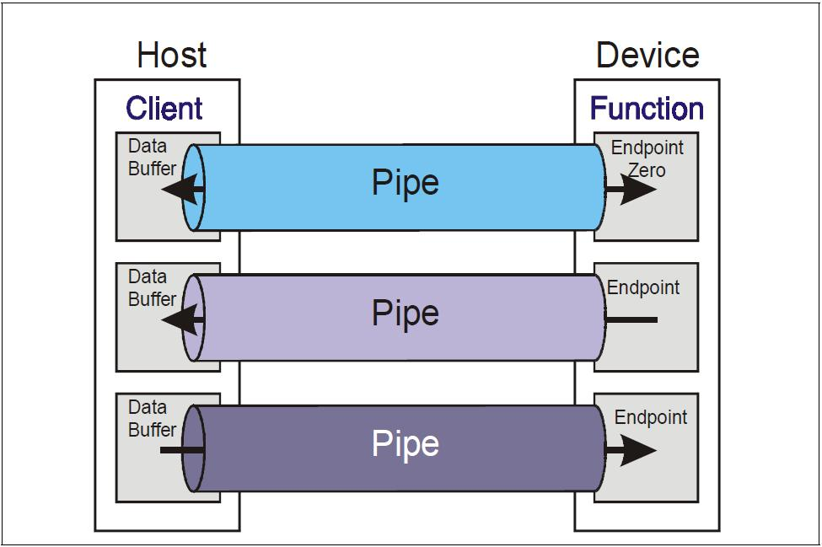
Pipe(s)
A Pipe is a logical connection between the Host and a Endpoint.
‘Default Pipe’ is a bi-directional Pipe made up of Endpoint zero IN and Endpoint zero OUT with a control transfer type.
Default Pipe receives all Control and Status requests during enumeration.

Slide 58
SuperSpeed Transactions
All protocol layer communications are accomplished via the exchange of Packets.
SuperSpeed is a host-directed protocol. SuperSpeed transactions are initiated by the host when it either requests or sends data to an endpoint on a device.
SuperSpeed transactions are completed when the endpoint sends the data or acknowledges receipt of the data.
Host transmitted protocol packets are routed through intervening hubs directly to a peripheral device. They do not traverse bus paths that are not part of the direct path between the host and the target peripheral device

Slide 59
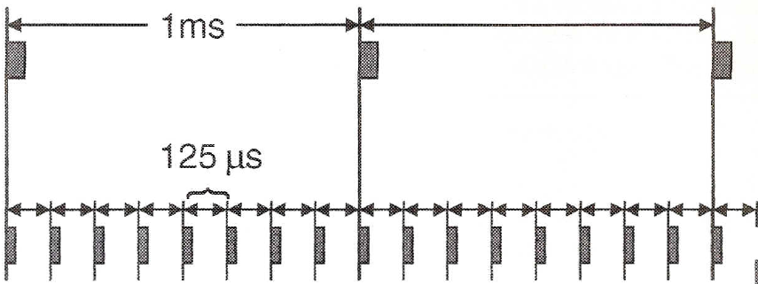

Bus Interval at FS & HS Speeds
Frame
(LS & FS)
microFrame (HS)
SOF
(LS & FS)
SOF (HS)
SOF Packet
Bus Interval is 125us at HS Speed while it is 1 ms at LS & FS Speeds.
It is the job of Host Controller to generate & communicate the bus timing.
Start-of-Frame (SOF) packets are issued by the host at a nominal rate of once every 1.00 ms ±0.0005 ms for a FS bus and 125 μs ±0.0625 μs for a HS bus i.e. once every bus interval.

Slide 60
Bus Interval at Superspeed
Bus Interval is 125us at Superspeed.
Again it is the job of Host Controller to generate & communicate the bus timing.
Host controller does this by sending Isochronous Timestamp Packet (ITP) around each bus interval boundary.
ITP communicates the current bus interval number and the time from the start of the timestamp packet to the previous bus interval.

Slide 61
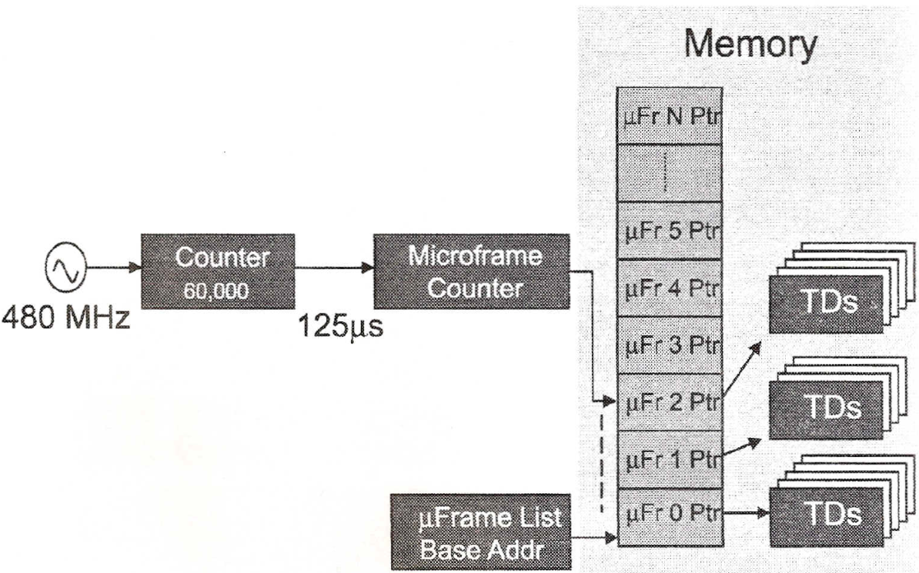
Transaction Generation HS & SS Speeds
USB Host generates USB Transactions by fetching & executing a linked list of data structures called Transaction Descriptors (TDs) from the Memory.
Each TD defines a USB Transaction that software has requested and scheduled for the purpose of accessing a USB device. For Example, one TD is to read data from a webcam while another TD may specify a data transfer to a printer.
Each TD contains a link address to the next TD in the list. By this way, each TD in the list is fetched & executed resulting in a series of Transactions during the current microframe.
microframe counter is incremented once every 125us. It is used as address to fetch the first TD in the linked list of descriptors that is going to be executed in current microframe.
Some devices may require bus access every microframe while other may require on periodic basis.

Slide 62
SuperSpeed Packet Types
Superspeed defines four basic types of packets:
Link Management Packets (LMP)
Transaction Packets (TP)
Data Packets (DP)
Isochronous Timestamp Packets (ITP):
SuperSpeed packets start with a 16-byte header.
Some packets consist of a header only.

Slide 63
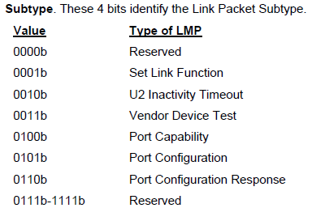
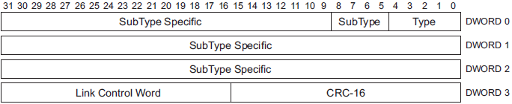
Link Management Packet (LMP)
LMP only traverses a pair of directly connected ports and is primarily used to manage that link.

Slide 64
LMP Subtypes
Set Link Function : Used to force a port to accept all LGO_U1 and LGO_U2 Link Commands.
U2 Inactivity Timeout : Used to define the timeout from U1 to U2.
Vendor Device Test : Used for vendor-specific device testing and shall not be used during normal operation of the link.
Port Capabilities : It describes each port's link capabilities and is sent by both link partners after the successful completion of training and link initialization. Main capabilities advertized are:
Link Speed supported (Must be 5GT/s)
Number of HP Buffer at Tx & Rx side (Must be equal to 4)
Direction : Downstream Port /Upstream Port

Slide 65
LMP Subtypes Continued …
Port Configuration : Sent by the Downstream Port after Link Initialization. It describes the link speed at which the upstream port shall operate.
Port Configuration Response : Sent by the upstream port in response to a Port Configuration LMP. It is used to indicate acceptance or rejection of the Port Configuration LMP.

Slide 66
Example Trace: Port Capability & Port Configuration LMP

Slide 67
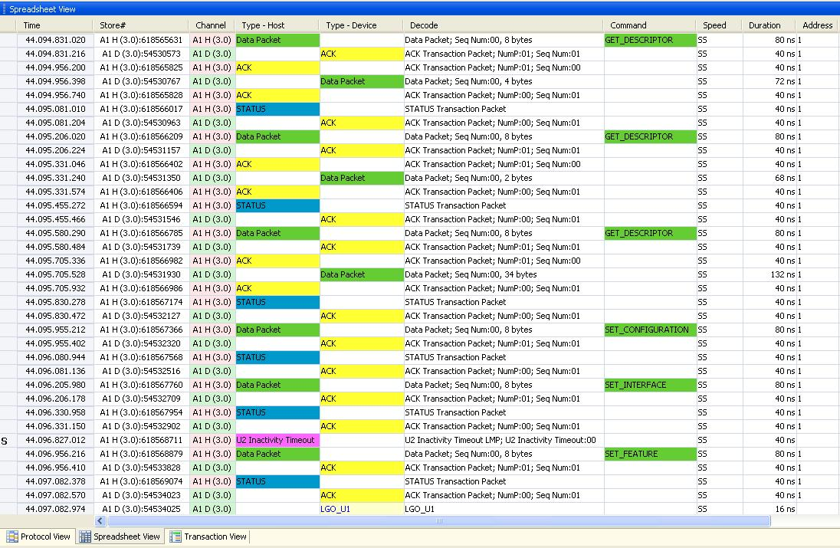
Example Trace: Set U2 Inactivity Timeout LMP

Slide 68
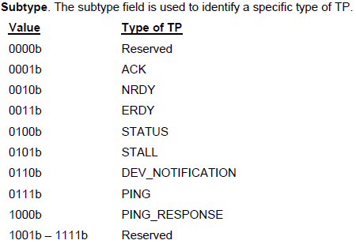
Transaction Packet (TP)
A Transaction Packet (TP) traverses all the links in the path directly connecting the host and a device.
It is used to control the flow of data packets, configure devices and hubs, etc.
A Transaction Packet does not have a data payload.

Slide 69
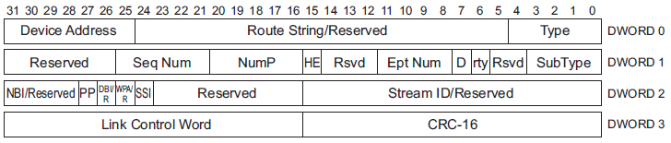
Acknowledgement (ACK) Transaction Packet
This TP is used for two purposes:
For IN endpoints it is sent by the Host to:
request data from a device
acknowledge the previously received data packet.
For OUT endpoints, this TP is sent by a device to
Acknowledge receipt of the previous data packet sent by the host,
Inform the host of the number of data packet buffers it has available after receipt of this packet.

Slide 70
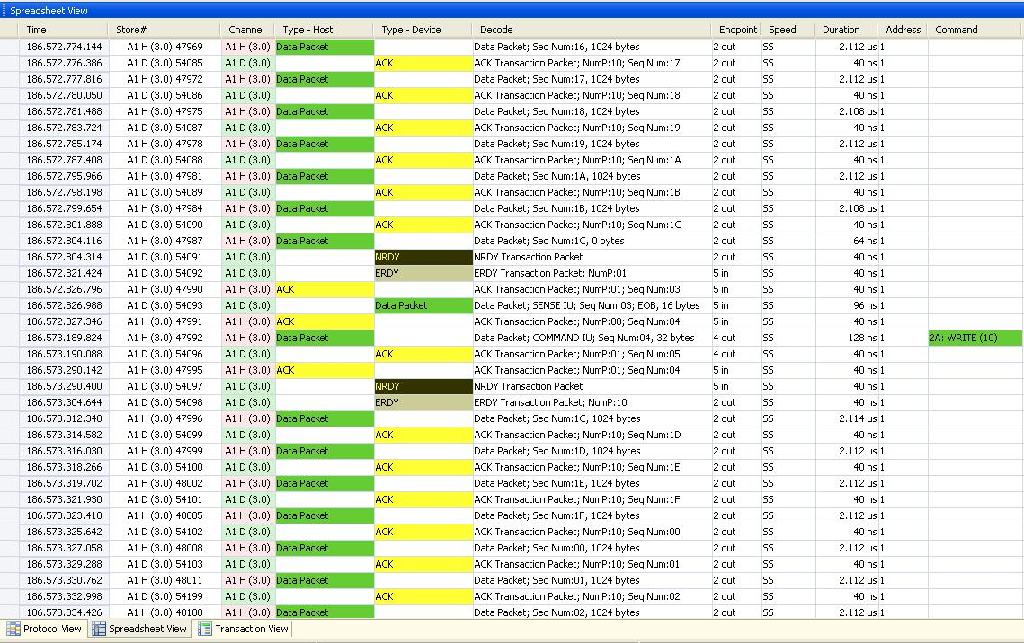
Example Trace: ACK TP
Transfer to OUT EP
Transfer to IN EP

Slide 71
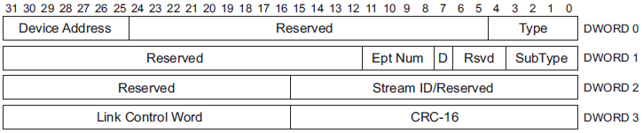
Not Ready (NRDY) Transaction Packet
An OUT endpoint sends this TP to the host if it has no packet buffer space available to accept the DP sent by the host.
An IN endpoint sends this TP to the host if it cannot return a DP in response to an ACK TP sent by the host.
This TP can only be sent by a device for an access to non-isochronous endpoint .

Slide 72
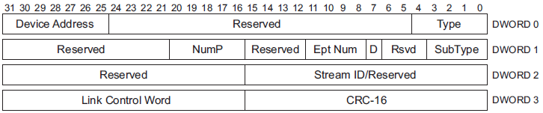
Endpoint Ready (ERDY) Transaction Packet
It is used to inform the host that an endpoint is ready to send or receive data packets.
This TP can only be sent by a device for an access to non-isochronous endpoint.

Slide 73
Example Trace: NRDY/ERDY for Bulk IN/OUT EP

Slide 74
STATUS, STALL & DEV NOTIFICATION TP
STATUS TP :
Status TP can only be sent by the host to a Control Endpoint.
It is used to inform a control endpoint that the host has initiated the Status stage of a control transfer.
STALL TP :
This TP can only be sent by an endpoint on the device.
It is used to inform the host that the endpoint is halted or a control transfer is invalid.
Device Notification (DEV_NOTIFICATION) TP :
This TP can only be sent by a device.
It is used by devices to inform the host of an asynchronous change in a device or interface state, e.g. to perform a remote wake operation.

Slide 75
PING & PING RESPONSE TP…
PING TP :
This TP can only be sent by the host.
It is used by the host to transition all links in the path to a device back to U0 prior to initiating an isochronous transfer.
PING_RESPONSE TP :
This TP can only be sent by a device in response to a PING TP sent by the host.
A PING_RESPONSE TP shall be sent for each PING TP received.

Slide 76
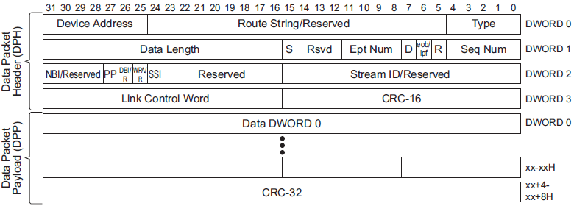
Data Packets (DP)
A Data Packet (DP) traverses all the links in the path directly connecting the host and a device.
Data Packets consist of two parts:
A Data Packet Header (DPH) which is similar to a TP
A Data Packet Payload (DPP) which consists of the data block plus a 32-bit CRC (CRC-32) used to ensure the data’s integrity.

Slide 77
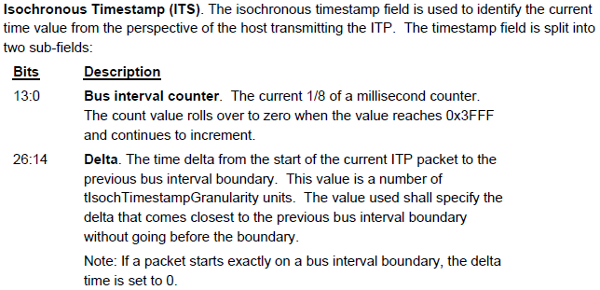

Isochronous Timestamp Packet (ITP)

Slide 78
ITP Continued…
ITPs are used to provide host timing information to devices for synchronization. Only a host can initiate an ITP transmission.
ITPs carry no addressing or routing information and are multicast by hubs to all of their downstream ports with links in the U0 state.
A device shall not respond to an ITP.
The host shall transmit an ITP on a root port link if and only if the link is already in U0. The host shall not bring a root port link to U0 for the purpose of transmitting an ITP.
The host shall transmit an ITP in every bus interval if the root port link is in U0.
If a device receives an ITP with the delayed flag (DL) set in the link control word, the timestamp value may be significantly inaccurate and may be ignored by the device.

Slide 79

Example Trace - ITPs
~125us

Slide 80
Transaction Types
Non-Periodic Transfers
Bulk Transfers
Control Transfers
Periodic Transfers
Interrupt Transfers
Isochronous Transfers
Periodic endpoints may be allocated up to 90% of the total available bandwidth on SuperSpeed.
Control transfers can go upto remaining 10%.
Once these have been allocated, bulk transfers will get their slice of what is left.

Slide 81
Bulk Transfer
Guaranteed delivery of data through error checking & retry, but no guarantee of bandwidth or latency
It can be IN or OUT:
BULK IN : When Host reads data from Device.
BULK OUT : When Host writes Data to the Device

Slide 82
Data Bursting
Ability of an Endpoint to send or receive more then one DP without an intermediate ACK TP, is known as Bursting.
The burst transaction continues as long as the NumP field in the ACK TP is not set to zero and each packet has a data payload of maximum packet size.
Each individual packet in the burst shall have a data payload of maximum packet size. Only the last packet in a burst may be of a size smaller than the reported maximum packet size.
The NumP field can be incremented at any time by the host or a device sending the ACK TP as long as the device or host wants to continue receiving data.

Slide 83

Bulk In Transfer
When the host is ready to receive bulk data, it sends an ACK TP to a device indicating the sequence number and number of packets it expects from the device.
A Bulk endpoint shall respond with the data.
The host shall send an ACK TP for each valid DP it receives from a device.
A device does not need to wait for the ACK TP to send the next DP if the previous ACK TP has NumP field > 1).
If the host detects an error while receiving any of the DPs, it shall send an ACK TP with the sequence number value set to the first DP that was received with an error with the Retry bit set.
The transfer is completed when Device sends DP with EOB bit set or a DP with payload length less then MaxPayloadSize of that Endpoint.

Slide 84

Example Trace: Bulk IN Transfer

Slide 85

Bulk Out Transfer
When the host is ready to transmit bulk data, it sends one or more DPs to a device.
If a DPH with valid values (valid device address, endpoint number, and direction as well as the expected sequence number) is received by a device, it shall respond with an ACK TP with appropriate Seqnum & NumP field.
A transfer is complete when the host sends all the data it has to a device; however the last DP of the transfer may or may not have a payload which is equal to the MaxPacketSize of the endpoint.

Slide 86

Example Trace: Bulk OUT Transfer

Slide 87
Control Transfer
Control transfers are typically used for command and status operations.
Control transfers are essential to set up a USB device with all enumeration functions being performed using control transfers.
Control transfers have a minimum of two transaction stages: Setup and Status. A control transfer may optionally contain a Data stage between the Setup and Status stages.

Slide 88
Control Transfer – SETUP Stage
Setup stage is the first stage of a Control Transfer
During the Setup stage, a SETUP transaction is used to transmit information to a control endpoint of the device.
SETUP transactions are similar in format to a Bulk OUT transaction but have the Setup field set to one in the DPH along with the Data Length field set to eight.
Setup packet always uses a Data sequence number of zero.

Slide 89
Control Transfer – Optional Data Stage
The Data stage, if present, consists of one or more IN or OUT transactions and follows the same protocol rules as bulk transfers except that the Direction field shall always be set to zero.
All the transactions in the Data stage shall be in the same direction (i.e., all INs or all OUTs).
The Data stage always starts with the sequence number set to zero.
All control endpoints only support a burst of one and hence the host can only send or receive one packet at a time to or from a control endpoint.

Slide 90
Control Transfer – STATUS Stage
The Status stage of a control transfer is the last transaction in the sequence.
The Status stage transaction is identified by a TP with the SubType set to STATUS.
During the Status stage, a device reports to the host the outcome of the previous Setup and Data stages of the transfer. Three possible results may be returned:
The command sequence completed successfully.
The command sequence failed to complete.
The device is still busy completing the command.

Slide 91

Control Read Sequence
BULK OUT with Seqnum = 0
BULK IN with Seqnum = 0

Slide 92

Control Write Sequence
BULK OUT with Seqnum = 0
BULK OUT with Seqnum = 0

Slide 93

Service Interval
Service Interval is defined as an integral multiple of Bus Intervals within which a periodic endpoint must be serviced.
Periodic Endpoints specifies its desired service interval via its Endpoint descriptor.
An interrupt endpoint can specify a desired period 2^{(bInterval-1)} x 125 μs, where 1 <= bInterval <= 16.
The USB System Software uses this information during configuration to determine a period that can be sustained.

Slide 94
Interrupt Transfers
In a typical microcontrollers system interrupts are generated by the devices.
If a USB Interrupt Endpoint requires the attention of the Host, it must wait until the host polls it.
Interrupt transfers are scheduled periodically by the Host based on the requirement of the device so that overrun condition do not occur.
An Interrupt Endpoint specifies its desired service interval bound via its endpoint descriptor.
Interrupt transactions are very similar to bulk transactions – but are limited to a burst of three DPs in each service interval.

Slide 95

Interrupt IN Transaction
The host periodically polls the interrupt Endpoint using ACK TP.
If an interrupt has been queued by the device, the function will send a data packet containing data.

Slide 96


Interrupt IN Transaction – Device not ready
When an endpoint receives an ACK TP from the host and cannot respond by sending data, it shall send an NRDY (or STALL in case of an internal endpoint or device error) TP to the host.
The host shall not perform any more transactions to the endpoint in subsequent service intervals.
The host shall resume interrupt transactions within 2x service interval after it receives ERDY TP.

Slide 97

Interrupt OUT Transaction
Host starts Interrupt OUT transaction to an endpoint, by sending a DP with expected sequence number.
The host may send more packets to the endpoint in the same
service interval if the endpoint supports a burst size greater than one.
If an endpoint was able to
receive that data from the host, it sends an ACK TP to acknowledge the successful receipt of data.

Slide 98


Interrupt OUT Transactions – Device Not Ready
When an endpoint receives data from the host, and it cannot receive data momentarily, it shall send an NRDY (or STALL in case of an internal endpoint or device error) TP to the host.
The host shall not perform any more transactions to the endpoint in subsequent service intervals.
The host shall resume interrupt transactions within 2x service interval after it receives ERDY TP.

Slide 99
Isochronous Transaction
Isochronous transfers occur continuously and periodically. They are attempted in each service interval.
They typically contain time sensitive information, such as an audio or video stream. Data reliability is sacrificed for guaranteed bandwidth.
Isochronous transactions do not support retry capability. The reason is that if there is a delay or retry of data in an audio stream, then there can be some erratic audio containing glitches. The beat may no longer be in sync. However if a packet or frame was dropped every now and again, it is less likely to be noticed by the listener.

Slide 100
Isochronous Transaction Continued…
Isochronous Transfers provide
Guaranteed access to USB bandwidth.
Bounded latency.
Error detection via CRC, but no retry or guarantee of delivery.
Data packets sent to or received from an isochronous endpoint are not acknowledged, i.e., no ACK TPs are sent to acknowledge the receipt of data packets.
Isochronous transfers do not use ERDY or NRDY TPs as they are serviced by the host at periodic intervals.

Slide 101

Isochronous IN Transaction
Host issues an ACK TP followed by a data phase in which the endpoint transmits data

Slide 102

Isochronous OUT Transaction
Host simply transmits data when there is data to be sent in the current service interval.

Slide 103
Configuration

Slide 104
Configuration Process
The process of identifying and configuring a USB device is known as Device Enumeration.
If a device is not attached to a hub port, the Hub disables that port.
As a device is attached at the hub port, the Status bit corresponding to that port is set inside the Hub. Hub implement an Interrupt Endpoint that keeps track of Status change event.
Host Software polls the Status change Endpoint. As it recognizes that a device is attached, it enables the port, resets the USB device, assigns a unique address, and completes the configuration process.
This operation is performed for each port until all devices attached to the root hub have been identified & configured.
These operations are performed using Control Transfers to device’s control Endpoint (Endpoint Zero) to access its descriptors.

Slide 105
Descriptors
Every USB Device contains the standard Descriptors.
USB driver software parses these descriptors to determine the device’s USB characteristics and its Device Class information to locate the appropriate client software.
Following are the various Descriptor Types of defined:
Device Descriptor
Configuration Descriptor
Interface Descriptor
Endpoint Descriptor
String Descriptor
Class-specific Descriptor

Slide 106

Standard Device Descriptor with two configurations

Slide 107
Device Descriptor
Main Information Contained in Device Descriptor are:
Vendor Information
Device Class Information
Number of Configurations Supported

Slide 108

Device Classes
USB defines class codes used to identify a device’s functionality and to load a device driver based on that functionality.
This enables every device driver writer to support devices from different manufacturers that comply with a given class code.

Slide 109
Configuration Descriptor
A Device may provide additional Configurations to provide flexibility during configuration and enhance the probability that the device can be successfully configured.
For Example, A device normally consumes 200mA of current, however the device designer may provide another configuration which would be less featured but consumes 100ma of current.
If this device is bus powered and connected to a port which can only deliver 100ma of current max, the host software would enable the second configuration and would support the device.
If device had not been supporting the second configuration, the Host software would not support the device and would not enable it.
Configuration Descriptor defines if this configuration is Bus Powered or Self powered.
Configuration Descriptor also defines the Number of Interfaces supported.

Slide 110
Interface Descriptor
Interface Descriptor defines the ‘Alternate Settings’ feature.
Intent is to fine tune a configuration after the initial configuration has been completed.
It gives the Number of Endpoints used by this Interface (excluding Endpoint Zero)

Slide 111
Endpoint Descriptor
Endpoint Descriptor broadly defines the following:
Type of Transfer required by this Endpoint (Bulk, Isochronous, Control or Interrupt)
Direction of the transfer (IN or OUT)
Bandwidth needed :The total number of bytes this endpoint will transfer every service interval.
Service Interval

Slide 112
String Descriptor
This is an optional Descriptor.
It contains a UNICODE string that provides human-readable information that can be displayed.

Slide 113
Class Specific Descriptor
This is Device class specific Descriptor.
A given Device class may require additional descriptors as defined by a particular device class specification.

Slide 114

Example Trace: Set Address & Get Descriptors

Slide 115
Example Trace: GET/SET Descriptors

Slide 116
Thank You

