Slide 1
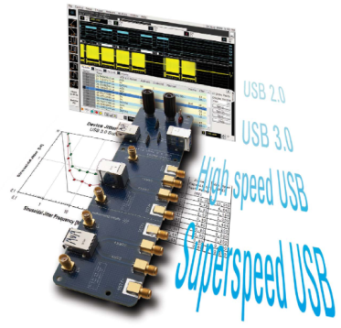
SuperSpeed USB 3.0 Technology Overview and Industry Update

Slide 2
Agenda
Introduction
Physical Layer Overview
Transmitter Test Requirements and Pitfalls
Calibration Caution
Receiver Test Requirements and Pitfalls
Synchronizing the USB analysis traces
Questions

Slide 3
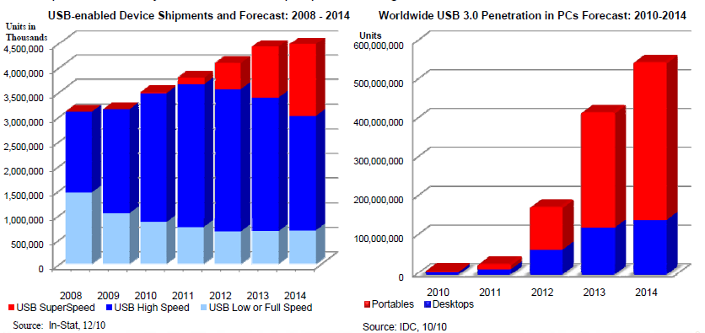
Worldwide shipment of USB-enabled Devices
Notes:
USB 3.0 has been around for awhile now, but as the graphs above show the growth forecast over the next few years for this standard is exponential.
USB install base is 10+ billion and growing at 3+ billion a year.

Slide 4



SuperSpeed USB Timeline
Broad Deployment
Initial Deployment
Product Development
USB 3.0 Electrical Compliance Test Specification
0.9RC
1.0 Test
Spec – Pending ECN updates
SSIC spec
Work started
Test Lab
Qualification – Pending resolution of USB 3.0 Gold Tree
#76
#77
#78
#79
#80
#81
#82
#83
#84
#85
Wksp:
OR
Jul
Wksp:
HI
Jan
Wksp:
OR
Nov
Wksp:
TPE
Sept
Wksp: OR
April
Wksp:
HI
Feb 6-10
(TBD)
Oregon
April
(TBD)
Oregon
July
(TBD)
Taipei
Sept
(TBD)
Oregon
Nov
Compliance Program/Industry Enabling Development
2011
2012
Notes:
SSIC = SuperSpeed USB Inter-Chip
SSIC aims to support physical layer data rates starting at 1.2 to 2.9 Gbits/s and eventually extending up to 5.8 Gbits/s. It also plans a low power mode for data rates between 10 Kbits/s and 600 Mbits/s.
This isn't a race between the Thunderbolt and SuperSpeed, as they are addressing different applications. SSIC is addressing low-power, chip-to-chip connections for high-speed data such as between next-generation connectivity devices (802.11ac), applications processors and modems.

Slide 5
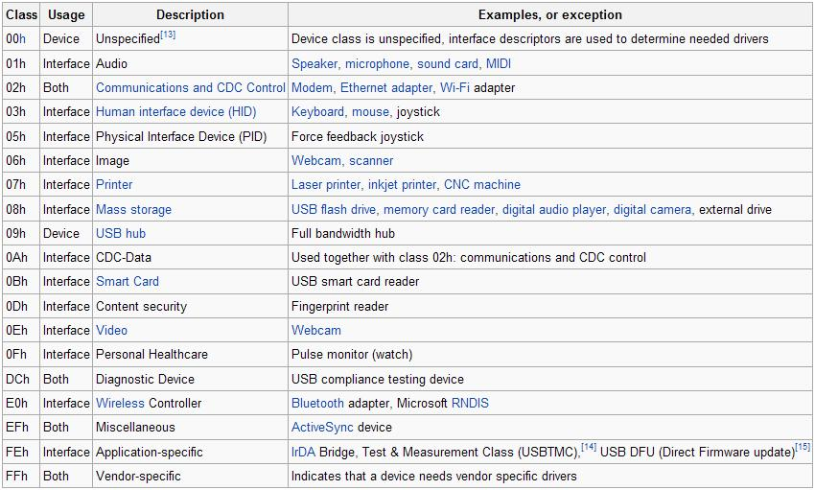
Device Classes
Notes:
USB defines class codes used to identify a device’s functionality and to load a device driver based on that functionality.
This enables every device driver writer to support devices from different manufacturers, and there are just a few out there, that comply with a given class code.

Slide 6
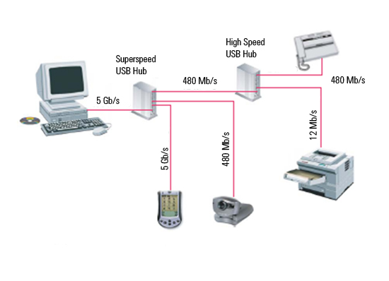
USB 3.0 Physical Topology
Notes:
The baseline structural topology is the same as USB 2.0. A tiered star topology with a single host at tier 1 and hubs at lower tiers to provide bus connectivity to devices.
The connection model accommodates backwards and forward compatibility for connecting USB 3.0 or USB 2.0 devices into a USB 3.0 bus.
Similarly, USB 3.0 devices can be attached to a USB 2.0 bus. The mechanical and electrical backward/forwards compatibility.
To diagnose fallback issues you have to simultaneously capture USB 2.0 and 3.0 traffic

Slide 7
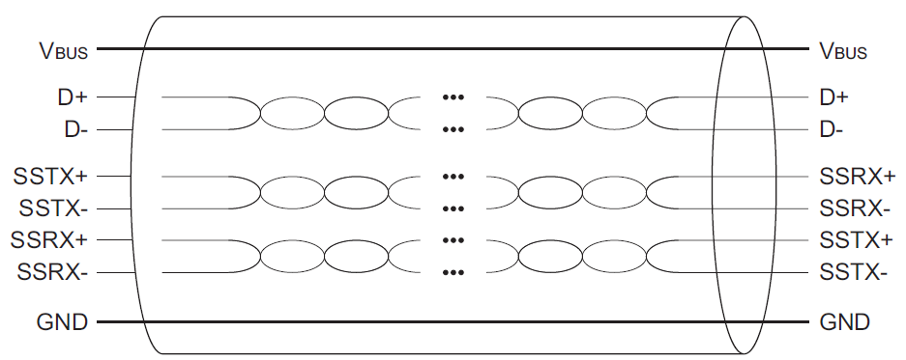
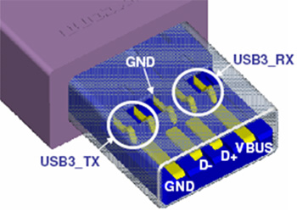
USB 3.0 Cable
Notes:
USB 3.0 cables have eight primary conductors: three twisted signal pairs for USB data paths and a power pair.
In addition to the twisted signal pair for USB 2.0 data path, two twisted signal pairs are used to provide the SuperSpeed data path, one for the transmit path and one for the receive path.

Slide 8
What is New With USB 3.0?
High Speed
480Mb/s NRZ half duplex 1 bi-directional link 4 signals (D+, D-, V_{BUS}, GND)
Super Speed
5Gb/s 8B/10B coded 2 uni-directional links 4 additional signals
USB 2.0
USB 3.0
Notes:
The biggest issues many customers are having when testing 3.0 is that they forget to test backward compatibility to 2.0 until the very end of design, or right before they ship, and many issues. They may pass all 3.0 requirements, and still fail 2.0 backward compatibility.

Slide 9
What is different for USB 3.0
USB 2.0 High-Speed
480Mbps
NRZI, Half Duplex
4 signals
Dp, Dm, VCC, GND
Cable Lmax= 5meter
I_{configLP/FP} = 100mA/500mA
I_{suspend} = 500uA
No SSC
TX SQ at Near End
No Host RX testing
USB 3.0 SuperSpeed
5 Gbps
8B/10B PRBS, Full Simplex
8 signals
4 USB2 , 4 SS Signals
Cable L_{max}= 3 meters
I_{configLP/FP} = 150mA/900mA
I_{suspend} = 2.5mA
SSC
TX at End of Channel (Far end)
RX Jitter tolerance
RX
TX
Half Duplex
TX
TX
Full Simplex
RX
RX
TX
RX
Notes:
This slide shows a comparison of USB2 vs 3.0 for most of the biggest differences.
Obviously the speed change is the biggest difference
USB2 is half duplex (since twisted pair, bi directional) and 3.0 will be 8b/10 full simplex.
The block diagrams as the bottom of the slide show this difference.
USB2 has 4 signals, usb3 includes those 4 plus 4 additional signals.
For USB3 cable length details are “spec detail” because they haven’t been publically discussed yet so you should only verbally mention that the requirements don’t list a specific length yet, only performance requirements
I config limits will change by increasing approximately 50% to 150mA for low power devices and 750mA for high power devices. Again, this detail is not something you should give in text in the slides as it may change.
SSC is not supported in USB2, SSC is required for USB3

Slide 10
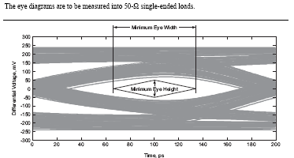
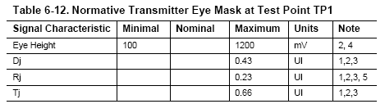

Transmitter test requirements
(TX Far End)
Notes:
This is the actual requirements of the Tx testing, that many of you are probably familiar with.

Slide 11
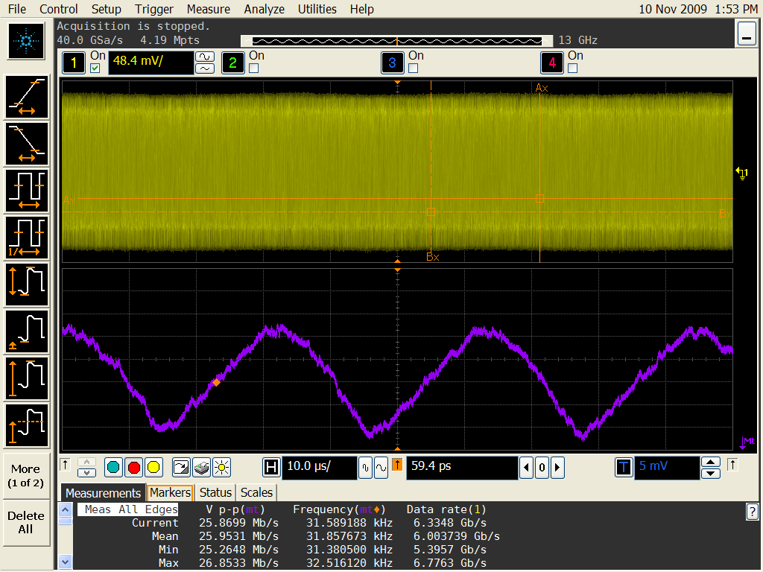
TX Compliance Pitfalls
Notes:
SSC modulation
SSC deviation
High Rj :flicker Jitter)
Poor de-emphasis :Causes eye failure at end of channel

Slide 12
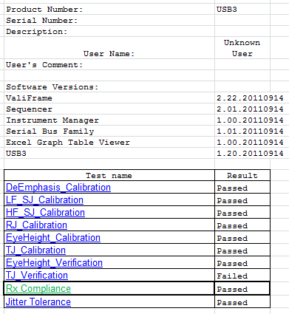
Calibration Cautions and Pitfalls
Calibration takes time
Calibration accuracy is critical to repeatable measurements
Calibration is where most users spend a majority of their time getting ready to test

Slide 13
Receiver Test Procedure External Error Counter
2.
1.
.
Pattern Generator
…stress pattern…training sequences…LFPS
Pattern Checker
stress pattern…
Error Counter
3.
Pattern Checker: USB Protocol Analyzer; Ellisys USB Explorer and NOW JBERTB SER
Turn on loopback by sending LFPS and required training sequences
The receiver stress pattern is BDAT with SKPs inserted as described in the standard. The pattern checker receives the looped stress pattern BDAT and recognizes bit errors
After sufficient test time the error counter of the pattern checker is read
Pattern Generator: J-BERT, ParBERT
Notes:
13

Slide 14
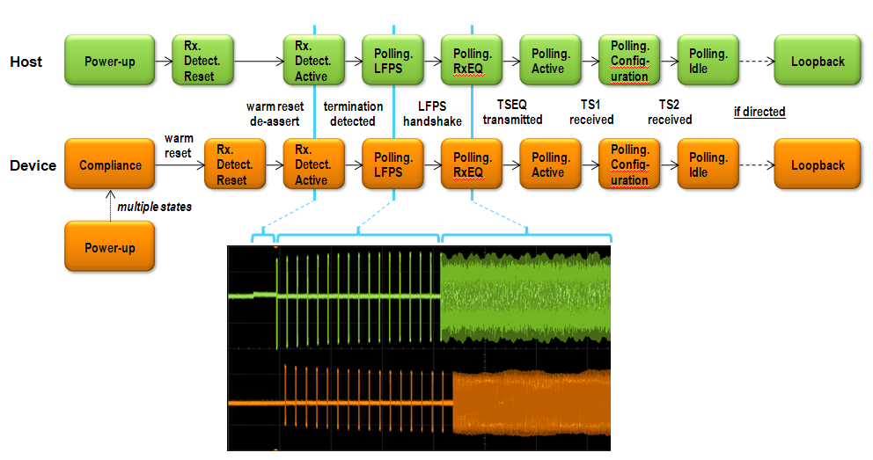
Typical SuperSpeed Link Turn-on Sequence

Slide 15
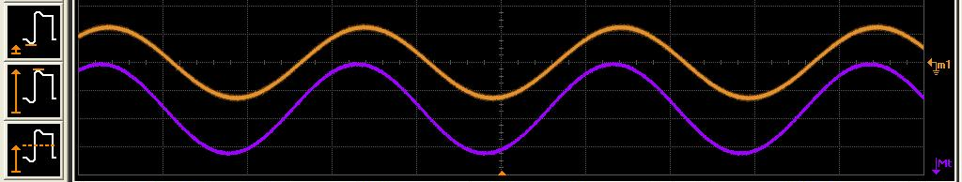
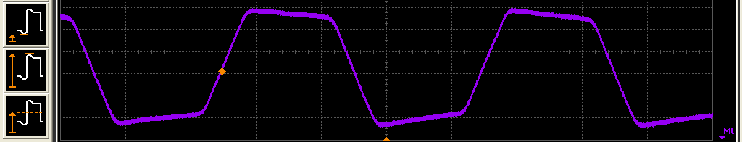


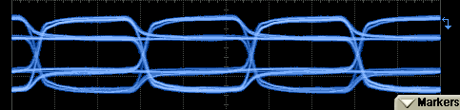
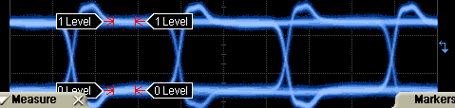
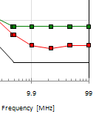
RX Compliance Pitfalls
Compliant SJ
Loopback issues
Dut needs custom sequence
DUT drops out easily
Calibration issues
Inconsistent
Poor Sj/Rj mod
Automation of Cal
SSC deviation
invalid de-emphasis
Great impact on TJ
Jitter tolerance failures
10MHz, 20MHz, 33MHz
Poor/wrong SJ
Compliant SSC Profile
Intentional SSC Stress
Non-deterministic noisy SSC
Compliant De-emphasis
Non-compliant Overshoot
Notes:
Absence of commas in compliance pattern can be an issue
Use alternating sequence because commas must not account into measurement
According to standard invalid 10B codes substituted by K28.4
Analyzers based on bit compare count too many errors

Slide 16
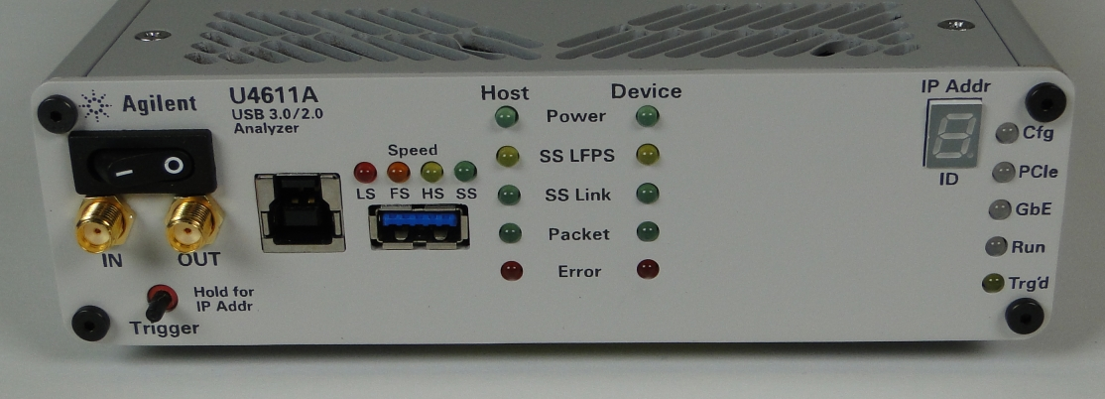
Synchronizing the USB analysis traces from Protocol to Electrical
Diagnostic requires synchronization of protocol events to a physical trace on an Oscilloscope
Uses a physical connection between the two pieces of equipment
SMA cable going from the ‘trigger out’ on the Agilent USB analyzer to the ‘trigger in’ on the Agilent scope.
The scope should be setup to trigger on an ‘high to low’ alternating signal.
Trig IN / Trig OUT for use with other Agilent equipment

Slide 17
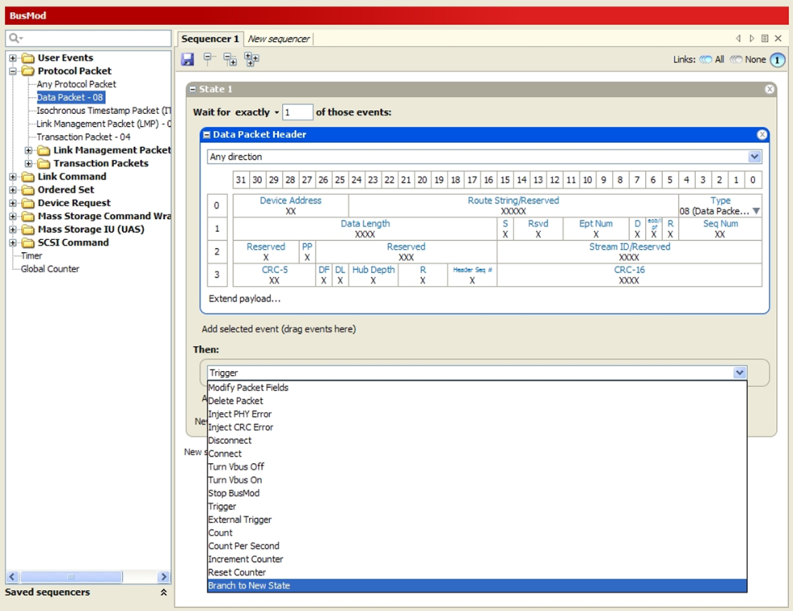
USB 3.0 Jammer
Can be used to create a variety of errors in a real OS environment that cannot necessarily be created by a generator
Standalone unit (does not require analyzer)
Example error types, events, packet modification, etc.
LGOOD_n / LCRD_a out of order
Corrupted ordered sets, LMPs, etc.
CRC-5/16/32 errors
LBA out of range
Link connect / disconnect
Power up / down (bus powered devices only)
Missing or corrupt frames
BOT or UAS Sense IU / Response IU errors
The jammer can inject errors, modify or delete packets, or even turn off Vbus and turn it back on again
Notes:
There are come cases where an exerciser/generator is required; there are many more cases where a jammer is a better fit.

Slide 18



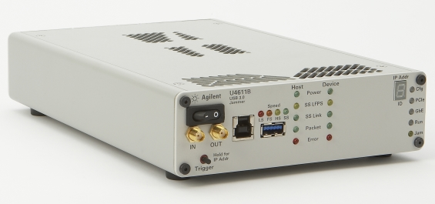

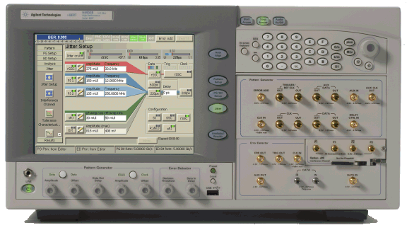

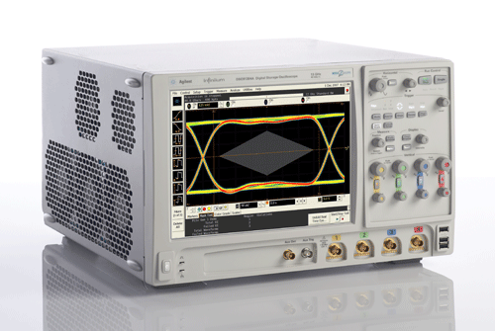
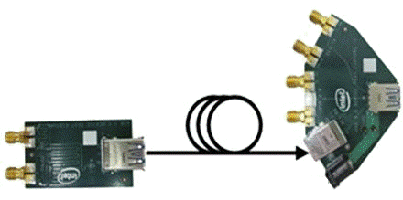




Agilent’s USB 3.0 – Total Solution
Transmitter Test
Interconnect Test
Receiver Test
Protocol Test
(link/transaction layers)
N8805A USB3.0 Protocol decode & triggering SW
U7243A USB Compliance Test Software
N5990A Automatic SW for USB compliance
SW
U4612A Jammer
DSOX90000A Infiniium
real time scope
E5071C Option TDR
ENA Network Analyzer
N4903B J-BERT High-Perf Serial BERT
HW
or
U4611A/B
USB 3\2\1.1 Analyzer
DSO91304A Infiniium
real time scope
with
Signal Condi-tioning
De-emph
N4916A or N4916B or N4903B-002
U7242A
Test Fixture
U7242A USB 3.0 Test Fixture
Fixture
Bit-USB- CBL-0001
from BitifEye
USB3ET from USB-IF
Tx
Tx
Tx
Tx
Tx
DUT
Rx
Rx
Rx
Cable
Rx
Notes:
Point out the different instruments and which you did or will do a demo of.

Slide 19
Demonstration

Slide 20
Backup

Slide 21
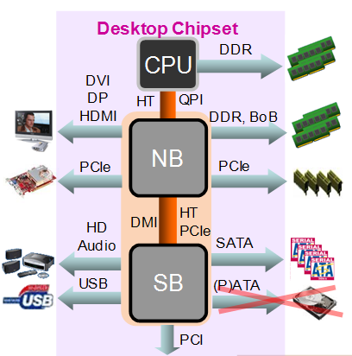
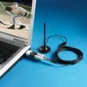



Agilent Digital Test Roadmap
Covering all key technologies in the computing eco system
Faster font-side buses
forwarded clocking
QPI at 9.6 Gb/s and higher
DVI → DP & HDMI
Display Port 1.1 → 1.2
HDMI 1.3 → HDMI 1.4
Faster DDR3
DDR3 moving to 2133MHz
DDR4 expected in 2010+
USB 2.0 → USB 3.0 (5Gb/s)
SATA 3G → SATA 6G
SATA Trends
HD Video
Camera
PCIe 2.0 → PCIe 3.0 (8GT/s)
SATA 3.0
6 Gbps
USB HDTV receiver
SATA 2.0
3 Gbps
smart
phone
PCIe Speed Trends
SATA 1.0
1.5 Gbps
2009
USB devices
PCIe 3.0
8GT/s
2002
flash memory
ATA/ATAPI
PCIe 2.0
5.0GT/s
2000
 | USB Flash | SD-Movie | USB Flash | HD-Movie
 | 1 GB | 6 GB | 16 GB | 25 GB
USB 1.0 | 22 min | 2.2 hr | 5.9 hr | 9.3 hr
USB 2.0 | 33 sec | 3.3 min | 8.9 min | 13.9 min
USB 3.0 | 3.3 sec | 20 sec | 53.3 sec | 70 sec
PCIe 1.x
2.5GT/s
2009+
1986+
2007
PCI
133MT/s
2003
1993
Notes:
If we look inside a single computing device, it is driven by multiple technologies. A single computer utilizes memory, PCIe, SATA, USB, HDMI, and DP of which devices then fan out to additional technologies of DigRF, Ethernet, more memory, more USB, and MIPI! Virtually every part of your design, whether inside or outside the box, relies
on these new technologies.
And these technologies are constantly changing. The ones that we are going to be focused on today are PCIe, USB and SATA

Slide 22
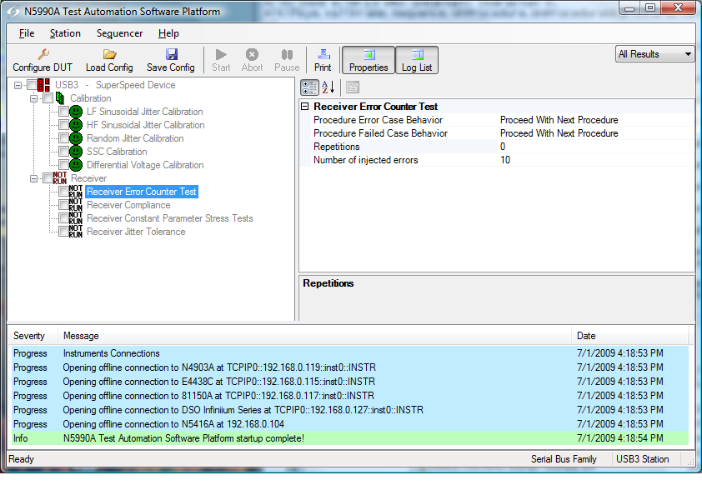
N5990A Test Automation Software
Automated instrument control for:
Setup calibration
Compliance test
Characterization test
Support for debugging
Operator guidance
Sophisticated test reports
Supports full product characterization including transmitter measurements
Notes:
Controls multiple instruments simultaneously
Automated setup calibration
Automated compliance and characterization
Step by step operator guidance
Complete test report

Slide 23
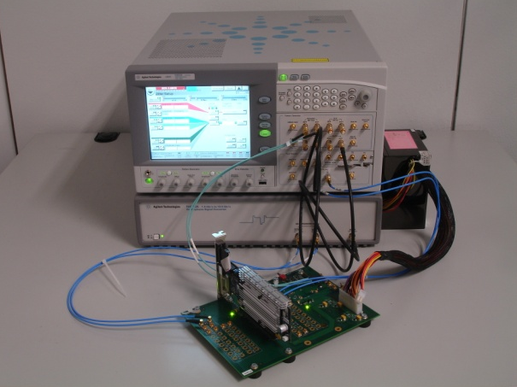
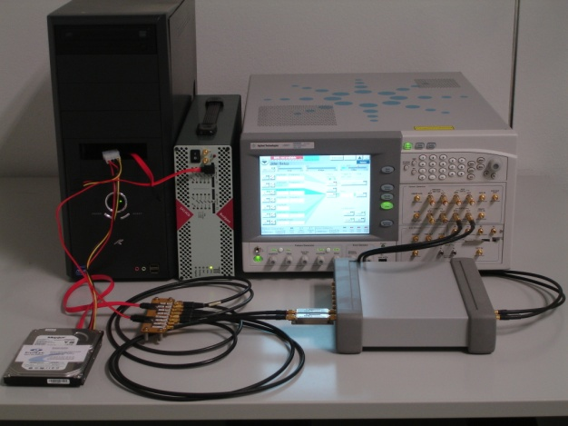
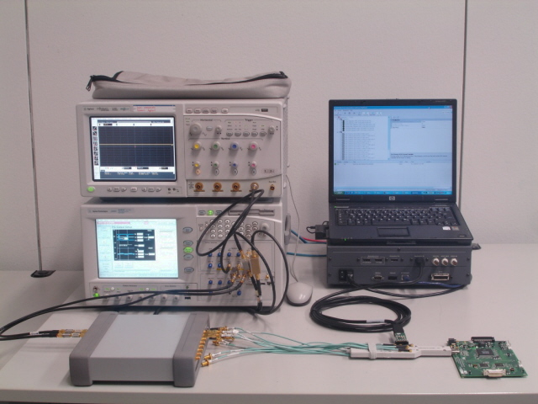
Same Setup Supports Multiple Standards
J-BERT, oscilloscope and test automation software also cover
PCI Express 1.1, 2.0
SATA 1.5, 3, and 6Gb/s
DisplayPort 1.1
Note: Additional applications may require additional instruments and accessories
PCIe
SATA
DisplayPort
Notes:
The N5990A Test Automation Software and the main test instruments cover a wide range of applications. This slide shows the applications which can be addred with J-BERT and N5990A.
23

Slide 24
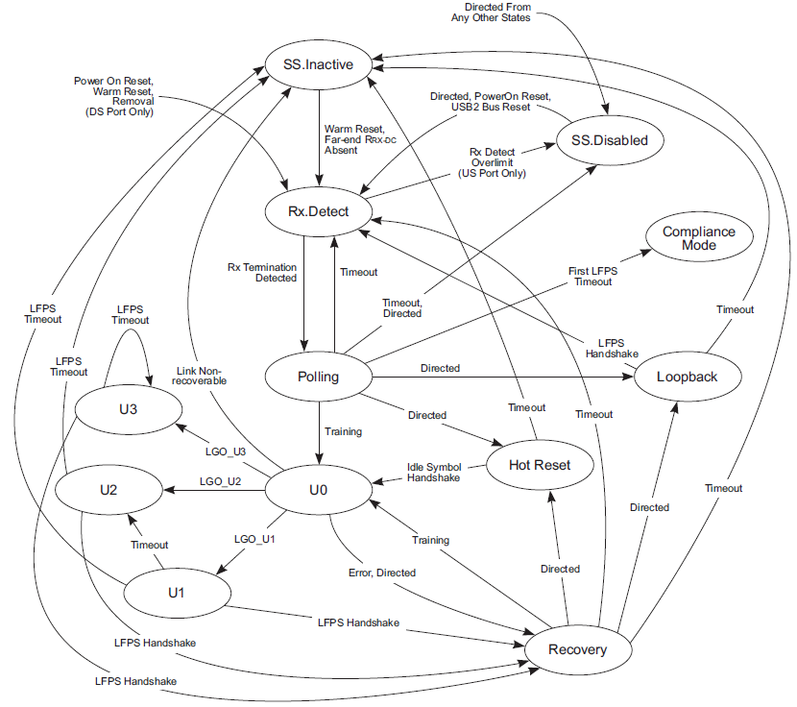
LTSSM

Slide 25
Flow Control (LCRD_x)
x is called Rx Header Buffer Credit Index. x= (A, B, C, D).
Signifies that a single Rx Header Buffer Credit has been made available.
Sent by a port after receiving a header packet that meets the following criteria:
LGOOD_n has been or will be sent.
The header packet has been processed, and an Rx Header Buffer Credit is available.
LCRD_x is sent in the alphabetical order of A, B, C, D, and back to A without skipping. Missing LCRD_x will cause the link to transition to Recovery.

Slide 26
Rx Header Buffer Credit Advertisement
The Rx Header Buffer Credit Advertisement refers to exchange of available Local Rx Header Buffer Credits information.
Rx Header Buffer Credits Advertisement is done every time the port enters into U0.
A port shall initiate the Rx Header Buffer Credit Advertisement after sending LGOOD_n during Header Sequence Number Advertisement.
If a port enters U0 from Polling or Hot Reset, its Local Rx Header Buffer Credit Count is 4.
If a port enters U0 from Recovery, its Local Rx Header Buffer Credit Count is the number of Header Buffer space available at the receiver.

Slide 27
U4612A USB 3.0 Jammer
Can be used to create a variety of errors in a real OS environment that cannot necessarily be created by a generator
Standalone unit (does not require U4611A/B analyzer)
Example error types, events, packet modification, etc.
LGOOD_n / LCRD_a out of order
Corrupted ordered sets, LMPs, etc.
CRC-5/16/32 errors
LBA out of range
Link connect / disconnect
Power up / down (bus powered devices only)
Missing or corrupt frames
BOT or UAS Sense IU / Response IU errors
Notes:
There are come cases where an exerciser/generator is required; there are many more cases where a jammer is a better fit.

Slide 28
LMP Subtypes
Set Link Function : Used to force a port to accept all LGO_U1 and LGO_U2 Link Commands.
U2 Inactivity Timeout : Used to define the timeout from U1 to U2.
Vendor Device Test : Used for vendor-specific device testing and shall not be used during normal operation of the link.
Port Capabilities : It describes each port's link capabilities and is sent by both link partners after the successful completion of training and link initialization. Main capabilities advertized are:
Link Speed supported (Must be 5GT/s)
Number of HP Buffer at Tx & Rx side (Must be equal to 4)
Direction : Downstream Port /Upstream Port

Slide 29
LMP Subtypes Continued …
Port Configuration : Sent by the Downstream Port after Link Initialization. It describes the link speed at which the upstream port shall operate.
Port Configuration Response : Sent by the upstream port in response to a Port Configuration LMP. It is used to indicate acceptance or rejection of the Port Configuration LMP.

