Slide 1
USB Protocol Analysis
Looking for the detail
finding errors in protocol operations

Slide 2
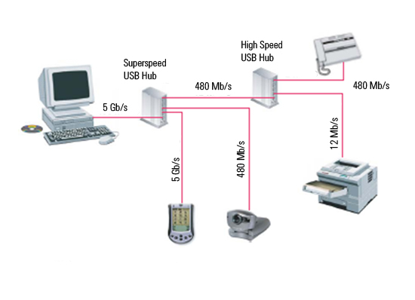
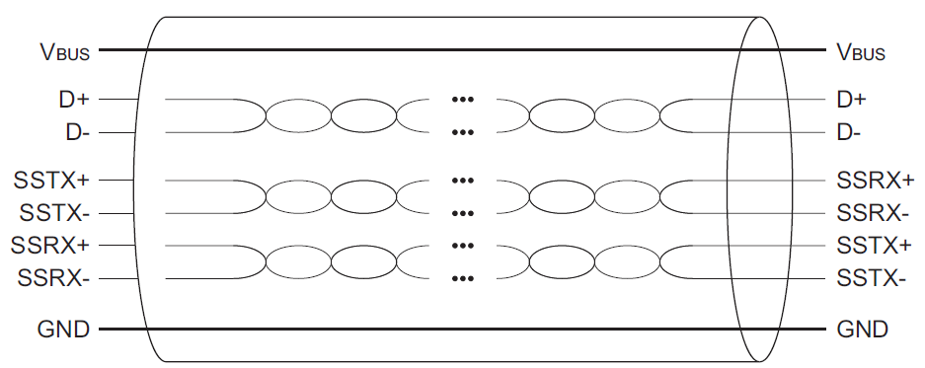
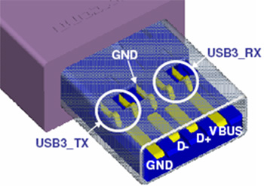
Analyzing USB 2.0 and 3.0 Mass Storage traffic
Requires simultaneous capture simultaneous USB 2.0 and 3.0 traffic to diagnose fallback issues.
USB 3.0 cables are two completely independent cables in one shielded shell
The USB analyzer can capture all traffic from device communication.
Notes:
Capturing simultaneous USB 2.0 and USB 3.0 traffic to diagnose fallback issues. Because USB 3.0 cables are basically two completely independent cables in one shielded shell, you can simply plumb the USB analyzer into the traffic stream as normal but be sure to place the unit in the topology where both styles of traffic will certainly exist. Example: USB 3.0 Host going to USB 3.0 Hub and on the other side of the hub is one USB 3.0 HDD and one USB 2.0 HDD so if you connect the analyzer between the USB 3.0 host and the USB 3.0 hub then you’ll be able to capture all traffic going to the USB 3.0 host from both the USB 3.0 HDD and the USB 2.0 HDD. Make sure you go into the pre-filtering part of the Agilent USB analyzer and enable both USB 2.0 and USB 3.0 capture. Start the analyzer. Now power up the USB 2.0 HDD and then the USB 3.0 HDD and then stop the capture and display the trace. All views in the trace file will have a ‘speed’ indicator to see what was USB 2.0 traffic and what was USB 3.0 traffic but the Protocol view shows the side by side traffic down the ‘word’ level and if very easy to diagnose what’s being communicated on both the USB 2.0 and USB 3.0 bus simultaneously.

Slide 3
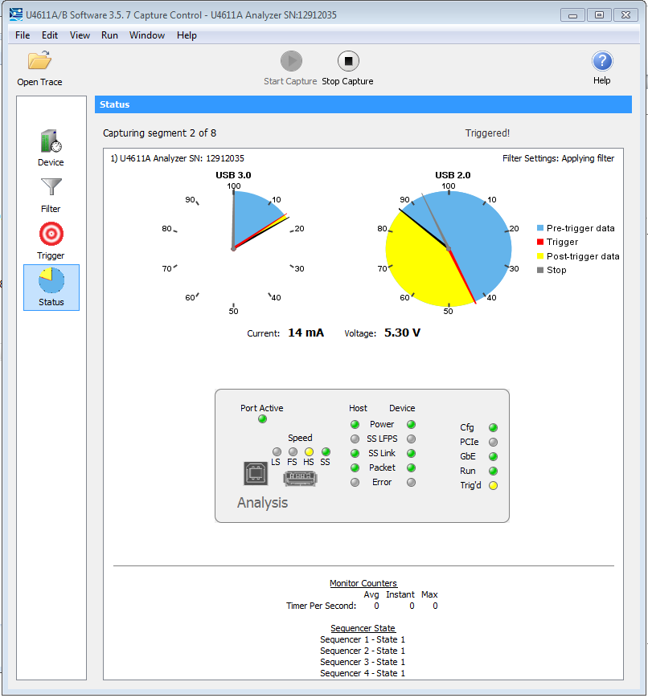
Deep Buffer required to capture Mixed traffic
Red tic shows trigger event
Customizable counters and sequences
Definable event (32 counters/timers)
Count
Count per second

Slide 4
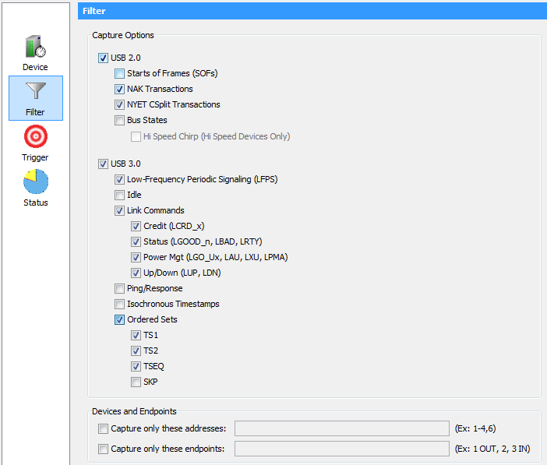
Optimize the buffer with Capture Filter
Check to capture the data of interest
Optimizes capture buffer
Simul 2.0 / 3.0 USB
Address filtering of devices and end points

Slide 5
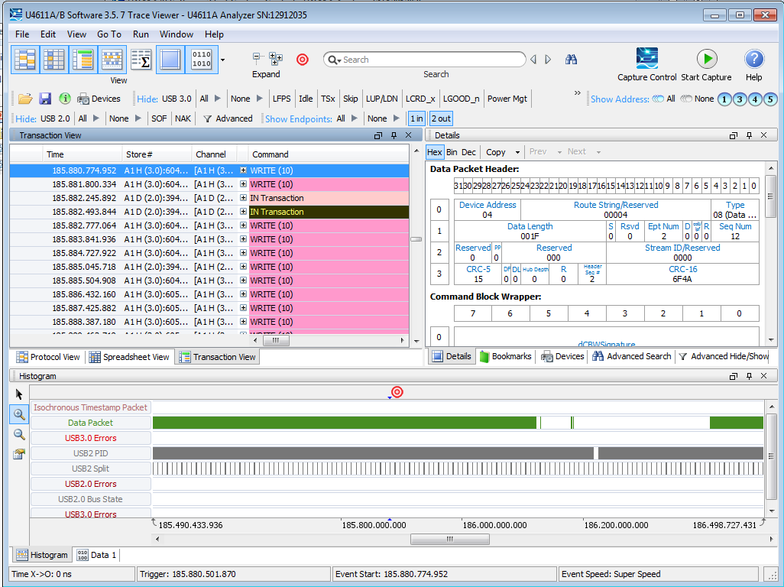
Data displayed instantly Synchronized - Multi window

Slide 6
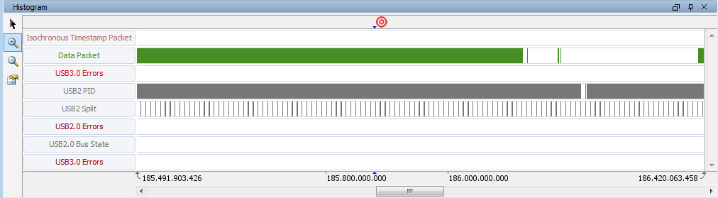
Data capture Histogram
Linear display of entire buffer
Trigger event
Watch effect of 3.0 traffic mixed with 2.0 traffic
Full and Low speed data in Split traffic

Slide 7
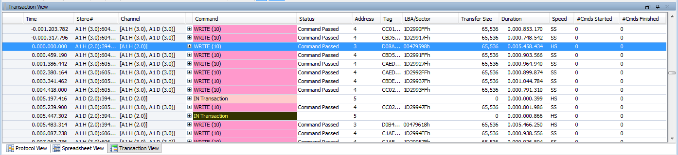
Transaction Display
Data capture of 2.0 and 3.0 mass store operations
Review Transactions, Data frames, all errors
2 nsec time accuracy of all results

Slide 8
Analyzing USB 2.0 and 3.0 Mass Storage traffic
Capture traffic to diagnose fallback issues
Locate the analyzer where all traffic is available
Example: USB 3.0 Host going to USB 3.0 Hub and on the other side of the hub is one USB 3.0 HDD and one USB 2.0 HDD so if you connect the analyzer between the USB 3.0 host and the USB 3.0 hub then you’ll be able to capture all traffic going to the USB 3.0 host from both the USB 3.0 HDD and the USB 2.0 HDD.
Use pre-filtering part of the Agilent USB analyzer and enable both USB 2.0 and USB 3.0 capture.
Power up the USB 2.0 HDD and then the USB 3.0 HDD
Stop the capture to display the trace
All views in the trace file will have a ‘speed’ indicator to see what was USB 2.0 traffic and what was USB 3.0 traffic
Use the Protocol view to show the side by side traffic down the ‘word’ level
Notes:
Capturing simultaneous USB 2.0 and USB 3.0 traffic to diagnose fallback issues. Because USB 3.0 cables are basically two completely independent cables in one shielded shell, you can simply plumb the USB analyzer into the traffic stream as normal but be sure to place the unit in the topology where both styles of traffic will certainly exist. Example: USB 3.0 Host going to USB 3.0 Hub and on the other side of the hub is one USB 3.0 HDD and one USB 2.0 HDD so if you connect the analyzer between the USB 3.0 host and the USB 3.0 hub then you’ll be able to capture all traffic going to the USB 3.0 host from both the USB 3.0 HDD and the USB 2.0 HDD. Make sure you go into the pre-filtering part of the Agilent USB analyzer and enable both USB 2.0 and USB 3.0 capture. Start the analyzer. Now power up the USB 2.0 HDD and then the USB 3.0 HDD and then stop the capture and display the trace. All views in the trace file will have a ‘speed’ indicator to see what was USB 2.0 traffic and what was USB 3.0 traffic but the Protocol view shows the side by side traffic down the ‘word’ level and if very easy to diagnose what’s being communicated on both the USB 2.0 and USB 3.0 bus simultaneously.

Slide 9
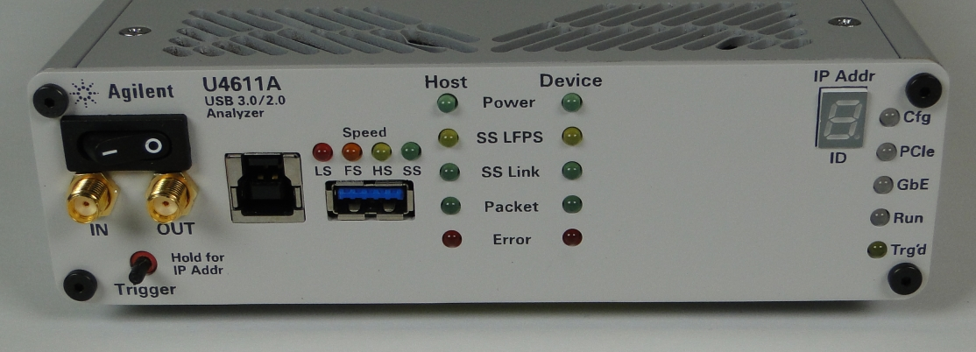
Synchronizing the USB analysis traces from Protocol to Electrical
Diagnostic requires synchronization of protocol events to a physical trace on an Oscilloscope
Uses a physical connection between the two pieces of equipment
SMA cable going from the ‘trigger out’ on the Agilent USB analyzer to the ‘trigger in’ on the Agilent scope.
The scope should be setup to trigger on an ‘high to low’ alternating signal.
Trig IN / Trig OUT for use with other Agilent equipment

Slide 10
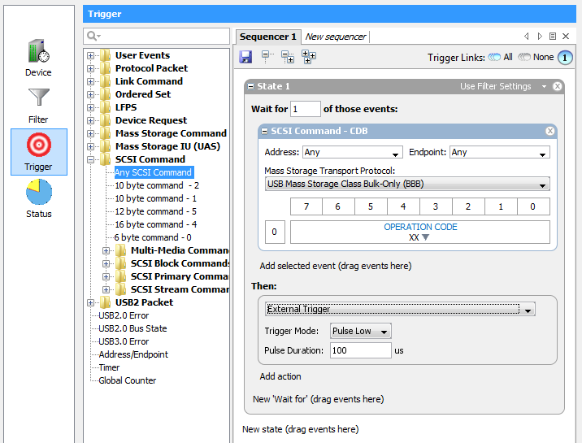
Synchronizing the USB analysis traces from Protocol to Electrical
Now, go into the USB analyzer trigger section and drag ‘n drop any patterns you are interested in. (Such as a Read(10) followed by the handshake ordered et followed by a Data frame and then ‘trigger’ as an action for the analyzer. Then simply add a second action into that trigger state machine and select ‘external trigger’ and select alternating ‘high to low’ TTL pulse. Hit run on the analyzer and start running your USB 3.0 traffic and as soon as the trigger is satisfied, then the scope should have triggered too.

Slide 11
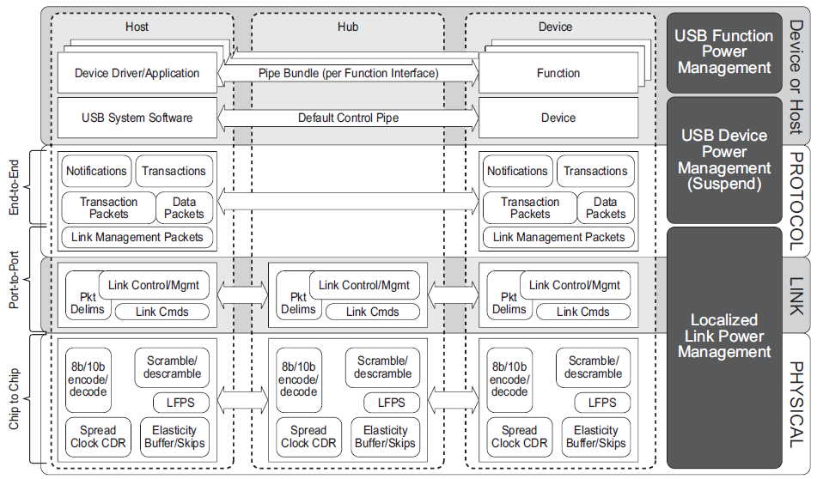
SuperSpeed Bus Communications Layers and Power Management Elements

Slide 12
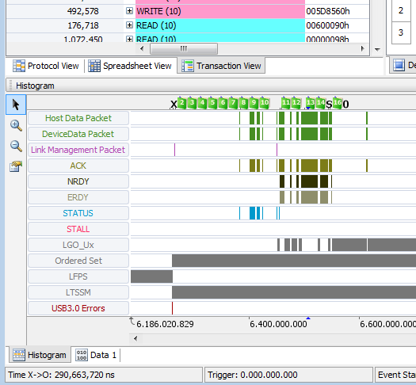
Analyze 18GB traffic in seconds Histogram view of all data activity

Slide 13
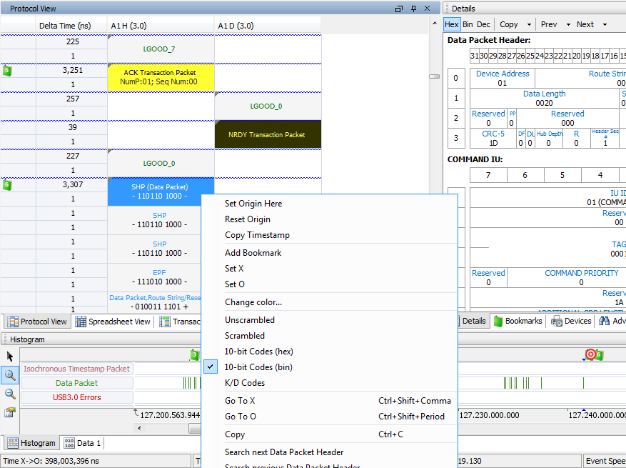
8b/10b Decode and display

Slide 14
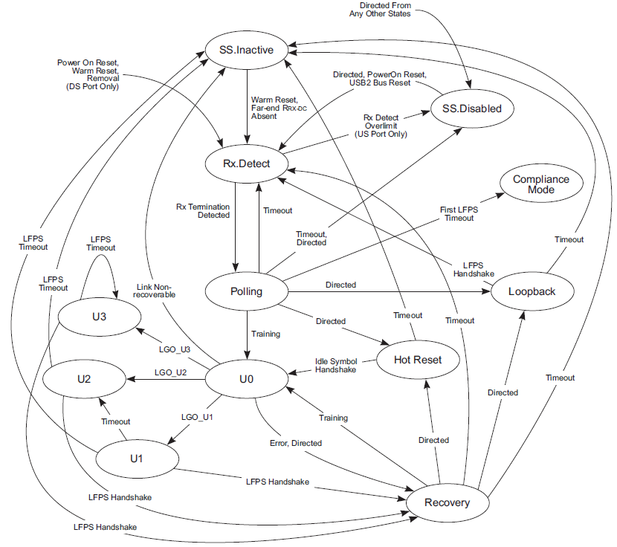
LTSSM

Slide 15
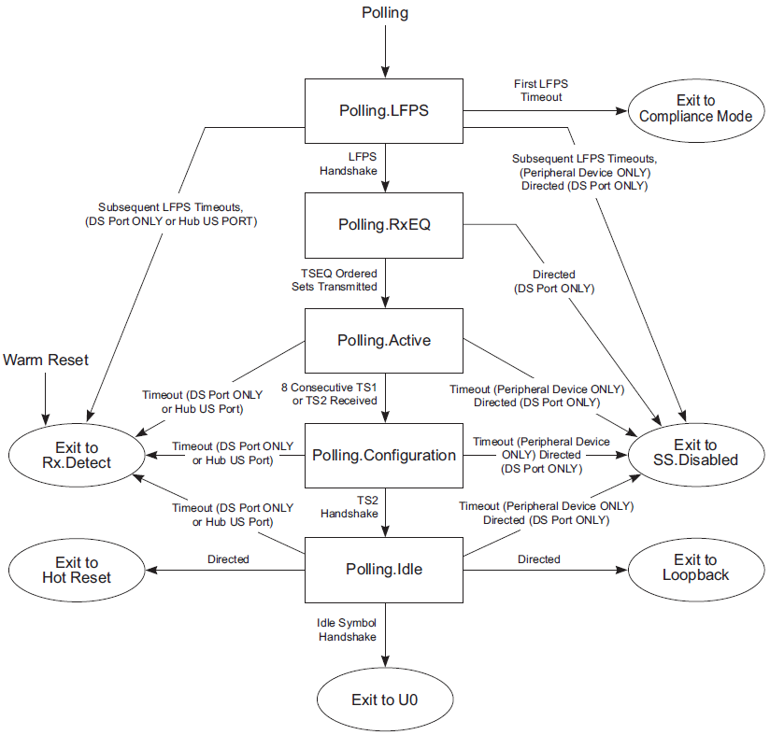
POLLING State

Slide 16
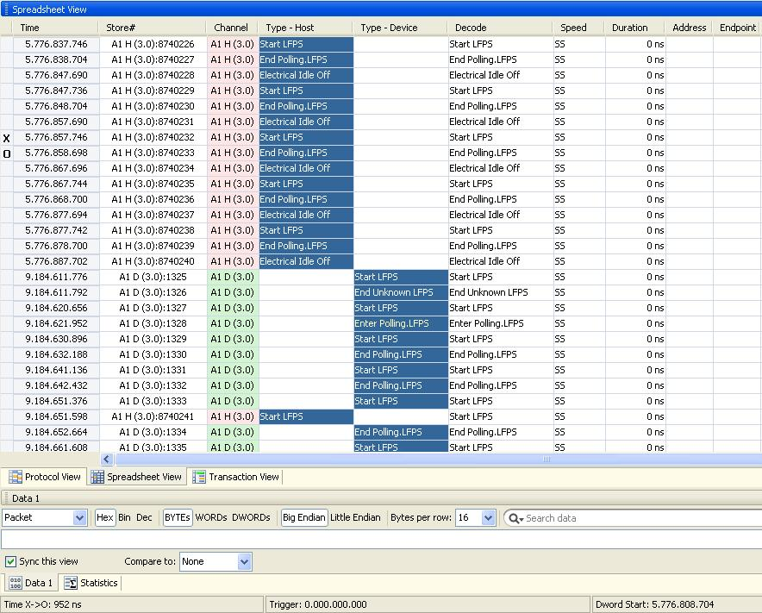
Example Trace - POLLING.LFPS
X – O = 952ns
tBurst time for Polling.LFPS

Slide 17
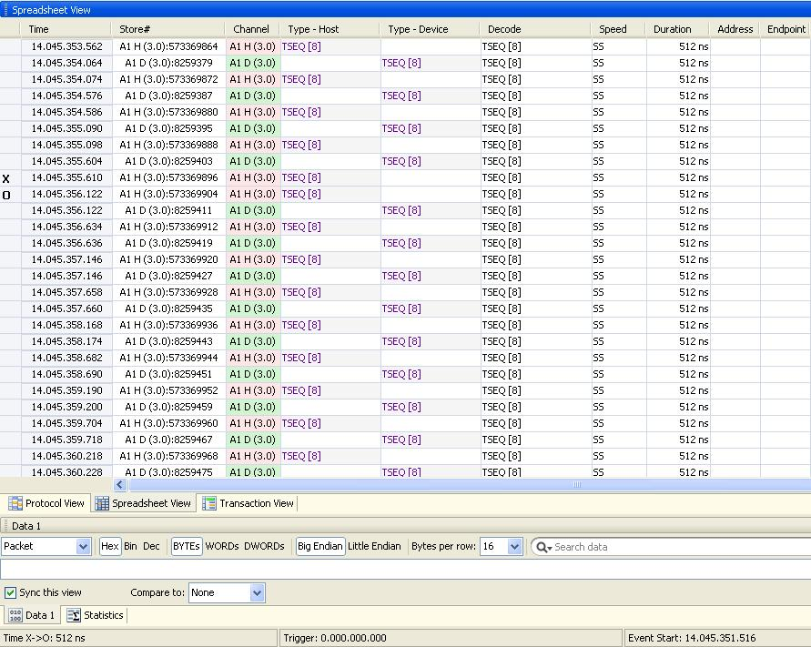
Example Trace – Polling.RxEQ

Slide 18
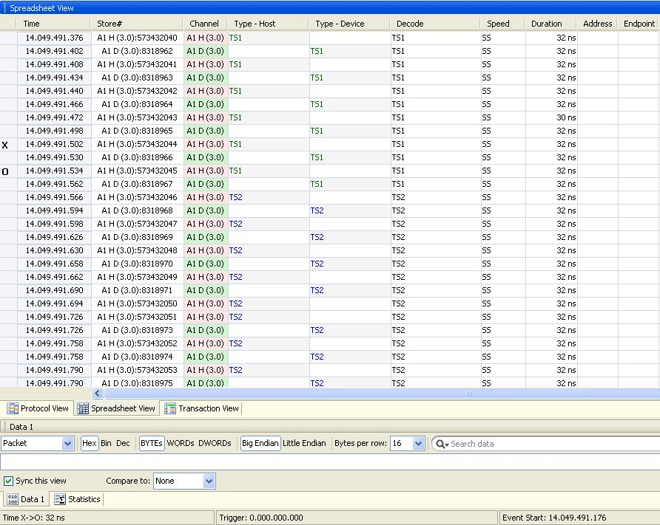
Example Trace – Polling.Active & Polling.Configuration

Slide 19
Flow Control (LCRD_x)
x is called Rx Header Buffer Credit Index. x= (A, B, C, D).
Signifies that a single Rx Header Buffer Credit has been made available.
Sent by a port after receiving a header packet that meets the following criteria:
LGOOD_n has been or will be sent.
The header packet has been processed, and an Rx Header Buffer Credit is available.
LCRD_x is sent in the alphabetical order of A, B, C, D, and back to A without skipping. Missing LCRD_x will cause the link to transition to Recovery.

Slide 20
Rx Header Buffer Credit Advertisement
The Rx Header Buffer Credit Advertisement refers to exchange of available Local Rx Header Buffer Credits information.
Rx Header Buffer Credits Advertisement is done every time the port enters into U0.
A port shall initiate the Rx Header Buffer Credit Advertisement after sending LGOOD_n during Header Sequence Number Advertisement.
If a port enters U0 from Polling or Hot Reset, its Local Rx Header Buffer Credit Count is 4.
If a port enters U0 from Recovery, its Local Rx Header Buffer Credit Count is the number of Header Buffer space available at the receiver.

Slide 21
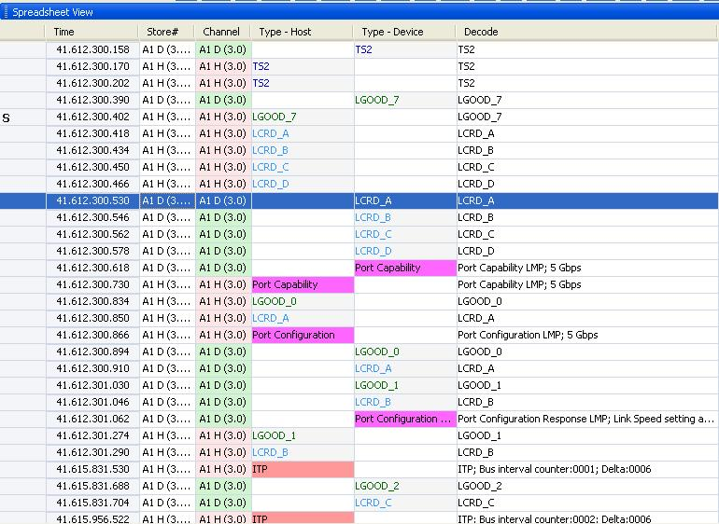
Example Trace – SEQNUM & CREDIT Advertisement

Slide 22
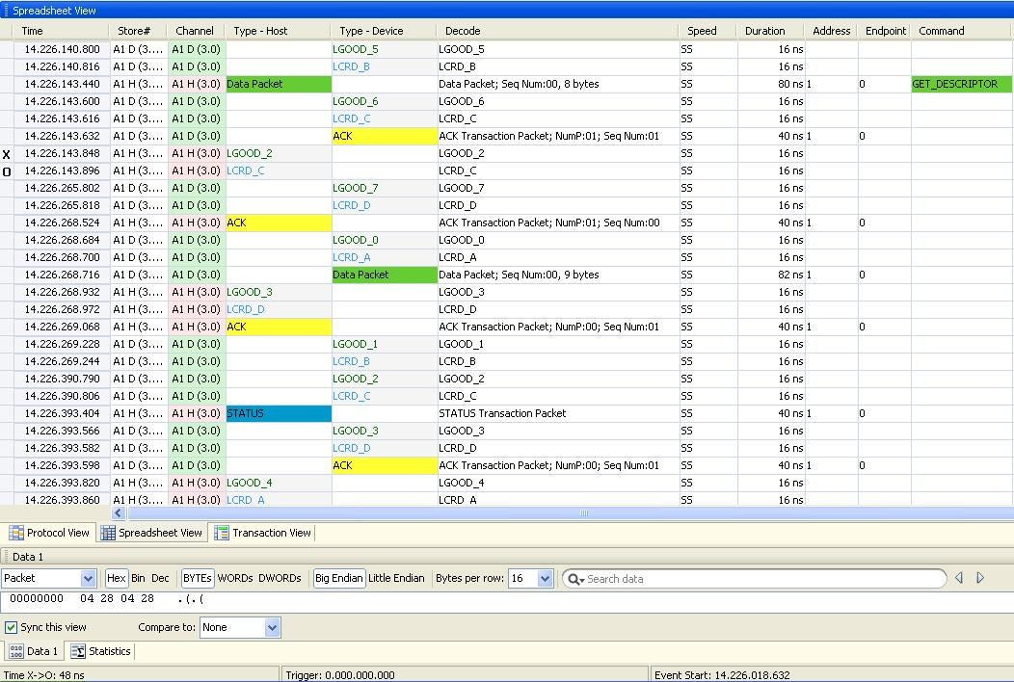
Example Trace – LGOOD_n & LCRD_X on Reception of Packets

Slide 23
Link Power Management (LGO_Ux, LAU, LXU, LPMA)
LGO_U1: Sent by a port requesting entry to U1.
LGO_U2: Sent by a port requesting entry to U2.
LGO_U3: Sent by a downstream port requesting entry to U3. An upstream port must accept the request.
LAU: Sent by a port accepting the request to enter U1, U2, or U3.
LXU: Sent by a port rejecting the request to enter U1 or U2.
LPMA: Sent by a port upon receiving LAU. Used in conjunction with LGO_Ux and LAU handshake to guarantee both ports are in the same state.

Slide 24
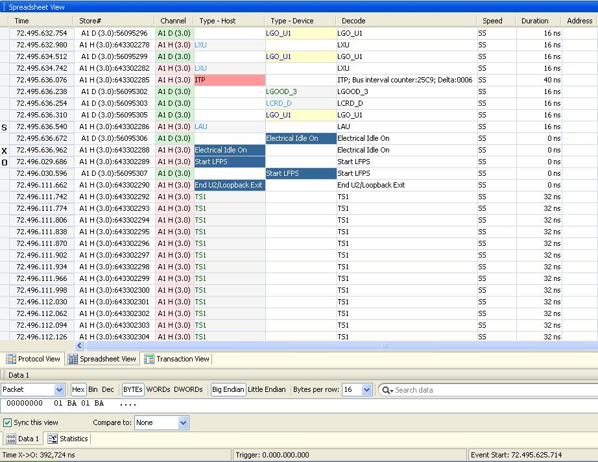
Example Trace – U1 Entry/Exit
U2 Inactivity Timer is set to 256us. So Link silently entered into U2 after spending 256us in U1.
X-O = ~392us total time in Elec Idle

Slide 25
Port Presence Indication in U0 (LDN, LUP)
LDN: Downstream port present in U0. Sent by a downstream port every 10 μs when there are no packets or other link commands to be transmitted.
LUP: Device present in U0. Sent by an upstream port every 10 μs when there are no packets or other link commands to be transmitted.
A downstream port shall transition to Recovery upon not receiving any link commands in U0 for 1 ms.
An upstream port shall transition to Recovery if it does not receive any link command or any packet in U0 for 1 ms.

Slide 26
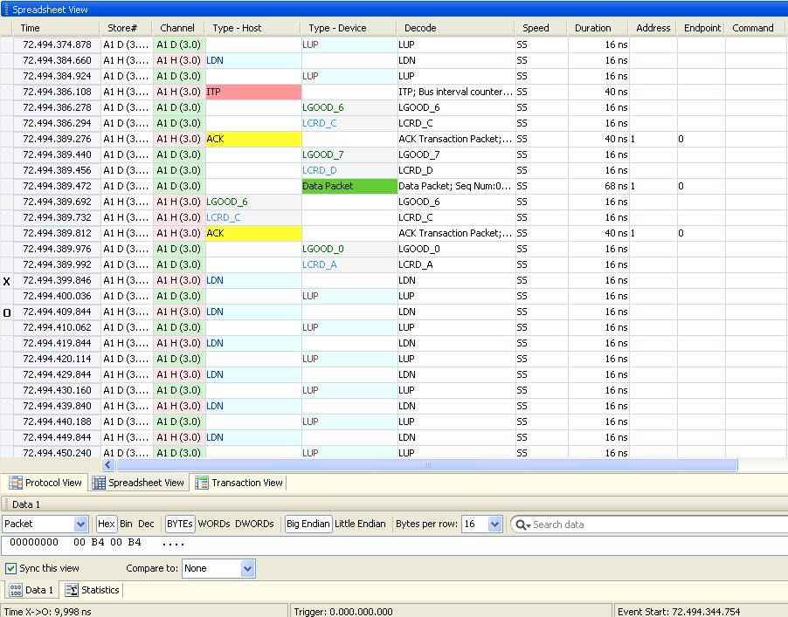
Example Trace – LDN/LUP
X-O = ~10us

Slide 27
LMP Subtypes
Set Link Function : Used to force a port to accept all LGO_U1 and LGO_U2 Link Commands.
U2 Inactivity Timeout : Used to define the timeout from U1 to U2.
Vendor Device Test : Used for vendor-specific device testing and shall not be used during normal operation of the link.
Port Capabilities : It describes each port's link capabilities and is sent by both link partners after the successful completion of training and link initialization. Main capabilities advertized are:
Link Speed supported (Must be 5GT/s)
Number of HP Buffer at Tx & Rx side (Must be equal to 4)
Direction : Downstream Port /Upstream Port

Slide 28
LMP Subtypes Continued …
Port Configuration : Sent by the Downstream Port after Link Initialization. It describes the link speed at which the upstream port shall operate.
Port Configuration Response : Sent by the upstream port in response to a Port Configuration LMP. It is used to indicate acceptance or rejection of the Port Configuration LMP.

Slide 29
Example Trace: Port Capability & Port Configuration LMP

Slide 30
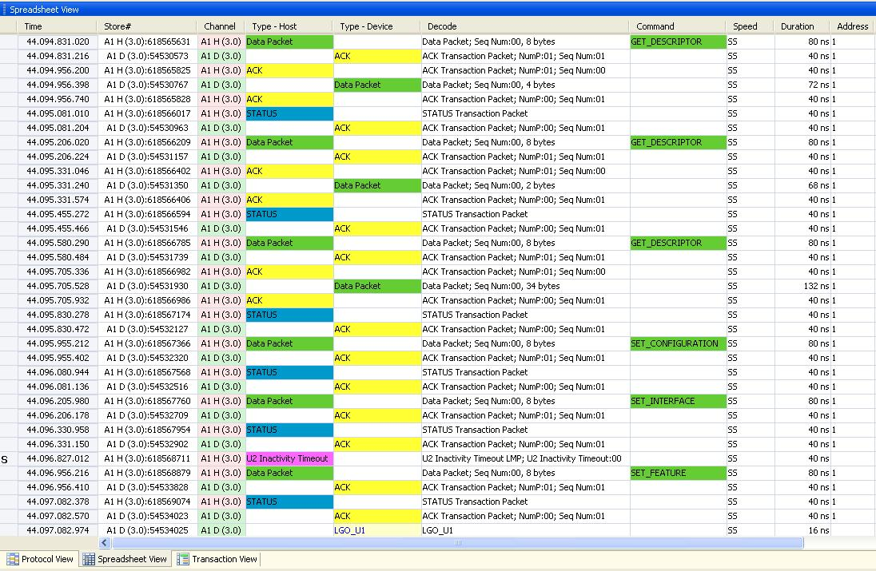
Example Trace: Set U2 Inactivity Timeout LMP

Slide 31
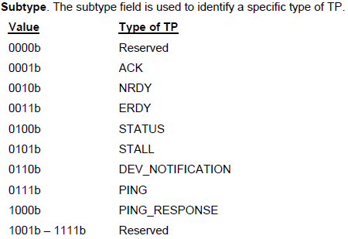
Transaction Packet (TP)
A Transaction Packet (TP) traverses all the links in the path directly connecting the host and a device.
It is used to control the flow of data packets, configure devices and hubs, etc.
A Transaction Packet does not have a data payload.

Slide 32
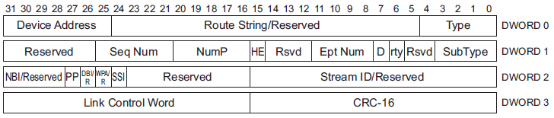
Acknowledgement (ACK) Transaction Packet
This TP is used for two purposes:
For IN endpoints it is sent by the Host to:
request data from a device
acknowledge the previously received data packet.
For OUT endpoints, this TP is sent by a device to
Acknowledge receipt of the previous data packet sent by the host,
Inform the host of the number of data packet buffers it has available after receipt of this packet.

Slide 33
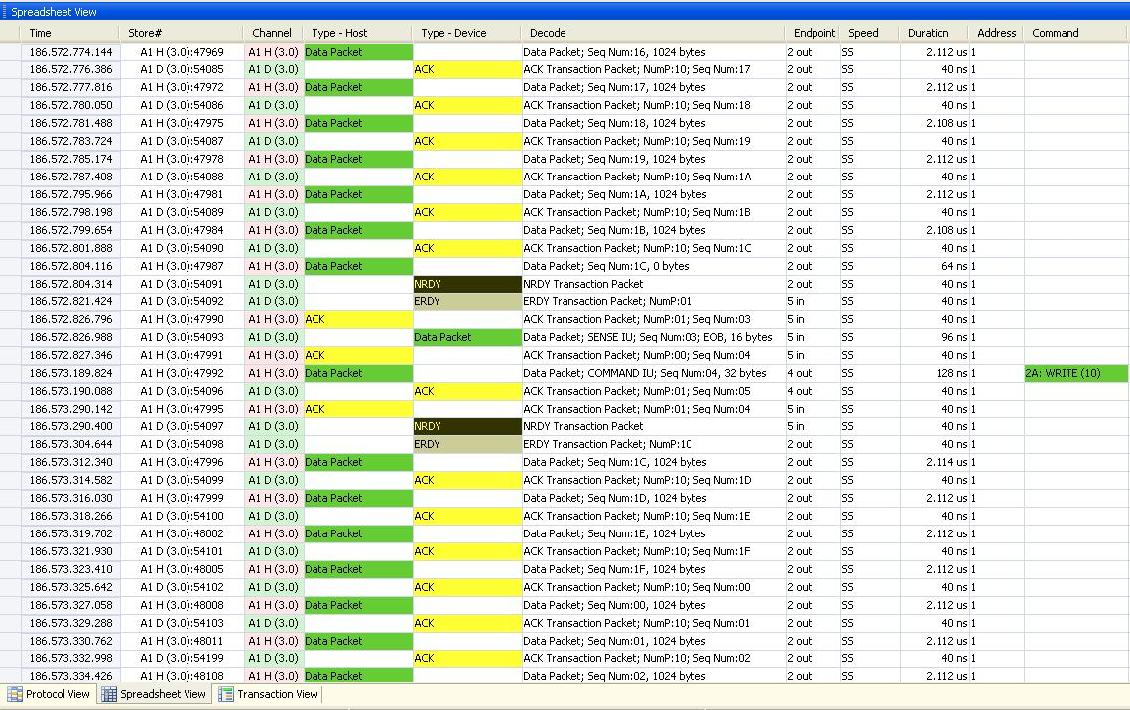
Example Trace: ACK TP
Transfer to OUT EP
Transfer to IN EP

Slide 34
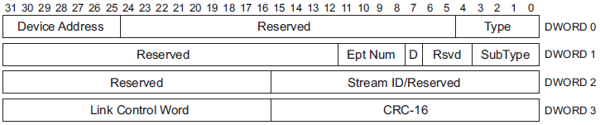
Not Ready (NRDY) Transaction Packet
An OUT endpoint sends this TP to the host if it has no packet buffer space available to accept the DP sent by the host.
An IN endpoint sends this TP to the host if it cannot return a DP in response to an ACK TP sent by the host.
This TP can only be sent by a device for an access to non-isochronous endpoint .

Slide 35
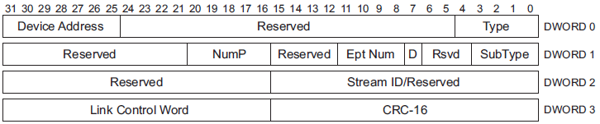
Endpoint Ready (ERDY) Transaction Packet
It is used to inform the host that an endpoint is ready to send or receive data packets.
This TP can only be sent by a device for an access to non-isochronous endpoint.

Slide 36
Example Trace: NRDY/ERDY for Bulk IN/OUT EP

Slide 37
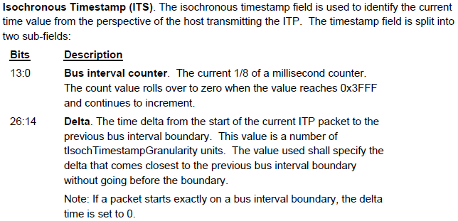
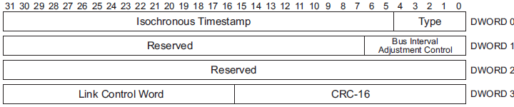
Isochronous Timestamp Packet (ITP)

Slide 38
ITP Continued…
ITPs are used to provide host timing information to devices for synchronization. Only a host can initiate an ITP transmission.
ITPs carry no addressing or routing information and are multicast by hubs to all of their downstream ports with links in the U0 state.
A device shall not respond to an ITP.
The host shall transmit an ITP on a root port link if and only if the link is already in U0. The host shall not bring a root port link to U0 for the purpose of transmitting an ITP.
The host shall transmit an ITP in every bus interval if the root port link is in U0.
If a device receives an ITP with the delayed flag (DL) set in the link control word, the timestamp value may be significantly inaccurate and may be ignored by the device.

Slide 39
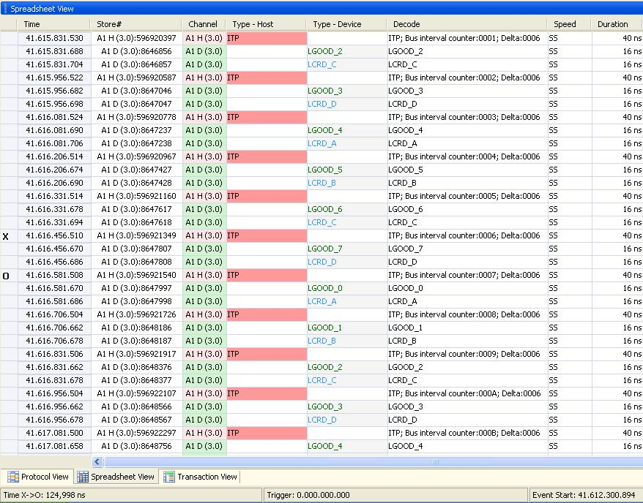
Example Trace - ITPs
~125us

Slide 40
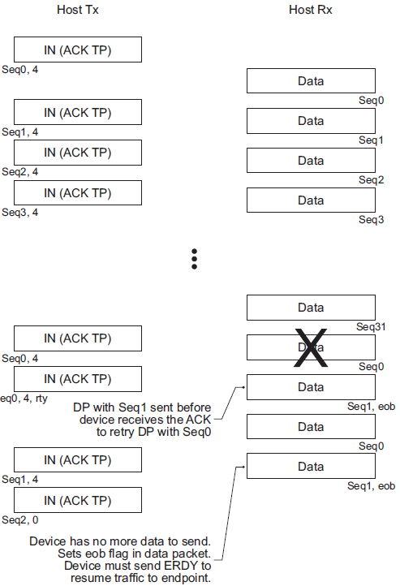
Bulk In Transfer
When the host is ready to receive bulk data, it sends an ACK TP to a device indicating the sequence number and number of packets it expects from the device.
A Bulk endpoint shall respond with the data.
The host shall send an ACK TP for each valid DP it receives from a device.
A device does not need to wait for the ACK TP to send the next DP if the previous ACK TP has NumP field > 1).
If the host detects an error while receiving any of the DPs, it shall send an ACK TP with the sequence number value set to the first DP that was received with an error with the Retry bit set.
The transfer is completed when Device sends DP with EOB bit set or a DP with payload length less then MaxPayloadSize of that Endpoint.

Slide 41
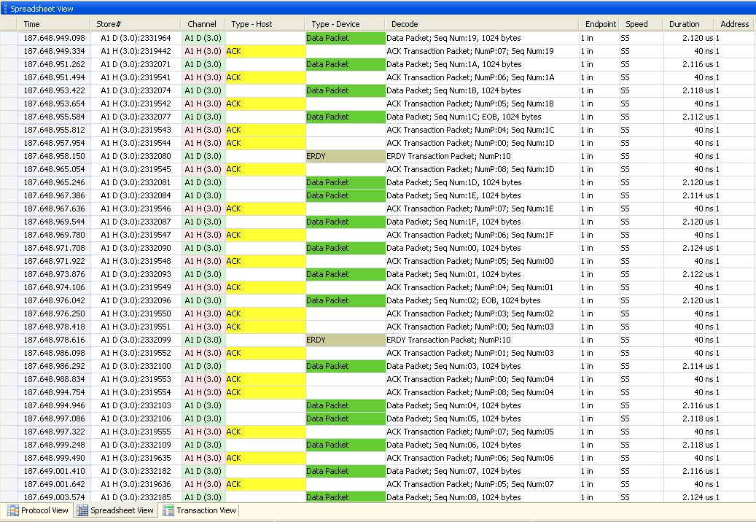
Example Trace: Bulk IN Transfer

Slide 42
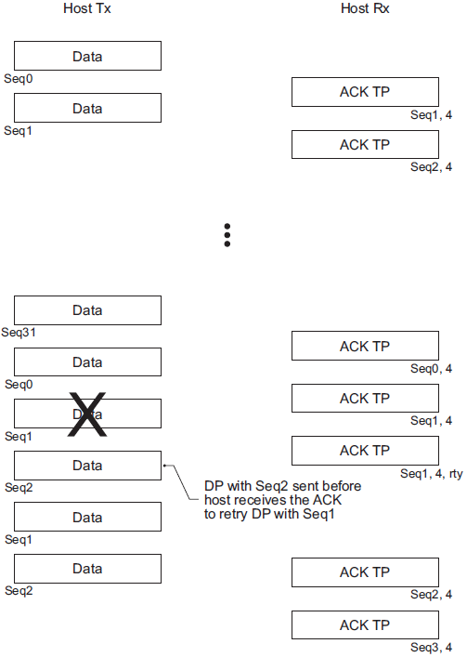
Bulk Out Transfer
When the host is ready to transmit bulk data, it sends one or more DPs to a device.
If a DPH with valid values (valid device address, endpoint number, and direction as well as the expected sequence number) is received by a device, it shall respond with an ACK TP with appropriate Seqnum & NumP field.
A transfer is complete when the host sends all the data it has to a device; however the last DP of the transfer may or may not have a payload which is equal to the MaxPacketSize of the endpoint.

Slide 43
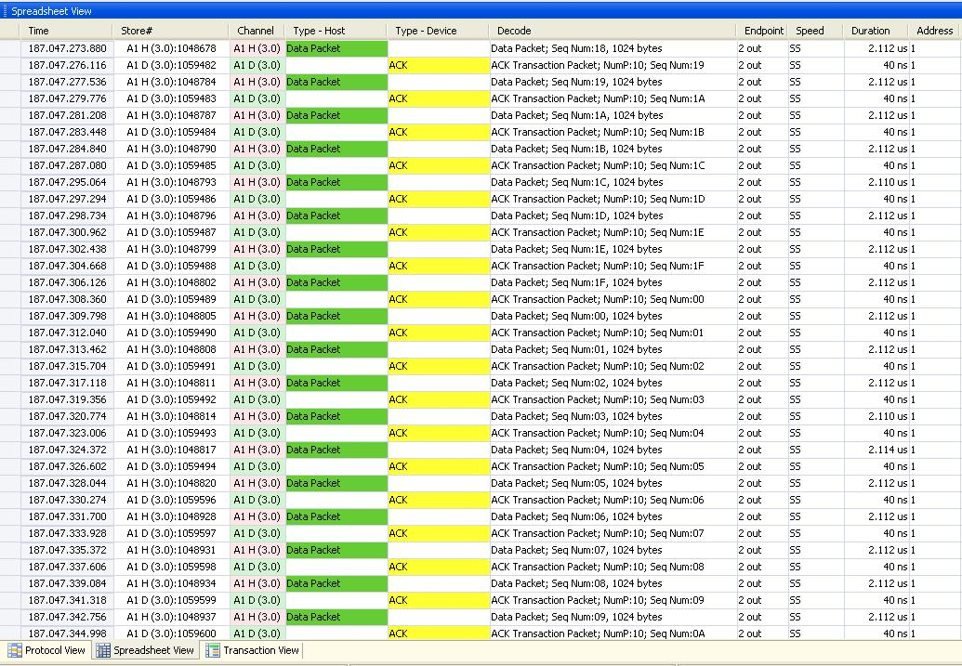
Example Trace: Bulk OUT Transfer

Slide 44
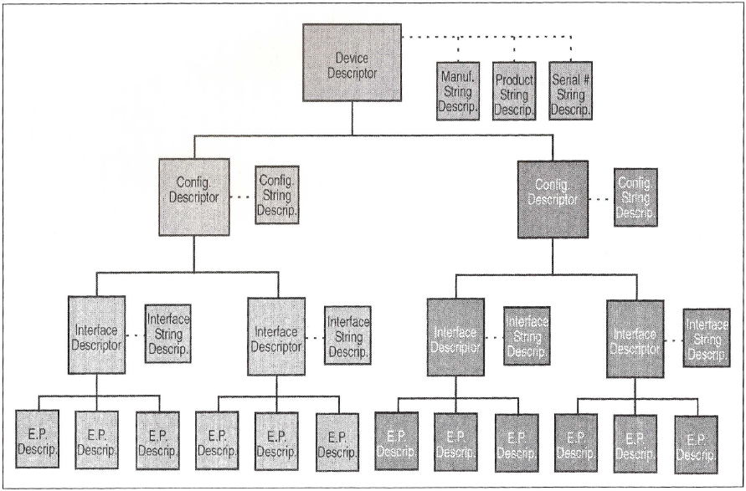
Standard Device Descriptor with two configurations

Slide 45
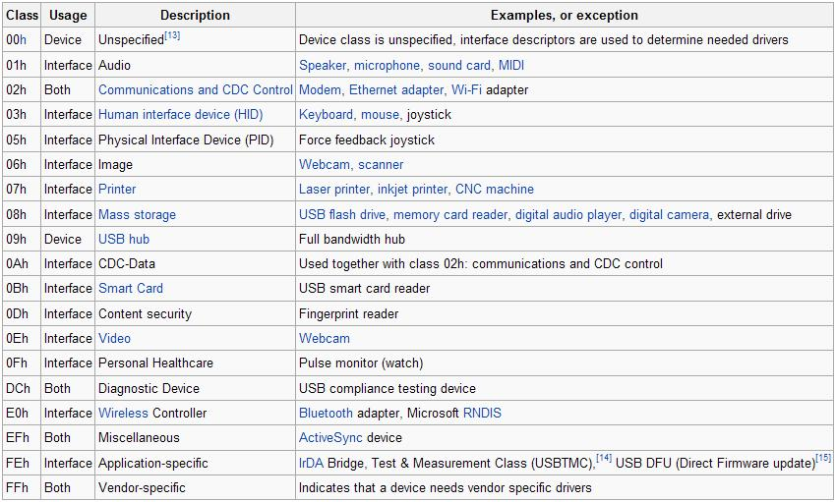
Device Classes
USB defines class codes used to identify a device’s functionality and to load a device driver based on that functionality.
This enables every device driver writer to support devices from different manufacturers that comply with a given class code.

Slide 46
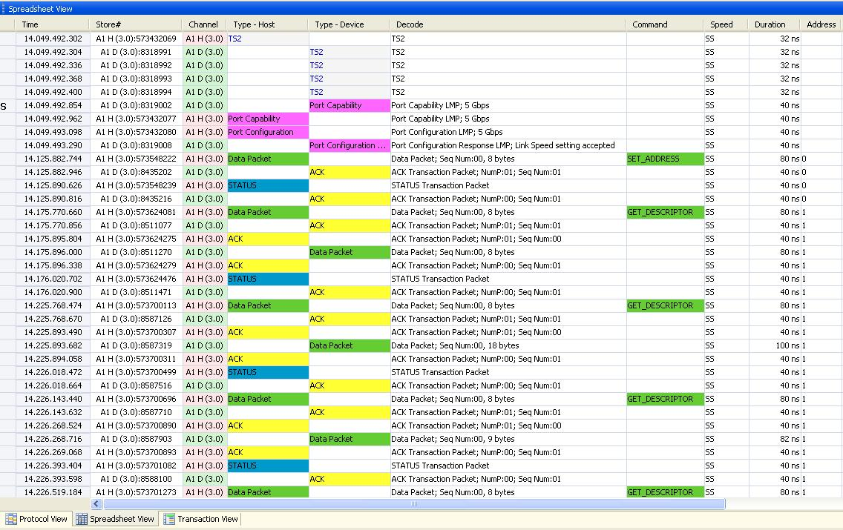
Example Trace: Set Address & Get Descriptors

Slide 47
Example Trace: GET/SET Descriptors

