Slide 1
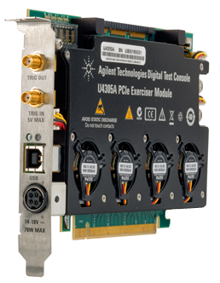
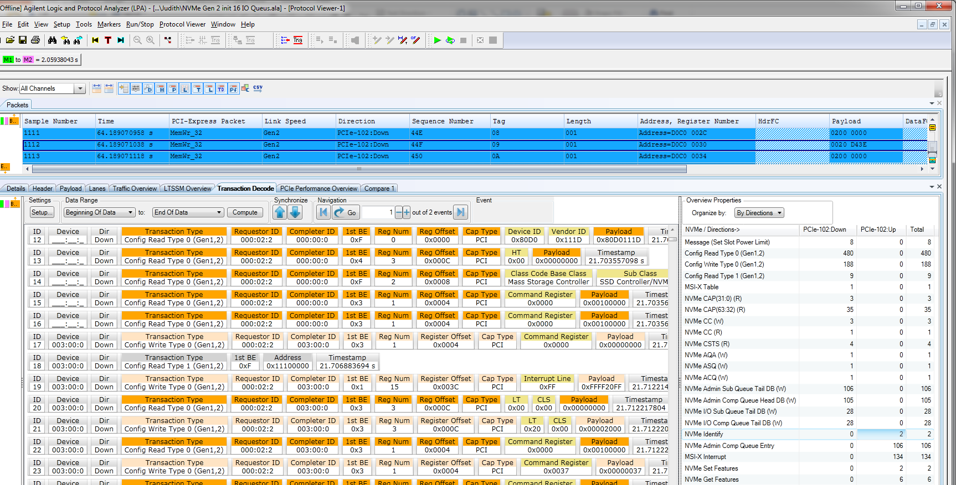
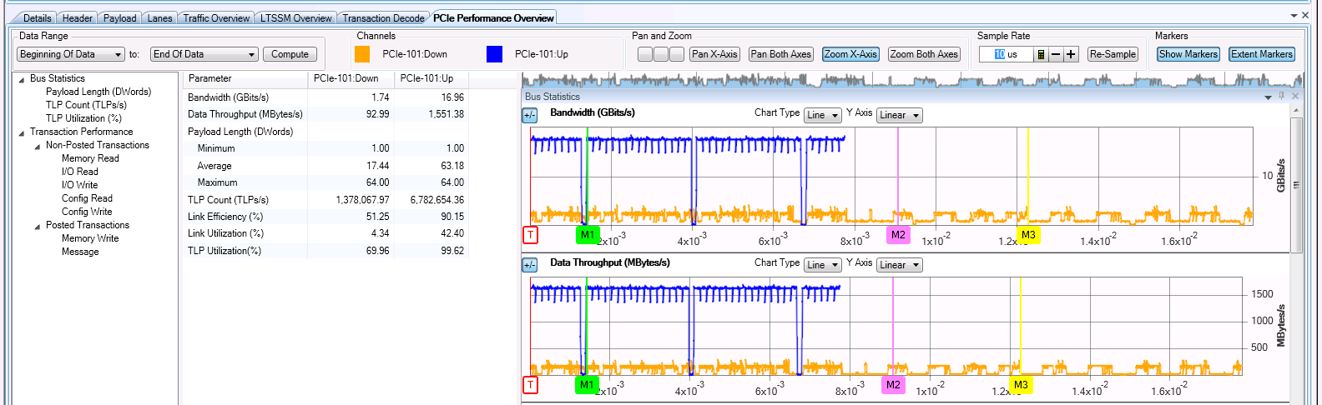
Storage Protocol Test
Transaction Decode
PCIe / NVMe
NVMe RC emulation
Performance Overview

Slide 2
Transaction Decode
Transaction decode pane
Transaction overview pane
Pane | Description
Transaction decode pane | The left pane displays a list of transactions. New decoders automatically work as they become available. Initial release has NVMe with PCIe; Under development: AHCI
Transaction overview pane | The right pane displays the number of occurrences of these transactions

Slide 3
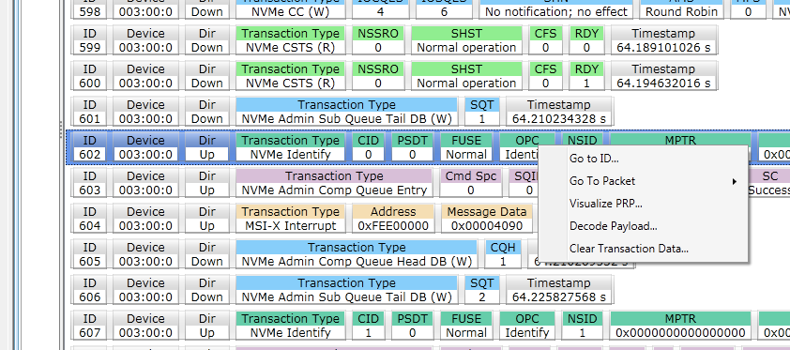
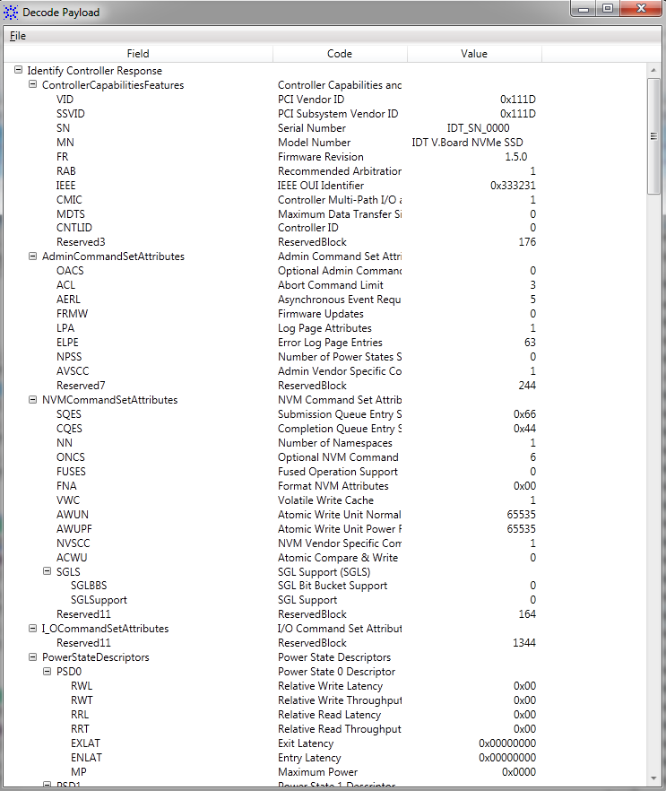
NVMe Identify → Decode Payload into Easily Readable Display of Namespace Capabilities
NVMe Identify command returns capabilities and status of a specific namespace.
View easily readable namespace capabilities in a single display from the Identify command (right-click the NVMe Identify transaction and select Decode Payload)

Slide 4
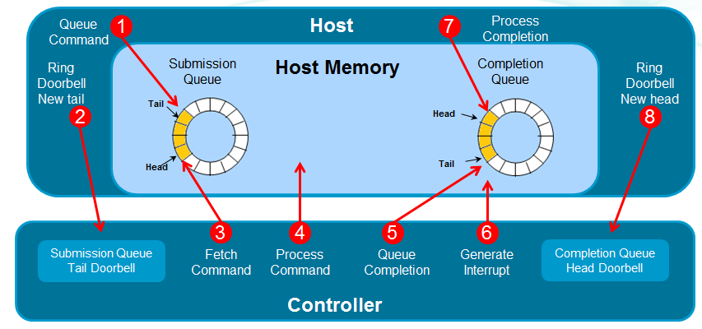
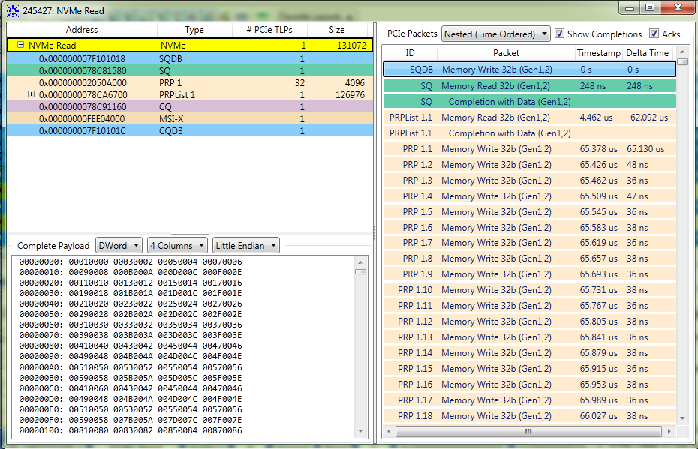
Visualize Transaction: Understanding NVMe
NVMe Command processing
Agilent: Visualize Transaction display
Ring Doorbell New Tail
Fetch Command
Process Command
Queue Completion
Generate Interrupt
Ring Doorbell New Head
2
3
4
5
6
8
PCIe messages
NVMe Data
Preliminary: Coming March 2014

Slide 5
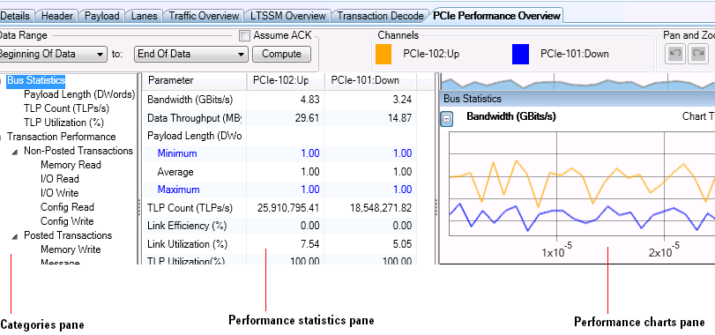
PCIe Performance Overview
Pane | Description
Categories pane | The leftmost pane displays a list of categories for which statistics will be generated and displayed.
Performance Statistics pane | The middle pane displays a list of performance parameters for the category that you select in the Categories pane. For each of these parameters, statistics are displayed based on the link directions (upstream as well as downstream).
Performance Charts pane | The rightmost pane displays a performance chart

Slide 6
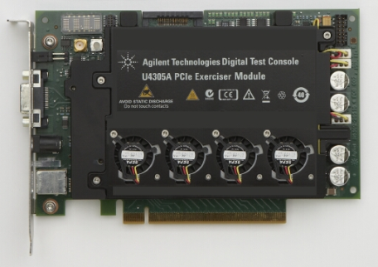
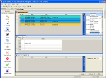
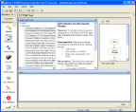

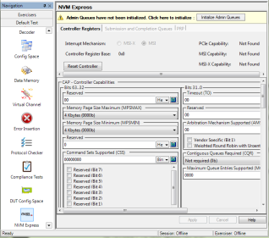
Exerciser (Packet Generator) One Hardware, Multiple Applications
End Node Emulation
Root Complex & DUT
LTSSM Tester
State specific solicitation
Protocol Test Card
Specification compliance tool
IO Virtualization
Multi Root and Single Root
NVMe RC emulation
EndPoint testing
EP/RC Emulation Exerciser
LTSSM Tester
PTC 3.0
NVMe

Slide 7
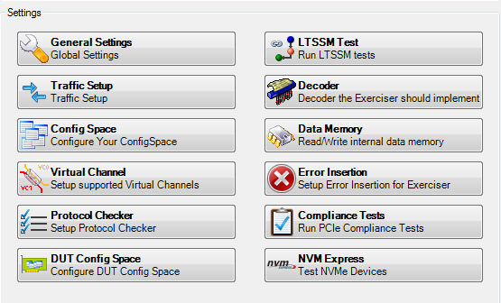
NVMe Exerciser Features
Scan and initialize the NVMe capabilities of the DUT.
NVMe controller registers of DUT are available for viewing and editing.
Configure the Admin submission and completion queue attributes.
Set the interrupt mechanism to be used and then configure the selected interrupt mechanism.
Define, view, and edit the MSI-X table of the DUT.
Create multiple I/O submission and completion queues
Configure submission queue Head and Tail pointers and completion queue head pointer.
Add NVMe commands to submission queues and submit these to the NVMe DUT. The commands are available as predefined templates.
View the commands and their subsequent completions in the completion queues.
Create PRP lists and PRP entries that can be used in the submitted NVMe commands for data transfer.

Slide 8
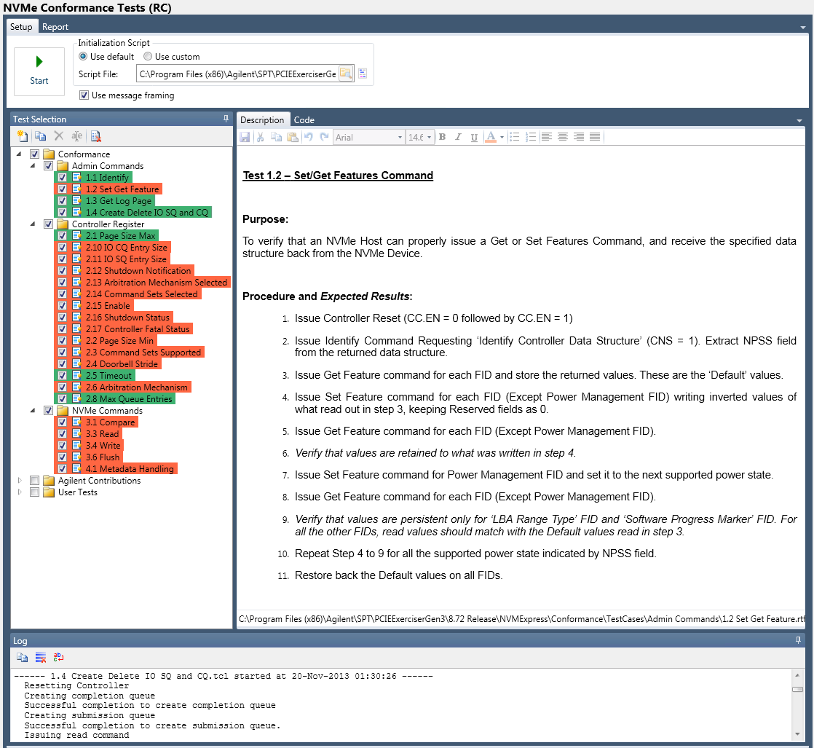

NVMe Conformance
Interoperability Tests
Defined by
University of New Hampshire (UNH)
Interoperability Lab (IOL)
Automated Test Scripts verify
Admin Commands
NVM Commands
NVM Features
Controller Registers
System Memory Structure
Controller Architecture
Available February 20th, 2014
U4305A-1FP NVMe RC Emulation option $12,000
Look for announcement at
January 28-31, 2014

