Slide 1
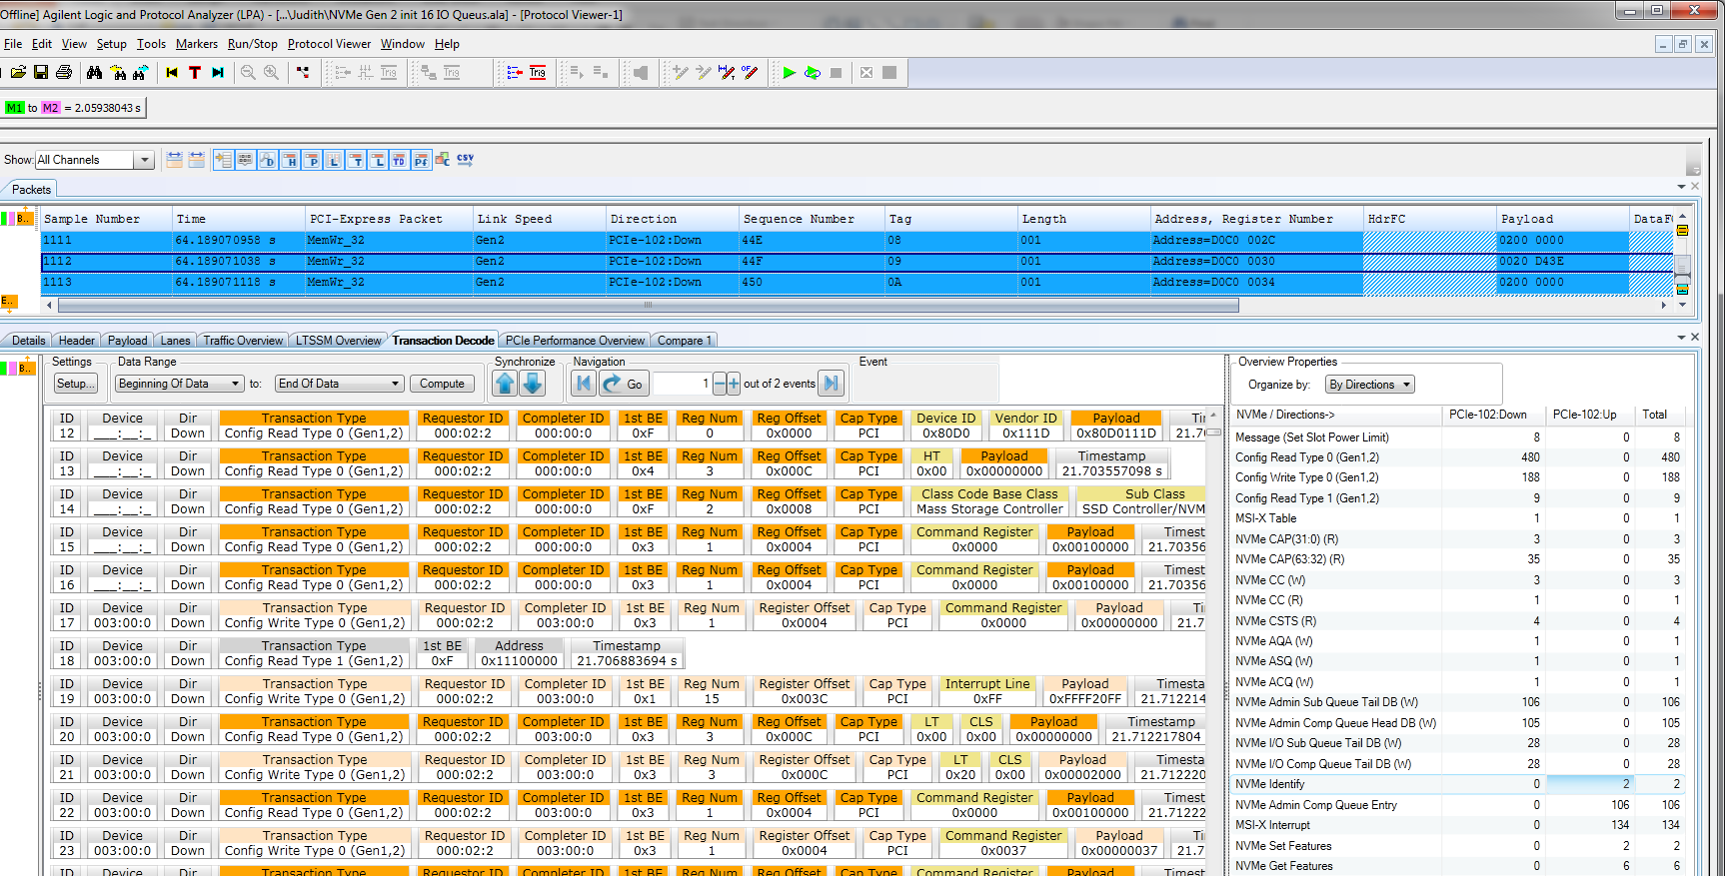
NVMe Transaction Decode and RC Emulation
October 23, 2013

Slide 2
Agenda
  NVMe Overview – Queuing structure and command processing
  U4301A-3FP Transaction Decoder – NVMe transaction decoder overview
  U4305A-1FP NVMe RC (Exerciser) Overview

Slide 3
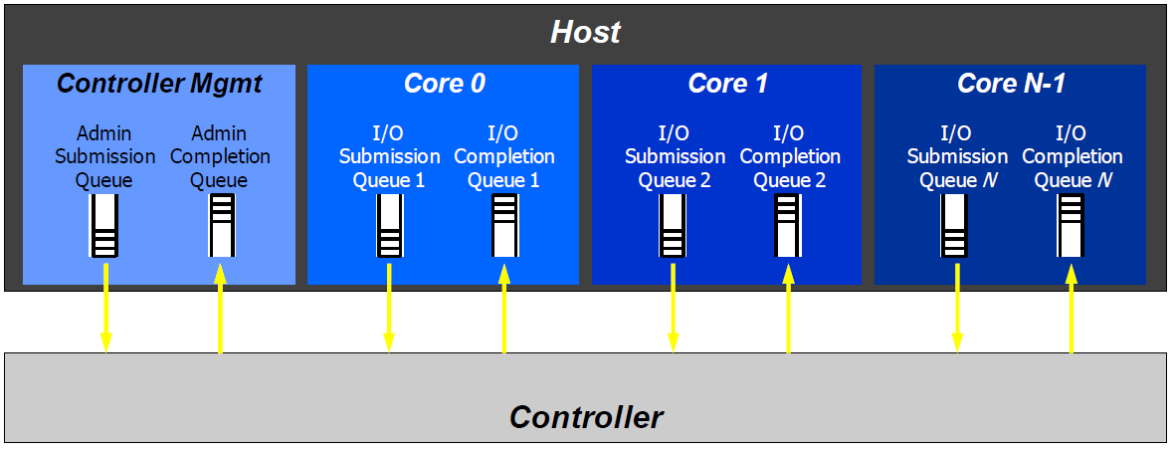
Queuing Structure, 1:1 Mapping
NVM Express is based on a paired Submission and Completion Queue mechanism. Commands are placed by host software into a Submission Queue. Completions are placed into the associated Completion Queue by the controller. Multiple Submission Queues may utilize the same Completion Queue. Submission and Completion Queues are allocated in host memory.
Source: NVMe Specification
NVM Express is based on a paired Submission and Completion Queue mechanism.
Host software creates the Queues in Host Memory.
Commands are placed by host software in a Submission Queue.
Completions are placed in the associated Completion Queue by the controller.
One Admin Queue Pair is mandatory per function, it can’t be more then one.
Up to 64K IO Submission & 64K IO Completion Queues can exist, each can carry up to 64K Entries.
Notes:
NVM Express is a scalable host controller interface designed to address the needs of Enterprise and Client systems that utilize PCI Express based solid state drives. The interface provides optimized command submission and completion paths. It includes support for parallel operation by supporting up to 64K I/O Queues with up to 64K commands per I/O Queue.

Slide 4
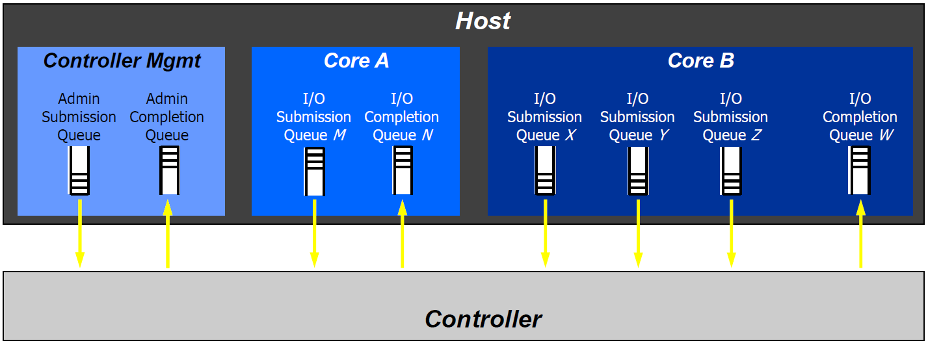
Queuing Structure, 1:n Mapping
Source: NVMe Specification
Multiple I/O Submission Queues can utilize same I/O Completion Queue

Slide 5

NVMe Queue Interface for Command Processing
Queue Command
1
Host
7
Process Completion
Ring Doorbell New tail
Submission Queue
Host Memory
Completion Queue
Ring Doorbell New head
2
Tail
Head
8
Head
Tail
3
4
5
6
Submission Queue Tail Doorbell
Fetch Command
Process Command
Queue Completion
Generate Interrupt
Completion Queue Head Doorbell
Controller
Command Submission
1. Host writes command to
submission queue
2. Host writes updated submission
queue tail pointer to doorbell
Command Processing
3. Controller fetches command
4. Controller processes command
Command Completion
5. Controller writes completion to
completion queue
6. Controller generates MSI-X
interrupt
7. Host processes completion
8. Host writes updated completion
queue head pointer to doorbell

Slide 6
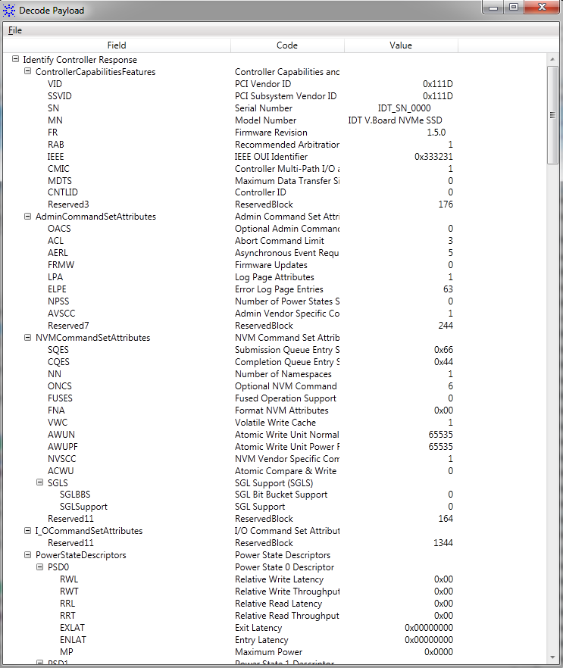
U4301A-3FP PCIe Analyzer Transaction Decoder
Making NVMe Testing Easier

Slide 7
Insight from NVMe Transaction Decode Results
  Decoded NVMe transactions provide a sequential view of the communication cycle between the host software and NVMe controller for various requests placed by the host software in queues.
  Using the Transaction Decoder, you can check how the NVMe controller responds to and completes these requests.
  At the administrative management level, you can verify how the NVMe controller handles admin requests such as queue management requests.

Slide 8
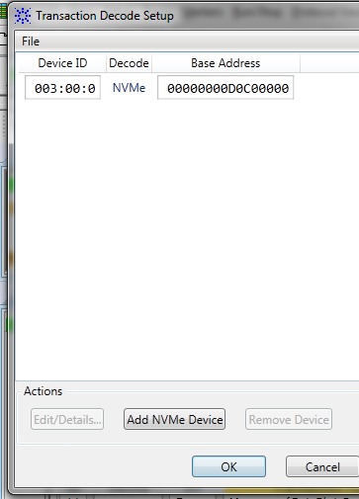
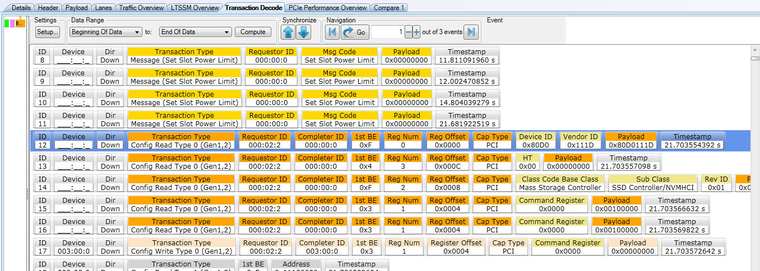
Discover / Verify NVMe Device Setup
  The first trace automatically discovers information about the NVMe device (like device ID, type, and base address)
    Start analyzer first, then DUT.
    Trigger on any TLP (initial run from boot, link up, real traffic)
    Decode can be done as long as traffic can be captured reliably
    Turn off ASPM (easier to decode)
    Understand what type of device, look for “Class Code”

Slide 9
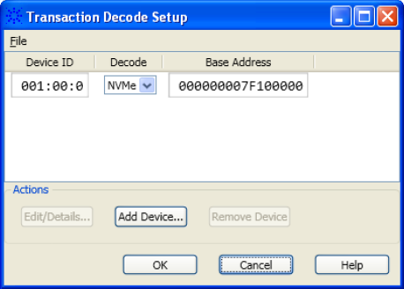
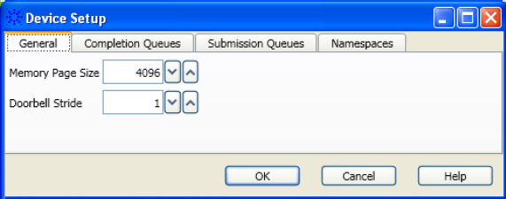
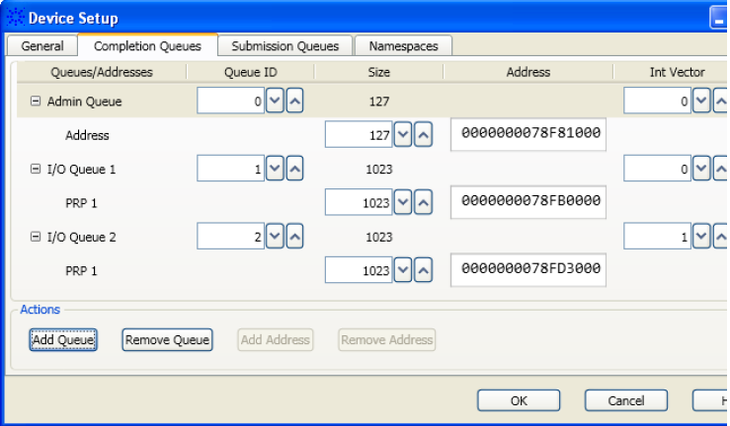
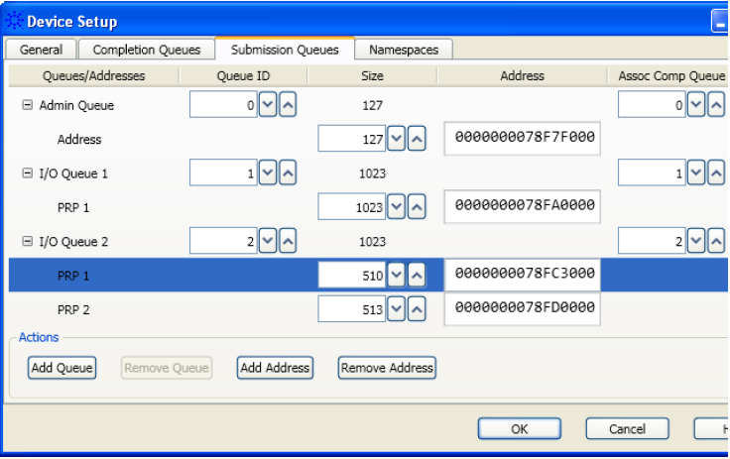
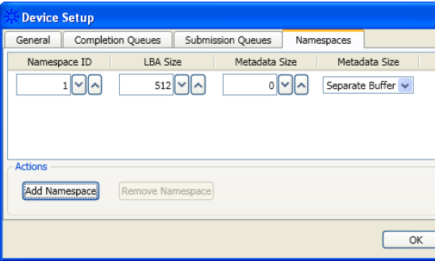
Quickly Verify/Modify Device Setup Information
  Automatically discovers/displays info about the device in a single location
  Enables addition/modification of device details when details are not available in the captured data
  Provides a way to rectify auto discovered device details or add details of multiple devices or queues.
  Saves the device, its queues, & namespace details in a Transaction Decode file (.tdprop) to enable decode computation of other traces without having to rediscover device detail information.
  Easily edit a .tdprop file with an XML editor

Slide 10
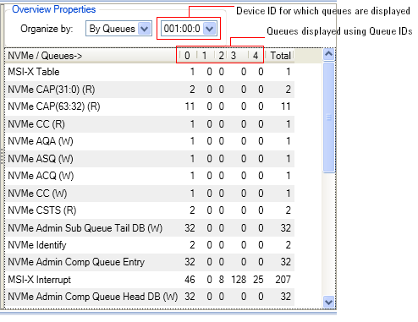
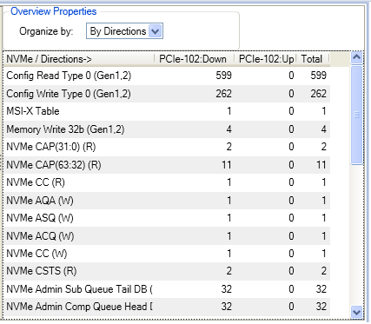
Instant Insight with Transaction Overview Pane
  Lists the transaction types for the computed transaction data and the number of events/occurrences for each.
  Organizes the number of transaction occurrences/events on the basis of link direction or queues.
    If the data is unidirectional, this view displays occurrences for one direction only.
    If multiple devices are involved, the Queue field provides multiple options representing multiple device IDs of multiple devices.

Slide 11
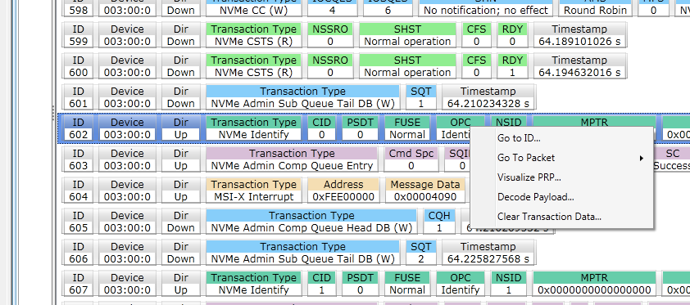
Easily Readable Display of Namespace Capabilities Using Payload Decode
  NVMe Identify command returns capabilities and status of a specific namespace.
  View easily readable namespace capabilities in a single display from the Identify command (right-click the NVMe Identify transaction and select Decode Payload)

Slide 12
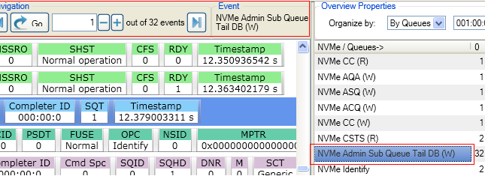
Rapid Navigation of Transaction Decode Results
  Select a transaction type in the Transaction Overview pane. The navigation bar in the Transaction Decode tab displays the total number of occurrences found. Use the buttons to navigate to the event of interest.
  Double-clicking a particular occurrence number in the Transaction Overview pane navigates to the first transaction mapped to that occurrence number.
  Between Transactions and associated packets: double-click a transaction in the Transaction Decode tab. Doing so highlights the first packet for that transaction in the upper pane of the Protocol Viewer.

Slide 13
Examples of Interpreting NVMe Transaction Decode Results

Slide 14
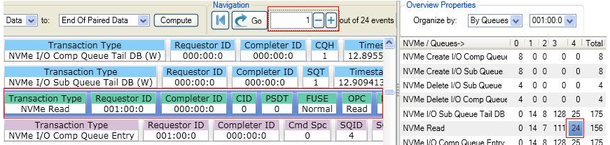

Navigating Through Transactions
Double-click a particular occurrence number in the right pane to navigate to the first transaction mapped to that occurrence number.
Use the navigation buttons to quickly access Next/Previous or first and last.

Slide 15
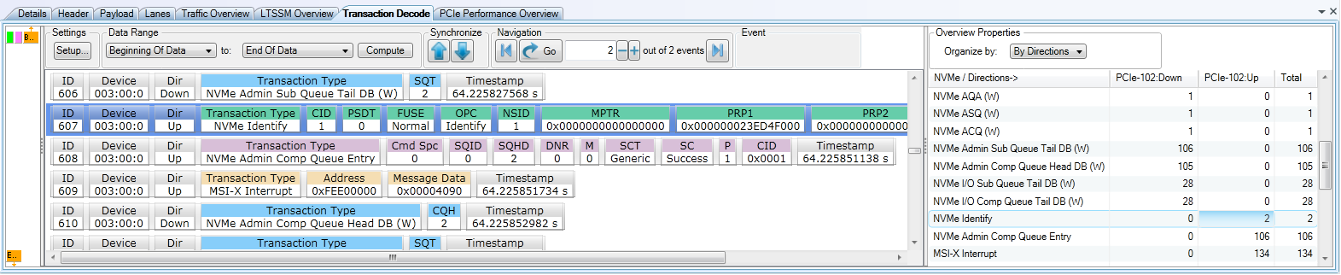
Interpreting and Navigating Through the Transaction Decode
Decoded transactions order is based on the timestamp of the first packet associated with a transaction. One or many PCIe packets may be associated with a transaction.
The right pane of the Transaction Decode tab displays statistics for the computed transactions. This pane lists the transaction types applicable for the computed transaction data and the number of events/occurrences for each transaction type in the computed data. This can be displayed by direction of by queue.

Slide 16
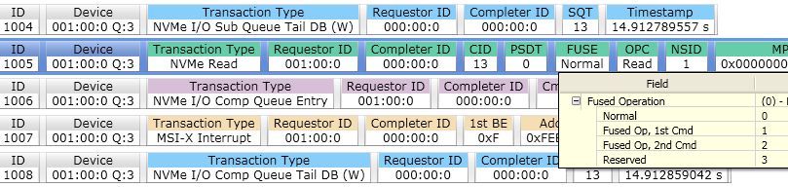
Interpreting and Navigating Through the Transaction Decode
  Transaction details vary by their type and applicable protocol
  Moving the mouse pointer over a field presents a tool tip with information about the field.
  Color coding is used to identify different transaction types
Color Coding Key (subject to change)
Color | Transaction Type
Orange | Config Read Transactions
Bisque | Config Write Transactions
Gold | Message Request Transactions
LightGreen | NVMe Transactions (Control Register Read)
LightSkyBlue | NVMe Transactions (Control Register Write)
MediumAquamarine | NVMe Transactions (Submission Queue Entry)
Thistle | NVMe Transactions (Completion Queue Entry)
LightSteelBlue | Memory Reads or MSI-X Table Transaction
LightGray | Memory Writes
Wheat | MSI-X Interrupt
Red | Indicates Error

Slide 17
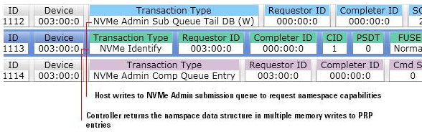
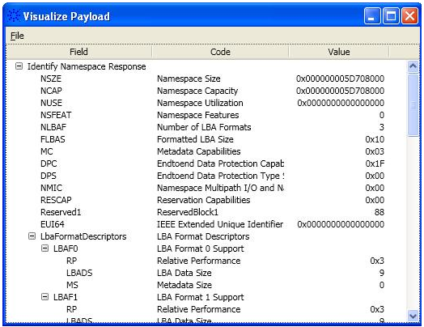
Viewing Admin Command Transactions
Identify command submission and completion to return capabilities and status of a specific namespace.
Right-click the NVMe Identify transaction and select Decode Payload

Slide 18
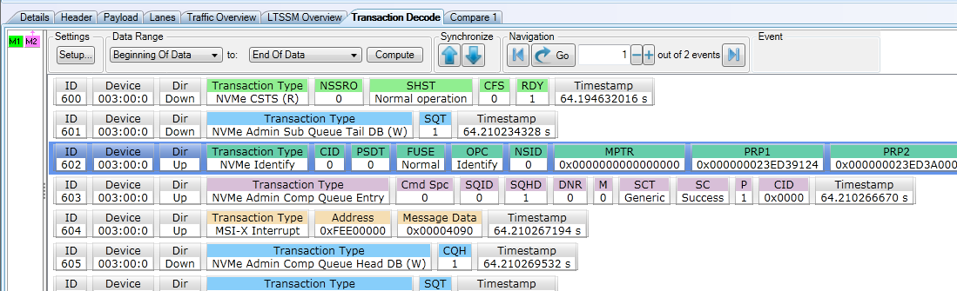
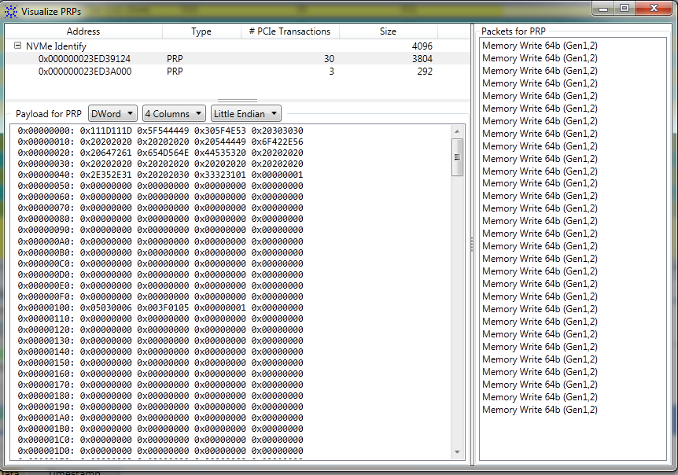
NVMe Identify → See returned data stored in PRPs
Host writes to NVMe Admin Submission queue to request namespace capabilities
Controller returns the namespace data structure in multiple memory writes to PRP entries
  Visualize how the data returned by the Identify command is stored in specific PRP entries by right-clicking the transaction and selecting Visualize PRPs

Slide 19
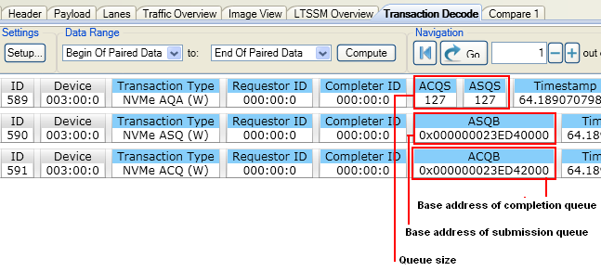
How to Discover the Admin Queue
  Use the transaction overview pane to navigate to NVMe AQA, NVMe ASQ, and NMVe ACQ.
  AQA, ASQ, and ACQ registers are modified to define the Admin Submission Queue and its corresponding Admin Completion Queue.
  For the transaction decode above the Admin queue attributes are 128 entries (in terms of size) and 64-bit physical address (for the base address) to be used for Admin submission queue and completion queue.

Slide 20
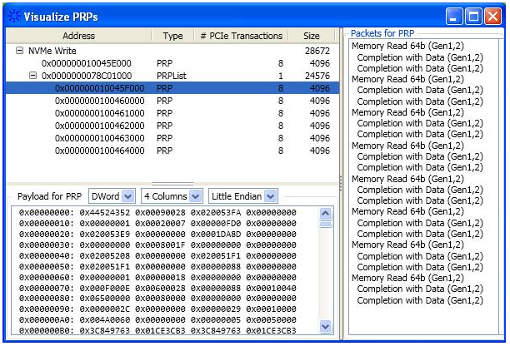
Visualize PRP (Physical Region Page)
Right-click the transaction and select Visualize PRP
Physical Region Page (PRP) entries are used in read/write transactions to indicate the physical memory locations in system memory. These memory locations are used by controller for data transfers to and from system memory.
Addresses can be directly a memory location or a pointer to a location that provides a set of addresses.

Slide 21
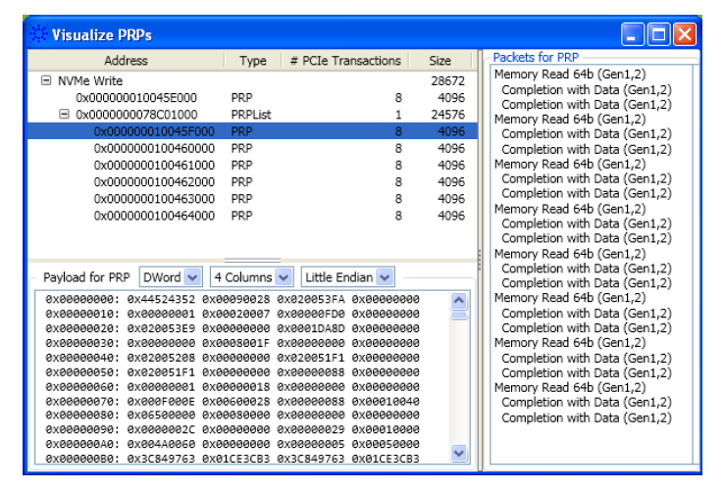
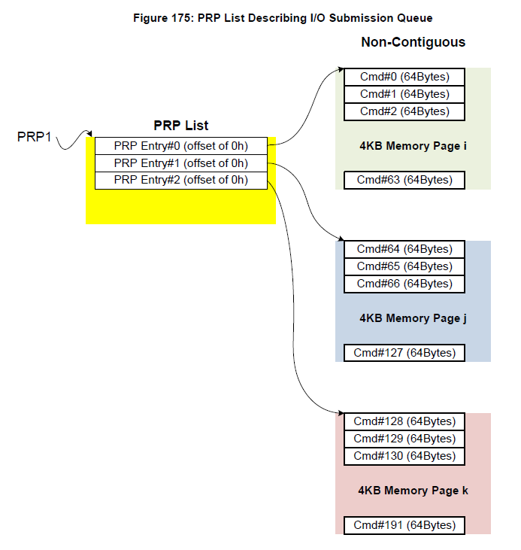
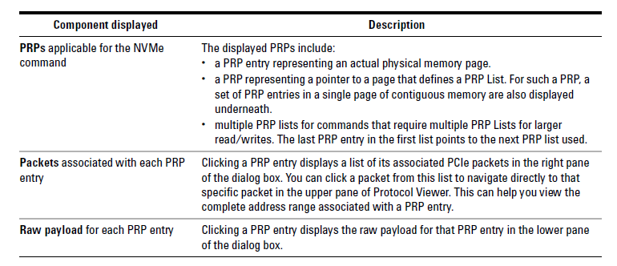
Physical Region Page (PRP)
NVMe Spec – Chapter 7
Visualize PRPs GUI
Source: NVMe Specification

Slide 22

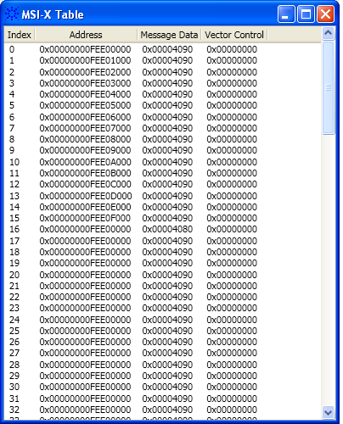
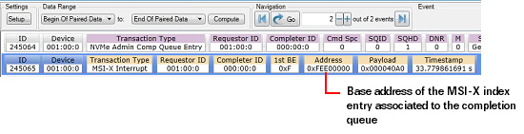
Viewing Decoded MSI-X Table
An MSI-X index entry is associated to a completion queue at the time of creation of the queue. Details about the MSI- X index entry associated to a completion queue are in the Completion Queues tab of the Setup dialog box.
Each MSI- X index entry in the MSI- X table has a base address associated to it. This is the address at which the controller writes the MSI- X interrupt for the associated completion queue.

Slide 23
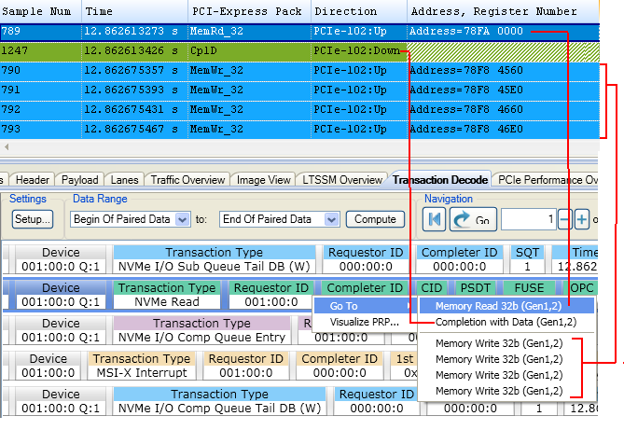
Viewing NVMe I/O Command Transactions
For this NVMe transaction the controller…
  First performs a Memory Read to read the request entry from the base address of the submission queue 1.
  Then fetches the requested data from system memory
  Then performs multiple Memory Writes to write this data to the applicable PRP entries for data transfer to host
  In the transaction following the NVMe Read, the controller updates the completion queue 1 with the status of the Read command completion.

Slide 24
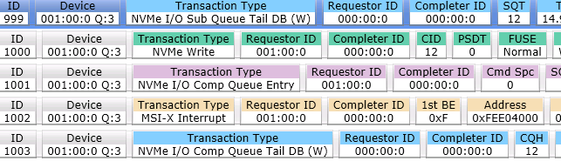
View a Complete Set of Transactions for a Command Submission and Completion
ID 999 Indicates to the controller that a command is submitted for processing.
ID 1000 Represents the NVMe Write command that the host created in the submission
queue. The controller reads this command from the submission queue for
execution and executes the command.
ID 1001 Represents the command completion entry that the controller writes to the
completion queue.
ID 1002 Represents the MSI- X interrupt generated by the controller to indicate that a
completion entry has been added to the completion queue.
ID 1003 Indicates to the controller that the host has processed the completion entry that
the controller added to the completion queue.

Slide 25
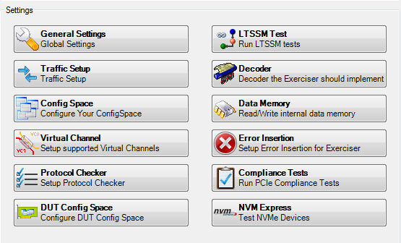
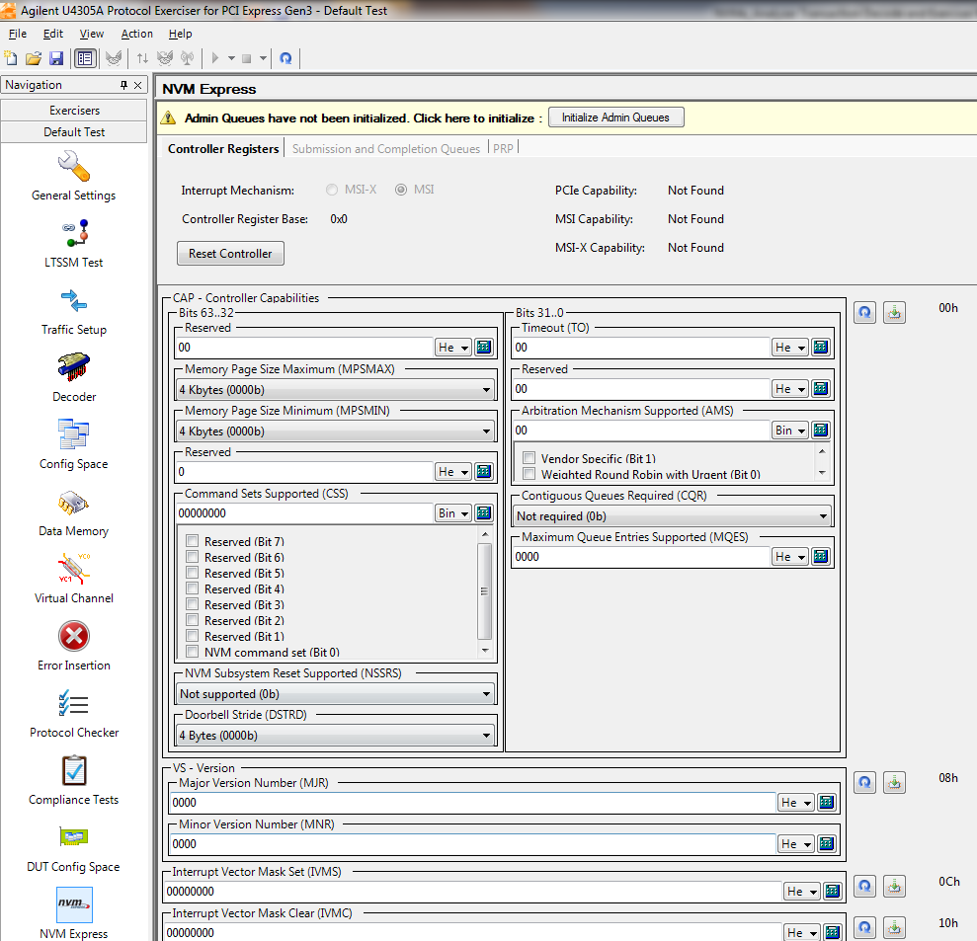
U4305A-1FP NVMe RC (Exerciser)

Slide 26
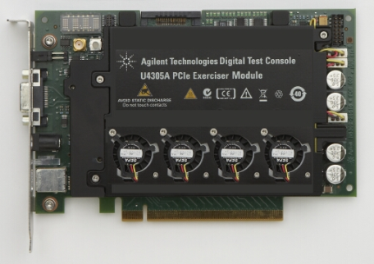
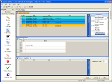
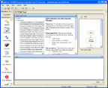

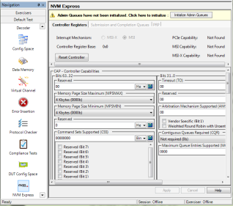
Exerciser (Packet Generator)
One Hardware, Multiple Applications
End Node Emulation
  Root Complex & DUT
LTSSM Tester
  State specific solicitation
Protocol Test Card
  Specification compliance tool
IO Virtualization
  Multi Root and Single Root
NVMe RC emulation
EP/RC Emulation Exerciser
LTSSM Tester
PTC 3.0
NVMe

Slide 27
NVMe Exerciser Features for RC
Scan and initialize the NVMe capabilities of the DUT.
NVMe controller registers of DUT are available for viewing and editing.
Configure the Admin submission and completion queue attributes.
Set the interrupt mechanism to be used and then configure the selected interrupt mechanism.
Define, view, and edit the MSI-X table of the DUT.
Create multiple I/O submission and completion queues
Configure submission queue Head and Tail pointers and completion queue head pointer.
Add NVMe commands to submission queues and submit these to the NVMe DUT. The commands are available as predefined templates.
View the commands and their subsequent completions in the completion queues.
Create PRP lists and PRP entries that can be used in the submitted NVMe commands for data transfer.

