Slide 1

PCI Express 3.0 Protocol Tool Solutions
Analyzer and Exerciser Products
Agilent Technologies
Digital Debug Solutions
Don Schoenecker PCIe Product Manager
Don_schoenecker@agilent.com
719-590-2553 July 13, 2013

Slide 2
Table of Contents
Page
System Configuration . . . . . . 3
Backplane . . . . . . 5
Probe Connection . . . . . . 8
Embedded Controller and Analyzer Blade . . . . 9
Analyzer . . . . . . . 11
Module Setup . . . . . . 12
Probe Setup . . . . . . 13
Open and Create PTU Files . . . . . 14
Triggering . . . . . . 17
Filtering . . . . . . 19
Decoders (including Traffic and LTSSM viewers) . . . . 20
Exerciser . . . . . . . 25
Adaptive Equalization . . . . . . 28
LTSSM Tester . . . . . . 30
Protocol Test Card (PTC3) . . . . . 34
Probes . . . . . . . 36
PCIe3 Total Solution . . . . . . 40
PCIe3 Products and Part Numbers . . . . . 41

Slide 3
PCI Express 3.0 Customer Challenges & Needs
1. Probing at 8GT/s
Close eye spec, need mechanism to recover signal ?
2. Significant changes in Logic Sub-Layer
3. Lack of stimulus for testing
No devices or limited devices on the market
How to probe (view) the signal without breaking the link?
How to probe (view) the signal without changing the actual signal?
Significant changes in the Link Training Status State Machine (LTSSM), how to validate all the different branches
Scrambling only, (no 8b/10b)
New scrambling polynomial
New encoding mechanism 128/130 (sync header)
Encapsulation changes at the TLP layer
Notes:
F

Slide 4
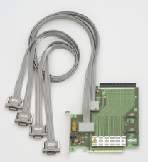
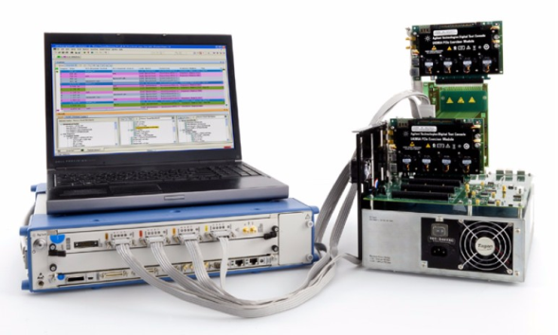
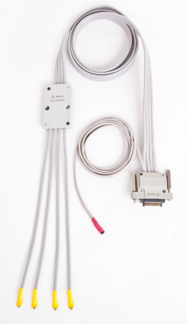
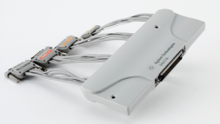
Agilent Digital Test Console U4300A Series PCI Express® 3.0 Protocol Test
Protocol Analyzer
Exerciser/Emulation
Probing
Agilent offers
the complete platform for PCI Express® 3.0 Protocol Solution; “integrated analysis and stimulus tools and direct probing“
to address key challenges of PCIe 3.0 design and development

Slide 5
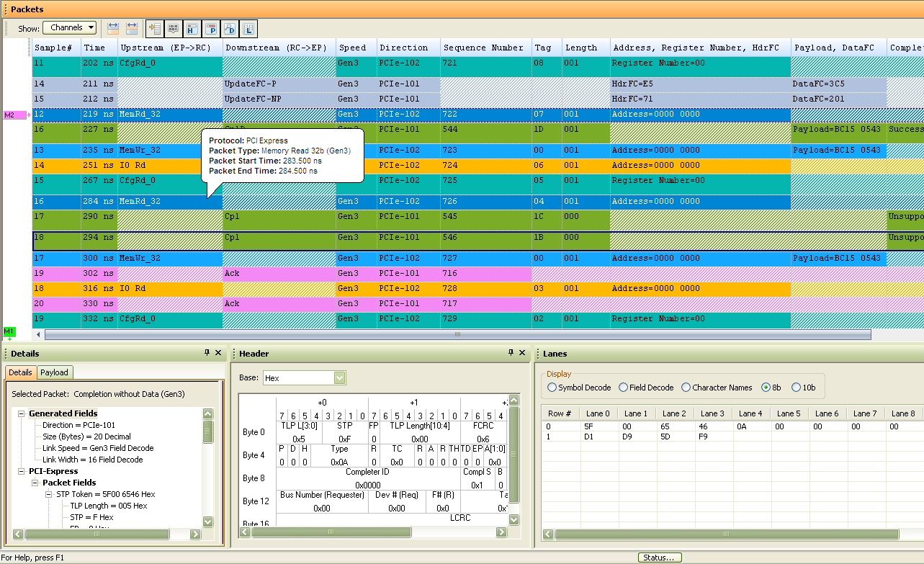
Example Gen3 x16 Traces (Online Packet Viewer)
Packet Viewer
Name it as you like! Customizable columns
Tag ID info
Floating Tip Message
Details and Payload info
Header info
Lane info
Notes:
The GUI for PCIe 3.0 will leverage the existing Gen2 viewer, with changes to support the new decodes required in Gen3

Slide 6
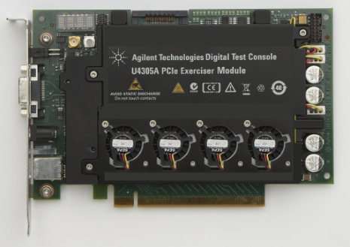
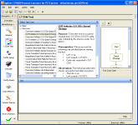
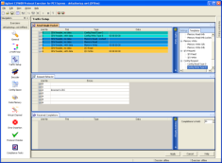
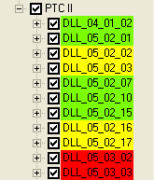
5 in 1! LTSSM Tester & Exerciser with Future Scalability
LTSSM Tester & Scalability to Meet Future Testing Needs
Single hardware, with multiple applications
LTSSM Tester (opt LT3)
Exerciser – EP emulation (opt EX3)
Exerciser – RC emulation (opt EX3)
Exerciser – EP/RC Gen2 MR-IOV emulation (opt MR2)
PTC 3 & Compliance Assured Tests (investigation for the future releases)
Same form-factor as existing exerciser
LTSSM Tester
EP/RC Emulation Exerciser
PTC (Protocol Test Card) 3
investigation for the future releases
Notes:
6

Slide 7
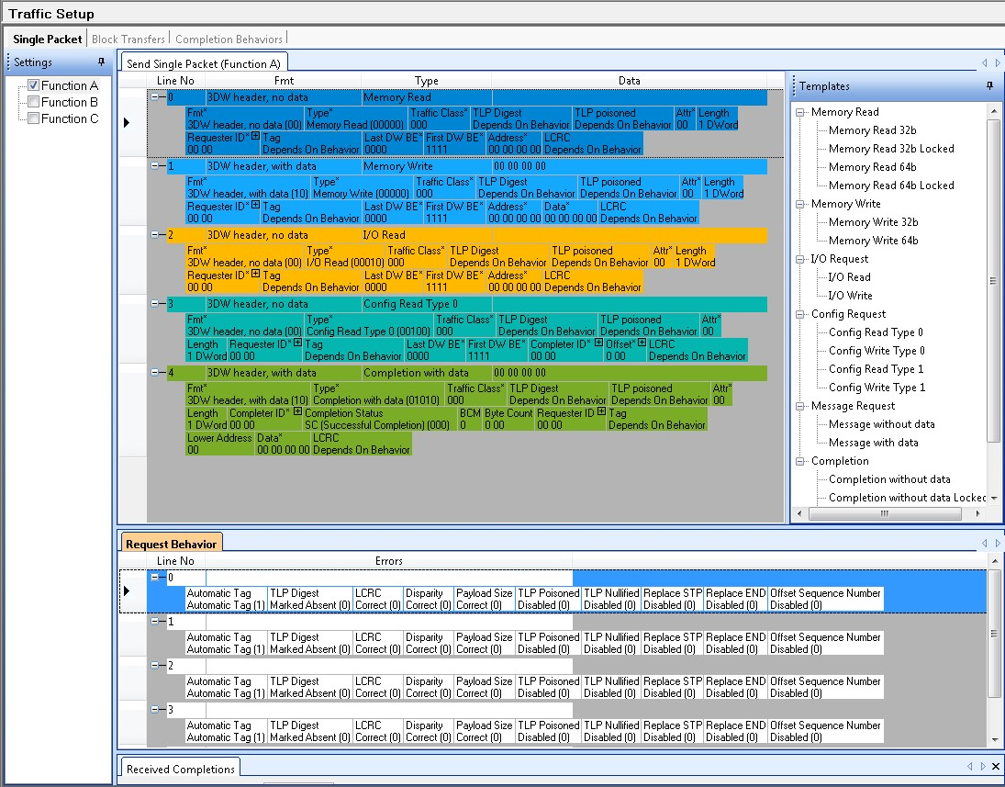
RC/EP Emulation – Gen 1~3 DLLP & TLP I/O generation
Memory Read 32b
Memory Write 32b
I/O Request
Config Request
Completion with data

Slide 8
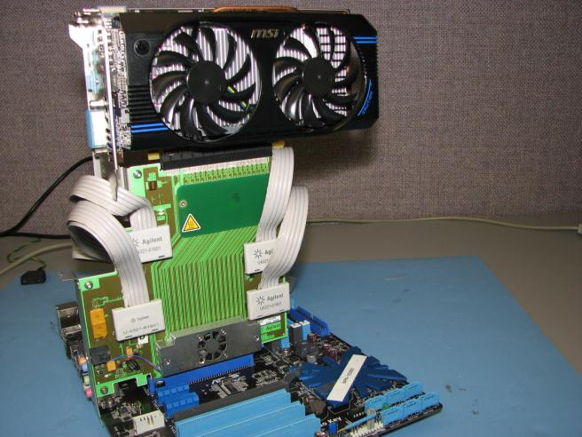
System Configuration Trace Capture Between Root Complex (RC) and DUT
The U4321A, Solid Slot Interposer (SSI) probe is installed between the RC and DUT. Protocol packets (or traffic) are passed between the RC and the DUT through the SSI probe
The 4 cables attached to the SSI probe connect to the front of the U4301A, Protocol Analyzer module (not shown)
Each SSI cable supports up to 8 PCIe 3.0 links. Therefore 4 SSI cables provide 32 links or 16 links in each direction or x16 bidirectional lanes
Bidirectional means protocol packets are passed back and forth between the RC and the DUT simultaneously
Downstream packets travel from the RC to the DUT. Upstream packets travel from the DUT to the RC
DUT
SSI Probe
PCIe x16 connector
(previously hidden by DUT)
8 link SSI probe cable

Slide 9
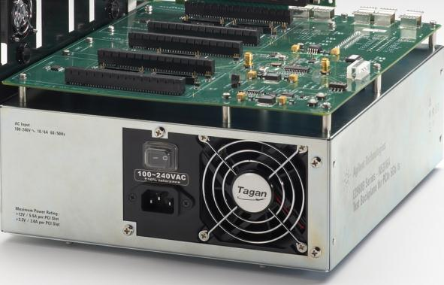
System Configuration Backplane - Motherboard Substitute
Features of the N5316A Backplane
Allow testing of the end nodes without access to RC system
Provides power and clock to the DUT (Test Fixture)
Power, Reset + AUX power for DUT if required
Clock generator with/without SSC (Spread Spectrum) selectable
Input for external reference clock
All link widths supported – x1, x2, x4, x8, and x16
Connectors: Two (2) independent x16 PCIe connector pairs (Link 1&3) & one x16 PCIe connector with loop back (Link 2)

Slide 10
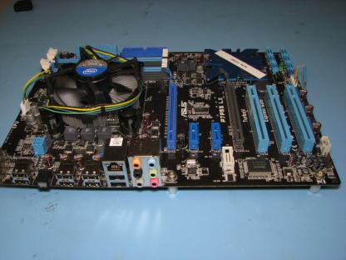
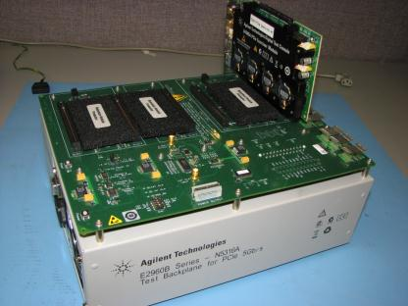
System Configuration PCIe3 Root Complex (CPU) Emulation using U4305A + N5316A
Arbitrary Selected PCIe System/Motherboard
Backplane N5316A
RC Emulator U4305A
DUT
(same)
Reset
AUX Power Output
Power
Benefits of RC Emulation and Backplane over a System Motherboard
Problem accessing a PCIe3 motherboard or CPU
Full PCIe 3.0 Protocol control of the DUT
DUT functional isolation from the Root Complex

Slide 11
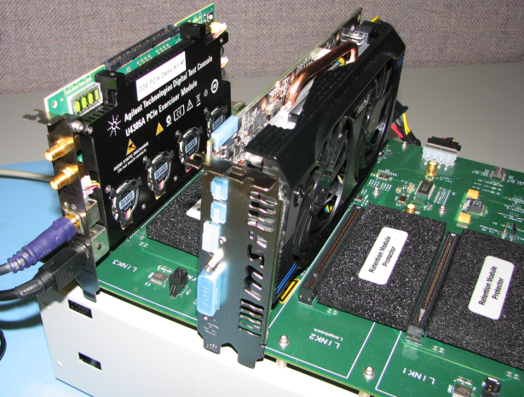

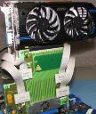
System Configuration RC Emulator to DUT via Backplane Connection
Using the Link3 x16 connector pair, the U4305A Exerciser configured as a RC emulator is linked up to the DUT
This configuration also happens to be the same for using the PCIe 3.0 Protocol Test Card which will be discussed later
To capture trace, the SSI probe can be placed into either one of the two Link3 connectors for the Analyzer U4301A to intercept and capture the packets
U4305A
RC Emulator
DUT
Link2 Connector Loopback
or
Link3 x16 Connector Pair
(2nd connector hidden)
Link1 x16 Connector Pair
(2nd connector not shown)

Slide 12
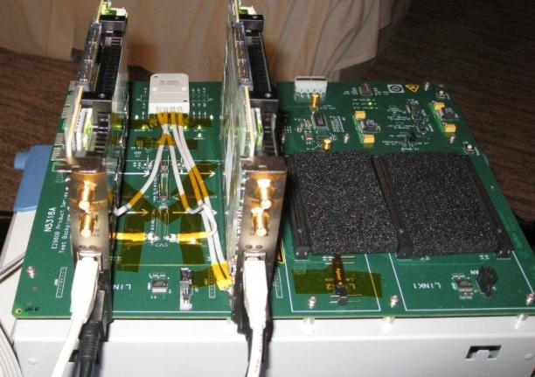
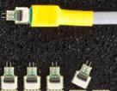
System Configuration Probes – SSI, Flying Lead (solder down), & Midbus Probes
The SSI, Midbus, and Flying Lead probes all serve the same purpose; send upstream and downstream protocol traffic to the analyzer
Ideally, all probes should have a large enough input impedance to be ‘invisible’ to both end-nodes of the channel under capture
Any probe can be used in place of the other provided there exists a probe connection point
SSI requires a PCIe slot connector
Midbus requires a PCI-SIG spec’d footprint masked into the trace copper
Flying Lead requires an end node Si pin or test point differential pair within the ZIF width apart
Flying Lead (solder down)
Midbus Footprint
Unused links
Lane0 Upstream
Lane0 Downstream
Flying Lead Zero Insertion Force (ZIF) Tip soldered to Lane0 of the upstream and downstream channel

Slide 13
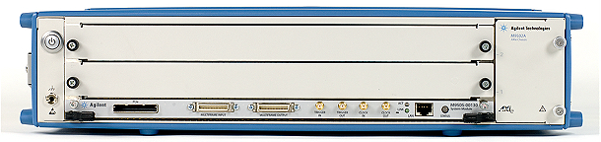
System Configuration Analyzer & Embedded Controller in AXIe 2 Slot Chassis
16 Channels per Analyzer Module
4 Probe POD ports with 4 channels per port
2 Slot AXIe Chassis
Analyzer Module Trigger In/Out
Controller VGA Output
PCIe 3.0 Analyzer Module
3 USB 3.0 ports
(Keyboard, Mouse, External drive)
AXIe Embedded Controller
2 GbE Ethernet ports
Embedded Controller
Software host for Analyzer and Exerciser
PCIe 2.0 x4 backplane connection from analyzer to host (No PCIe or USB cable connection required)
Remote access via Gigabit Ethernet port
160 GB 3½ inch SSD
Windows® 7 (32 and 64 bit)

Slide 14
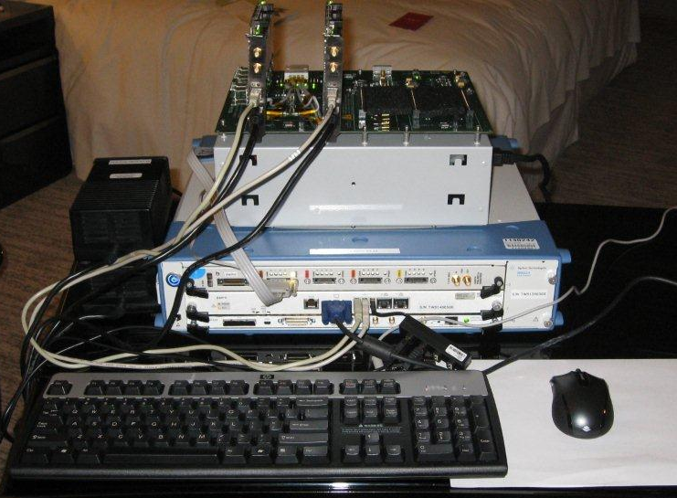
System Configuration Putting it all together …PCIe 3.0 Protocol Tools Top to Bottom
DUT Emulation
Protocol trace capture using solder down probe
Two Slot Chassis
Protocol Analyzer
Embedded Controller. Host for the PTC 3.0, DUT Emulation, and Analyzer Module software
Probe cable attachment to Analyzer
Root Complex Emulation

Slide 15
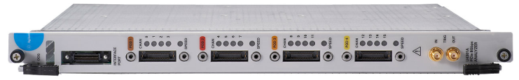
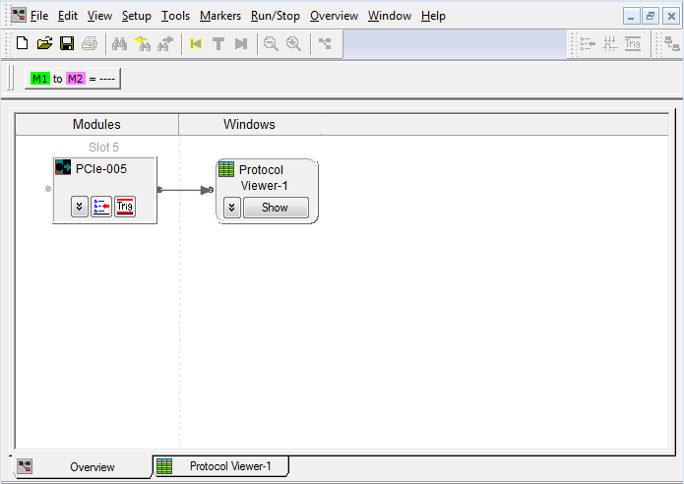
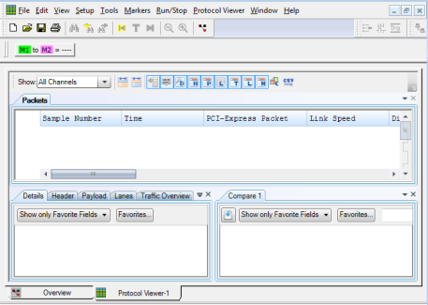
Analyzer software Overview

Slide 16
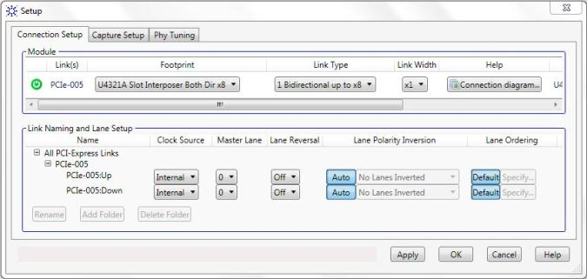
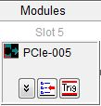
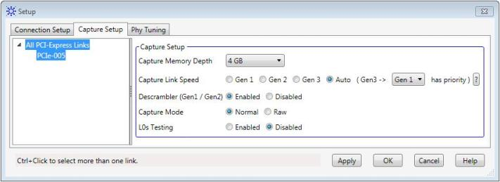
Analyzer Module Setup
Probe selection
Link and Module configuration
Probe wiring diagram
Clock source
Lane configuration
Custom Lane mapping with Analyzer soft switch
Set Memory size (64K to 4GB)

Slide 17
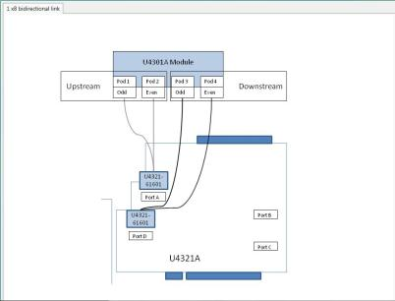
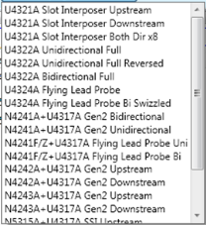
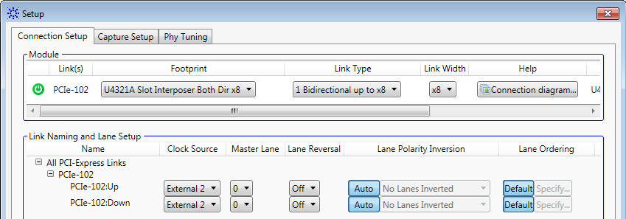
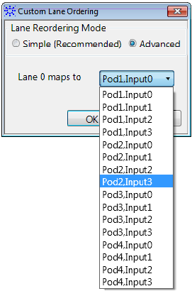
Analyzer - Probe Setup Selection, Connection, Lane Mapping
Probe Selection Menu
Slot Interposer
Mid Bus Probe
Solder Down Tip
Module Configuration
Gen2 Probe Reuse Using Gen3 Adaptor
Link Width
Lane Mapping

Slide 18
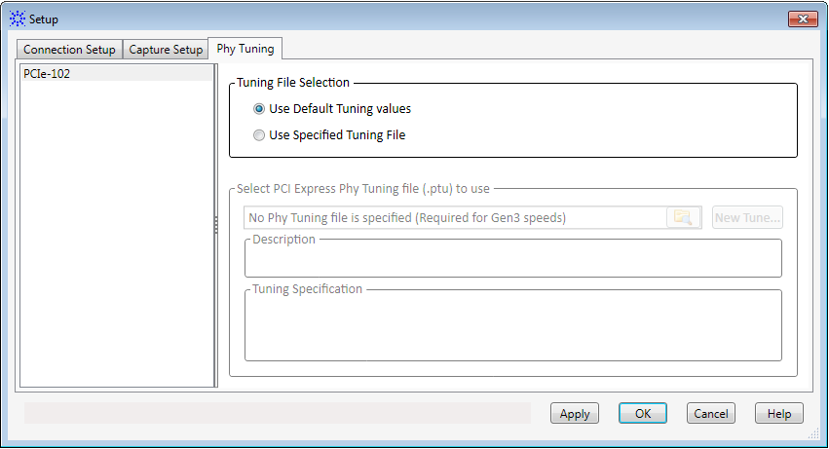
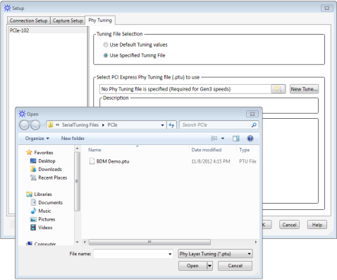
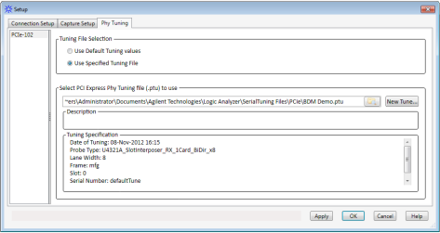
Analyzer Open Existing .ptu File

Slide 19
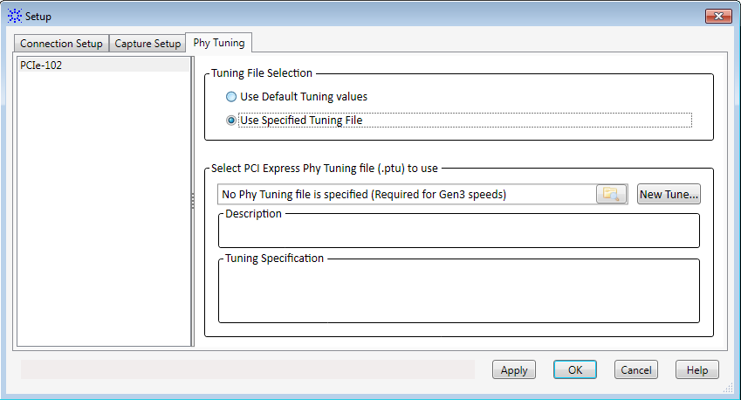
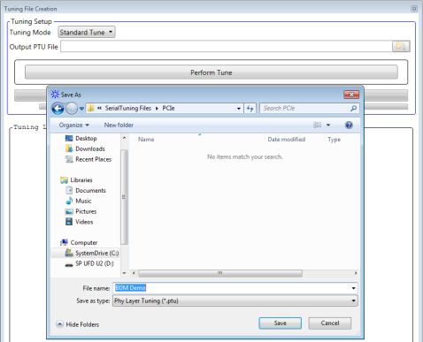
Analyzer Create a Custom .ptu File
Name the custom .ptu file

Slide 20
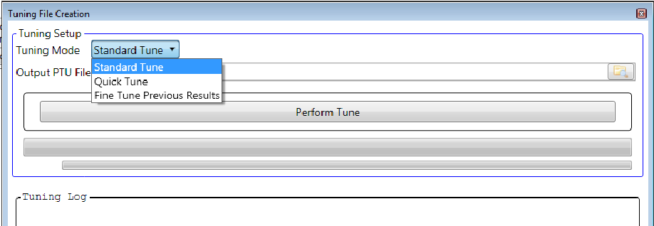
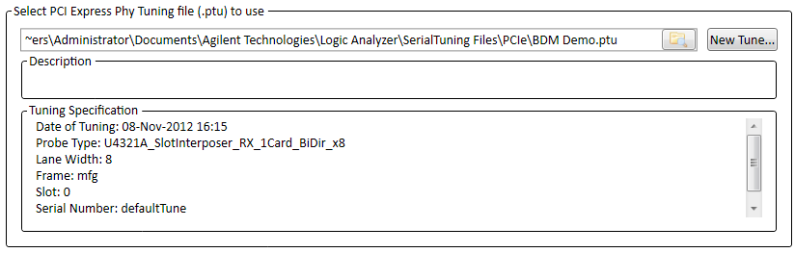
Analyzer Tuning Modes
Select a Tuning Mode then …
… click here to Perform a Tune
Tune progress bar
Tune progress bar
The probe tuning algorithm will apply an Analog Tune then a Fine Tune across each lane indicated in the probe lane-width setup
Analog Tune is an Agilent proprietary ‘eye scan’ sweep of whatever signal is on the channel
Fine Tune applies a digital tune to the result generated by the Analog Tune
The Fine Tune will attempt to converge the probe lane transceiver values to 10⁻¹² BER (accuracy is system dependent)
Standard Tune Mode limits the number of Fine Tune attempts to converge a lane to 100 tries
Quick Tune Mode limits the number of Fine Tune attempts to converge a lane to 10 - good for demos
Fine Tune Previous Result Mode will apply a Fine Tune ONLY to a previously created .ptu file named in the ‘Select PCIe Phy Tuning file (.ptu)’
Selecting Fine Tune Previous Result mode will run a Fine Tune ONLY on the “BDM Demo.ptu” file listed here

Slide 21
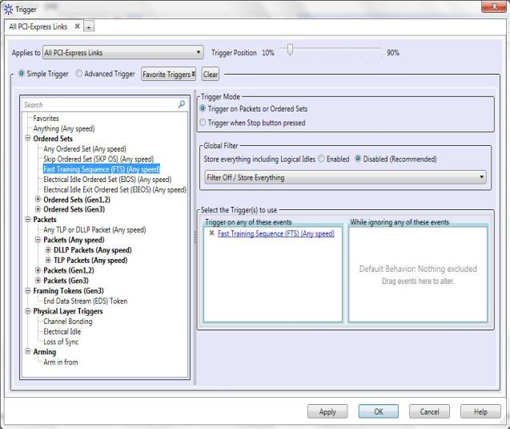
Analyzer Triggering
Trigger position relative to available memory
Text search for trigger term
Triggering Capabilities
4 states supported in trigger sequencer
Trigger sequencer supports
Pattern matchers
Protocol errors and events
Counters
Timers
External Triggers in/out
Click, Drag & Drop
Trigger Event Condition Window
Trigger Else Condition Window

Slide 22
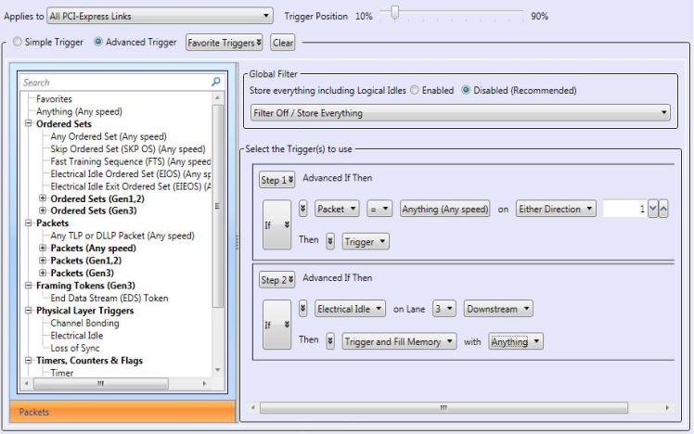
Analyzer Advanced Triggering Mode
Advanced Trigger :
Can specify a trigger event sequence
Packet events are dropped into event boxes and sequencer
Events can be dropped within a sequence level, in between levels, or replace an entire level

Slide 23
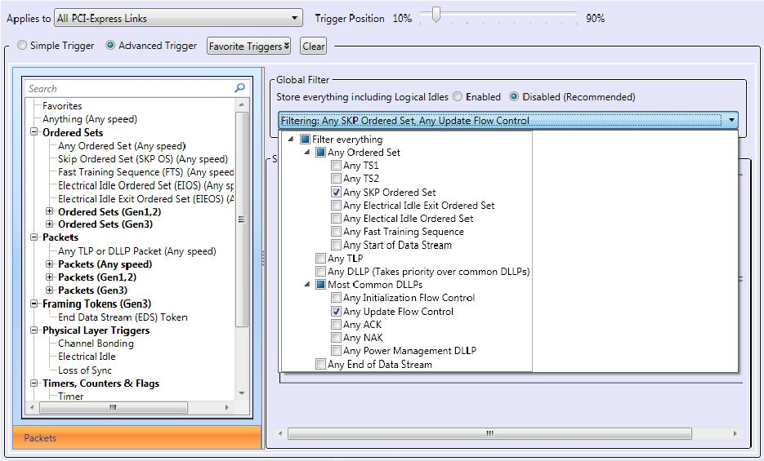
Analyzer Packet Filtering Options
Pull Down Selection

Slide 24
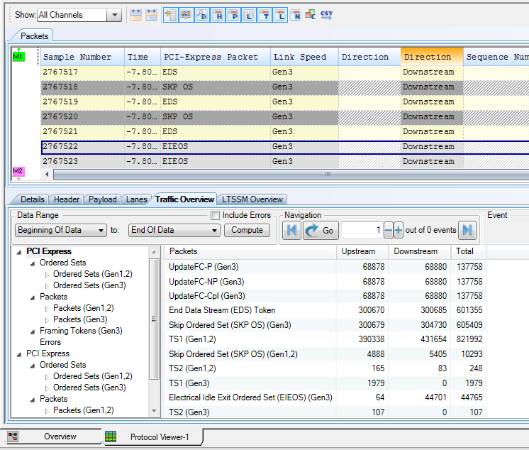
Analyzer Decoder Viewers Post Process Overview of Trace
Trace View
Compute Button Builds Decoder Data from the Trace Captured
Available Decoders
Step Through Navigation Window Packet(s) Occurrences
Set Decoder Data Range

Slide 25
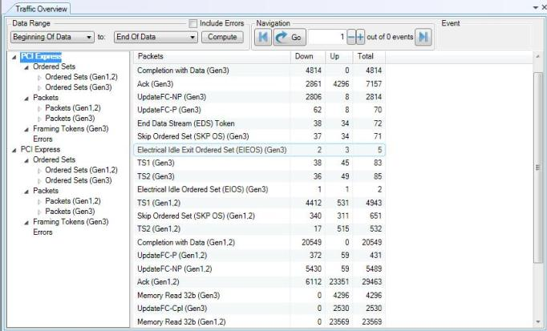
Analyzer Decoder Overview Traffic Viewer
Computes packet occurrence from the captured trace file within the selected data range
Post Process View of a Trace Capture
Data Range computed from Trace capture
Packet Navigation control buttons
Decoder packet grouping
Highlight packet(s) to jump too in the trace view using the Navigation control buttons
Packets decoded within the selected Data Range
Downstream, Upstream & Total packet occurrence

Slide 26
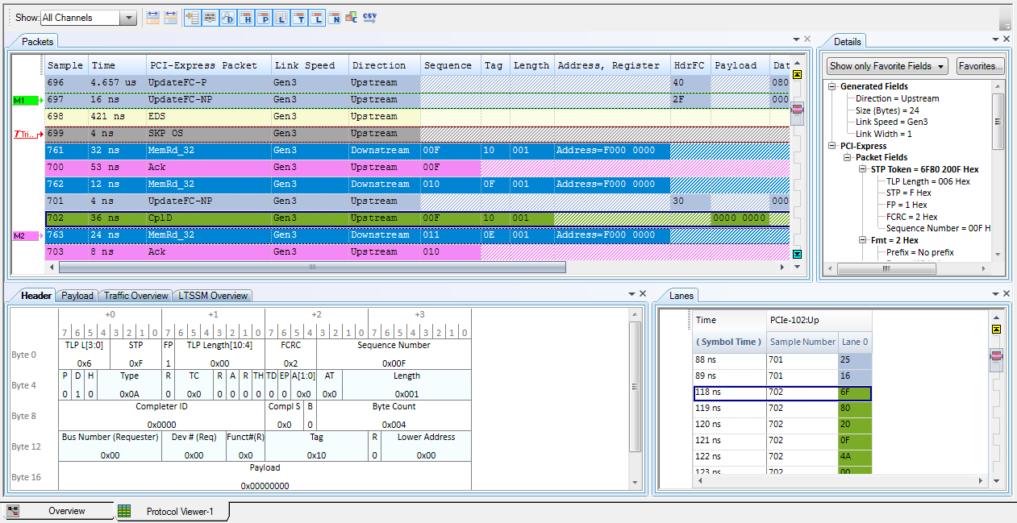

Analyzer Protocol Trace and Decoder Viewers
Packet Viewer
Name it as you like! Customizable columns
Details info
Tag ID info
Trigger Point
Floating Tip Message
Gen3
Lane info
Header info
Decode Overview Selections

Slide 27
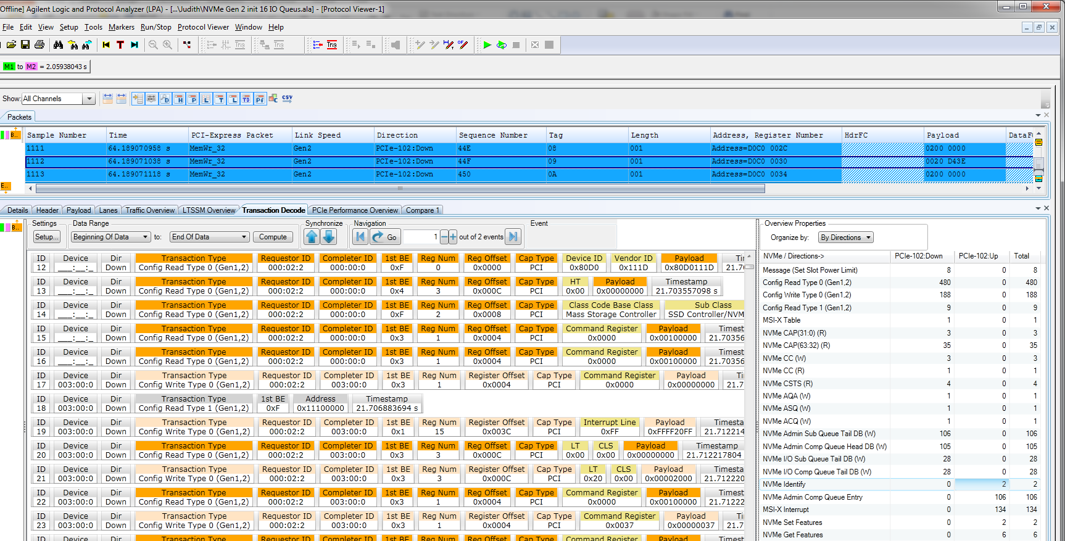
Transaction Decode
Transaction decode pane
Transaction overview pane
Pane | Description
Transaction decode pane | The left pane displays a list of transactions. New decoders automatically work as they become available. Initial release has NVMe with PCIe; Under development: AHCI
Transaction overview pane | The right pane displays the number of occurrences of these transactions

Slide 28

NVMe Queue Interface for Command Processing
Queue Command
1
Host
7
Process Completion
Ring Doorbell New tail
Submission Queue
Host Memory
Completion Queue
Ring Doorbell New head
2
Tail
Head
8
Head
Tail
3
4
5
6
Submission Queue Tail Doorbell
Fetch Command
Process Command
Queue Completion
Generate Interrupt
Completion Queue Head Doorbell
Controller
Command Submission
1. Host writes command to submission queue
2. Host writes updated submission queue tail pointer to doorbell
Command Processing
3. Controller fetches command
4. Controller processes command
Command Completion
5. Controller writes completion to completion queue
6. Controller generates MSI-X interrupt
7. Host processes completion
8. Host writes updated completion queue head pointer to doorbell

Slide 29
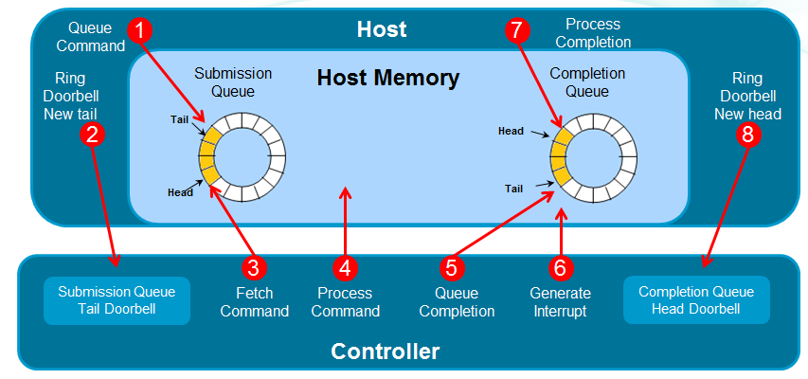
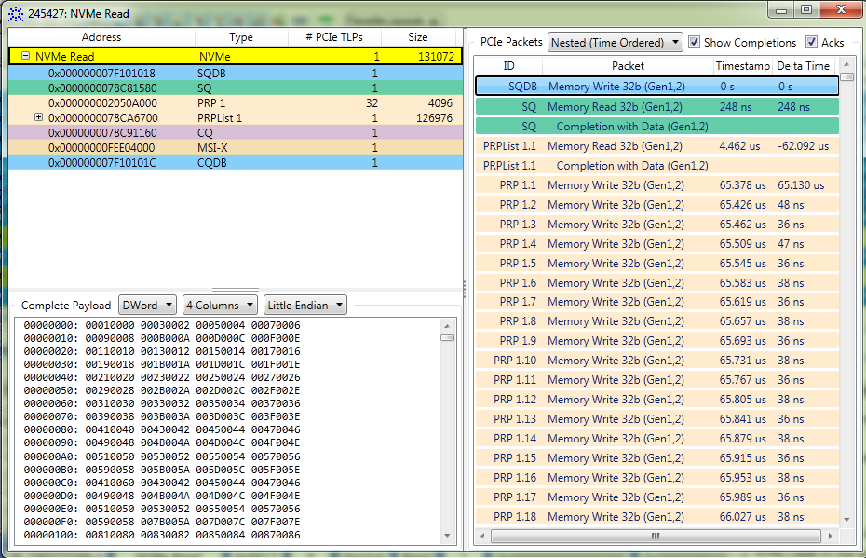
Visualize Transaction: Understanding NVMe
NVMe Command execution
Ring Doorbell New Tail
Fetch Command
Process Command
Queue Completion
Generate Interrupt
Ring Doorbell New Head
2
3
4
5
6
8
PCIe messages
NVMe Data

Slide 30
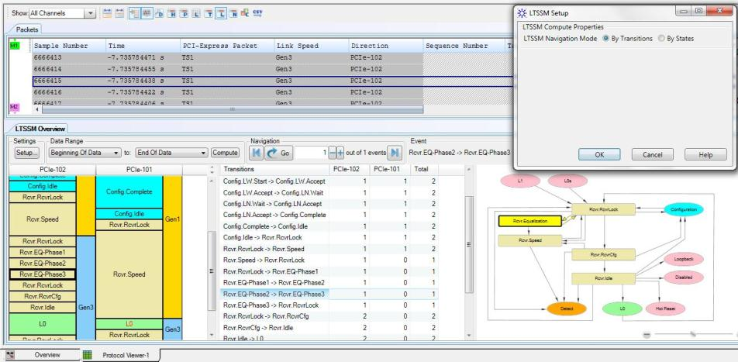
Analyzer LTSSM Decoder (pg 1of2)
Select LTSSM Navigation by
State or Transitions
Trace Capture Window
Upstream traffic
Downstream traffic
Link speed by state
Bubble view

Slide 31
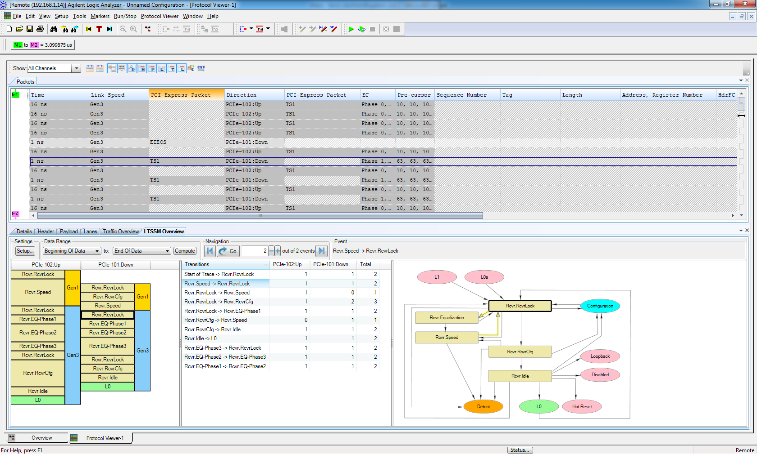
PCIe LTSSM Analyzer

Slide 32

Analyzer LTSSM Decoder (pg 2of2)
Navigate window, Trace capture, Ribbon view, and Bubble view are correlated
Jump from state to state, upstream or downstream using arrow keys

Slide 33
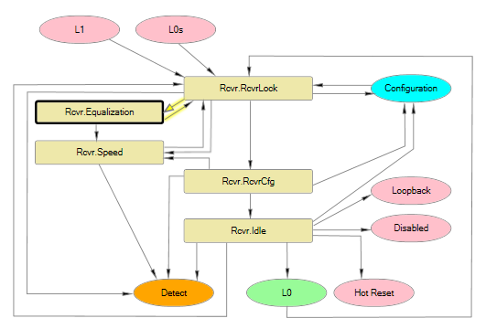
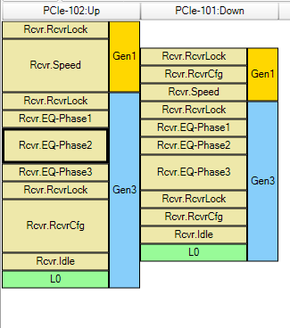

Linked LTSSM Flow
Reference Flow Chart
Navigate State Transitions

Slide 34

PCIe Performance Overview
Pane | Description
Categories pane | The leftmost pane displays a list of categories for which statistics will be generated and displayed.
Performance Statistics pane | The middle pane displays a list of performance parameters for the category that you select in the Categories pane. For each of these parameters, statistics are displayed based on the link directions (upstream as well as downstream).
Performance Charts pane | The rightmost pane displays a performance chart

Slide 35

Analyzer Performance Overview
On/Off Performance Window switch
Check for License & Compute Completed Transactions
Chart Pan and Zoom Controls
Notes:
There are On/Off buttons to enable/disable each of the post process panes.
After loading an .ala config file you have to compute transactions and statistics to produce this display. Select a range and then select the compute button, just like in the Traffic or LTSSM overviews.
The compute occurs in two phases. In the first phase a transaction list is constructed from the packets captured in the config file. The second phase computes the performance statistics using the transaction list computed in the first phase and is much quicker than the first phase.

Slide 36

Analyzer Performance Overview
Setting Markers on Chart
Setting Chart Sample Rate
Statistic Type
Statistic Type Tables

Slide 37





Exerciser (Packet Generator) One Hardware, Multiple Applications
End Node Emulation
Root Complex & DUT
LTSSM Tester
State specific solicitation
Protocol Test Card
Specification compliance tool
IO Virtualization
Multi Root and Single Root
EP/RC Emulation Exerciser
LTSSM Tester
PTC 3.0
MRIOV & SRIOV

Slide 38

Exerciser Feature Capability High Lights
2.5, 5, & 8 GT/s speed support at x1, x4, x8, & x16 lane widths
Autonomous (Adaptive) Equalization capable for phases 2/3
DLLP and TLP I/O generation
ECRC checker
Packet level Error Insertion
5 Virtual Functions for PCIe, MRIOV, and SRIOV
PCIe 3.0 compliance measurement for DUT and BIOS (x1 only)
New

Slide 39


Exerciser software Overview

Slide 40



Exerciser General & Adaptive Equalization Setup
Pre, Post, & Data cursor ON – Exerciser will determine proper coefficient values
Transmitter pre-emphasis and auto Boost is ON – Exerciser will determine the correct tap and Boost settings

Slide 41


Exerciser Pattern Matcher & Power Management Setup

Slide 42

Exerciser LTSSM Tester GUI
Run/Stop Test
52 total tests available
High lighted test details
Prerequisite condition. The test will not move on without passing these prerequisites
Test result log file

Slide 43


Exerciser End Node Emulation – DLLP & TLP Packet Generator
Up to 5 Physical Functions for I/O Virtualization
Memory Read 32b
Click, Drag & Drop Template into Function window
Left dbl click mouse anywhere on function to open packet editor
Memory Write 32b
I/O Request
Config Request
Completion with data

Slide 44


Exerciser Config Space Setup
Config Space Setup for up to 5 Physical Functions of I/O Virtualization
Slide down to see all Config Space setup for PCI Express Capabilities
Notes:
Here is a snap shot of what the LTSSM looks like. We will focus on the test case, changing speed from 2.5G (Gen1) to 8G (Gen3). We walked through the state machine in the last webinar, so you know the different transitions that need to take place for the speed change. And in the software, in the setup window this is also spelled out for you.
When you run this test, the LTSSM will step through the different stages of the state-machine, and force the dut to also make the same changes in its state-machine. By looking at the responses from the DUT, the exerciser will know if the DUT has taken the correct arcs in the state-machine and made the correct transitions or not.
!

Slide 45

Exerciser Error Insertion
Request and Completion Errors
Dynamic Link Layer Error Insertion
ACK/NAK Error Insertion
Notes:
Here is a snap shot of what the LTSSM looks like. We will focus on the test case, changing speed from 2.5G (Gen1) to 8G (Gen3). We walked through the state machine in the last webinar, so you know the different transitions that need to take place for the speed change. And in the software, in the setup window this is also spelled out for you.
When you run this test, the LTSSM will step through the different stages of the state-machine, and force the dut to also make the same changes in its state-machine. By looking at the responses from the DUT, the exerciser will know if the DUT has taken the correct arcs in the state-machine and made the correct transitions or not.
!

Slide 46

Exerciser PTC Tester GUI
Run/Stop Test
Gen2 and Gen3 Tests available
Test Description
View & Print Log
Gen2 and Gen3 Tests available
Select Message Framing to trigger Analyzer for trace capture
Notes:
Here is a snap shot of what the LTSSM looks like. We will focus on the test case, changing speed from 2.5G (Gen1) to 8G (Gen3). We walked through the state machine in the last webinar, so you know the different transitions that need to take place for the speed change. And in the software, in the setup window this is also spelled out for you.
When you run this test, the LTSSM will step through the different stages of the state-machine, and force the dut to also make the same changes in its state-machine. By looking at the responses from the DUT, the exerciser will know if the DUT has taken the correct arcs in the state-machine and made the correct transitions or not.
!

Slide 47

Exerciser PTC Log File Sample
Notes:
Here is a snap shot of what the LTSSM looks like. We will focus on the test case, changing speed from 2.5G (Gen1) to 8G (Gen3). We walked through the state machine in the last webinar, so you know the different transitions that need to take place for the speed change. And in the software, in the setup window this is also spelled out for you.
When you run this test, the LTSSM will step through the different stages of the state-machine, and force the dut to also make the same changes in its state-machine. By looking at the responses from the DUT, the exerciser will know if the DUT has taken the correct arcs in the state-machine and made the correct transitions or not.
!

Slide 48

Explored PCIe Capabilities

Slide 49

Enable Memory Space and Setup Bar0
Enable for Memory Space
Press Apply
Setup Bar0

Slide 50

Program Controller Registers
Press Initialize Admin Queue
Setup Admin SQ
Setup Admin CQ

Slide 51

Once Setup is Complete You Can…
Create, Delete, and View Submission and Completion Queues
Submit an NVMe command and view its completion status
Reset the NVMe controller capabilities

Slide 52

NVMe Conformance Testing

Slide 53
Exerciser (Packet Generator) One Hardware, Multiple Applications
End Node Emulation
Root Complex & DUT
LTSSM Tester
State specific solicitation
Protocol Test Card
Specification compliance tool
IO Virtualization
Multi Root and Single Root
5. NVMe RC emulation
EP/RC Emulation Exerciser
LTSSM Tester
PTC 3.0
MRIOV & SRIOV

Slide 54
NVMe Exerciser Features
Scan and initialize the NVMe capabilities of the DUT.
NVMe controller registers of DUT are available for viewing and editing.
Configure the Admin submission and completion queue attributes.
Set the interrupt mechanism to be used and then configure the selected interrupt mechanism.
Define, view, and edit the MSI-X table of the DUT.
Create multiple I/O submission and completion queues
Configure submission queue Head and Tail pointers and completion queue head pointer.
Add NVMe commands to submission queues and submit these to the NVMe DUT. The commands are available as predefined templates.
View the commands and their subsequent completions in the completion queues.
Create PRP lists and PRP entries that can be used in the submitted NVMe commands for data transfer.

Slide 55



Gen3 Probes
Interposer
Midbus
Flying Lead
(Solder Down)
Gen2 to Gen3 Adaptor

Slide 56


Probing ESP (Equalization Snoop Probe) Technology
Super receiver to account for a wide spectrum of losses (probing at different points on the bus).
Auto tuning, to account for being plugged into any location in the channel.
Compensation for probe cable losses.
Protocol Analyzer Probe with Custom Tunable Equalization (ESP)
Unequalized Signal at 8GT/s
Equalized Signal at 8GT/s

Slide 57




Probing
U4321A Slot Interposer :
Slot Interposer available with first release
All link widths (x1, x4, x8, x16)
U4322A Mid-bus probe :
Footprints are available now
KOV available now
Full size mid-bus probe available (x8 bidirectional)
Investigating ½ size mid-bus probe and flying lead set
U4324A Flying Lead (solder down):
4 channels per probe
Full customizable mapping per channel
N5426A ZIF tip kit to connect probe to DUT
Notes:
Talk about Gen3 being closed eye spec. At probe points, the signal from specs right now is going to be a closed eye. Need special techniques to ensure that the signal can be probed without breaking the bus, and also getting enough signal to the analyzer for debug.
Agilent has some unique capabilities in this area that we have used for other technologies (disk drive read channel technology within Agilent). That is the technology that will enable us to develop both the mid-bus probe and the slot interposer.

Slide 58


















PCI Express® 3.0 – Total Solution
Transmitter Test
Interconnect Test
Receiver Test
Protocol Test
(link/transaction layers)
N5393C PCI Compliance Test Software
N5990A Automatic SW for PCIe compliance
Digital
Test
Console
SW
DSOX900000A Infiniium
real time
scope
E5071C Option TDR ENA Network Analyzer
U4305A
PCIe Exerciser/
LTSSM
N4903B
J-BERT High-Performance Serial BERT
U4301A
PCIe Analyzer
HW
or
86100C
DCA-J
N4916B
De-emphasis
Signal Condi-tioning
N4915A-014
Cal Channel
CBB2
CBB2
CBB2
U4321A
PCIe Interposer Probe
or
or
or
Fixture
CLB2
CLB2
U4317A PCIe Adapter
CLB2
U4322A PCIe mid-bus probe
PCI-SIG
Compliance boards
PCI-SIG
Compliance boards
PCI-SIG
Compliance boards
Rx
Tx
∫∫
DUT
Tx
Tx
...
Tx
Tx
Rx
Transmitter
Receiver
Motherboard
Rx
Rx
Add-in Cards
Notes:
Agilent, which has a 60% HDMI market share, has developed tools in the physical, data link and protocol layers to meet the challenges posed by the standard. The solutions are designed to reduce development costs, provide accurate test results and simplify the measurement processes for test engineers in the consumer electronics, cable manufacturer and semiconductor industries. Agilent's HDMI solutions are different than its competitors due to its full automation software testing capabilities, which speeds up testing; efficient electrical performance of the devices and fast test throughput, increasing productivity up to 50 percent. Furthermore, Agilent offers scalable solutions, considered an improvement in the HDMI market because companies now have the flexibility to test from 3-7 Gb per second.
Agilent’s source test solution is approved in all 7 test centers. Tek’s solution is only approved in 3 test centers.
The TMDS signal generator and cable emulator has lower noise than Tek.
Agilent offers a unique solution of integrated PAG with protocol test.

Slide 59



PCIe 3.0 Products Protocol Trace Capture & Form Factor
M9502A
2 slot AXIe Chassis
U4301A
Protocol Analyzer module
M9536A
Embedded Controller
M9505A
5 slot AXIe Chassis
Shown with M9536A

Slide 60


PCIe 3.0 Products Protocol Exerciser/Emulation
U4305A
Root Complex/End Node emulator
U4305A-021
Protocol Test Card 3.0 (PTC3)
N5316A
Backplane
Supports 8.0, 5.0, & 2.5 GT/s

Slide 61


PCIe 3.0 Products Protocol Trace Capture Probes
U4321A
Solid Slot Interposer Probe
U4322A
Full Width Midbus Probe (x8 bidirect)
U4324A
Flying Lead Probe (Solder Down)
U4317A
Gen2 to Gen3 Probe Adapter
N5426A
ZIF (zero insertion force) Tip Kit for U4324A

Slide 62
Typical configuration for PCIe Gen3 analysis
Partnumber |  | Option | Description
Chassis
M9502A |  | M9502A | AXIe Chassis: 2-slot with Integrated System Module
 |  | M9502A-U20 | ESM with USB 2.0
M9536A |  | M9536A | AXIe Embedded Controller: Quad Core, 8GB RAM, 160 SSD, 2 GB/s
 |  | M9536A-M08 | Memory, 8GB Standard
 |  | M9536A-W76 | Windows 7 operating system: 64 bit
Gen3 Analyzer Module
 | U4301A-A08 |  | Analyzer linkwidth x8
Viewer upgrades
U4301A | U4301A-1FP |  | LTSSM Viewer, Fixed Perpetual License
 | U4301A-2FP |  | Performance Analysis Package, Fixed Perpetual License
 | U4301A-3FP |  | Transaction Decoder, Fixed Perpetual License
Gen3 Slot Interposer
 | U4321A-A08 |  | Slot interposer 3.0 for PCIe 8Gbps x8
Gen3 Flying Lead
U4324A | U4324A |  | Probe, Four Channel Flying Lead, ZIF Tip for PCIE up to 8Gbps
 | N5426A |  | ZIF Tip, Kit of 10

Slide 63
Typical configuration for PCIe Gen3 analysis
Partnumber |  | Option | Description | Price (USD)
Chassis
M9502A |  | M9502A | AXIe Chassis: 2-slot with Integrated System Module | 8,087.00
 |  | M9502A-U20 | ESM with USB 2.0 | 550.00
M9536A |  | M9536A | AXIe Embedded Controller: Quad Core, 8GB RAM, 160 SSD, 2 GB/s | 9,323.00
 |  | M9536A-M08 | Memory, 8GB Standard | 0.00
 |  | M9536A-W76 | Windows 7 operating system: 64 bit | 0.00
Gen3 Analyzer Module
 | U4301A-A08 |  | Analyzer linkwidth x8 | 45,272.00
 | U4301A-AN3 |  | Analyzer software license for PCIe 8Gbps | 23,343.00
Viewer upgrades
U4301A | U4301A-1FP |  | LTSSM Viewer, Fixed Perpetual License | 1,545.00
 | U4301A-2FP |  | Performance Analysis Package, Fixed Perpetual License | 1,500.00
 | U4301A-3FP |  | Transaction Decoder, Fixed Perpetual License | 1,500.00
Gen3 Slot Interposer
 | U4321A-A08 |  | Slot interposer 3.0 for PCIe 8Gbps x8 | 18,377.00
Gen3 Flying Lead
U4324A | U4324A |  | Probe, Four Channel Flying Lead, ZIF Tip for PCIE up to 8Gbps | 8,813.00
 | N5426A |  | ZIF Tip, Kit of 10 | 563.00
 |  |  |  | 118,310.00

Slide 64
Typical configuration for PCIe Gen2
Chassis
N5302A | N5302A | N2X 2-slot portable chassis | 5,632.00
Gen2 Analyzer Module
N5306A | N5306A | Analyzer Module for PCIe 5Gb/s (requires 2 for x 16) | 28,912.00
 | N5306A-A08 | Analyzer SW License x8 for PCIe 5Gb/s | 25,078.00
Interposer
 | N5315A-A08 | Slot Interposer x8 for PCIe 5Gb/s | 15,584.00
 |  |  | 75,206.00
Exerciser
N5309A | N5309A-E08 | Half Sized Exerciser and LTSSM Board x8 for PCIe 5Gb/s | 34,403.00
 | N5309A-EX2 | Exerciser SW License and LTSSM for PCIe 5Gb/s | 48,351.00
 | N5309A-PTC | Exerciser SW License PTC | 0.00
 | N5309A-COM | Exerciser SW License Compliance Assured Test Package | 17,759.00
N5316A | N5316A | Test Backplane for PCIe 5Gb/s | 6,953.00
 |  |  | 107,466.00
Jammer
 | N5323A-J08 | Jammer Module x8 for PCIe 5Gb/s | 33,220.00
 | N5323A-JM2 | Jammer SW License : Jammer at 5 Gb/s | 34,474.00
 | N5323A-SCR | Jammer SW License : Jammer Scripts | 8,635.00
 |  |  | 76,329.00

Slide 65
Typical configuration for PCIe Gen3 exerciser
Partnumber | Option | Description | Quantity | Price (USD)
Exerciser Hardware; select lane width ( 1 Required)
U4305A | U4305A-E08 | Exerciser board x8 for PCIe 8Gbps | 1 | 57,744.00
License at least one required
 | U4305A-EX3 | Exerciser software license for PCIe 8Gbps | 1 | 37,377.00
 | U4305A-021 | Protocol Test Card (PTC) test suite | 1 | 5,253.00
Exerciser additional options - require EX3 option be purchased
 | U4305A-LT3 | LTSSM software license | 1 | 18,051.00
 | U4305A-1FP | NVMe test suite | 1 | 12,000.00
 | U4305A-021 | Protocol Test Card 3.0 software license | 1 | 5,253.00
 | U4305A-022 | Transaction layer end-to-end cyclic redundancy check (ECRC) software license | 1 | 3,152.00
PCIe Backplane
N5316A | N5316A | Test Backplane | 1 | 6,953.00
 |  |  | 1 | 145,783.00

