Slide 1
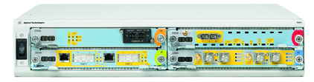

IxN2X Multiservices
Test Solution
R&D & Lab validation of triple play infrastructure and services, from broadband access through carrier core/edge.

Slide 2
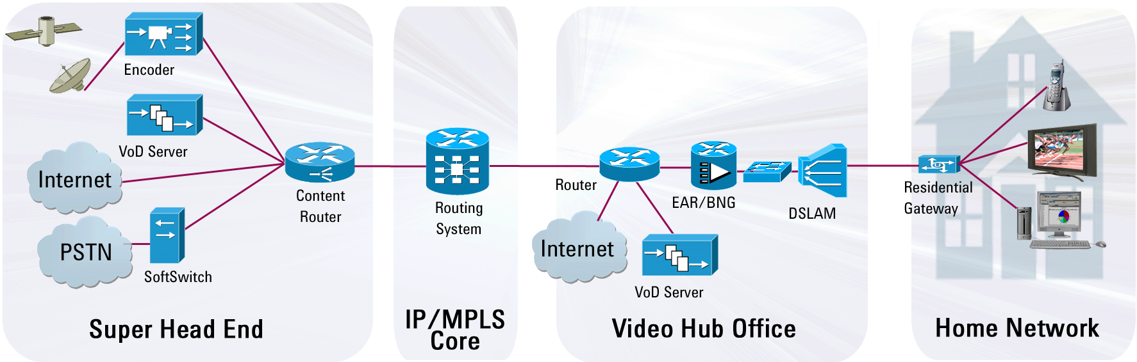
Where is IxN2X aimed?
Ethernet Aggregation (L2) Switch
Edge / Access Router
Broadband Network Gateway BNG /
Broadband Remote Access Server B-RAS
Core Router
Access Node
(DSLAM or PON OLT)
IP/MPLS Core
Home Network
Content Servers
Edge / Access

Slide 3



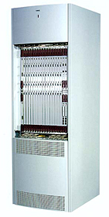

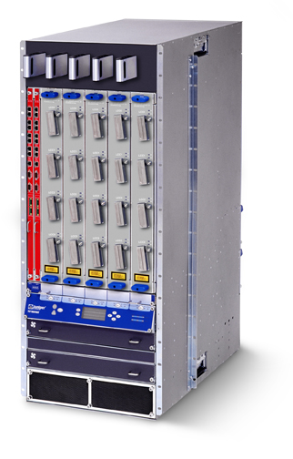
Core IP Router
High-capacity core routers process large amounts of traffic and routing information in the core of service-provider networks.
They are often situated at Internet Point-of-Presence (POP) locations and may connect to other carrier networks.
Key pain points
  Scalability: Ensure the router can handle huge traffic and routing loads over many high-speed interfaces
  High Availability: Verify that the router can maintain 99.999% availability during periods of network instability
Huawei 5000E
NEC CX5220
Cisco CRS-1
Juniper TX
IP/MPLS Core

Slide 4

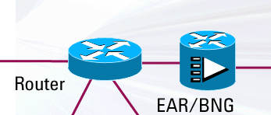
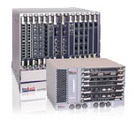

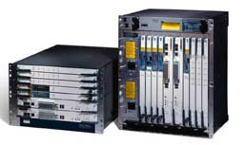

Edge/Access router, BNG / B-RAS
An Edge/Access or Multi-Service router, Broadband Network Gateway (BNG), or Broadband Remote Access Server (B-RAS) manages subscriber services, applies policies, and can act as a PPP or DHCP server.
Key pain points
  Multiple Services: Validate IPTV, VoIP, data applications / TCP, multicast, and business VPN deployment scenarios
  Access Protocols: Measure DHCP, DHCPv6, PPPoX, and ANCP performance and scalability
  QoS: Verify per-flow Quality of Service and prioritization
Edge / Access
Redback SmartEdge
Juniper E-Series
Cisco 10000
Alcatel-Lucent 7750

Slide 5

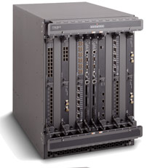

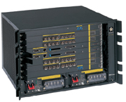
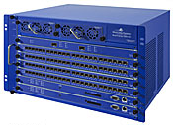
Ethernet Aggregation (layer-2) Switch
The Ethernet Aggregation (or Ethernet Services) Switch cost-effectively aggregates traffic, and is optimized for Ethernet services.
Key pain points
  Scalability: Verify Ethernet and/or MPLS switching from
  many GbE interfaces to a few high-speed 10GbE interfaces
  Layer-2 Protocols: Test conformance and performance of Ethernet OAM Fault Management, Spanning Tree (xSTP), Link Aggregation (LACP), BFD, Provider Backbone Bridging, Mac-in-Mac (PBB/MiM)
  Carrier Ethernet Services: Validate E-Line/E-LAN services shaping & policing
Ethernet Aggregation
Alcatel-Lucent 7750
Siemens Surpass 6670
Fujitsu Atrica A-4100
World Wide Packets LE-3300

Slide 6

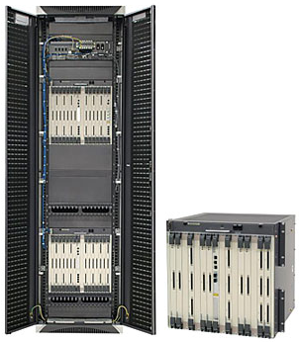
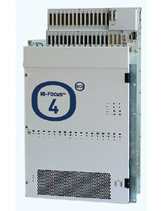
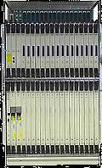
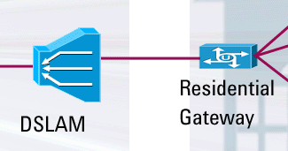
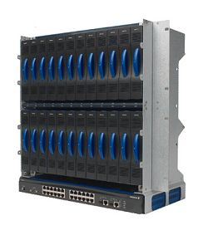
Access Node / IP DSLAM / OLT
Access Nodes are also known as Access Concentrator, DSL Access Multiplexer or Optical Line Terminator (OLT).
They terminate DSL or Passive Optical Network (PON) lines, aggregate subscribers, and assist IPTV multicast services.
Key pain points
  Traffic: Analyze forwarding performance (latency, loss, throughput)
  Multicast: Verify IGMP/MLD snooping (which accelerates IPTV channel-zapping) and multicast performance
  Access Protocols: Gauge DHCP relay agent and PPPoE performance & scalability
Access
Ericsson EDN288x
Huawei SmartAX 5300
ECI Hi-FOCuS
Alcatel-Lucent 7300

Slide 7




The 5 key application areas
Carrier Ethernet
Hits the
Buzz Words
LACP
BFD
PBB/MiM
Y.1731
RSTP & MST
MDI= 0:0
MEP
802.3ah
CFM
spanning tree
PBB-TE
E-OAM
802.1ag
VPLS
VPWS
S-VLAN
MEF 10, MEF 14
Delay Factor (DF) & Media Loss Rate (MLR)
CIR, EIR, CBS and EBS parameters
Q-in-Q
Mac-in-Mac
Ethernet Virtual Circuits
E-Line & E-LAN services
PWE3
Triple Play – IPTV, VoIP, Data
Routing, MPLS and VPNs
IPTV
SIP
QoE
Kompellla
failover
Fast re-route
LDP
MOS
Control Plane
Route flapping
VPLS
Channel Zapping
BGP4, OSPF, IS-IS and RIP
mVPN
Multi-Play
MPLS OAM
Route flapping
Graceful Restart
O-UNI
TCP
HTTP, FTP, RTSP
G-MPLS
RSVP
RFC 2147bis
L2 & L3 VPNs
LMP
Traffic Generation, Analysis & QoS
Access Protocols and Multicast
QoS
SLAs
Packet loss, latency, throughput
DHCP/DHCPv6
Relay agents
MDSP
PPP
PPPoEoA
IPv6
mVPN
MLD
PPPoE
packets per second
Inter-arrival time
W-RED
Rendezvous Point
IGMP
PIM
PPPoA
traffic encapsulations
forwarding
ANCP
L2C/L2CP
IGMP Snooping
Q-in-Q
Priority
VLAN tags
header
L2TP
wire-speed
PDU
payload
join/leave latency
LAC and LNS devices
PIM-SM

Slide 8



Fundamental Test Scenario 1 – Functional
“Does it work as it should?”
Test device under normal and abnormal conditions
“Ping” Echo-Request Message
Test DUT functionality under expected conditions
Ping Reply
IxN2X
DUT
Incorrectly formed Message
Test stability and response to unexpected stimulus (negative testing)
Appropriate Error Message
IxN2X
DUT
Traffic (data plane) functional test
Protocol (control plane) functional test

Slide 9
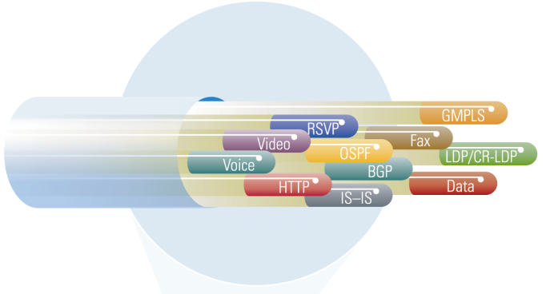

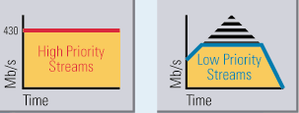
Fundamental Test Scenario 2 – Packet
“Does it perform?”
Measure packet performance through a forwarding device
Measure packets sent and received, latency, throughput, and lost and misdirected packets on each stream
Send thousands streams of realistic traffic into the device
        Each stream can represent a QoS level or traffic from an individual customer

Slide 10
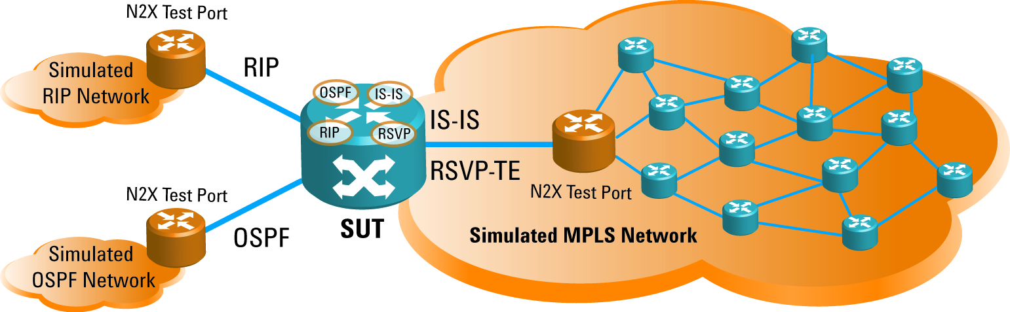
Fundamental Test Scenario 3 – Protocol
Emulation “Does it scale?”
Emulate routing, signaling and other protocols simultaneously, to simulate very large attached networks
Because IxN2X accurately sends and responds to protocol messages, the SUT thinks IxN2X is actually thousands of real devices
Measure protocol scalability
Verify multi-protocol management

Slide 11

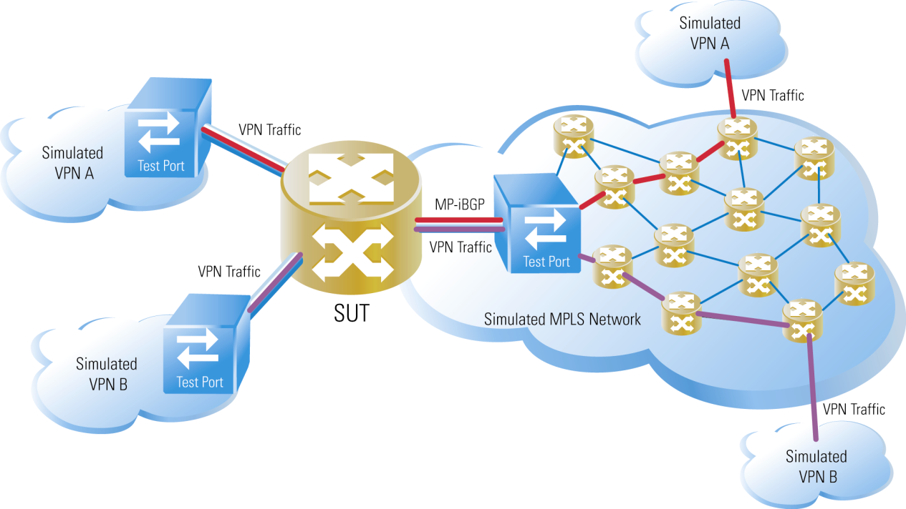
Fundamental Test Scenario 4 - Integrated traffic & protocol emulation
Combine traffic generation and protocol emulation
  Measure performance during integrated traffic and protocol stress
  Measure delivery of services such as IPTV, MPLS VPNs and Carrier Ethernet OAM

Slide 12
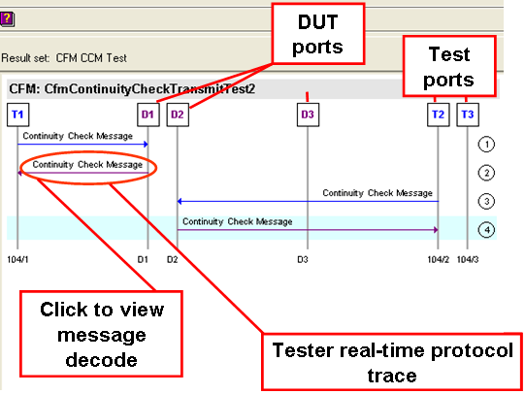
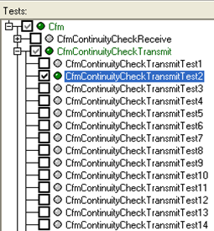
Fundamental Test Scenario 5 – Conformance Test “Does it conform to industry standards?”
IxN2X sends the DUT a message and tests for a correct and timely response
Verify protocol conformance to IETF, IEEE & MEF standards
Each IxN2X conformance test suite contains a hundred or hundreds of unique test cases
Conformance helps ensure interoperability with network devices from other vendors

Slide 13
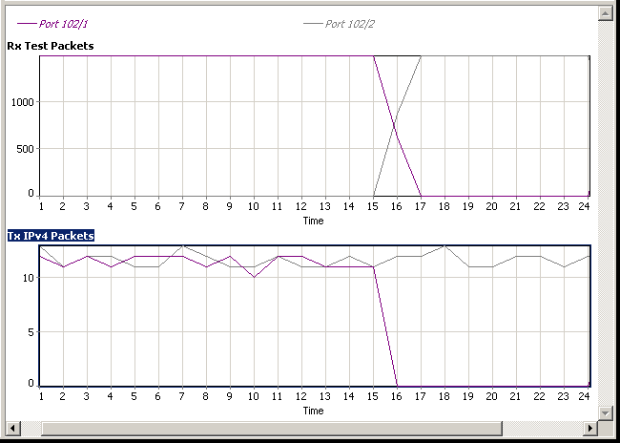
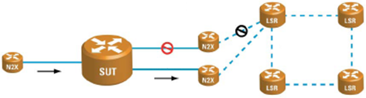
Fundamental Test Scenario 6 – Restoration Time
“Does it handle failures? How fast?”
Applies to many technologies
  MPLS Fast Re-Route
  Routing reconvergence
  LACP single-link failure
  Spanning Tree reconvergence
  Bidirectional Forwarding Detection
  Ethernet CFM Continuity Check
Packet loss during failover
Traffic failover
Failover (restoration) time
Fault occurs here
Simulated
failure
Simulated
network
Measure recovery from a simulated device or link failure
IxN2X traffic source
New traffic path

Slide 14

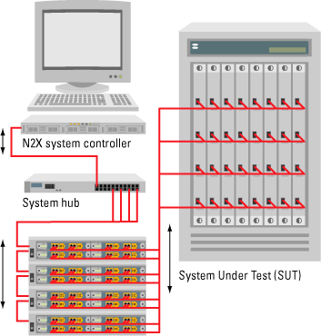

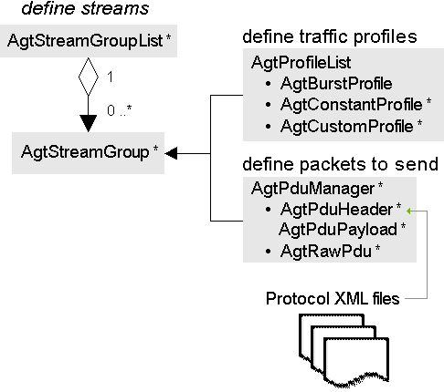
IxN2X Product Structure
IxN2X System Components:
Chassis – 2 slot or 4 slot
Controller – laptop or 2 levels of rackmount
Software (3 tiers)
  Packet only
  - including QuickTests
  Emulation Software
  Productivity Advantage – advanced pre-written tests
Hardware – Test Cards
Support & Software Updates
SUT
Local GUI or API
IxN2X system controller
System switch
Remote GUI/API
IxN2X System

Slide 15
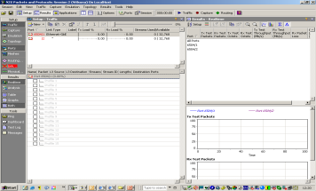
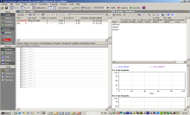

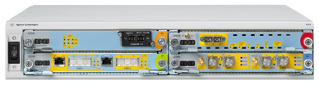
IxN2X session-GUI/API model
GUI on remote desktop
IxN2X controller – local GUIs and APIs
GUIs
APIs
GUIs
APIs
API on external computer
test session
1
Test session
2
…
…

Slide 16
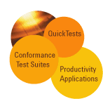
IxN2X Product Structure
Automated Applications
Conformance
Productivity Applications
SynchE
ESMC
SIP
HTTP
ANCP / L2CP
MPLS OAM
Optical Signaling
xSTP
MPLS Signaling
IPv4 Routing
DHCP
IGMP
MS TV
Emulation Software
Ethernet OAM Y.1731
E Link OAM (802.3ah)
E OAM CFM
L2 VPNs
PPPoX
BFD
Multicast Routing
IPv6 Routing
DHCP V6
MLD
LACP
Base
Software
Transport
Application
Packets
Application
Packets & Protocols Application
QuickTest
Test cards
OC192/STM64 STS-1, 1 port
J7241A, J7242A
10/100 Ethernet
16 port
E5215A
10/100 Ethernet
16 port
E7906A
10/100 Ethernet
4 port
N5550B
OC3/12c POS/ATM/FR
2 port
E7907A
10/100/1000
+ SFP
2 port
N5630B
OC3/12c
POS/ATM/FR
2 port
E7907B
OC48c
POS/FR
2 port
E7909B
OC3/12/48 /STM16, 2 port STS-1/VT J7244A, J7245A
10/100/1000 +SFP
4 port
N5553B
10/100/1000 +SFP
4 port/2port
N5551B/N5552B
10/100/1000 +SFP
10 Port
N5605A/N5606A
OC48c
POS/FR
2 port
E7909A
10 GbE & POS
XFP LAN/WAN
1-port
N5632A
10/100/1000 +SFP EPON
4 port
N5604A
10 GbE & POS
XFP LAN/WAN
1 port
N5602A
10 GbE
XFP LAN/WAN
1-port
N5603A
OC768c
40Gb/s POS
1 port
E7320B
XM Cards
SONET/SDH
testing
XP & XP-2 Cards
Packet testing
XS & XS-2 Cards
High performance
P&P testing
XR & XR-2 Cards
Protocol & Packet testing

Slide 17
IxN2X Software and Support Agreement
Includes software updates and technical support (telephone & email)
Order with software products to extend coverage period beyond the initial one year after purchase:
PS-S12-101 1 year of software support and updates (included)
PS-S12-102 2 years of software support and updates
PS-S12-103 3 years of software support and updates
Product
Coverage of software updates and technical support
E7880B
+PS-S12-10X
Packets Application
Packets & Protocol Application
Any emulation software licensed on the same controller
Any productivity application licensed on the same controller
E7881B
+PS-S12-10X
Conformance
+PS-S12-10X
Respective conformance test suite

Slide 18
Why IxN2X?
Some examples of where IxN2X stands out against other test equipment
Traffic generation and analysis
  32k streams, millions of flows – granular measurements for QoS (802.1p, DiffServ)
  RX monitor (optical ports) monitor and measure statistics on through traffic.
  VLAN support – setup QinQ (up to 6 VLAN tags) through the GUI and verify performance on ALL 8 priority levels
  Capture and decode traffic – filter down to specific byte or event triggers
  PDU Builder – custom frames, negative testing, resend captured traffic, etc.; can easily send different kinds of packets simultaneously. Create ANY traffic you want – largest list of default traffic types as standard
  Ease of use in setting up multiple MAC addresses and VLANs
  Can setup random parameters (e.g. random packet lengths, addresses, etc.)
  Send constant and burst traffic interleaved on SAME port – realistic traffic!
  Full support for Stateful TCP traffic with hundreds of applications for L4-7 testing at full Line rate up to 1GbE!

Slide 19
Why IxN2X?
Statistics
  View aggregated AND individual stream statistics in REAL TIME
  Convergence measurements – 10ns resolution and accuracy of +/- 30ns (only vendor to verify accuracy not just resolution)
  Packet Integrity check and misordered packets
  REAL-TIME latency and sequence error measurements on each stream
  Post processing capture analysis of all data captured in Buffer
  IxN2X Fast find – drill down to the results you want even if looking at thousands of streams

Slide 20
Why IxN2X?
Triple Play and Access Protocols
  IxN2X has full Triple-Play integration with routing emulation
  IxN2X is the only HW based solution – essential for determinism and repeatability
  IxN2X has full IGMP Querier solution
  IxN2X can send real video traffic at full line rate (up to 10 G!)
  IxN2X IPTV tests can be run for days and weeks for long term testing
  IxN2X can perform multicast tests (ie IGMP, PIM etc) at the same time on the same port as triple play tests
  Full support of VLAN priority bits for Access protocols - unique to Agilent’s IxN2X Access protocol emulation)
  Full support for Stateful TCP traffic with hundreds of applications for L4-7 testing at full Line rate up to 1GbE!

Slide 21
Why IxN2X Cont.
Routing protocols
  A wide variety of protocols, with industry best scalability numbers (including RIP,BGP, ISIS and OSPF)
  Multicast: a real state-machine emulation for PIM-SM and IGMP;
  VPLS & VPWS solution is simple and easy to use
  Full Carrier Ethernet solution (E-OAM, LACP, xSTP, PBB, T-MPLS, BFD etc)
  Bi-directional emulation capture – decode protocol messages as they are being sent and received live.
  ALL protocol emulations can be activated and controlled on the same port at the same time.
  Full summarization of routing state and statistics allow real time testing of multi protocol emulations without missing important measurements by changing to different platforms or different measurement tabs.

Slide 22
Why IxN2X?
Carrier Ethernet
  IxN2X has full support for Spanning tree, E-OAM and LACP emulation and assosciated Conformance TestS uites
  IxN2X is the only tester that supports route emulation over LACP!
  N2X’s unique topology viewer and full emulation support or CFM, (IEEE 802.1ag and ITU-T Y1731)
  Full support for BFD
  MEF 9 and 14 certifications are performed 95% of the time using the IxN2X
  First to launch MEF 21 Conformance test suite for Link OAM (see press release http://www.agilent.com/about/newsroom/presrel/2009/13may-em09093.html)
  Timing - 1588 protocol testing (Unicast and Multicast) and unique ESMC (for SYNC E) solution

Slide 23
Why IxN2X?
Troubleshooting
  Powerful capture features for troubleshooting: filters, triggers, etc.
  Capture errored packets
  Trigger out for connecting to different test equipment (e.g. logic analyzer)
Automation
  Easy-to-use fully documented Tcl API
  Pre-canned scripts with QuickTests which are open sourced so easy to alter and change
General
  Very easy to use GUI – don’t have to rely on scripts all the time;
  Everything available one Software platform – no need to learn several different GUIs or modes of operation
  Set up and run tests then exit GUI to do other things while leaving session running! Come back and re-attach to session later to check results, make changes etc
  Excellent Application support from local and factory teams – best value for money Software support agreement on market

