Slide 1
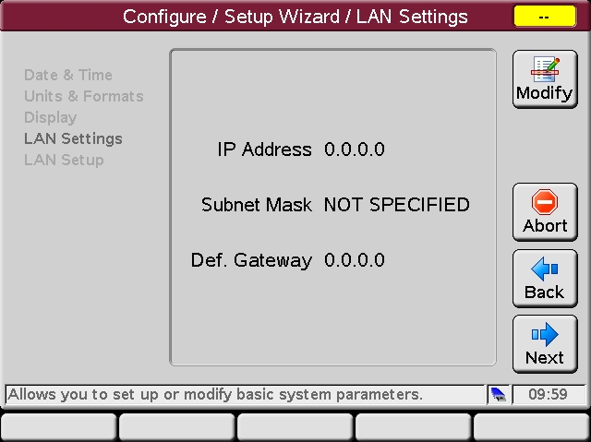
1100/1200 Instrument LAN IP Address Management
G4208A Instant Pilot (IP) Setup Screen
Allows modifications of the LAN/LAN card settings.
Notes:
This is the view from the welcome screen

Slide 2
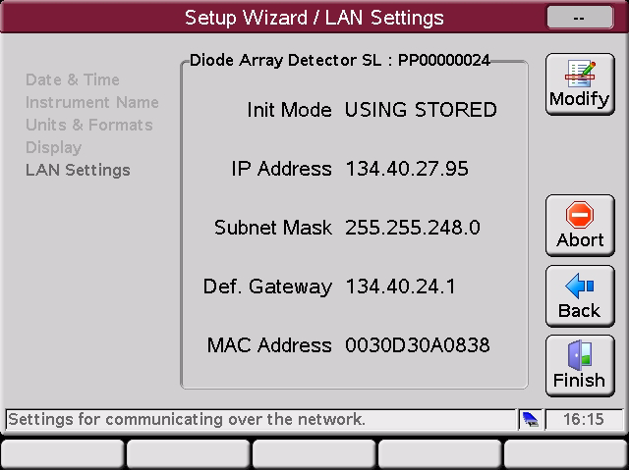
1100/1200 Instrument LAN IP Address Management
G4208A Instant Pilot (IP) Setup Wizard
Allows modifications of the LAN/LAN card settings.
For parameters, refer to the installed LAN
card’s documentation

Slide 3
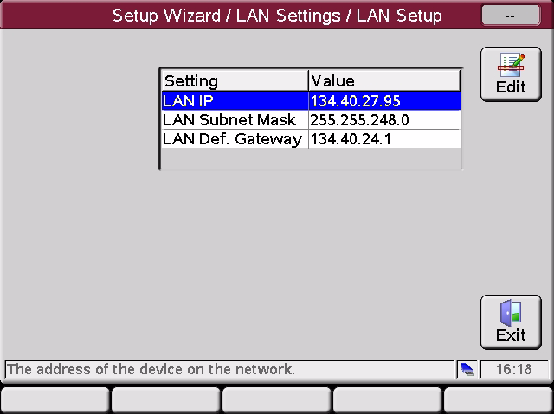
1100/1200 Instrument LAN IP Address Management
G4208A Instant Pilot (IP) Setup Wizard
Allows modifications of the LAN/LAN card settings.
Allows changes to the LAN card settings
When finished press Done to write the new values.

Slide 4
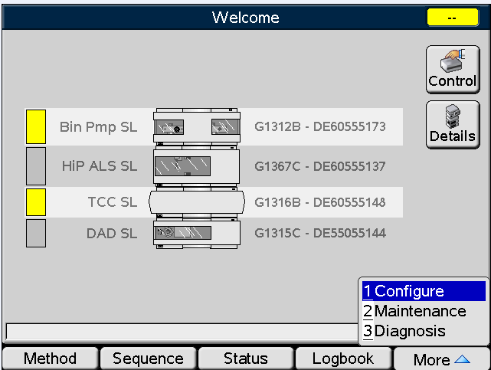
1100/1200 Instrument LAN IP Address Management
G4208A Instant Pilot (IP)-configure screen
Allows modifications of the LAN/LAN card settings.
Allows changes to the LAN card settings
.

Slide 5
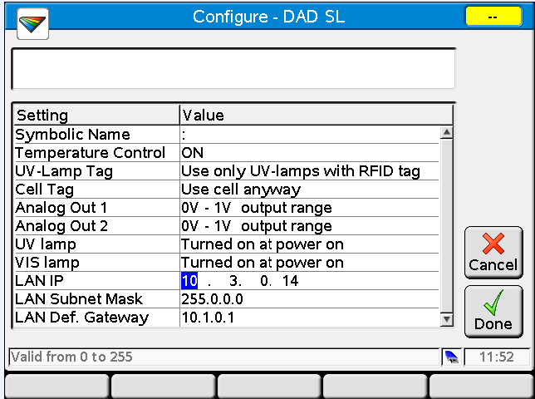
1100/1200 Instrument LAN IP Address Management
G4208A Instant Pilot (IP)-configuration screen
Allows modifications of the LAN/LAN card settings.
Allows changes to the LAN card settings
When finished press Done to write the new values.

Slide 6
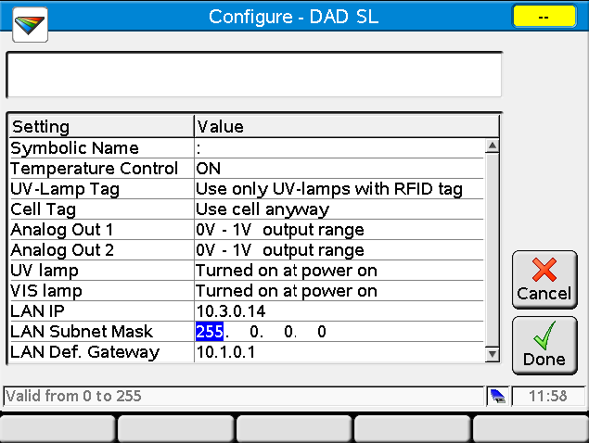
1100/1200 Instrument LAN IP Address Management
G4208A Instant Pilot (IP)-configuration screen
Allows modifications of the LAN/LAN card settings.
Allows changes to the LAN card settings
When finished press Done to write the new values.

Slide 7
Appendix- Establishing communication with a Hand Held Controller
Using a Telnet Session to disable BootP
Using Internet Explorer to disable BootP

Slide 8
1100/1200 Instrument LAN IP Address Management
Setting the IP address and Subnet Mask by using the BootP Server and disabling the BootP request with a Telnet Session
Normally if you power cycle the module which contains the JetDirect Card, a BootP request shall be send out by the card. The BootP server will respond to the instrument IP requests and supply the instrument JetDirect card with an IP address, a subnet mask and other necessary transfer parameters.
With the help of the BootP Server, you can set a fixed IP address and subnet mask. With a Telnet session we can disable the further BootP requests.

Slide 9
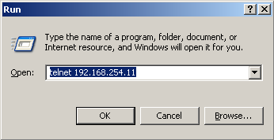
1100/1200 Instrument LAN IP Address Management
Telnet Session
1. Assign an IP address and Subnet Mask with the BootP server/service.
2. Open a Telnet Session by typing “telnet” followed by the IP address you was assigning to the JetDirect Card

Slide 10
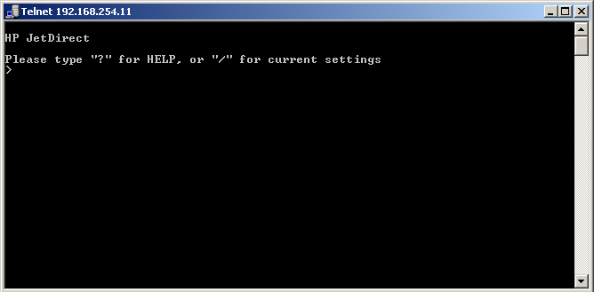
1100/1200 Instrument LAN IP Address Management
Telnet Session
That will open a Telnet session as shown

Slide 11
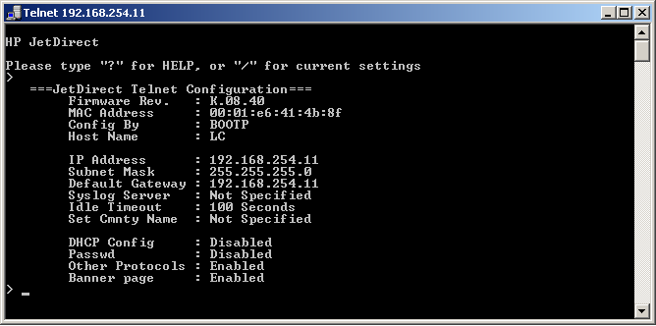
1100/1200 Instrument LAN IP Address Management
Telnet Session
Type “/” on the prompt line to read out the JetDirect Card
NOTE: in Windows XP you will not see “/” when you type it
Notes:
There is no echoing turned on…

Slide 12
1100/1200 Instrument LAN IP Address Management
Telnet Session
Notice the “Config By” listing…
In this case it is by BootP…

Slide 13
1100/1200 Instrument LAN IP Address Management
Telnet Session
To Disable the BootP request you have to type the IP address on the prompt line…
IP:192.168.254.11
…then press enter
NOTE: in Windows XP you will not see what you are typing
Caution! Be sure of what you are entering

Slide 14
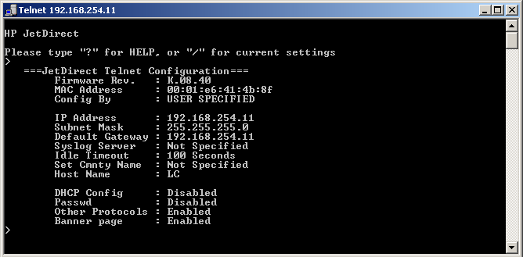
1100/1200 Instrument LAN IP Address Management
Telnet Session
Notice the “Config By” now states “User Specified”

Slide 15

1100/1200 Instrument LAN IP Address Management
Internet Explorer
As long as you know the IP Address of the JetDirect card then you can use Telnet to ‘reset’ the card to defaults…
Open a telnet session
Type in / and press Enter to list current settings
Type in cold-reset and press Enter to reset the card
It should respond with…
Type in quit and press Enter to complete the card reset

Slide 16
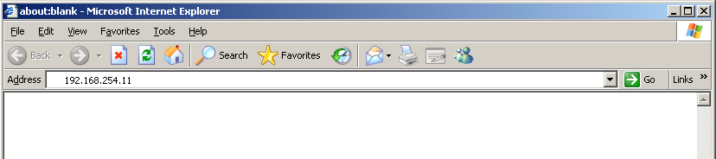
1100/1200 Instrument LAN IP Address Management
Internet Explorer
If you know the IP Address then there is another way to look at things…using Internet Explorer (IE)
Type in the IP Address of the JetDirect card and click Go

Slide 17
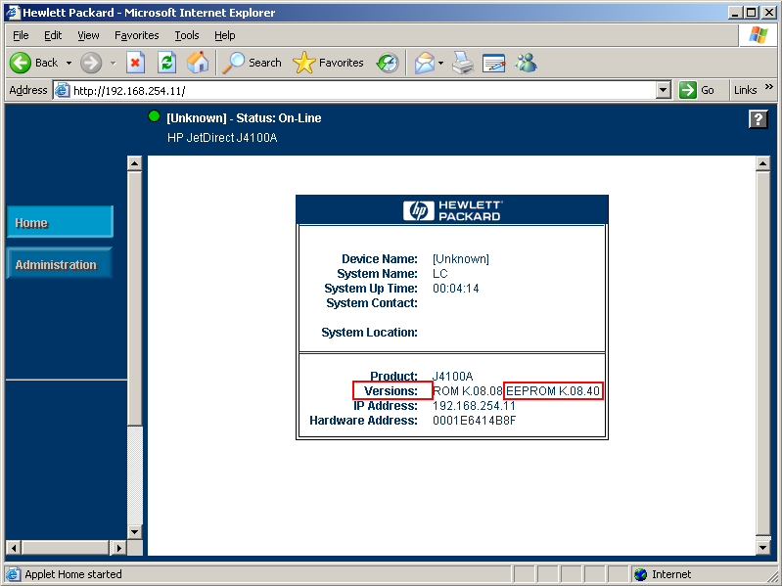
Internet Explorer
This does not work in all cases, but when it does you will see this Jet Admin Software Home Page from the card itself.
Notice:
the FW Ver. Number
(32-bit requires K.08.32 or higher)

Slide 18
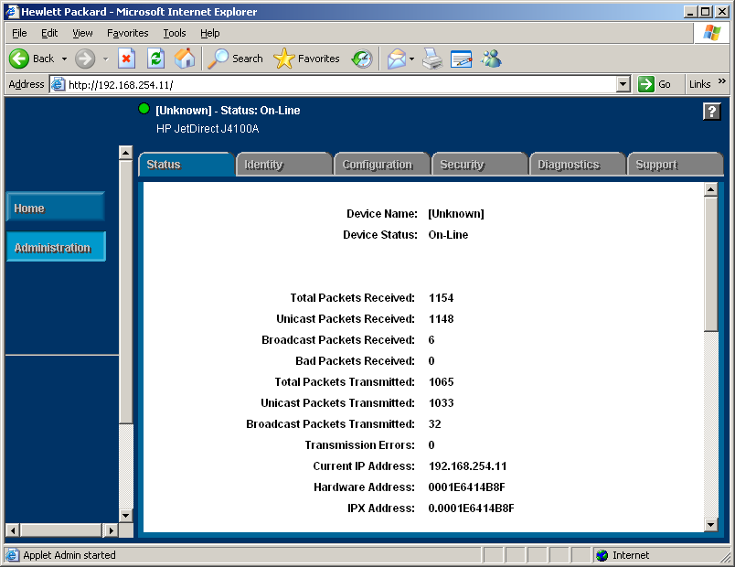
1100/1200 Instrument LAN IP Address Management
Internet Explorer
Click on the Administration button and wait

Slide 19
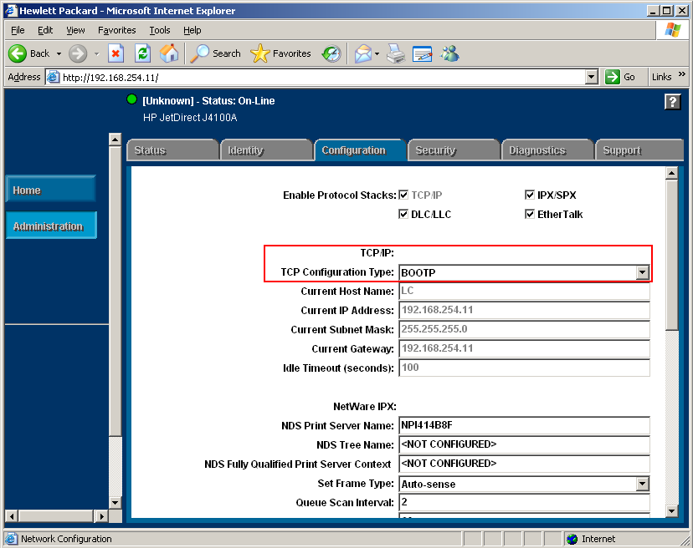
1100/1200 Instrument LAN IP Address Management
Internet Explorer
Click on the Configuration tab.
Under TCP/IP: Protocol
Notice: the setting for “TCP Config Type” here it is set to BootP
Notes:
the setting for “TCP Config Type” here it is set to BootP meaning that at every power on it will send out a BootP request

Slide 20
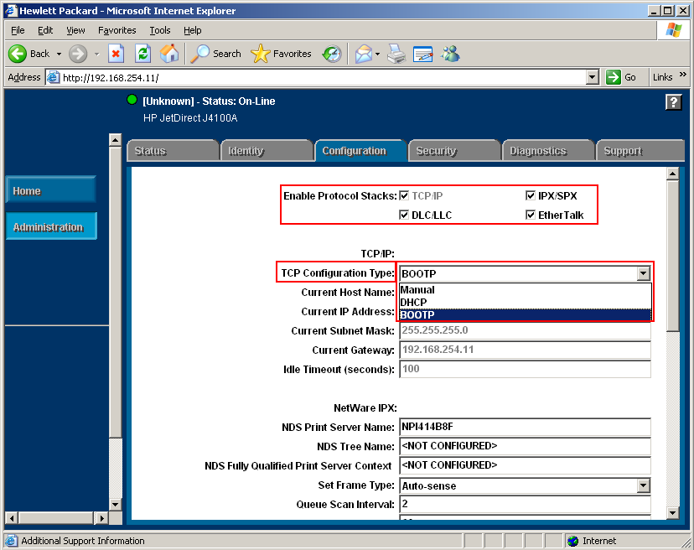
1100/1200 Instrument LAN IP Address Management
Internet Explorer
Click on the Configuration tab.
Notice: section titled
Enable Protocol Stacks
All 4 protocols must be checked!
Under TCP/IP: Protocol
Notice: the setting for “TCP Config Type” here it is set to BootP however it can be set to ‘manual’ or ‘DHCP’
Notes:
Notice: the setting for “TCP Config Type” here it is set to BootP however it can be set to ‘manual’ or ‘DHCP’
Manual meaning that it already has a ‘fixed’ IO Address and it will not send out a BootP request at power on.
DHCP (Dynamic Host Configuration Protocol) technically we do not support this, but if the customer insists upon it there is a white paper on how to set it up at their own risk.
The 4 protocols in the Enable Protocol Stacks must be checked, if they are not then when you boot up the PC and open the ChemStation the first time it will work fine, however if you close the ChemStation and then try to open it again it will not open. Rebooting the PC will again let it open the first time but not the second time.

Slide 21
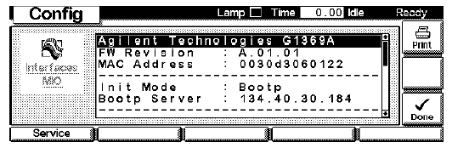
Setting Communication using Handheld Modules
Control Module (Da Vinci)
Instant Pilot (Hobbit)
Notes:
Manual configuration only alters the set of parameters stored in the non-volatile memory of the card.
It never affects the currently active parameters. Therefore, manual configuration can be done at any time.
A power cycle is mandatory to make the stored parameters become the active parameters, given that the initialization mode selection switches allow it.

Slide 22
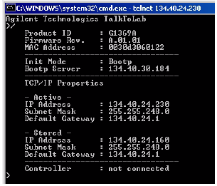
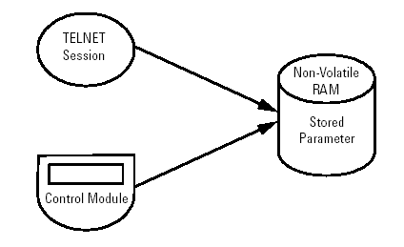
Manual Configuration
Notes:
Manual configuration only alters the set of parameters stored in the non-volatile memory of the card.
It never affects the currently active parameters. Therefore, manual configuration can be done at any time.
A power cycle is mandatory to make the stored parameters become the active parameters, given that the initialization mode selection switches are allowing it.

Slide 23
1100/1200 Instrument LAN IP Address Management
Setting the IP address and Subnet Mask and disabling the BootP request by using the handheld controller.
Normally if you power cycle the module which contains the JetDirect Card, a BootP request shall be send out by the card. The BootP server will respond to the instrument IP requests and supply the instrument JetDirect card with an IP address, a subnet mask and other necessary transfer parameters.
With the help of the handheld controller (G1323A/B), you can set a fixed IP address, subnet mask and disable the BootP request.

Slide 24
1100/1200 Instrument LAN IP Address Management
G1323B Hand-Held Controller

Slide 25
1100/1200 Instrument LAN IP Address Management
G1323B Hand-Held Controller

Slide 26
1100/1200 Instrument LAN IP Address Management
G1323B Hand-Held Controller

Slide 27
1100/1200 Instrument LAN IP Address Management
G1323B Hand-Held Controller

Slide 28
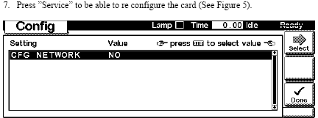
1100/1200 Instrument LAN IP Address Management
G1323B Hand-Held Controller

Slide 29
1100/1200 Instrument LAN IP Address Management
G1323B Hand-Held Controller

Slide 30
1100/1200 Instrument LAN IP Address Management
G1323B Hand-Held Controller

Slide 31
1100/1200 Instrument LAN IP Address Management
G1323B Hand-Held Controller

Slide 32
1100/1200 Instrument LAN IP Address Management
G1323B Hand-Held Controller

Slide 33
1100/1200 Instrument LAN IP Address Management
G1323B Hand-Held Controller

Slide 34
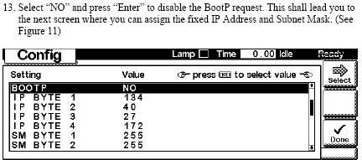
1100/1200 Instrument LAN IP Address Management
G1323B Hand-Held Controller

Slide 35
1100/1200 Instrument LAN IP Address Management
G1323B Hand-Held Controller

Slide 36
1100/1200 Instrument LAN IP Address Management
G1323B Hand-Held Controller

